Slide 1
P074 – SCG LMH
Base setup definition

Slide 2
Introduction
Hardpoint options
Main targets:
Roll stiffness tot/distribution
Heave minimum stiffness
- Control aero-balance
Control RHs via 3rd elements (more/less non linear, EoS RH)
- Check bodywork dynamic clearances
ARB and lateral coil springs
Damping
3rd springs and Belleville stacks
Lateral damper bump-stops

Slide 3
1- Roll stiffness targets
Total roll gradient
Bodywork clearance ~1.6deg max total roll
FIA homologation map scans up to 1.5deg max total roll
The roll sensitivity of the aero map is quite high, better controlling a lot
Target: 0.5 deg/g with tyres deflection
0.35 deg/g kinematic
Roll stiffness distribution
Michelin’s suggested aero-balance and weight-balance windows have been defined with 60% front roll stiffness
60% is also a typical value to start with, as in our case tyre widths already take care of the more rearward weight distribution
Target range: 55 to 65 % on front axle, starting value 60%

Slide 4
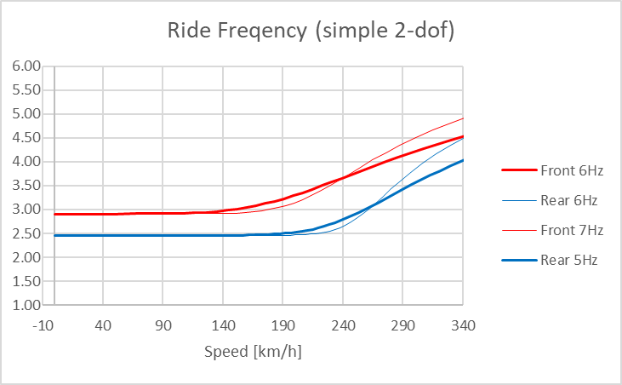
1- Lateral damper coil springs
Since the primary aim is to control RHs and so aero-balance, we are not particularly concerned in having
rear ride frequency > front ride frequency
We choose initial lateral coil springs taking into account:
Target roll stiffness distribution
Much lower front axle heave travel
Ride frequency vs speed plots
Initial take Front 7Hz, Rear 5Hz

Slide 5
1- ARBs and lateral coil springs choice
Add rebound stop in simulation

Slide 6
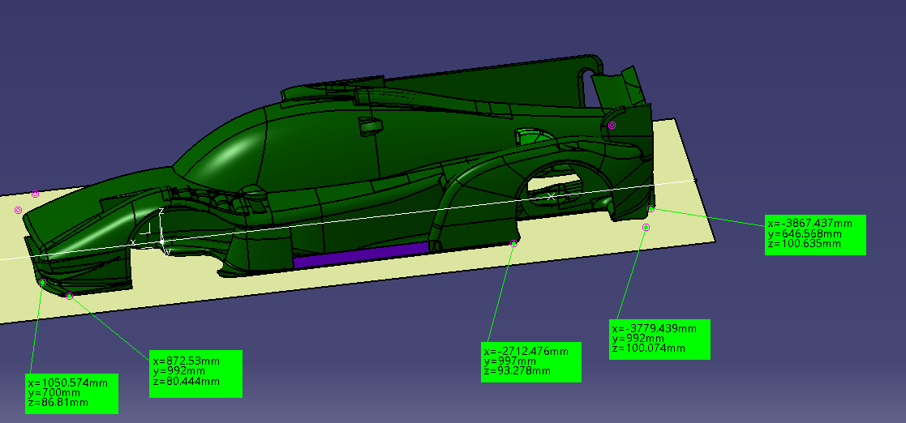

Slide 7
Hardpoint options
More rear anti-lift, more stable aero balance, but lower braking potential, to be traded on track with driver feeling.
(Requires braking more in straight line than trail braking)

Slide 8
“A-STIFF” Setup
Steady cornering stability (ramp steer analysis)

