Slide 1
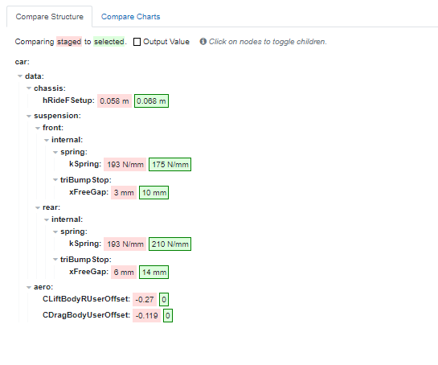
Staged: 21T03 (AD:110,AL:90) Laptime: 1:38:97
Selected: 21T04 (AD:110,AL:90) Laptime: 1:39:90

Slide 2


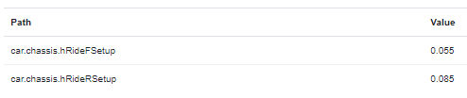
Frankenstein model (Best from exploration)
Single Exploration Results
Laptime: 205.59s
Laptime: 204.46s
hRIdeF_Setup | 60
hRIdeR_Setup | 75
Laptime: 204.04s
Frankenstein1 Laptime: 203.94
Frankenstein2 Laptime: 204.47
Frankenstein3 Laptime: 204.47
 | ApexSim | Stright Sim
hRideF/R_100 | 52.3 / 78 | 53.8 / 73.3
hRideF/R_200 | 38.6 / 61.8 | 42.4 / 57.2
hRideF/R_300 | 19.2 / 39.2 | 22.9 / 36.7
rAeroBal_100 | 41.48 % | 39.95 %
rAeroBal_200 | 43.9 % | 41.58 %
rAeroBal_300 | 50.2 % | 48.93 %
 | ApexSim | Stright Sim
hRideF/R_100 | 52 / 88.8 | 53.5 / 83.4
hRideF/R_200 | 36.8 / 72.3 | 40.8 / 67.1
hRideF/R_300 | 17.3 / 48.1 | 21.5 /43.9
rAeroBal_100 | 43.99 % | 42.24 %
rAeroBal_200 | 46.39 % | 43.86 %
rAeroBal_300 | 51.62 % | 49.36 %
 | ApexSim | Stright Sim
hRideF/R_100 | 57.9 / 78 | 59 / 73.3
hRideF/R_200 | 45.8 / 61.5 | 48.9 / 57.1
hRideF/R_300 | 26.3 / 38.6 | 31.1 / 36.2
rAeroBal_100 | 39.44 % | 38 %
rAeroBal_200 | 40.85 % | 38.79 %
rAeroBal_300 | 46.79 % | 44.98 %

