Slide 2
SCG004C Test Cremona 05/10/2021
Setup changes evaluation

Slide 3
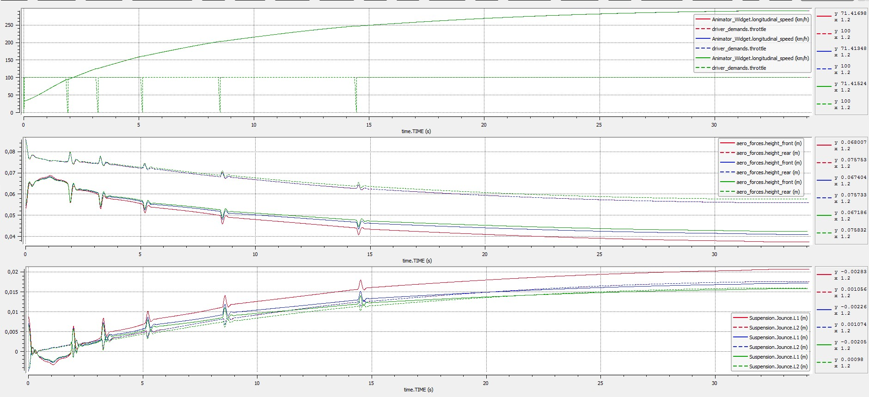
Acceleration to Top Speed (~250kph)

Slide 4

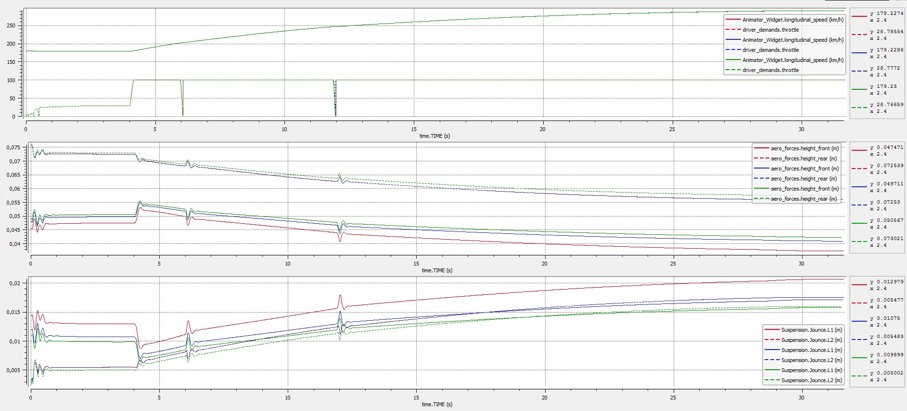
Acceleration From 180 kph

Slide 5

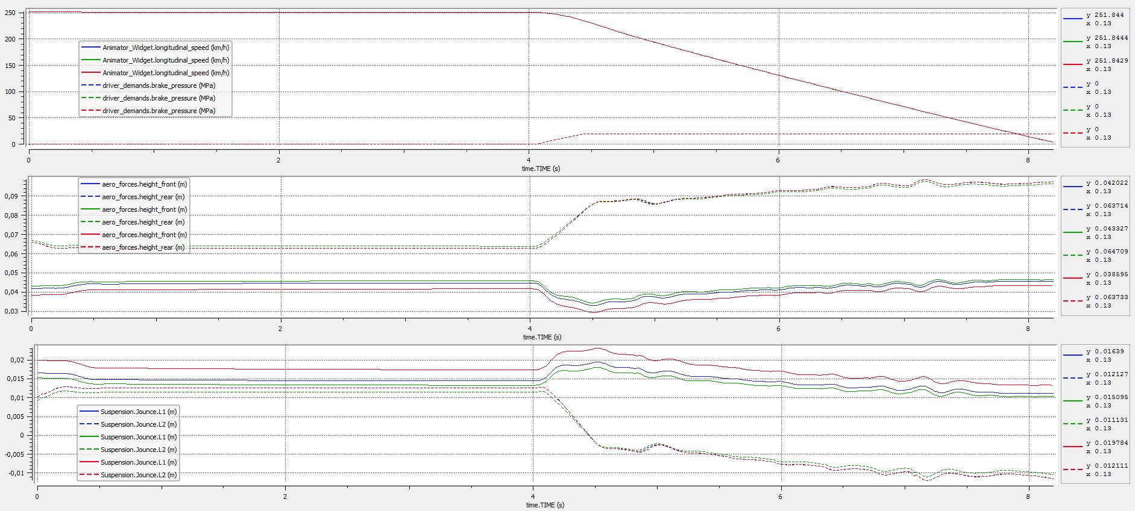
Braking from 250kph

