Slide 2
SCG-007C Le Mans Hypercar
PREvsPost Dyno Knock control session overview

Slide 3
Dyno Data
PRE | 21VALT05 (FROM DYNO DATA) |  | FULL LOAD | IGOR'S Version
 | RPM | 4000 | 4250 | 4500 | 4750 | 5000 | 5250 | 5500 | 5750 | 6000 | 6250 | 6500 | 6750 | 7000 | 7250 | 7500
 | mfuel [kg/h] | 64.3 | 69.5 | 77.3 | 86.3 | 93.2 | 103.9 | 115.8 | 120.5 | 140.7 | 137.4 | 156.9 | 153.3 | 153 | 154.5 | 152.1
 | mfuel [kg/s] | 0.0178611 | 0.0193056 | 0.0214722 | 0.0239722 | 0.0258889 | 0.0288611 | 0.0321667 | 0.0334722 | 0.0390833 | 0.0381667 | 0.0435833 | 0.0425833 | 0.0425000 | 0.0429167 | 0.0422500
 | EngineTorque [Nm] | 631.8 | 641.6 | 682.9 | 703.6 | 710.2 | 728.5 | 764.5 | 741.5 | 788.8 | 747.1 | 794.3 | 751.2 | 733.1 | 712.2 | 673.6
 | Engine Power [kW] | 264.5 | 285.4 | 321.6 | 349.8 | 371.7 | 400.3 | 440.1 | 446.3 | 495.4 | 488.7 | 540.4 | 530.7 | 537.1 | 540.4 | 528.8
 | bSFC [g/kWh] | 243.1 | 243.5 | 240.3 | 246.7 | 250.8 | 259.5 | 263.1 | 270.0 | 284.0 | 281.1 | 290.3 | 288.9 | 284.9 | 285.9 | 287.6
POST | R048-Map improved after knock control |  | FULL LOAD | IGOR'S Version
 | RPM | 4000 | 4250 | 4500 | 4750 | 5000 | 5250 | 5500 | 5750 | 6000 | 6250 | 6500 | 6750 | 7000 | 7250 | 7500
 | mfuel [kg/h] | 58.1 | 64.0 | 69.3 | 79.3 | 88.9 | 106.7 | 114.0 | 110.1 | 119.4 | 122.3 | 128.3 | 132.8 | 133.5 | 137.1 | 137.3
 | mfuel [kg/s] | 0.0161389 | 0.0177778 | 0.0192561 | 0.0220278 | 0.0246944 | 0.0296389 | 0.0316667 | 0.0305833 | 0.0331667 | 0.0339722 | 0.0356389 | 0.0368889 | 0.0370833 | 0.0380917 | 0.0381389
 | TORQUE DYNO [Nm] | 625.1 | 632.7 | 662.2 | 687.8 | 715.9 | 756.4 | 769.7 | 764.7 | 777.0 | 775.5 | 771.4 | 763.3 | 740.8 | 714.1 | 698.0
 | POWER DYNO [kW] | 261.7 | 281.4 | 311.9 | 342.0 | 374.7 | 415.6 | 443.1 | 460.2 | 488.0 | 507.3 | 524.8 | 539.3 | 542.8 | 541.9 | 547.9
 | BSFC DYNO [g/kWh] | 222.0 | 227.4 | 222.3 | 231.9 | 237.3 | 256.7 | 257.3 | 239.2 | 244.7 | 241.1 | 244.5 | 246.3 | 246.0 | 253.1 | 250.6

Slide 4
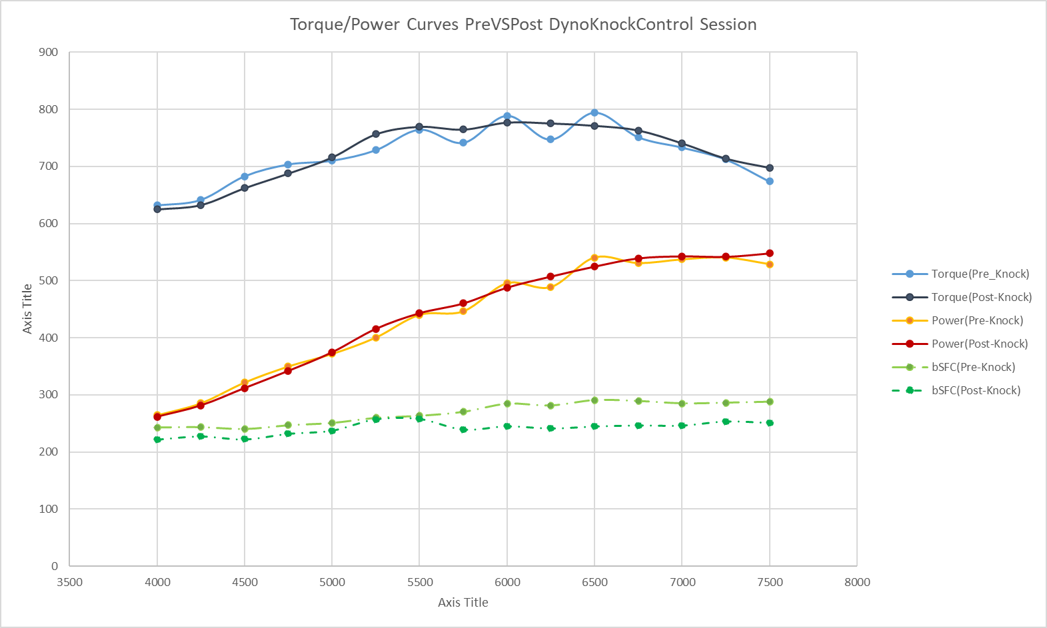
Dyno Data
Deltas --> (New-Old)/Old [%]
RPM | 4000 | 4250 | 4500 | 4750 | 5000 | 5250 | 5500 | 5750 | 6000 | 6250 | 6500 | 6750 | 7000 | 7250 | 7500
mfuel [kg/h] | -9.64% | -7.91% | -10.32% | -8.11% | -4.61% | 2.69% | -1.55% | -8.63% | -15.14% | -10.99% | -18.23% | -13.37% | -12.75% | -11.24% | -9.73%
mfuel [kg/s] | -9.64% | -7.91% | -10.32% | -8.11% | -4.61% | 2.69% | -1.55% | -8.63% | -15.14% | -10.99% | -18.23% | -13.37% | -12.75% | -11.24% | -9.73%
TORQUE DYNO [Nm] | -1.06% | -1.39% | -3.03% | -2.25% | 0.80% | 3.83% | 0.68% | 3.13% | -1.50% | 3.80% | -2.88% | 1.61% | 1.05% | 0.27% | 3.62%
POWER DYNO [kW] | -1.06% | -1.39% | -3.03% | -2.25% | 0.80% | 3.83% | 0.68% | 3.13% | -1.50% | 3.80% | -2.88% | 1.61% | 1.05% | 0.27% | 3.62%
BSFC DYNO [g/kWh] | -8.67% | -6.62% | -7.52% | -6.00% | -5.37% | -1.09% | -2.22% | -11.40% | -13.85% | -14.25% | -15.80% | -14.75% | -13.65% | -11.48% | -12.89%
Power/Torque curves almost equal (MAX deltas 3.83%)
Very sensible improvement in Specific Fuel Consumption (bSFC), especially at high RPM (where engine will work most of the time during races)

Slide 5
SCG-007C Le Mans Hypercar
Outcomes for WinDarab fuel consumption forecasts, and VAL21T05 Dyno-vs-Track use correlation

Slide 6
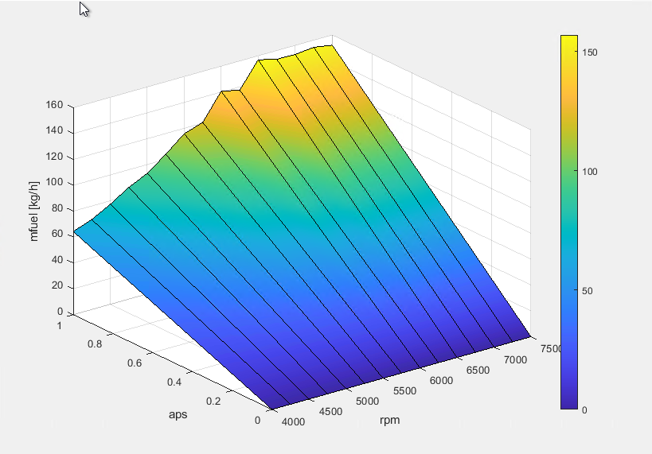
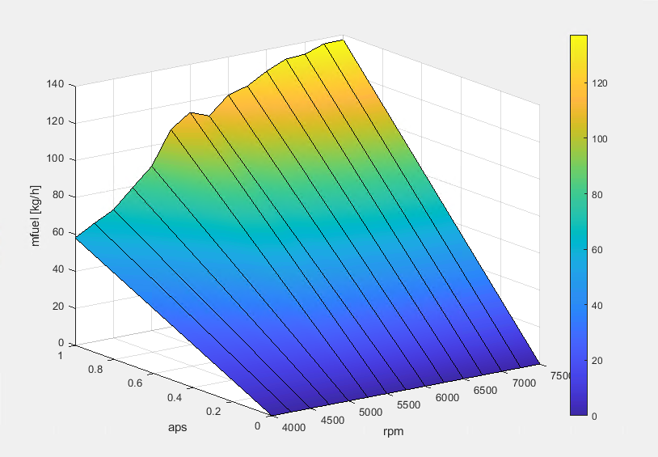
WinDarab Outcomes
LUT_fuelflow_V15
aps/RPM | 0 | 4000 | 4500 | 5000 | 5500 | 6000 | 6500 | 7000 | 7500 | 8000
0 | 0 | 0 | 0 | 0 | 0 | 0 | 0 | 0 | 0 | 0
1 | 0 | 70.53 | 85.42 | 99.56 | 115.52 | 128.59 | 138.47 | 146.68 | 150.48 | 160.51
LUT_fuelflow_VAL21T05
aps/RPM | 4000 | 4250 | 4500 | 4750 | 5000 | 5250 | 5500 | 5750 | 6000 | 6250 | 6500 | 6750 | 7000 | 7250 | 7500
0 | 0 | 0 | 0 | 0 | 0 | 0 | 0 | 0 | 0 | 0 | 0 | 0 | 0 | 0 | 0
1 | 64.3 | 69.5 | 77.3 | 86.3 | 93.2 | 103.9 | 115.8 | 120.5 | 140.7 | 137.4 | 156.9 | 153.3 | 153 | 154.5 | 152.1
LUT_fuelflow_V16 |  | (Post-Knock)
aps/RPM | 4000 | 4250 | 4500 | 4750 | 5000 | 5250 | 5500 | 5750 | 6000 | 6250 | 6500 | 6750 | 7000 | 7250 | 7500
0 | 0 | 0 | 0 | 0 | 0 | 0 | 0 | 0 | 0 | 0 | 0 | 0 | 0 | 0 | 0
1 | 58.1 | 64 | 69.322 | 79.3 | 88.9 | 106.7 | 114 | 110.1 | 119.4 | 122.3 | 128.3 | 132.8 | 133.5 | 137.13 | 137.3
VAL21T05
Post-Knock

Slide 7
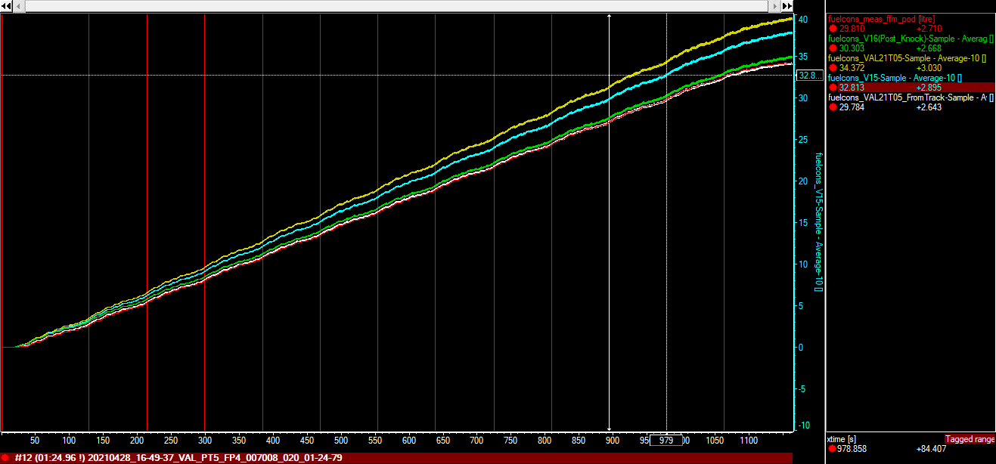
WinDarab AND Simulations Outcomes
 |  | Matlab Script
Lap | Max ffm_fuel_lap [L] | Fuelcons_ VAL21T05_FromTrack | Fuelcons_ V5 | Fuelcons_ VAL21T05 | Fuelcons_V16 (Post-Knock)
20210428_16-49-37_VAL_PT5_FP4_007008_020_01-24-79
#1 | 2.68 | 2.904 | 3.425 | 3.636 | 3.227
#2 | 2.64 | 2.514 | 2.762 | 2.89 | 2.543
#3 | 2.71 | 2.798 | 3.055 | 3.189 | 2.814
#4 | 2.72 | 2.766 | 3.013 | 3.149 | 2.776
#5 | 2.72 | 2.266 | 2.462 | 2.579 | 2.27
#6 | 2.73 | 3.085 | 3.374 | 3.532 | 3.108
#7 | 2.73 | 2.655 | 2.894 | 3.028 | 2.669
#8 | 2.71 | 2.932 | 3.228 | 3.37 | 2.971
#9 | 2.74 | 3.205 | 3.504 | 3.663 | 3.231
#10 | 2.72 | 1.797 | 1.96 | 2.051 | 1.804
#11 | 2.71 | 2.644 | 2.895 | 3.031 | 2.668
#12 | 2.74 | 3.68 | 4.032 | 4.217 | 3.719
#13 | 1.6 | 1.058 | 1.427 | 1.37 | 1.267
 |  |  |  |  | Average
[L] | 2.627 | 2.639 | 2.925 | 3.054 | 2.697
It seems that fuel map computation using Matlab script has worked; quite good correspondence with FFM measure can be observed in WD forecast using consumption map from VAL21T05 data postprocessed by the script
Also Canopy model forecast with same map seems to be almost on target (probably to discuss how to look at consumption during off-throttle phases)
Canopy (DynoMapVAL21T05) | Canopy (engineMapFROMTrack)
3.080 | 2.733

Slide 8
SCG-007C Le Mans Hypercar
Simulation results for Le Mans

Slide 9
Fuel consumption forecasts from previously exposed data
 |  |  | Max bop_lap_energy_meas [MJ] | bSFC Estimation at Driveshafts | Fuel From Canopy [L] | 12.3 Le Mans Stint Energy [MJ] | Full LeMans Stint Consumption [L]
Le Mans PreKnock engine map (VAL21T05Dyno) |  | 03:26.1 | 81.3 | 311.7343173 | 9.387 | 999.99 | 115.456
Le Mans PostKnock engine map (V16) |  | 3:26:16 | 81.3 | 270.1107011 | 8.133 | 999.99 | 100.04
… Still to be finished with conclusions….

