Slide 2
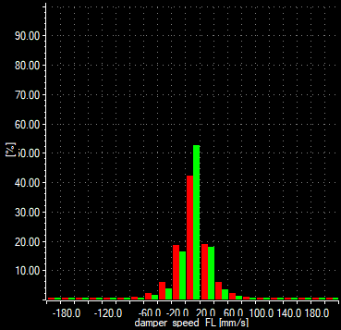
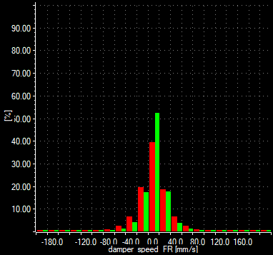
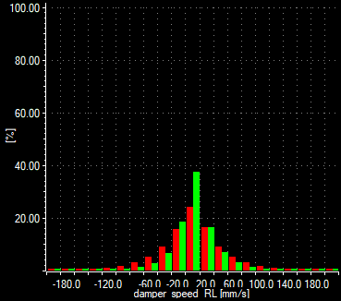
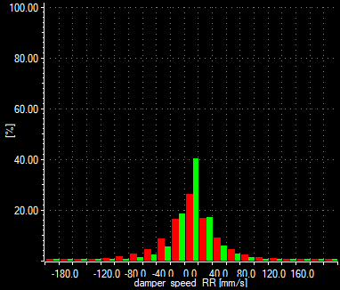
Damping 1
RED: 708
GREEN: 709
Data from 2nd race stint of both cars, they showed quite a consistent behavior on track, so these data can be taken as representative.
From travel/speed damper histograms, it can be observed:
709 car dampers stay 10% more time steady (0 mm/s speed), so on 709 higher level of low speed damping
708 histograms are more symmetric, while in 709 low speed bump a bit more closed than low speed rebound

Slide 3
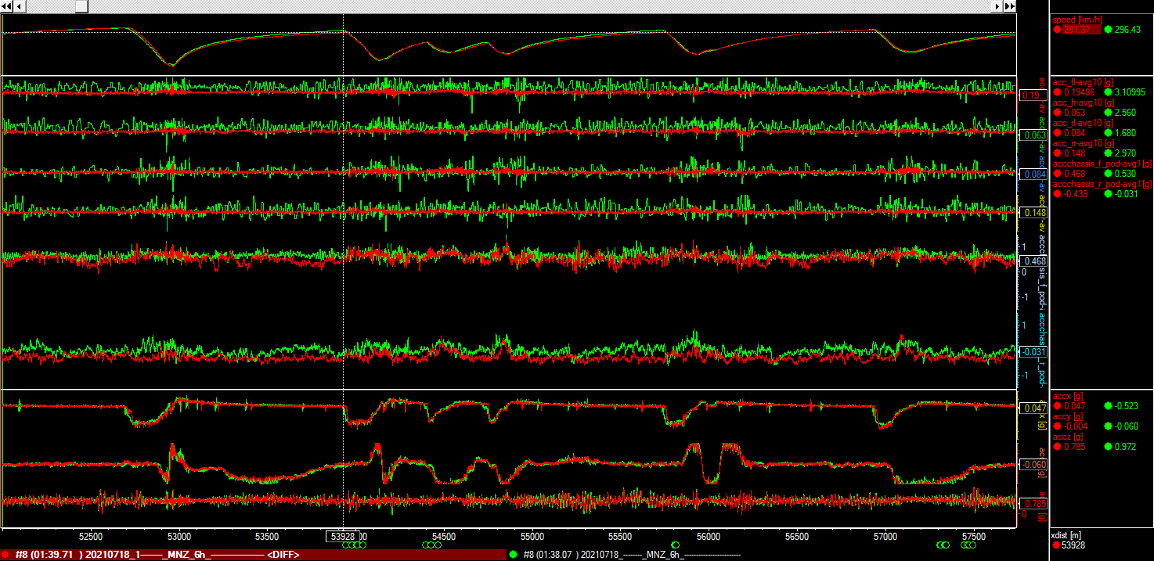
Damping 2
#709 rear saw higher accelerations, in line with rear of the car instability feedback reported from drivers
Note: difference in velocity profiles on straight nothing to do with damping levels probably, but connected to GB issues on 708

Slide 4
Tcockpit
11 AM 12 AM 1 PM 2PM 3PM 4 PM 5PM

Slide 5
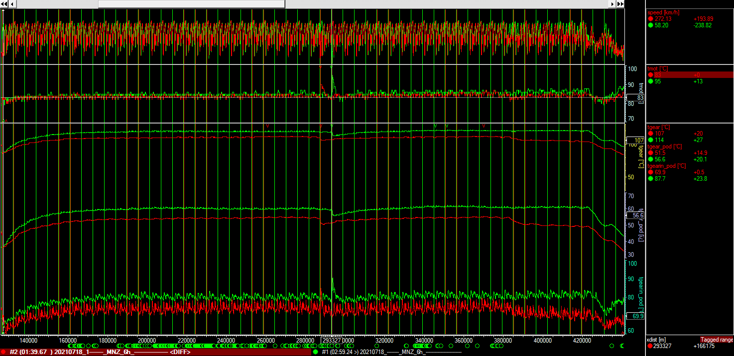
Gearbox and Engine T #708 vs #709
Data from 3rd and 4th stints both cars
Parameter | Avg | Max | min
Engine Temp [°C] | 84 / 85 | 90 / 95 | 80 / 79
Gearbox Temp [°C] | 107 / 117 | 112 / 122 | 84 / 87
Inlet GB Temp [°C] | 72.5 / 79.4 | 85 / 90.5 | 60.1 / 63.4
Outlet GB Temp [°C] | 51.6 / 58.5 | 55.4 / 62.3 | 34.1 / 36.5

Slide 6
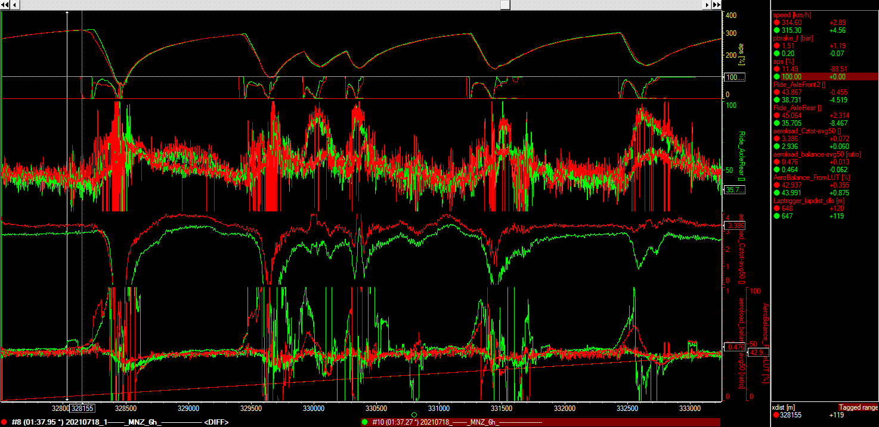
EoS #708 vs #709 (Fastest race laps)
EoS Parameter | #708 | #709
RH [mm] | 44.3/42.9 | 42.4/39.3
SCz meas | 3.38 | 2.93
SCz LUT | 3.79 | 3.76
AeroBal meas | 46.6% | 53.1%
AeroBal LUT | 42.7% | 42.8%

Slide 7
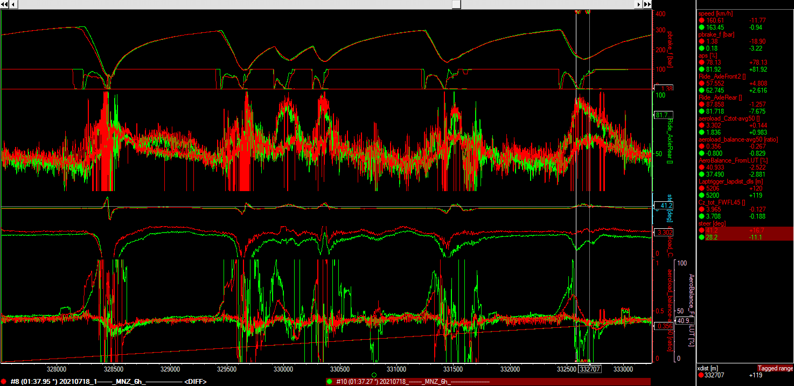
Parabolica #708 vs #709 (Fastest race laps)
Rear RH in corners not to be trusted since RL laser not working, some troubles in aeroload estimation, to in #709, to be analised second fastest lap…
EoS Parameter | #708 | #709
RH [mm] | 57.1/65.8 | 57.1/60.8
SCz meas | 3.47 | 1.68
SCz LUT | 3.90 | 3.82
AeroBal meas | 44.9% | /
AeroBal LUT | 40.38% | 39.55%

Slide 8
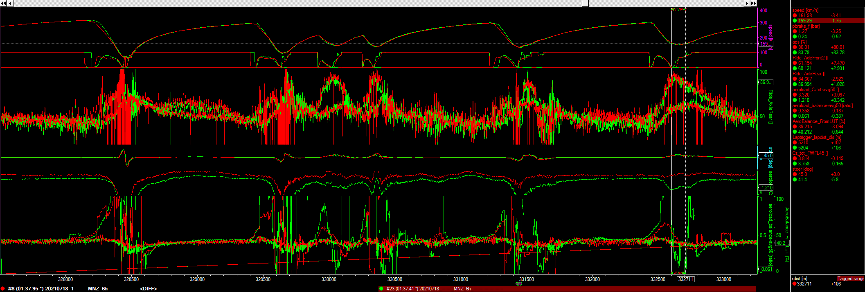
Parabolica #708 vs #709 (Fastest race lap #708, 2nd fastest #709)
EoS Parameter | #708 | #709
RH [mm] | 57.5/65.1 | 57.4/63.9
SCz meas | 3.47 | 1.20
SCz LUT | 3.882 | 3.866
AeroBal meas | 43.0% | /
AeroBal LUT | 40.09% | 39.92%

Slide 9
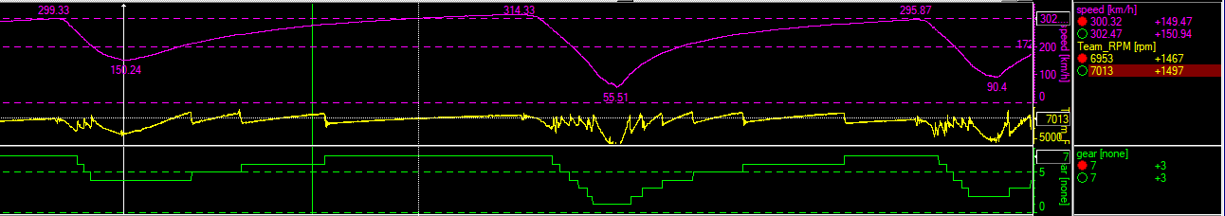
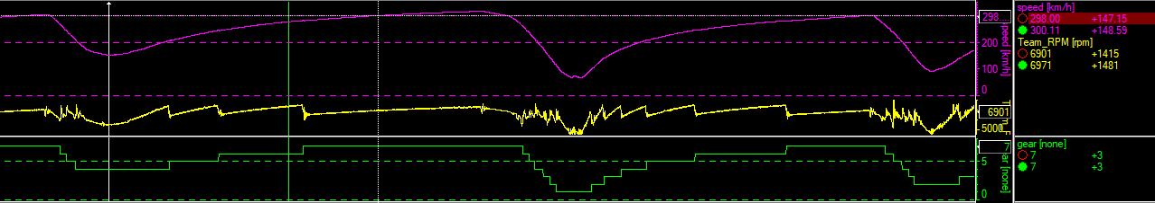
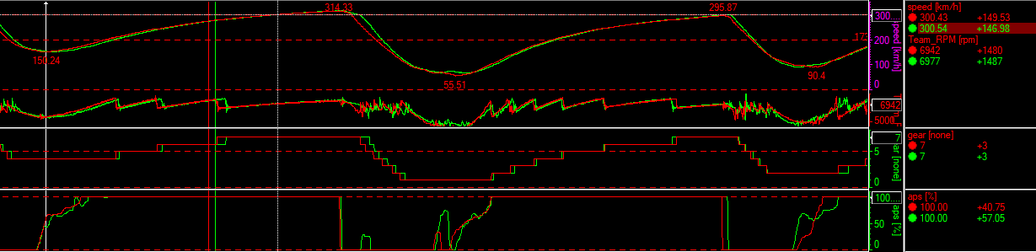
Delta Time 150-300 #708 vs #709
#708
Acceleration 150-300kph:
Time: 14.2s
Distance: 930m
#709
Acceleration 150-300kph:
Time: 13.7s
Distance: 892m
Overlay between the 2 starting when driver on throttle

Slide 10
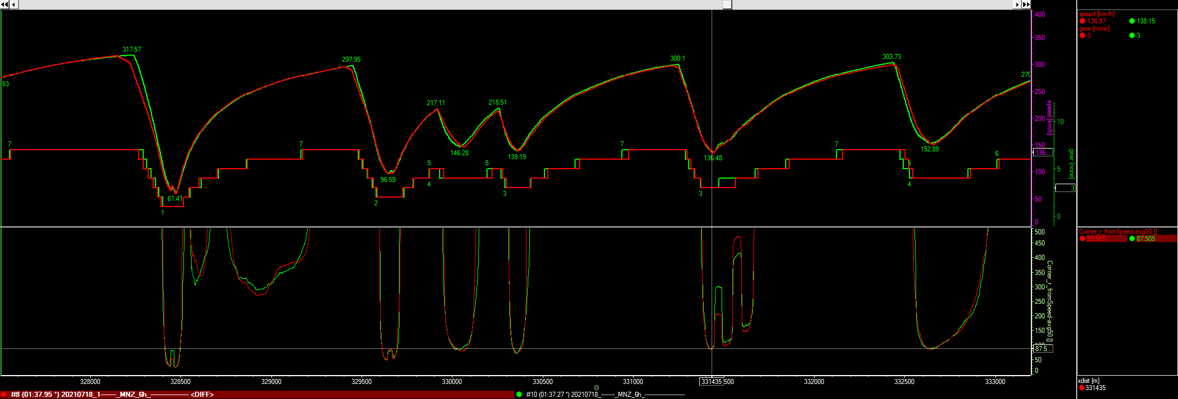
Speed profile and corner radius Best laps #708 vs #709
Best Laptimes:
#708: 1:37.95 GM
#709: 1:37.27 RD

