Slide 1
Present configuration
Actual layout overview
Brake system model
Compliance model - Input |  |  |  |  |  |  | Braking condition - Input
Front caliper compliance (CP6160-2/3S7MPD) | 12.5 | mm^3/bar |  |  |  |  | Total Fx | 42500
Rear caliper compliance (CP6078) | 12.8 | mm^3/bar |  |  |  |  | Split | 0.600
Front rigid brake pipe | 1.22 | m
Front flexi brake pipe | 1 | m |  |  |  |  |  | Front | Rear
Rear rigid brake pipe | 3.69 | m |  |  |  |  | Fx | 25500 | 17000
Rear flexi brake pipe | 1.51 | m |  |  |  |  | Wheel radius | 0.346 | 0.346 | m
Rigid brake pipe compliance | 0.5 | mm^3/bar per length |  |  |  |  | Torque (per side) | 4412 | 2941 | Nm
Flexible brake pipe compliance | 3 | mm^3/bar per length |  |  |  |  | Disc eff. Radius | 0.1635 | 0.151 | m
Front master cylinder diam. | 16.8 | mm | 222 | mm^2 |  |  | Disc tangential force (Ft) | 26982 | 19477 | N
Rear master cylinder diam. | 17.78 | mm | 248 | mm^2 |  |  | Pad mu | 0.5 | 0.5
Front line pressure | 108 | bar |  |  |  |  | Disc normal force (Fn) | 53963 | 38954
Rear line pressure | 78 | bar |  |  |  |  | Piston area (per caliper side) | 2.50E-03 | 2.50E-03 | m2
Front Pad/disc clearance | 0.3 | mm |  |  |  |  | Line pressure | 108 | 78 | bar
Rear Pad/disc clearance | 0.3 | mm
Front Caliper piston area | 2503.85 | mm^2 |  |  |  |  | Master cylinder diam. | 16.8 | 17.78 | mm
Rear Caliper piston area | 2503.85 | mm^2 |  |  |  |  | Master cylinder area | 2.22E-04 | 2.48E-04 | m2
 |  |  |  |  |  |  | Master cylinder force | 2387 | 1930 | N
Compliance model - Output
 |  |  |  |  |  |  | Balance bar ratio | 0.553 |  | -
Front oil volume | 3834 | mm^3 |  |  |  |  | Pedal ratio | 3.6 |  | -
Rear oil volume | 3238 | mm^3 |  |  |  |  | Pedal force | 1199 |  | N
Front master cylinder travel | 17.3 | mm | Delta | 4.3
Rear master cylinder travel | 13.0 | mm
Average travel | 15.2 | mm
Pedal travel | 54.6 | mm

Slide 2
Smaller rear caliper case study
Smaller piston caliper layout overview (Rear)
Brake system model
Compliance model - Input |  |  |  |  |  |  | Braking condition - Input
Front caliper compliance (CP6160-2/3S7MPD) | 12.5 | mm^3/bar |  |  |  |  | Total Fx | 42500
Rear caliper compliance (CP6078) | 12.8 | mm^3/bar |  |  |  |  | Split | 0.600
Front rigid brake pipe | 1.22 | m
Front flexi brake pipe | 1 | m |  |  |  |  |  | Front | Rear
Rear rigid brake pipe | 3.69 | m |  |  |  |  | Fx | 25500 | 17000
Rear flexi brake pipe | 1.51 | m |  |  |  |  | Wheel radius | 0.346 | 0.346 | m
Rigid brake pipe compliance | 0.5 | mm^3/bar per length |  |  |  |  | Torque (per side) | 4412 | 2941 | Nm
Flexible brake pipe compliance | 3 | mm^3/bar per length |  |  |  |  | Disc eff. Radius | 0.1635 | 0.151 | m
Front master cylinder diam. | 16.8 | mm | 222 | mm^2 |  |  | Disc tangential force (Ft) | 26982 | 19477 | N
Rear master cylinder diam. | 16.8 | mm | 222 | mm^2 |  |  | Pad mu | 0.5 | 0.5
Front line pressure | 108 | bar |  |  |  |  | Disc normal force (Fn) | 53963 | 38954
Rear line pressure | 103 | bar |  |  |  |  | Piston area (per caliper side) | 2.50E-03 | 1.90E-03 | m2
Front Pad/disc clearance | 0.3 | mm |  |  |  |  | Line pressure | 108 | 103 | bar
Rear Pad/disc clearance | 0.3 | mm
Front Caliper piston area | 2503.85 | mm^2 |  |  |  |  | Master cylinder diam. | 16.8 | 16.8 | mm
Rear Caliper piston area | 1894.68 | mm^2 |  |  |  |  | Master cylinder area | 2.22E-04 | 2.22E-04 | m2
 |  |  |  |  |  |  | Master cylinder force | 2387 | 2277 | N
Compliance model - Output
 |  |  |  |  |  |  | Balance bar ratio | 0.512 |  | -
Front oil volume | 3834 | mm^3 |  |  |  |  | Pedal ratio | 3.6 |  | -
Rear oil volume | 3855 | mm^3 |  |  |  |  | Pedal force | 1296 |  | N
Front master cylinder travel | 17.3 | mm | Delta | -0.1
Rear master cylinder travel | 17.4 | mm
Average travel | 17.3 | mm
Pedal travel | 62.4 | mm
Confirmed rear caliper compliance?
It does not look that convenient to have so long pedal travel...
With respect to actual system setup:
PROs
  More similar master cylinders strokes
CONs
  +7.8 mm pedal travel
  Enhanced ‘’spongy’’ feeling of the pedal from driver side
Smaller Rear Caliper (CP6077)
Do you think it can be convenient to switch to a smaller piston rear caliper?

Slide 3
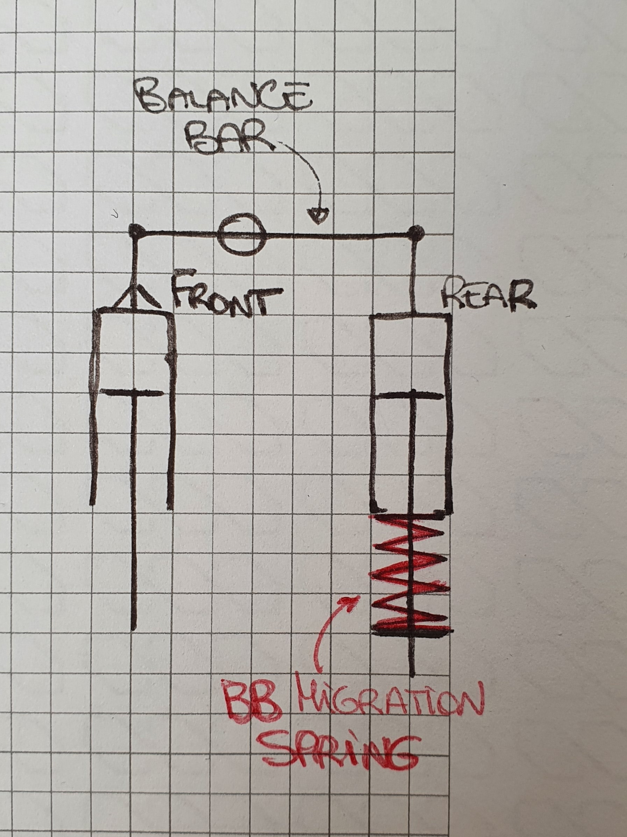
Brake Balance migration spring
BB migration spring
Drivers told about this so called ‘‘brake balance migration’’ spring, do you have any advice about it?
Did you already use this type of device and can give any technical-side opinion about this kind of solution?
Could it be suitable for our set of problems?

