Slide 2
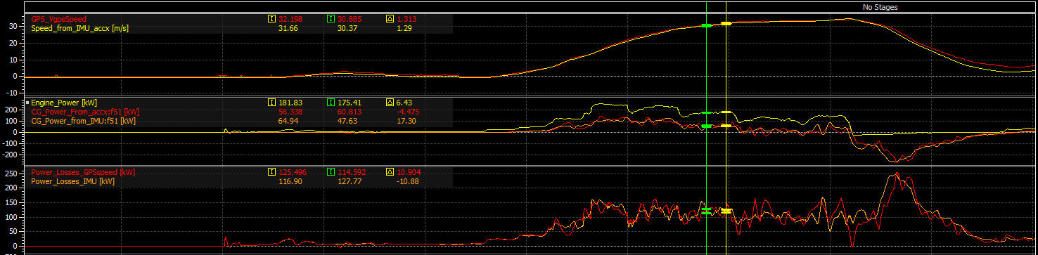
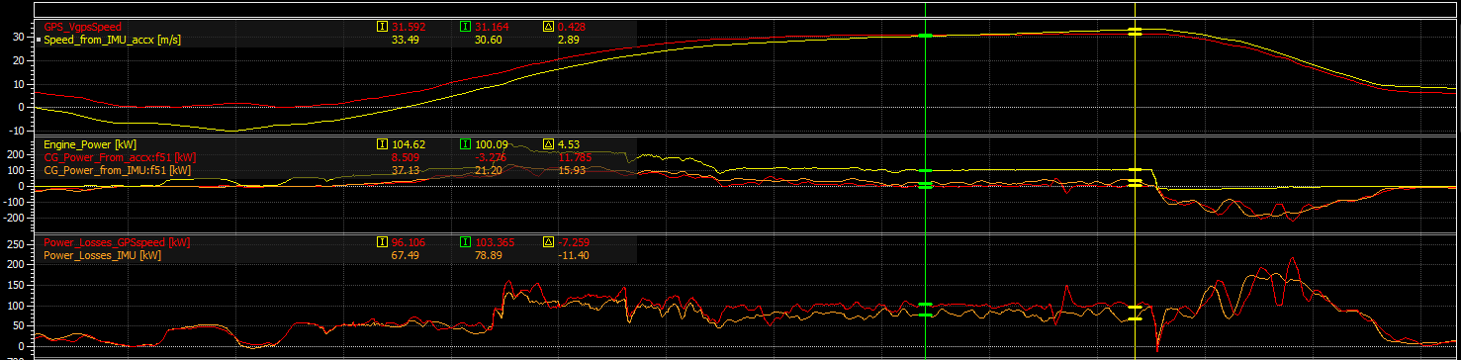
Power Losses 1
CG_Power_From_accx: mechanical power applied to vehicle mass, computed using acceleration obtained by the derivative of GPS Speed
CG_Power_From_IMU: mechanical power applied to vehicle mass, computed using longitudinal acceleration from IMU
Average Power Loss (Acceleration)
From GPS_Speed Calc | 121 kW
From IMU Calc | 119 kW
Average Power Loss (Constant Speed ~115kph)
From GPS_Speed Calc | 100 kW
From IMU Calc | 79 kW

Slide 3
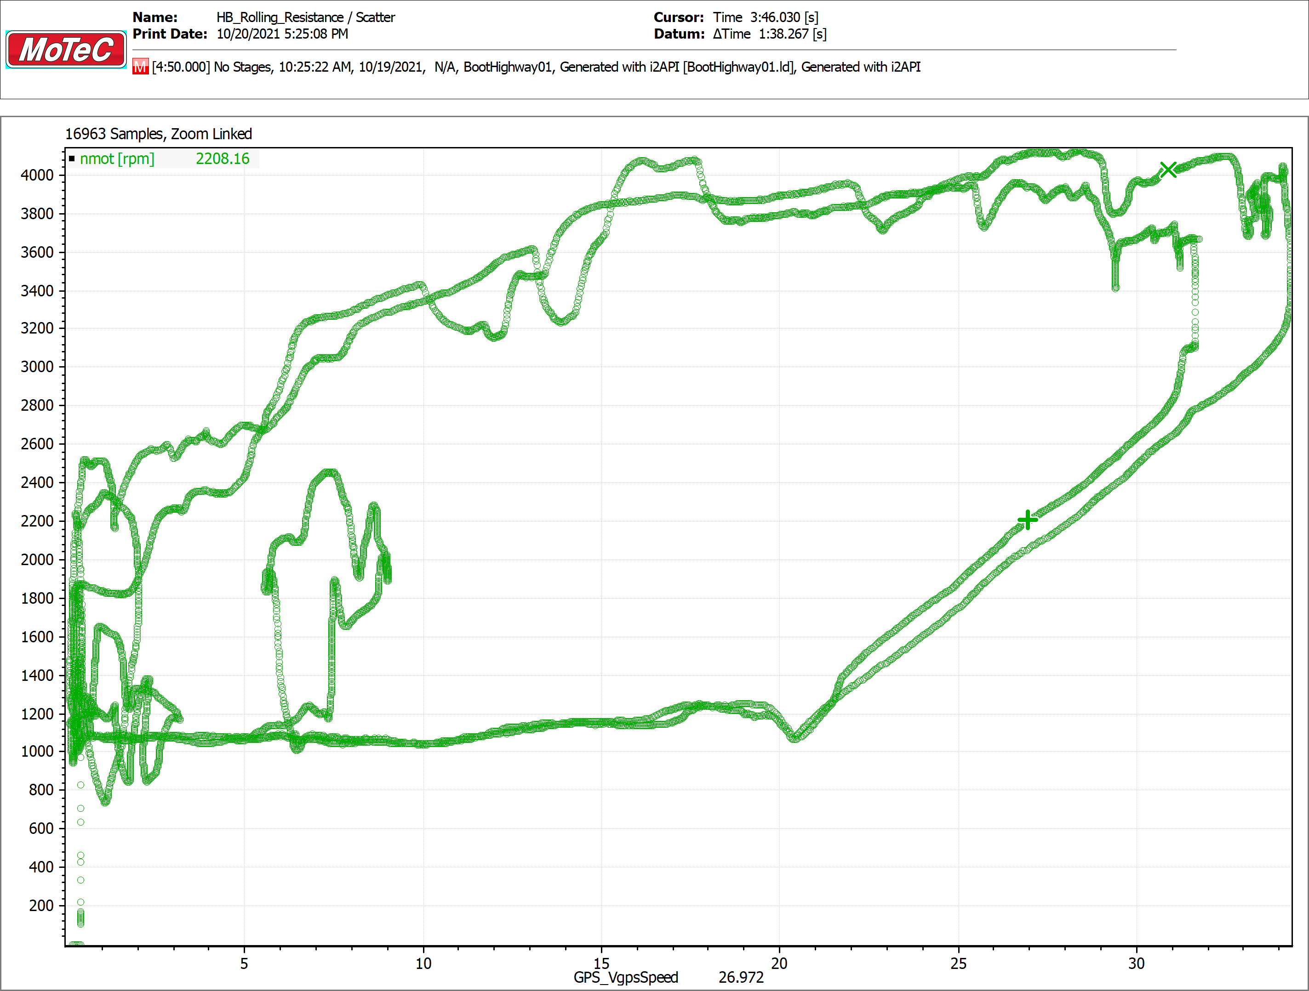
Power Losses 2 (Observations)
Seems really strange power losses are almost speed independent, not clear if connected to the type of terrain car ran on, if they are connected to transmission architecture or internal frictions… more detail on transmission and powertrain layout requested;
Looking at the scatter below seems reasonable to assume a CVT or some other torque converter was mounted on the car (please confirm);
In general more data requested to evaluate rolling resistance...

Slide 4
Questions for Armada
Available data logs:
- “Highway”: please describe testing conditions
- “ColdForwardXX”: please describe testing conditions
- 2020 Race (6.5h portion)
For each data log (if changes between them):
Gearbox ratios?
Is there an hydraulic torque converter?
Wheel size?
Transmission layout (clutch type, gears quantity, differential(s) layout, transfer cases, etc..)?
Total weight (including fuel and occupants)?
Missing signals for rolling resistance evaluation:
Wheel speeds; using GPS speed/IMU the quality of the result is not very good.
If there is a torque converter wheel speeds are mandatory.
Selected gear (missing in “Highway” and “ColdForward” logs)

