Slide 2
Boot FCEV
Battery capacity study

Slide 3
Battery capacity (CW43 starting point)
Main constrain:
Sustain 250kW charge rate, in case of quick accelerator pedal release, while the fuel cells are at maximum power.
Assuming a charging rate of 10C, the suggested capacity is around 25kWh.
To validate the performance of the vehicle, simulations will be run with 22kWh and 26kWh, which are the closest capacities achievable with already available modules design.
Higher capacity will allow slightly better performance of the vehicle, since instantaneous peak power is given by FC power production + available battery power.
The fuel cell management strategy plays a big role for the battery SOC/current profile:
The fuel cell can be controlled to “maintain” the battery SOC to a good level (40/80%), in fast transients the battery contribution can be more than 50% of the vehicle power.
Different control options will be simulated this week, assuming the 6h log terrain can be represented by the rolling resistance data extracted from the “BootLap4” data log.

Slide 4
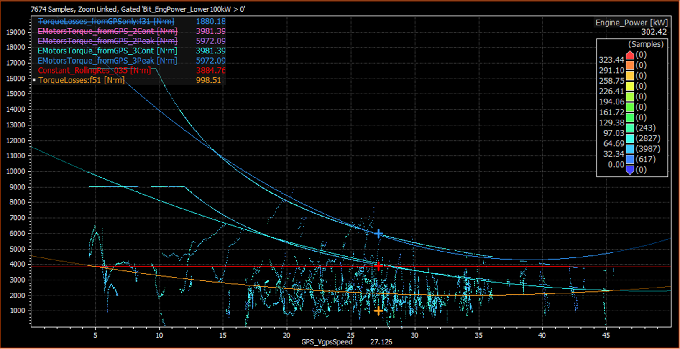
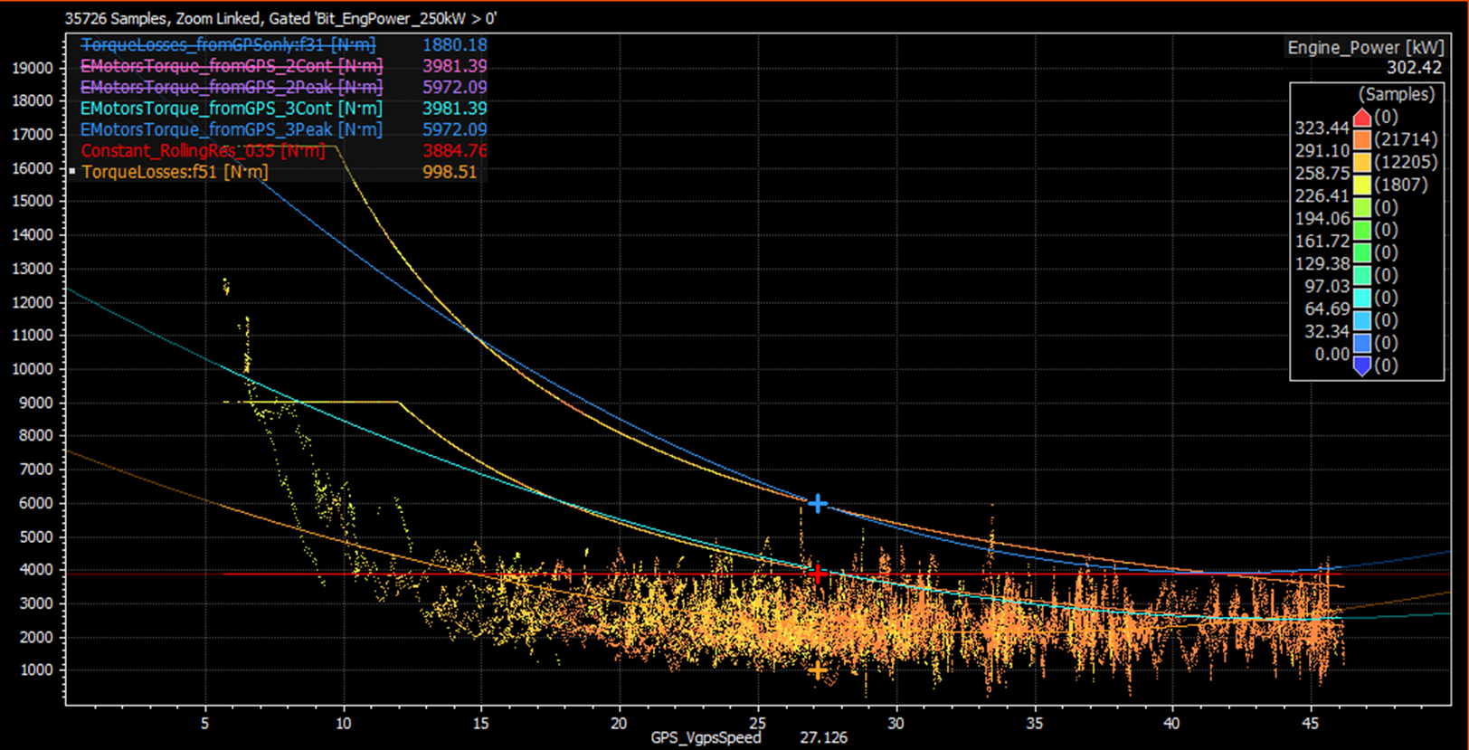
Drag torque = f(speed, power) step1
From data analysis of last test “BootLap4”, drag torque has been modelled as dependent of speed and applied torque, assumptions were made for all un-available parameters:
Torque dependence is covering the losses due to wheel slip, without having to model the phenomenon with un-reliable parameters.
For zero torque applied, data with engine power between 25-100kW have been fitted.
For maximum torque applied, data with engine power >250kW have been fitted.
Everything has been then scaled with the weight of the vehicle, to get to the following figures:
Torque losses, engine power <100kW
Losses [% GW] | Torque T/Tmax
Speed [m/s] | 0 | 100%
0 | 23% | 68%
5 | 23% | 68%
15 | 18% | 30%
20 | 15% | 30%
45 | 15% | 30%
Torque losses, engine power >250kW

Slide 5
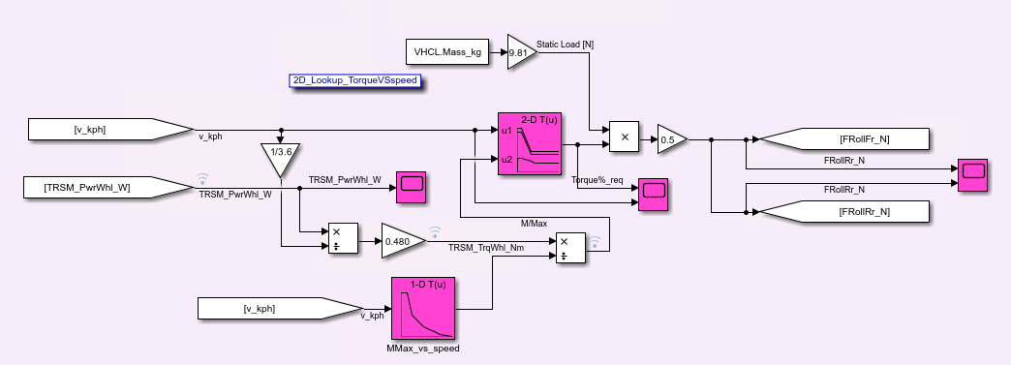
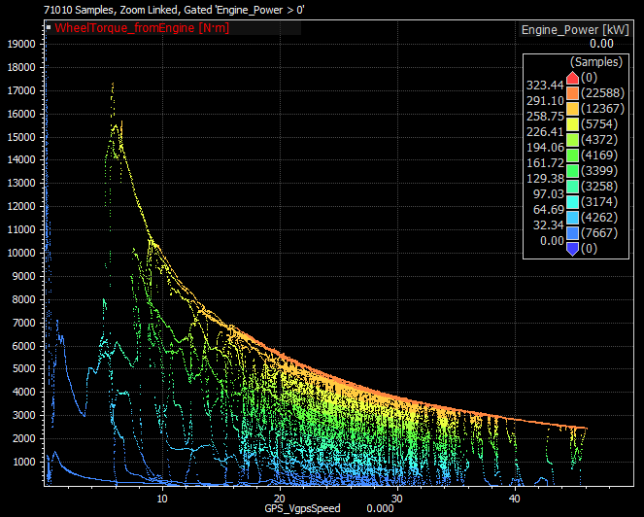
Rolling resistance modeling
Rolling resistance modeling was driven by ICE Boot datalogs analysis:
MMax (Maximum Torque values) were estrapolated from scatter plot below
Ratio between Axle Torques of the model and Mmax, together with speed, contributes in defining rolling resistance forces as a portion of car static load
Curve at 1.4 estimates losses in full power conditions for the new vehicle (the coefficient corresponds to the ratio between static load of the new Hydrogen Boot and ICE version).
Curve at 2 is to avoid rolling resistance signal clipping in case of M/MMax overshoot.
Torque [Nm]
Speed [km/h]
Speed [km/h]

Slide 6
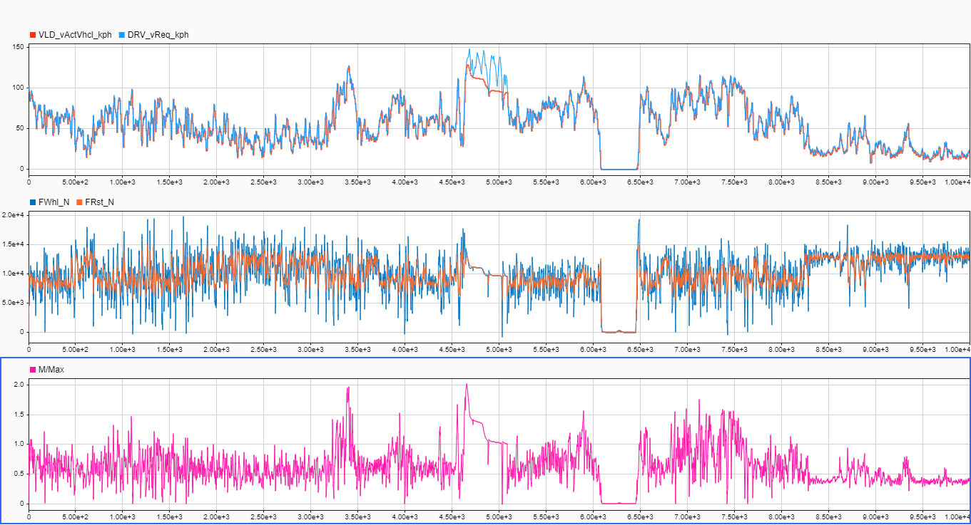
Rolling Resistance Profile
Rolling resistance signal (2nd plot, orange trace) follows speed and ground longitudinal force profiles, without clipping at fixed values.
Seems physically consistent and reasonably representative as an estimation.

Slide 7
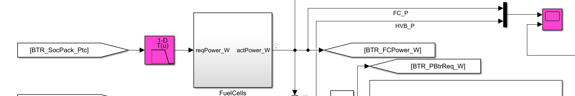
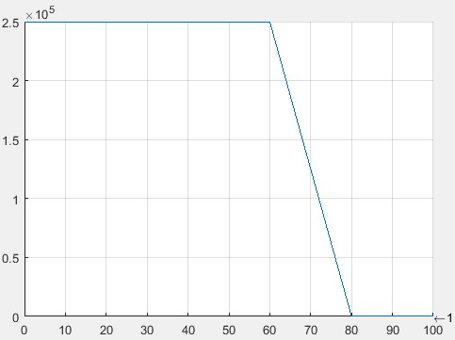
FC – Battery interaction
A simple logic was implemented to control battery recharge from Fuel Cells:
Power request to Fuel Cells:
250kW (full power, beginning of life condition) if battery SoC<60%
0 kW if battery SoC>80%
In this way we reduce the power requested to fuel cells if energy in the battery is enough to provide high amounts of power to the transmission, and in parallel we avoid overcharge in case the car has to stop or simply starts to request lower amounts of power. (Clearly the shape of this interaction can be further changed as soon as new needs or data will suggest it)
FC_Power [W]
BTR_SoC [%]

Slide 8
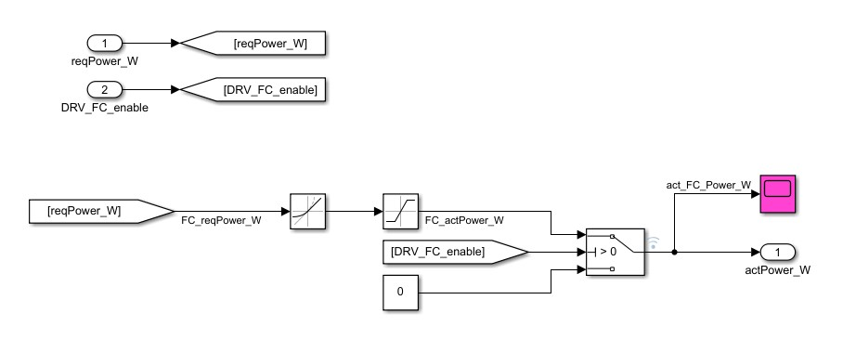
Fuel cell model
The fuel cells have been modelled with the following behaviour:
Electrical power output:
Min 19kW (20kW * 95% DCDC efficiency)
Max 237kW (250kW * 95% DCDC efficiency)
The change of power output is limited with the following rates:
Increasing rate 250kW/30s = 8.3 kW/s
Decreasing rate -250kW/10s = - 25 kW/s

Slide 9
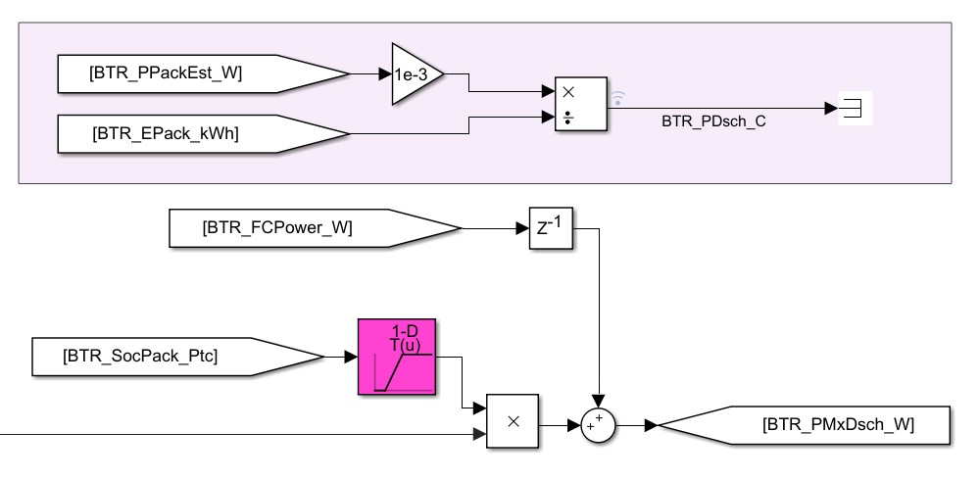

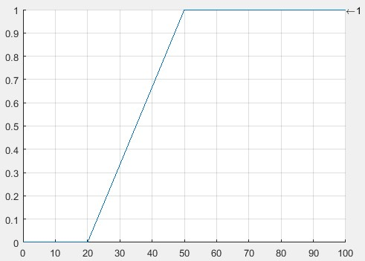
Battery Power
Power deliverable from battery goes to 0 for SoC values below 20% to protect cells, since for max power requests discharge rates can reach up to 10C.
In this part discharge power of the battery is added to the one coming from fuel cells, composing the actual power fed to the DC lines.
% of Max discharge Power
BTR_SoC [%]

Slide 10
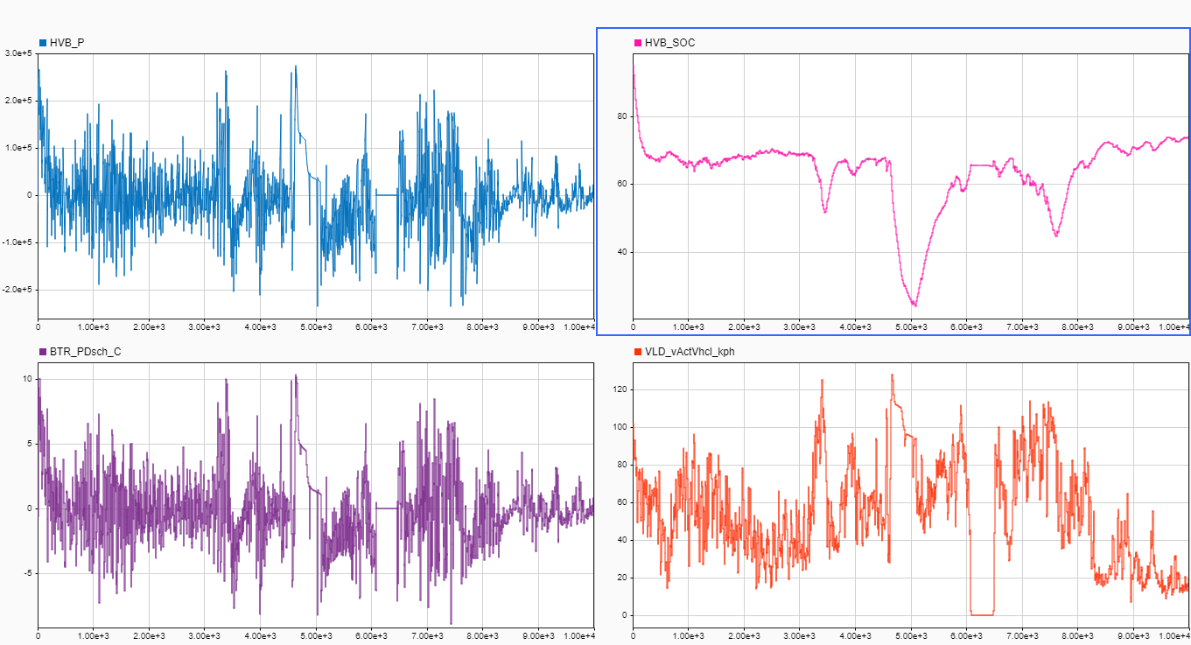
Battery working condition (26kWh option)
Summary of most important battery parameters in simulation following speed profile of 6h datalog from Baja 2020.

Slide 11
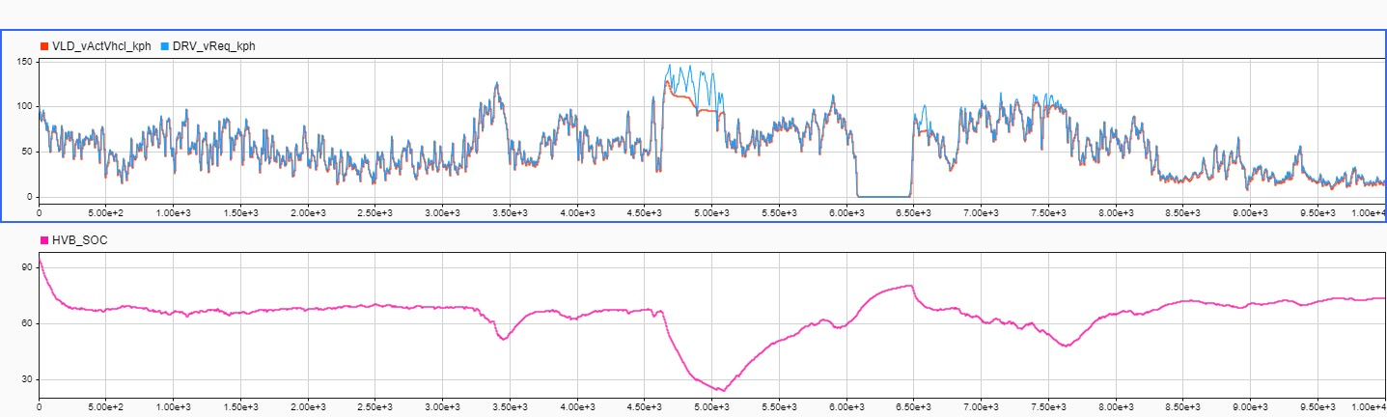
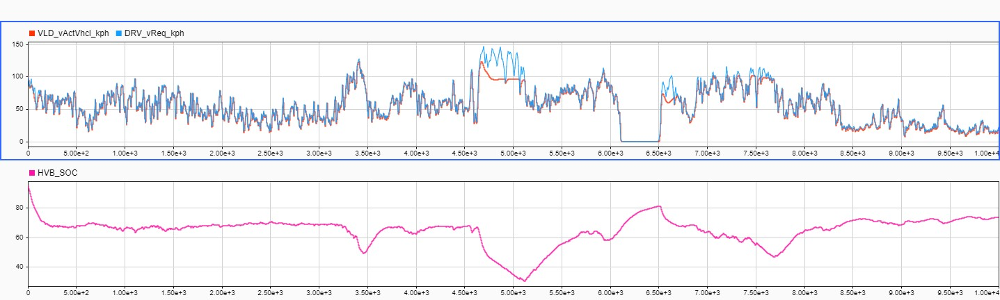
Actual velocity profile vs target velocity profile (Baja2020 logs)
1) 26kWh Battery Capacity
The main difference can be noticed in high speed/full power sections where 22kWh option shows a lower average speed (since drop in battery SoC is steeper), but in terms of minimum SoC and power supply from fuel cells, in none of the 2 cases energy available from battery seems insufficient to complete the speed profile (no zones where battery cannot give boost because SoC stopped at 20%)
2) 22kWh Battery Capacity

Slide 12
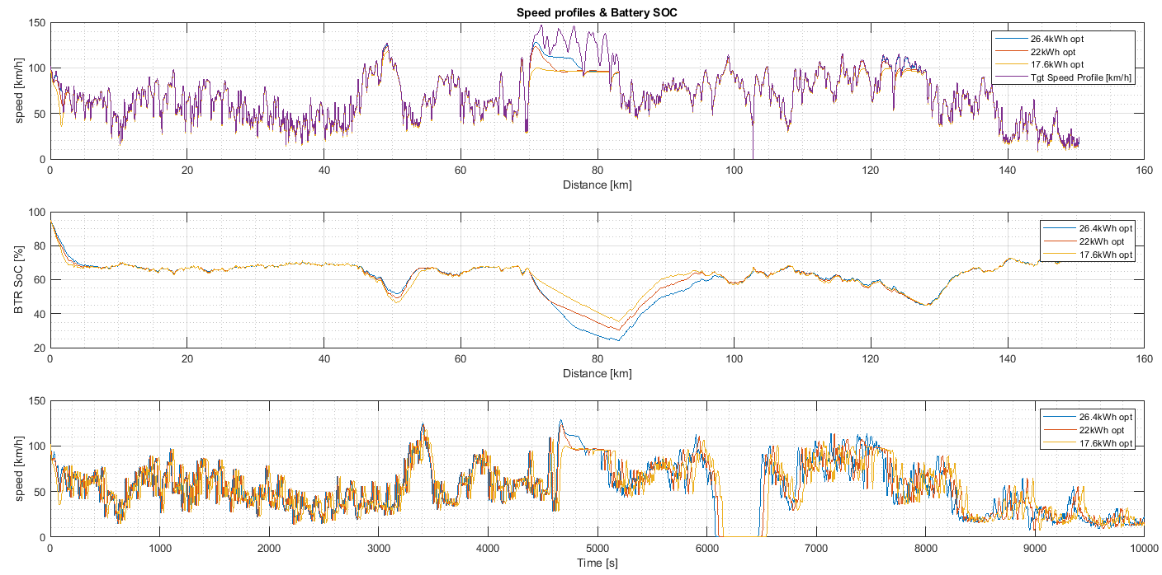
Velocity profile and SoC comparison
26.4kWh option allows better longitudinal performance, and available battery energy range is spanned almost completely, allowing driver to ask battery boost for longer times.
A rough indication on laptime sensitivity suggests an improvement of around 0.2% for each 1kWh increase in capacity

Slide 13
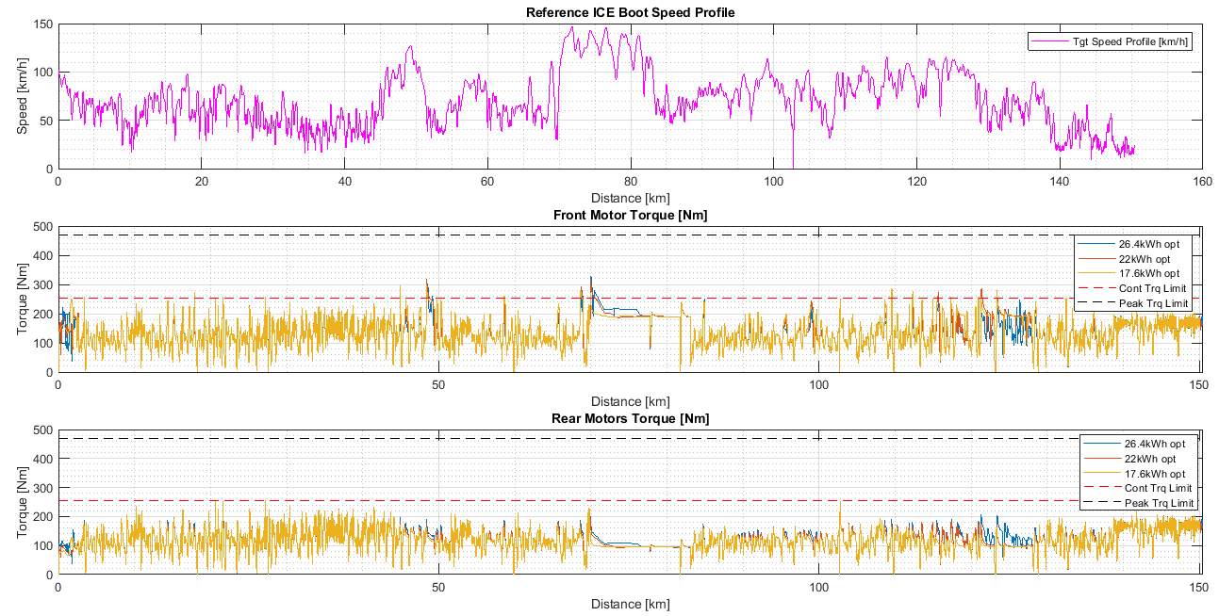
Motors working conditions
26.4kWh option makes available to the driver higher levels of torque especially in high-speed sections.
In everyone of the possible options investigated motors work in very safe region:
average torque levels below continuous torque limit;
peak torque limit never hit.

Slide 14
Electric power summary
Total Energy Consumed during 2020 Baja1000 6h datalog replay was 453 kWh, for a total distance of 150km.
Average consumption of 3.0 kWh/km

Slide 15
Summary
Battery design targets
Battery peak charge power target 250kW
Battery capacity target >18kWh, preferably 26kWh (priority will be given to charge power constraint on the cell model selection, considerations on the battery mass/volume will also be taken into account).
Expected discharge power peak from simulation ~250kW (total combined power of 500kW).

