Slide 1
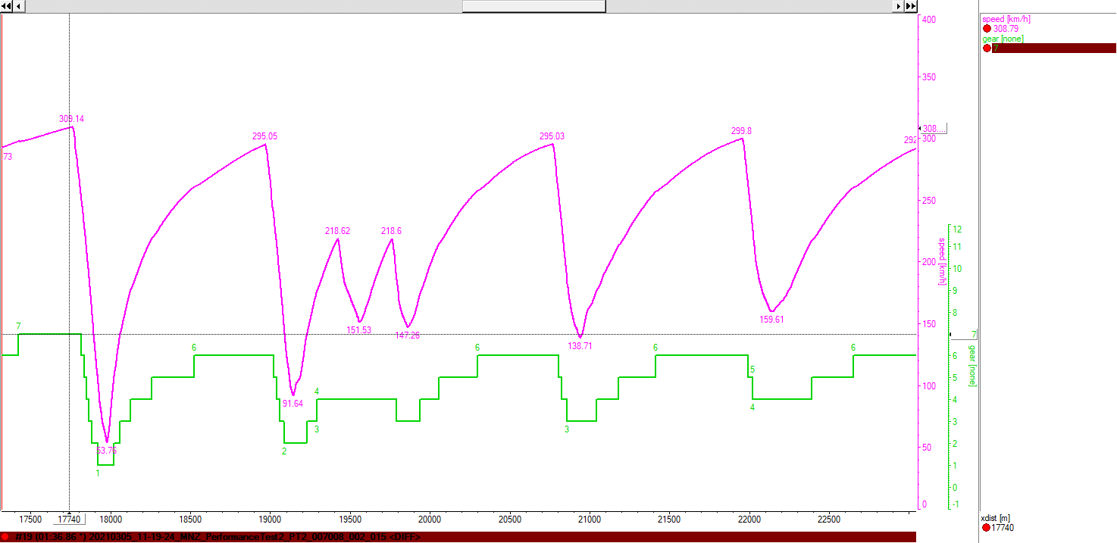
Driver: PD Laptime: 1:36.86

Slide 2
