Slide 1
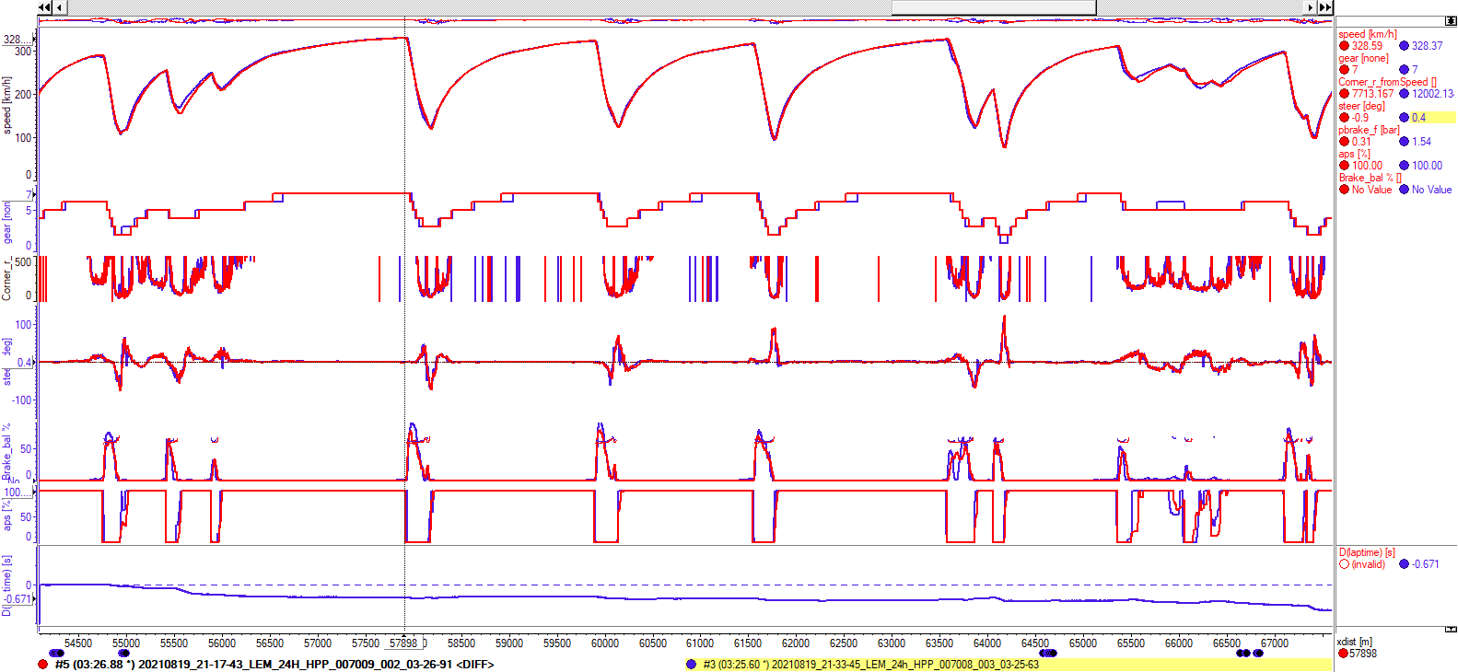
Romain (03:26.88) vs Olivier (03:25.60)

Slide 2
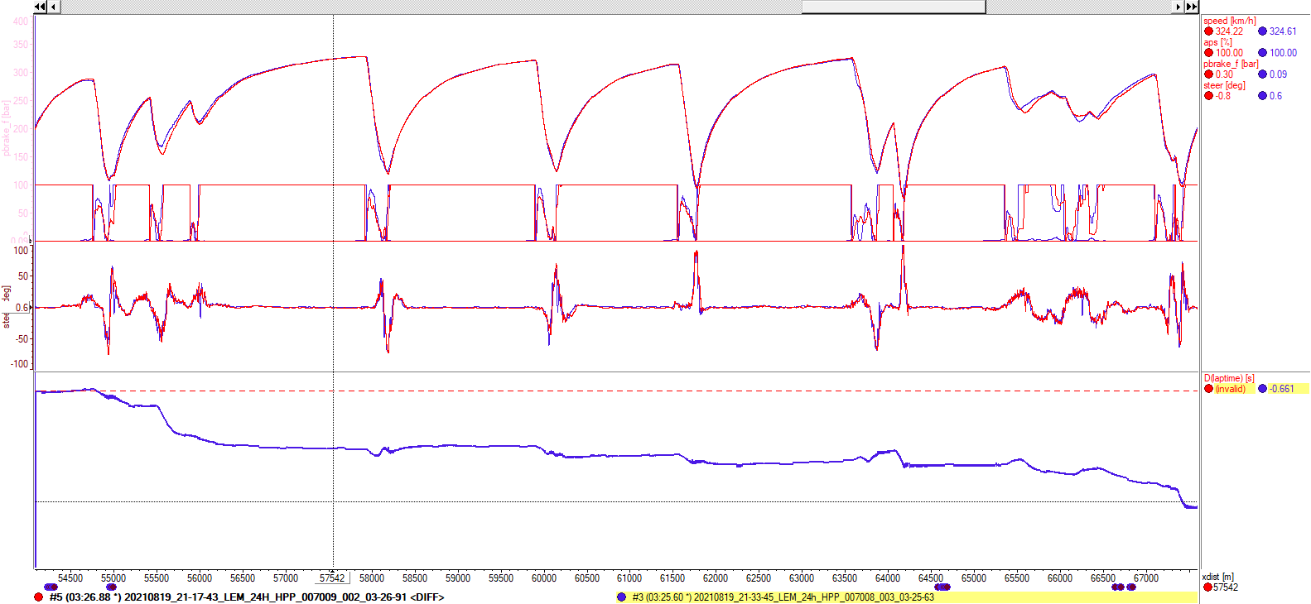
Romain (03:26.88) vs Olivier (03:25.60)

Slide 3
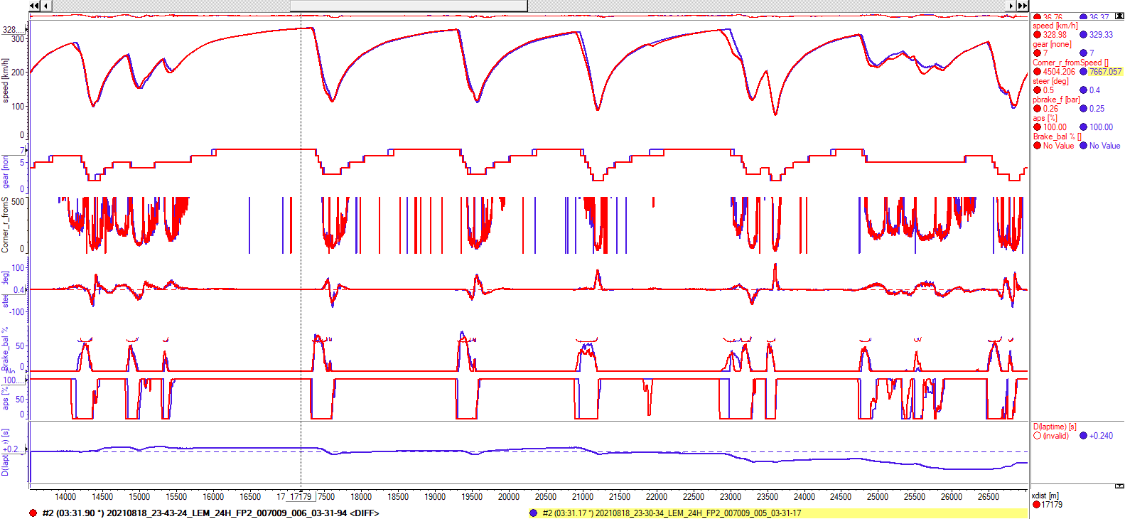
Richard (03:31.90) vs Romain (03:31.17)

