Slide 1
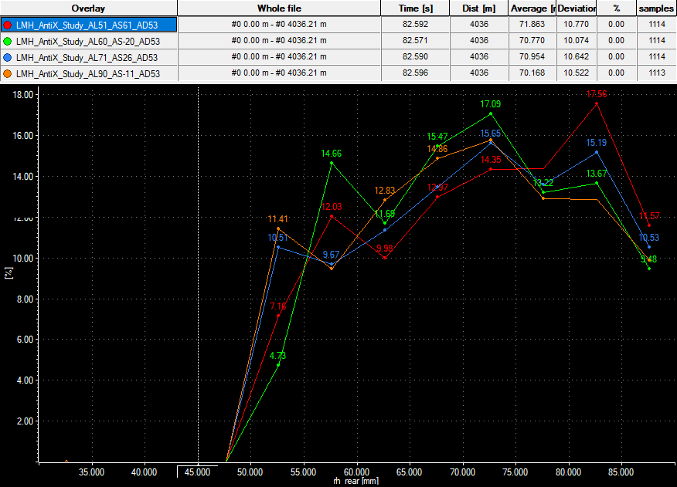
Kinematic change proposal for VAL21T04
Rear axle kinematic option change: Opt6 (AL51/AS61/RCH121)→Opt4 (AL90/AS-11/RCH108)
Rear
Option | UCA front | LCA front | RCH | AS | AL | Tie Outer Fix
# | mm | mm | mm | % | % | mm
1 | 0 | 0 | 102 | 16 | 40
2 | 0 | 20 | 114 | 26 | 71 | -3
3 | -20 | 0 | 95 | -20 | 60 | -4
4 | -20 | 20 | 108 | -11 | 90 | -7
5 | 20 | 0 | 109 | 52 | 20 | 3
6 | 20 | 20 | 121 | 61 | 51 | 0
Benefits:
Rear of the car in general lower and RH range across a lap narrower (see lines graph below)
Higher load on rear axle (~+1kN per wheel) with low loss on the front (<200N per wheel), so higher total vertical load connected also to the fact Cz rear moves toward its sweet spot (fixed FRH around 30mm) (see braking phase after T2)
Pro-squat can be a way to maximize traction in corner exit (see exit from Tornantino)
CZ tot | Rear RH
Front RH | 30 | 40 | 50 | 60 | 70 | 80 | 90
30 | 3.671 | 3.882 | 4.027 | 4.168 | 4.269 | 4.394 | 4.545
40 | 3.300 | 3.706 | 3.839 | 3.860 | 3.971 | 4.132 | 4.255
50 | 2.908 | 3.467 | 3.606 | 3.650 | 3.760 | 3.881 | 3.988
60 | 2.662 | 3.211 | 3.359 | 3.444 | 3.577 | 3.699 | 3.793
70 | 2.397 | 2.961 | 3.145 | 3.255 | 3.349 | 3.484 | 3.592
1)
2)
CZ Front | Rear RH
Front RH | 30 | 40 | 50 | 60 | 70 | 80 | 90
30 | 1.696 | 1.847 | 1.980 | 2.113 | 2.243 | 2.370 | 2.508
40 | 1.366 | 1.549 | 1.668 | 1.767 | 1.894 | 2.042 | 2.181
50 | 1.084 | 1.285 | 1.430 | 1.547 | 1.668 | 1.783 | 1.882
60 | 0.838 | 1.031 | 1.177 | 1.312 | 1.445 | 1.562 | 1.670
70 | 0.611 | 0.808 | 0.955 | 1.083 | 1.204 | 1.335 | 1.456
CZ Rear | Rear RH
Front RH | 30 | 40 | 50 | 60 | 70 | 80 | 90
30 | 1.975 | 2.035 | 2.047 | 2.055 | 2.026 | 2.024 | 2.037
40 | 1.934 | 2.157 | 2.171 | 2.093 | 2.077 | 2.090 | 2.074
50 | 1.824 | 2.182 | 2.176 | 2.103 | 2.092 | 2.098 | 2.106
60 | 1.824 | 2.180 | 2.182 | 2.132 | 2.132 | 2.137 | 2.123
70 | 1.786 | 2.153 | 2.190 | 2.172 | 2.145 | 2.149 | 2.136

Slide 2
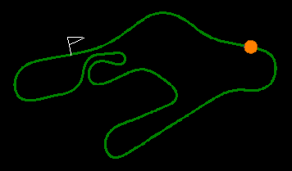
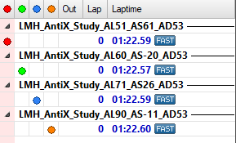
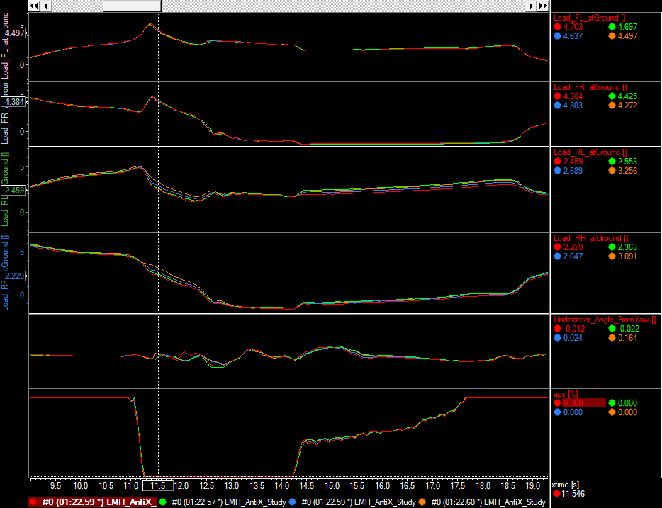
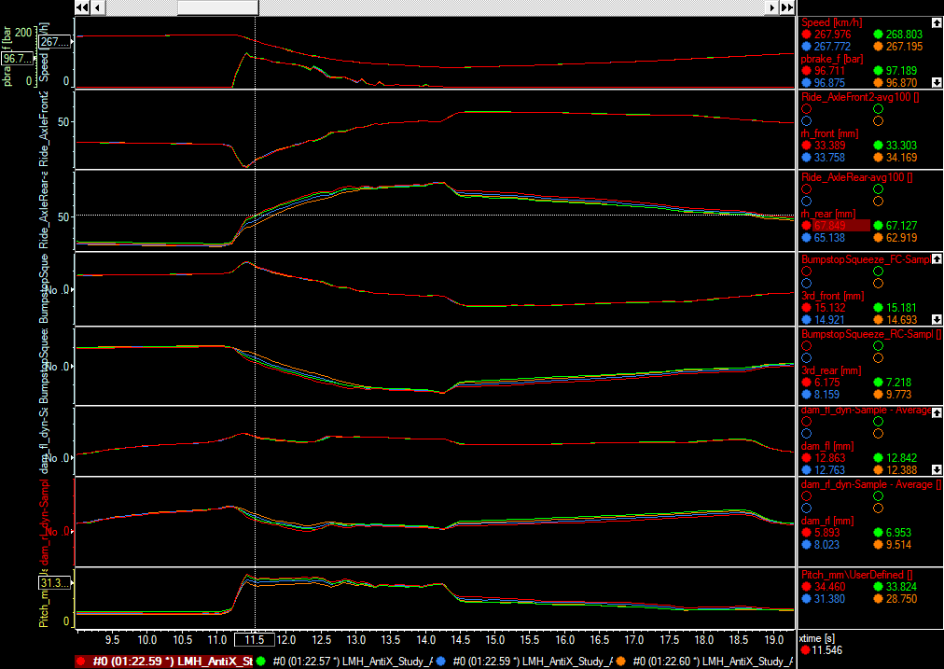
Kinematic change proposal for VAL21T04
Rear axle kinematic option change: Opt6 (AL51/AS61/RCH121)→Opt4 (AL90/AS-11/RCH108)
2)
braking phase after T2
2)

Slide 3
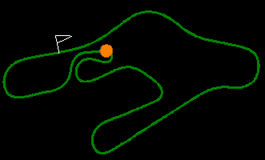
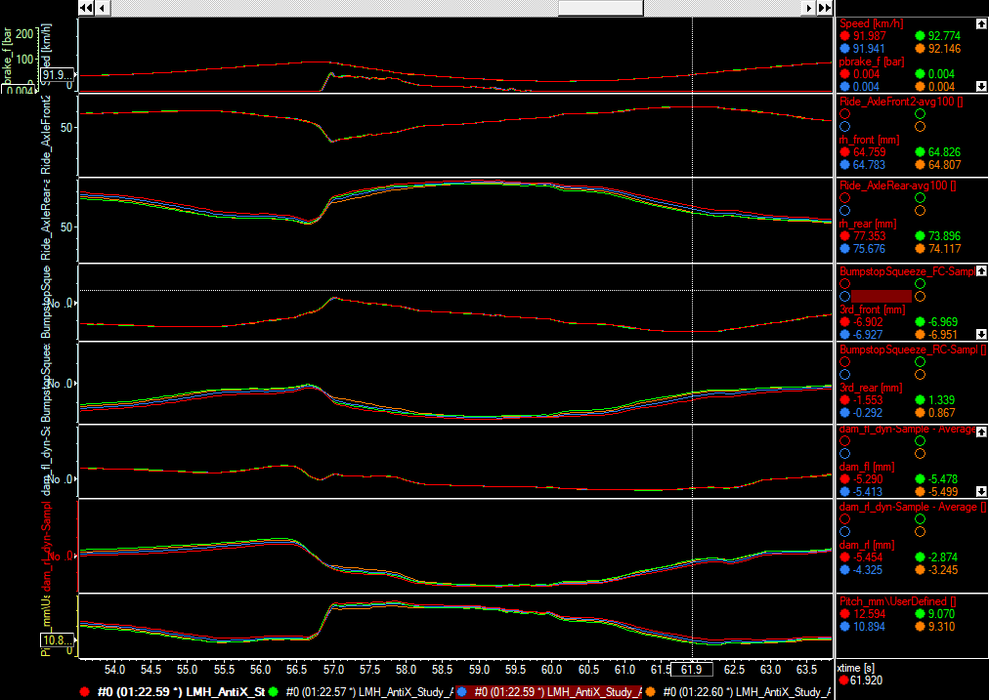
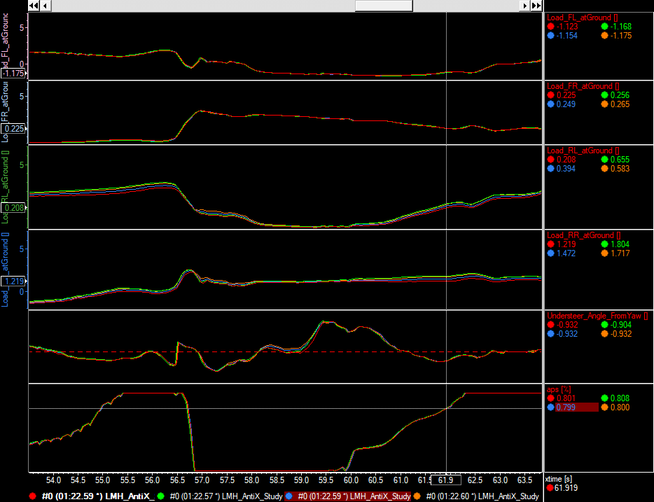
Kinematic change proposal for VAL21T04
Rear axle kinematic option change: Opt6 (AL51/AS61/RCH121)→Opt4 (AL90/AS-11/RCH108)
As can be seen by data pointed below, on exit from a low speed corner, we can exploit faster longitudinal load transfers and an higher aeroload on the rear connected to the lower position of the rear end... Again the resulting improved platform control can allow lighter springs to be mounted, recovering grip and setup margin (since the stiffest ones are already mounted)
Exit from Tornantino
3)
3)

Slide 4
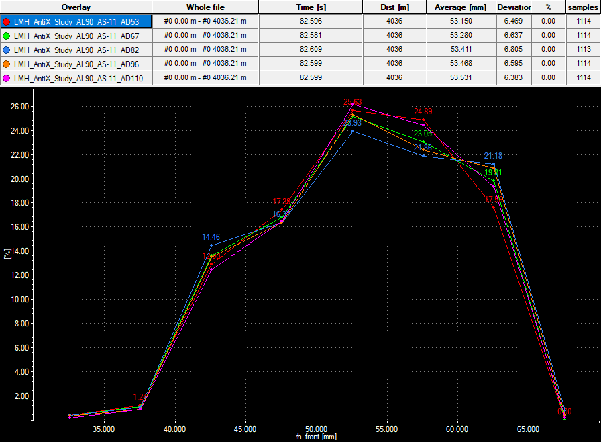
Kinematic change proposal for VAL21T04
Front axle kinematic option change: Opt7 (AD53/RCH51)→Opt9 (AD110/RCH54)
Front
Option | LCA front | LCA rear | RCH | AD
# | mm | mm | mm | %
1 | 0 | 0 | 53 | 82
2 | -5 | 0 | 41 | 96
3 | 5 | 0 | 64 | 67
4 | 0 | 5 | 66 | 96
5 | 0 | -5 | 40 | 67
6 | 5 | 5 | 77 | 82
7 | 5 | -5 | 51 | 53
8 | -5 | -5 | 28 | 81
9 | -5 | 5 | 54 | 110
In this case the conclusion is less straightforward to be stated, but from the data can be observed:
Front of the car is kinematically lifted, and so in general the average RH increases but its variability range across a lap is narrower (see lines graph below)
Loads on front axle decreases, due to the fact front of the car is generally higher, but this given last VAL21T03 setup (~-1.4kN per wheel on the front and almost not varying load per wheel on the rear), this behavior produces as a drawback a lower Cz front and in general a lower total aeroload, but as a pro allows lower car setups to be used, since pitch of the platform is better controlled
N.B. Looking at the data seems clear that the effect of this ‘‘strong’’ anti-dive configuration can be appreciated in transients, it’s impact in other than braking manouevres is very low, so it should not inficiate out-of-braking aero behaviour of the car, while the enhancement of platform control and the potentiality of exploiting lower car setups should massively...
2)
1)
CZ tot | Rear RH
Front RH | 30 | 40 | 50 | 60 | 70 | 80 | 90
30 | 3.671 | 3.882 | 4.027 | 4.168 | 4.269 | 4.394 | 4.545
40 | 3.300 | 3.706 | 3.839 | 3.860 | 3.971 | 4.132 | 4.255
50 | 2.908 | 3.467 | 3.606 | 3.650 | 3.760 | 3.881 | 3.988
60 | 2.662 | 3.211 | 3.359 | 3.444 | 3.577 | 3.699 | 3.793
70 | 2.397 | 2.961 | 3.145 | 3.255 | 3.349 | 3.484 | 3.592
35
CZ Rear | Rear RH
Front RH | 30 | 40 | 50 | 60 | 70 | 80 | 90
30 | 1.975 | 2.035 | 2.047 | 2.055 | 2.026 | 2.024 | 2.037
40 | 1.934 | 2.157 | 2.171 | 2.093 | 2.077 | 2.090 | 2.074
50 | 1.824 | 2.182 | 2.176 | 2.103 | 2.092 | 2.098 | 2.106
60 | 1.824 | 2.180 | 2.182 | 2.132 | 2.132 | 2.137 | 2.123
70 | 1.786 | 2.153 | 2.190 | 2.172 | 2.145 | 2.149 | 2.136
CZ Front | Rear RH
Front RH | 30 | 40 | 50 | 60 | 70 | 80 | 90
30 | 1.696 | 1.847 | 1.980 | 2.113 | 2.243 | 2.370 | 2.508
40 | 1.366 | 1.549 | 1.668 | 1.767 | 1.894 | 2.042 | 2.181
50 | 1.084 | 1.285 | 1.430 | 1.547 | 1.668 | 1.783 | 1.882
60 | 0.838 | 1.031 | 1.177 | 1.312 | 1.445 | 1.562 | 1.670
70 | 0.611 | 0.808 | 0.955 | 1.083 | 1.204 | 1.335 | 1.456
35
35

Slide 5
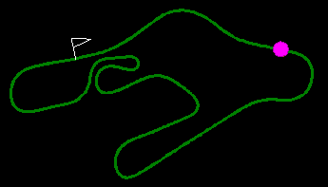
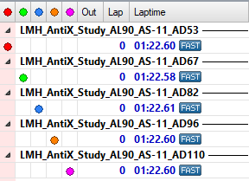
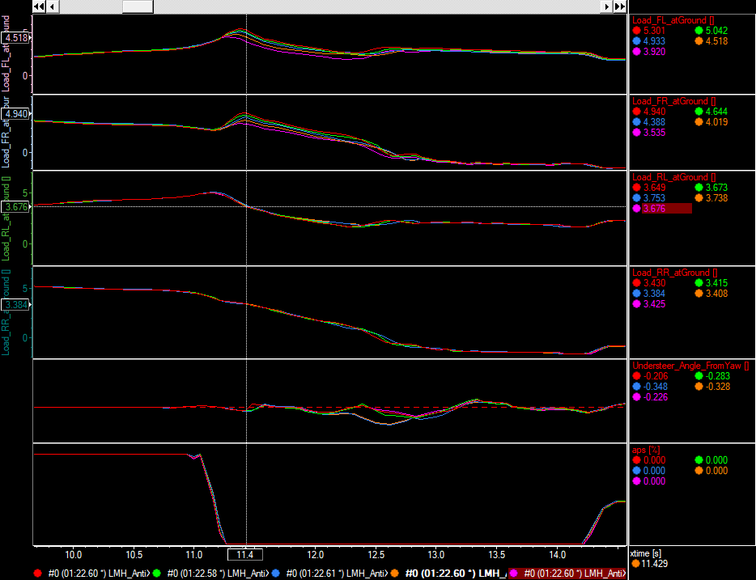
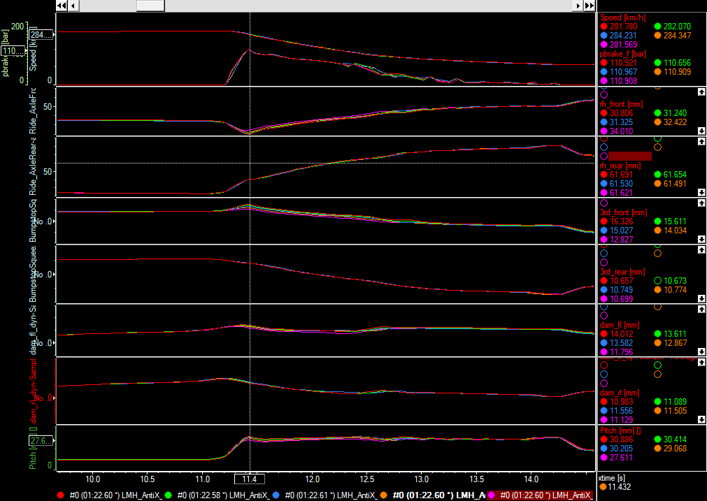
Kinematic change proposal for VAL21T04
Front axle kinematic option change: Opt7 (AD53/RCH51)→Opt9 (AD110/RCH54)
2)
braking phase after T2
2)

