Slide 1
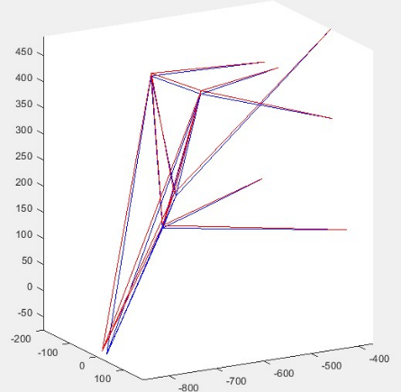
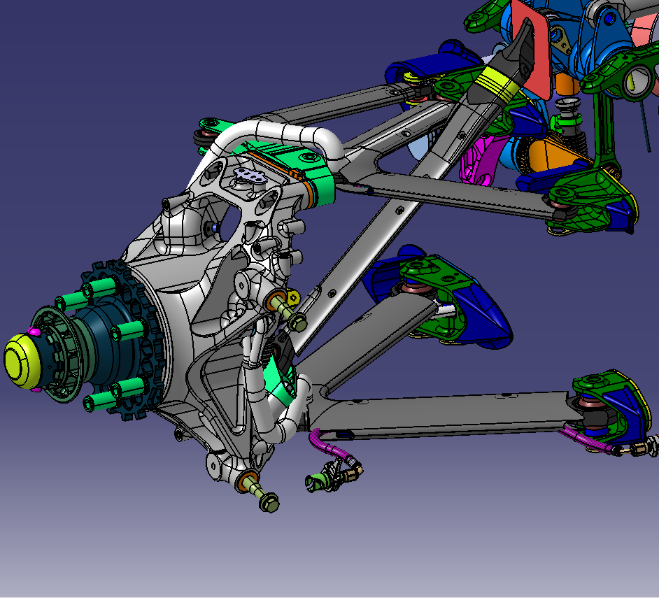
9
9
7
1
7
1
8
8
3
2
3
2
4
4
10
10
6
5
6
5
11
11

Slide 2
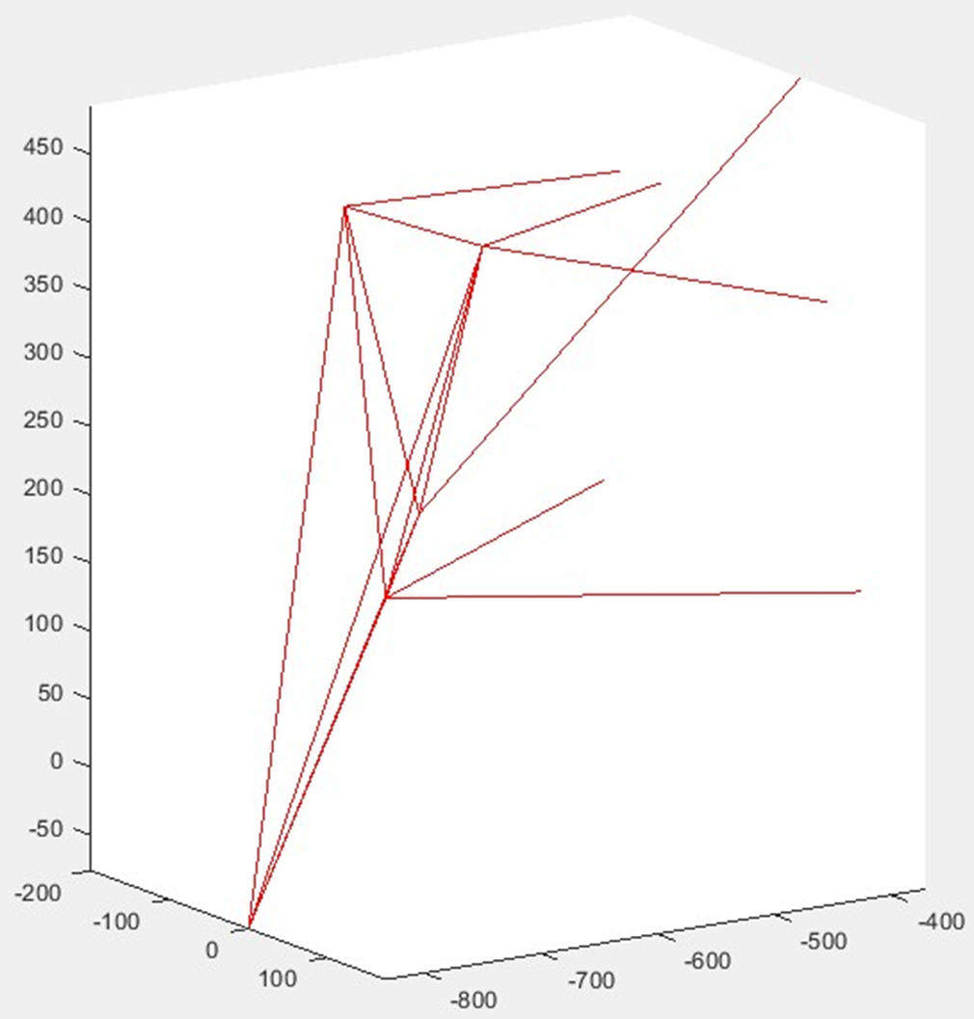
9
9
7
1
7
1
8
8
3
2
3
2
4
4
10
10
6
5
6
5
11
11

Slide 3
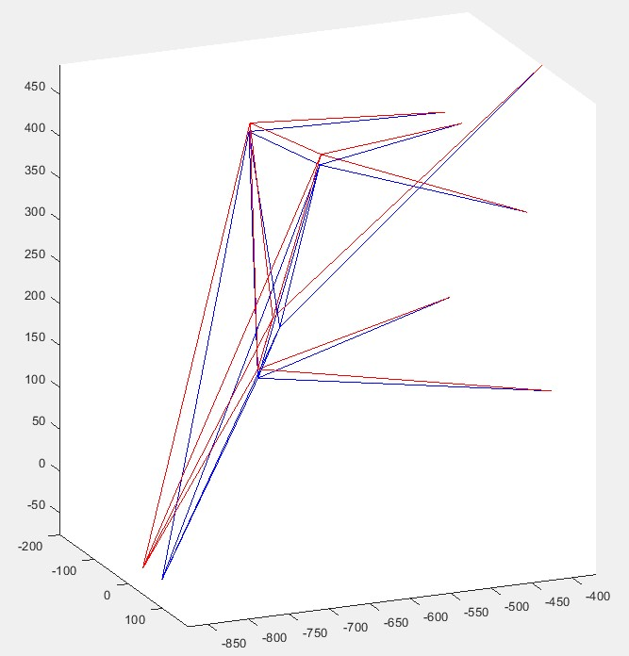

Slide 4
Track data acquisition
Driver feedbacks
Engineering Debrief
Data Analysis
Simulations
Proposal of options to be tested
Model Correlation

Slide 5
Pre-season Phase
Preliminary simulations
Performance Tests & Races
Data Analysis
Correlation
Possible solutions proposal: new components, new settings…
Simulations

Slide 6
Lap time Optimization
Data acquisition during race weekend
Model Correlation
Pre-Event Phase
Post-Event Phase

Slide 7
Tentative Setup
Calibration/performance track session
Driver feedbaks + data analysis
Reliable simulation tools
Pre-event track tests
Free Practice sessions
Qualification
If non-satisfying car configuration was found…
Race
Time to reach performance
Time and effort saving

