Slide 1
API

Slide 2
Algorithmic trading
Automatic trading
Programme running the trading system
Rule based trading
Strategies to trade
Systematic trading
No Human emotion involved in trading
Fast Execution and nothing to worry

Slide 3
Back testing the system and apply
Know the accuracy

Slide 4
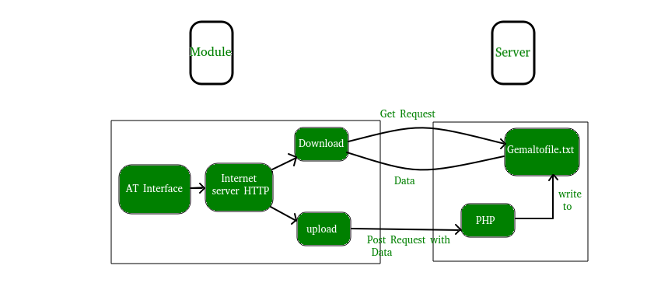

Slide 5
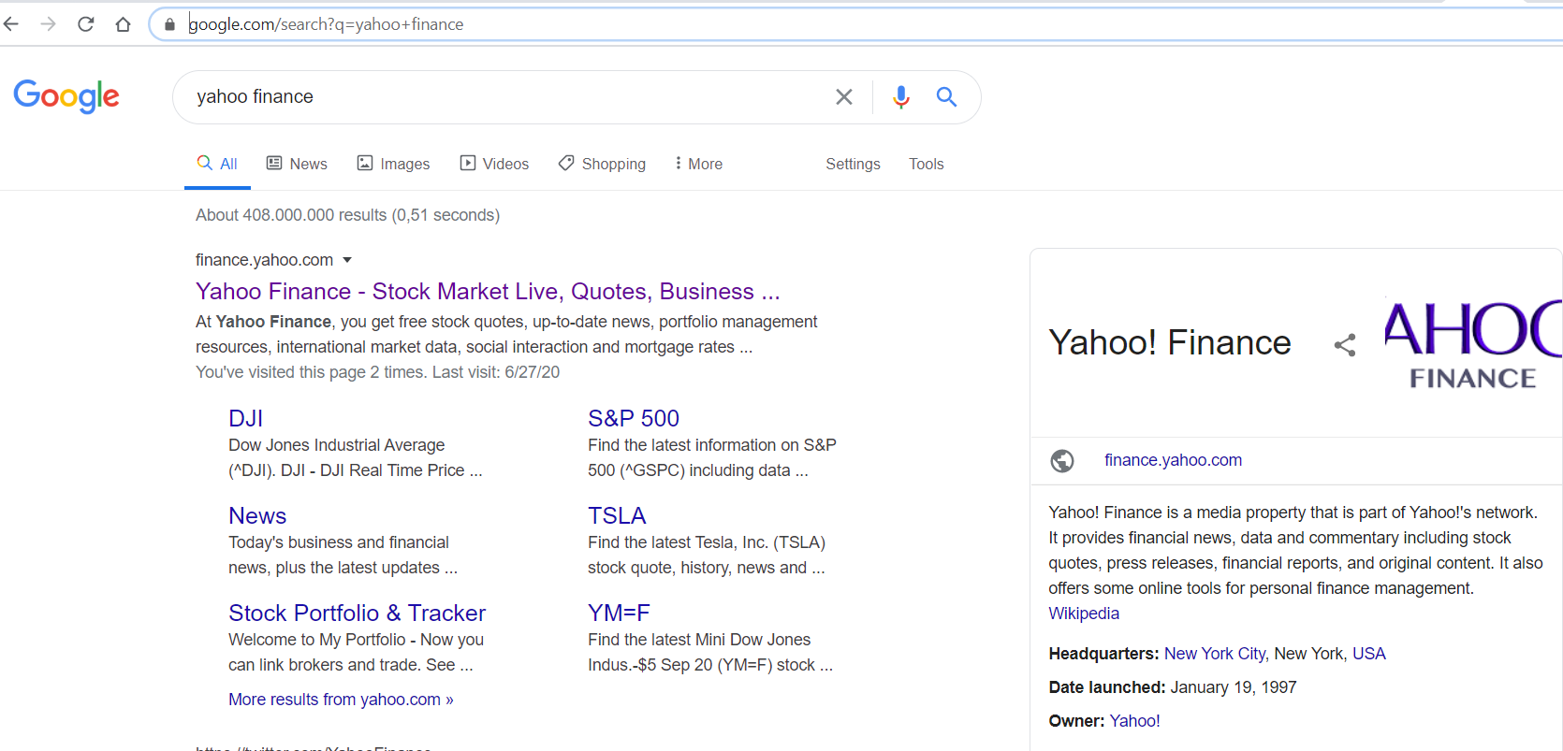

Slide 6
What is an API
A: Application: Software that does a task
P: Programming: Program (P) that does a task in the application
I: Interface: Place (I) that tell the program to run
An API exist where you tell (I) a computer program (P) to run in an application (A)
API = IPA

Slide 7
API Example1
https://www.google.com/search?q=yahoo+finance
A: Google
P: Search
I: Google website, search page

Slide 8
API Example2
https://finance.yahoo.com/
A: Yahoo Finace
P: about
I: Yahoo website, computer, mobile

Slide 9
API Example3
https://finance.yahoo.com/quote/AAPL?p=AAPL
A: Yahoo finance
P: AAPL data: Asking for quote for AAPL
I: mobile, computer, yahoo website
Web API

Slide 10
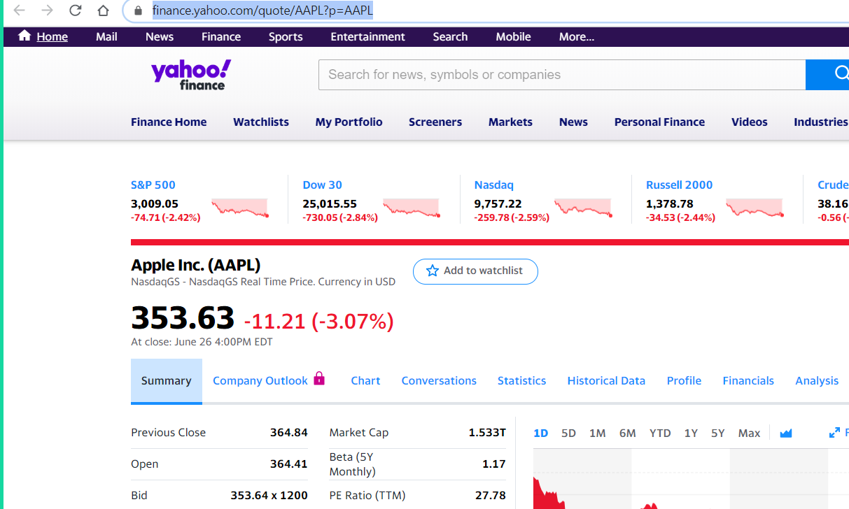

Slide 11
https://finance.yahoo.com/
https://sports.yahoo.com/

Slide 12
https://finance.yahoo.com/quote/AAPL?p=AAPL

Slide 13
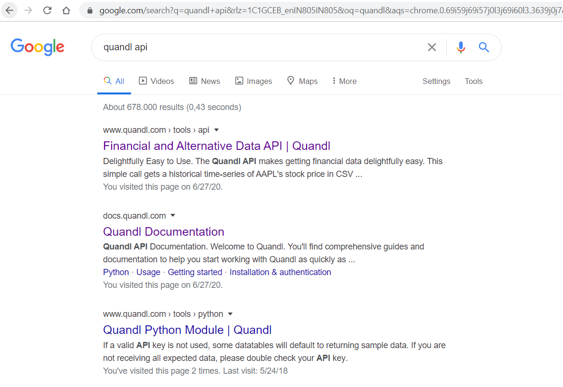

Slide 14
API Example
https://www.google.com/search?q=quandl+api&rlz=1C1GCEB_enIN805IN805&oq=quandl&aqs=chrome.0.69i59j69i57j0l3j69i60l3.3639j0j7&sourceid=chrome&ie=UTF-8
https://www.google.com/search?q=quandl+api
A: Google
P: search Quandl
I: mobile or computer with google website
SaaS

Slide 15
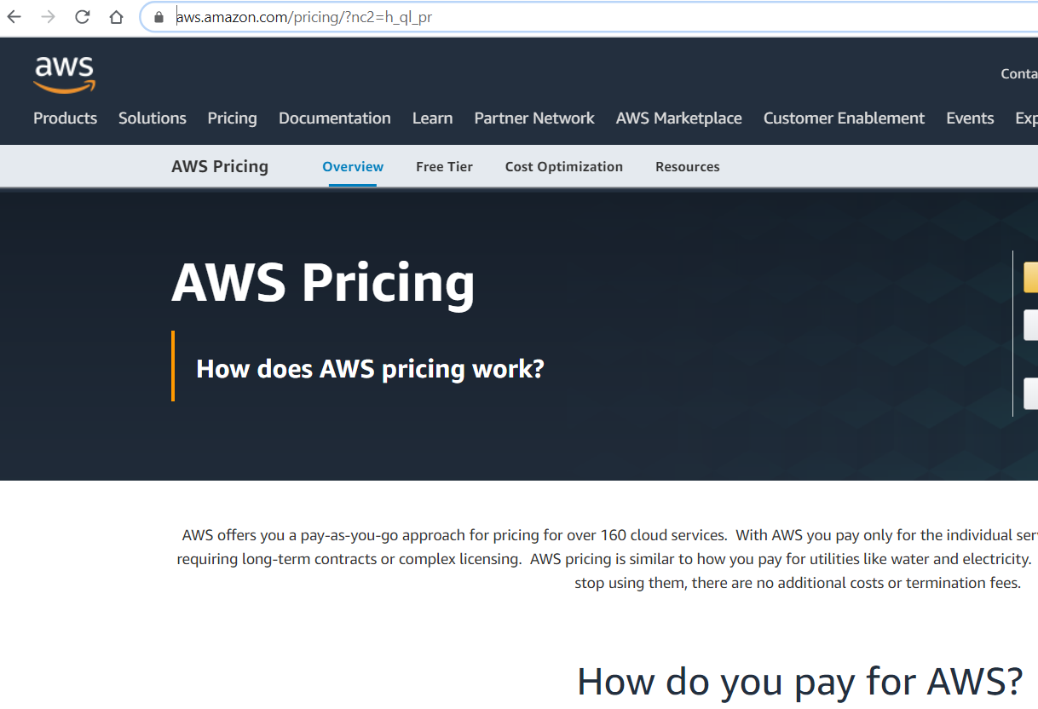

Slide 16
API Example
Server: https://aws.amazon.com/
End point
https://aws.amazon.com/pricing/
A: Amazon pricing
P: pricing
I: computer with AWS website
IaaS

Slide 17
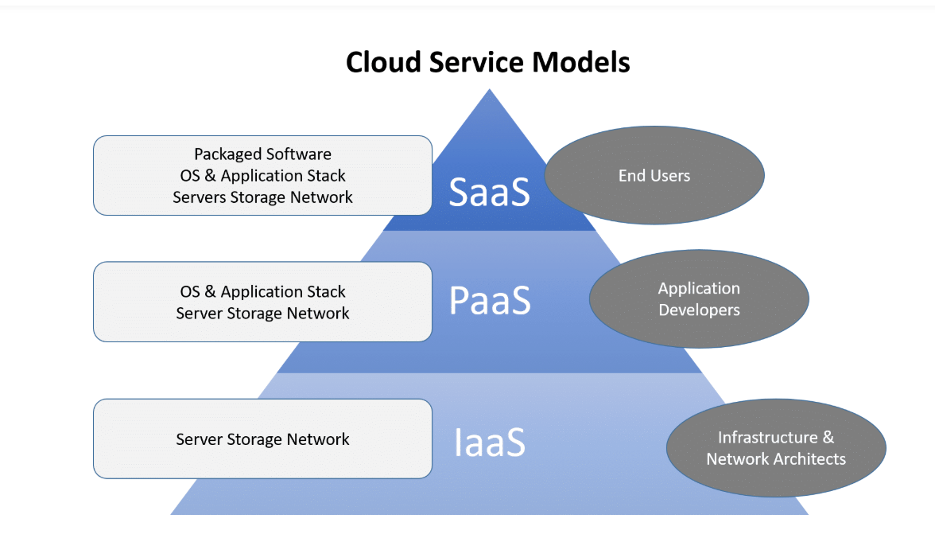
Cloud Service Models

Slide 18
API Example
https://www.quandl.com/tools/python

Slide 19
Why API are great
Use the program do not write it: send API request and get response
Platform independent: Mobile, laptop or other medium
Upgrade safe: app version change, update it, playstore

Slide 21
API Transaction
Request sent
Program run
Response sent

Slide 22
Web Service
Web = internet
Service = api
Web service = api that uses internet
XML or JSON to format the data over the internet

Slide 23
HTTP
Hypertext Transfer Protocol
Start line
Header
Blank Line
Body
Methods
Get
Post
Put (change)
Delete
CRUD

Slide 24
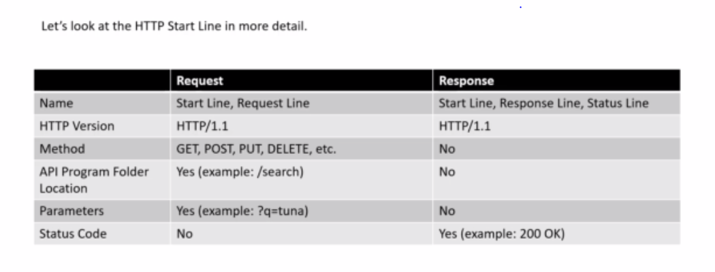

Slide 25
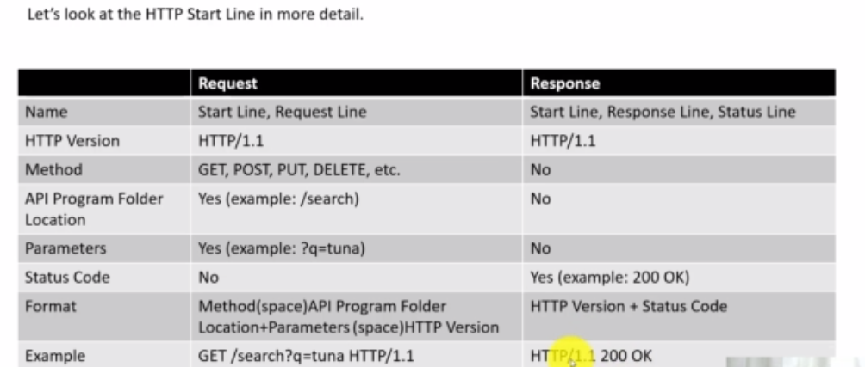

Slide 26
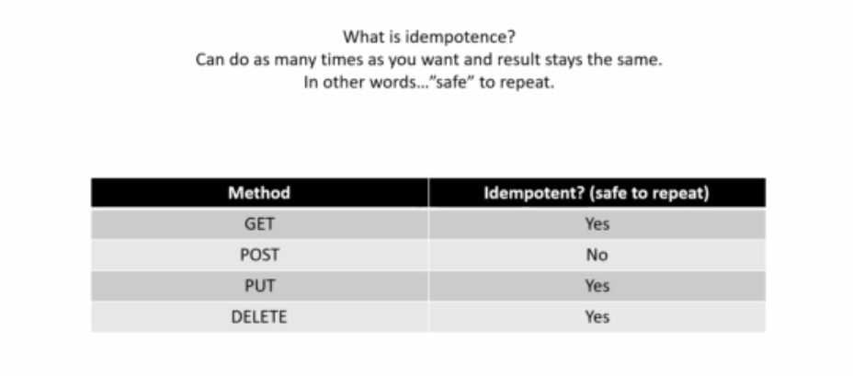

Slide 27
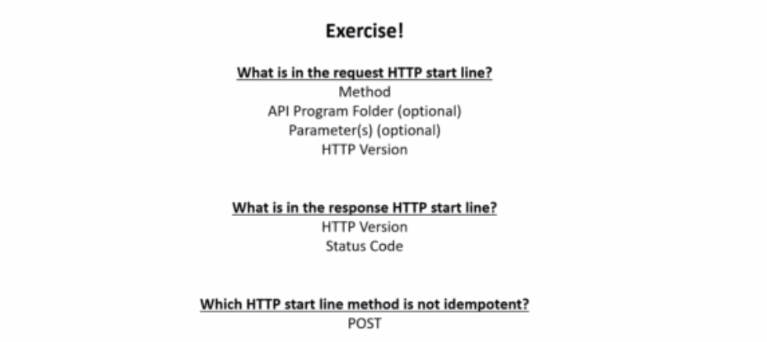

Slide 28
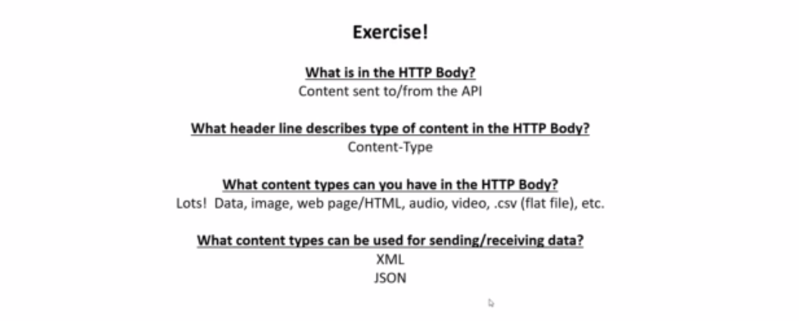

Slide 29
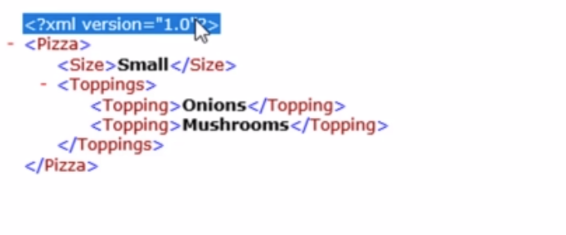
XML Data Format

Slide 30
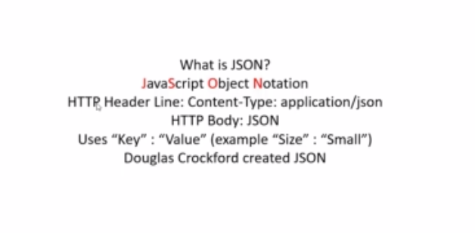
JSON Data format

Slide 31
Chrome web store

Slide 32
{ "Pizza" : [
{"Size": "Small",
"Toppings" : ["Onions", "Mushrooms"]
},
{"Size": "Large",
"Toppings" : ["Onions", "Mushrooms"]
}
]
}

Slide 33
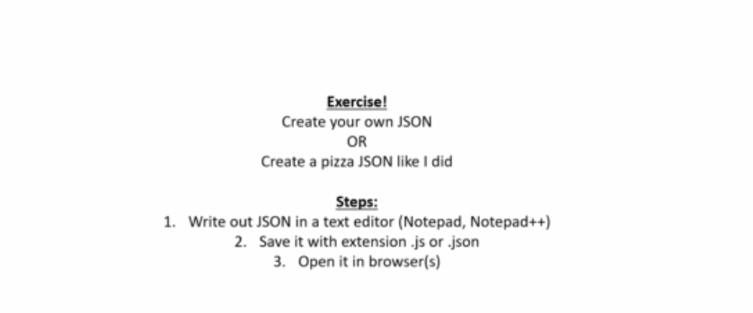

Slide 34
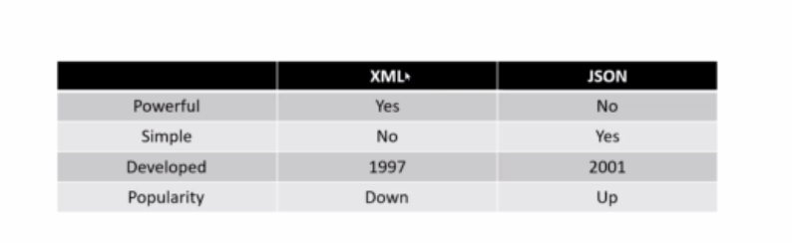

Slide 35
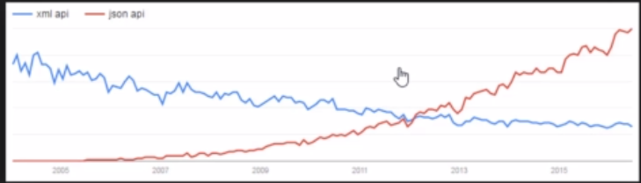
XML vs JSON

Slide 36
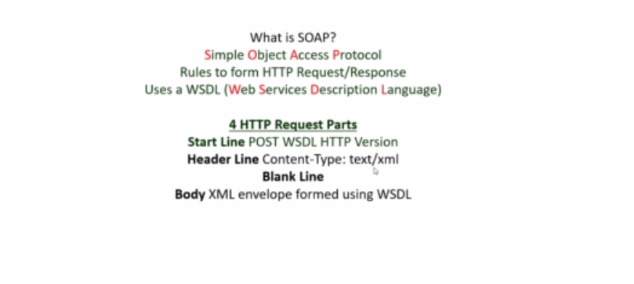
SOAP

