Slide 1
API
https://edgeverve.udemy.com/course/api-and-web-service-introduction/learn/lecture/11557472?start=15#overview

Slide 2
Algorithmic trading

Slide 3
What is an API
A: Application: Software that does a task
P: Programming: Program (P) that does a task in the application
I: Interface: Place (I) that tell the program to run
An API exist where you tell (I) a computer program (P) to run in an application (A)
API = IPA

Slide 4
Why API are great
Use the program do not write it
Platform independent
Upgrade safe

Slide 5
API Transaction
Request sent
Program run
Response sent

Slide 6
Web Service
Web = internet
Service = api
Web service = api that uses internet
XML or JSON to format the data over the internet

Slide 7
HTTP
Hypertext Transfer Protocol
Start line
Header
Blank Line
Body
Methods
Get
Post
Put (change)
Delete
CRUD

Slide 8
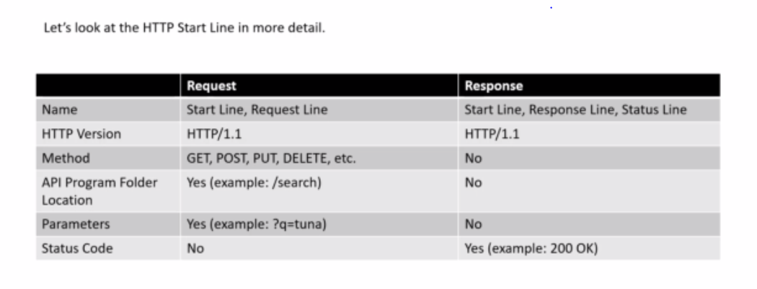

Slide 9
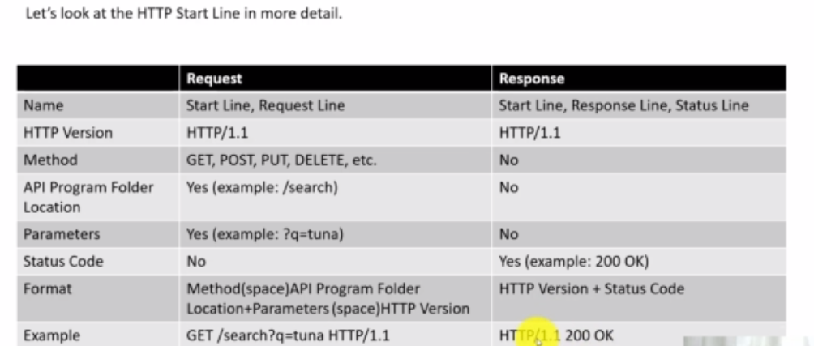

Slide 10
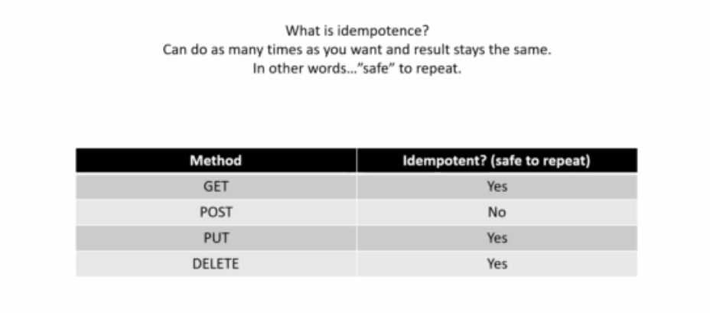

Slide 11
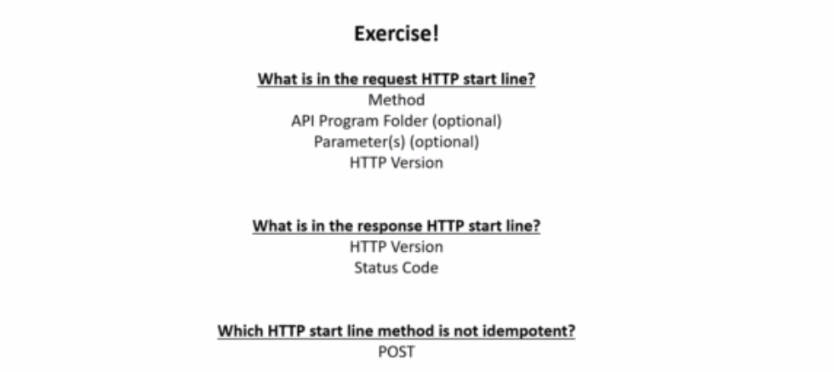

Slide 12
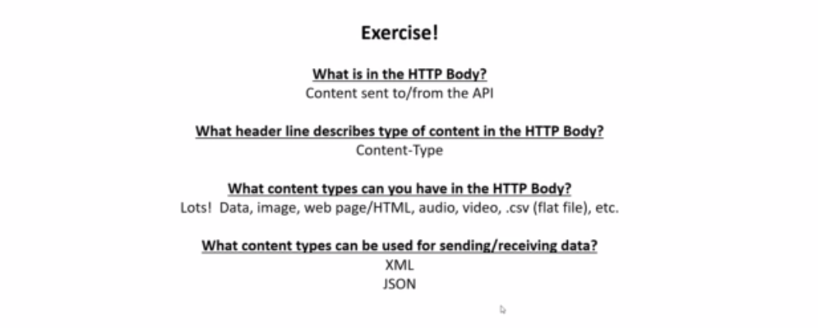

Slide 13
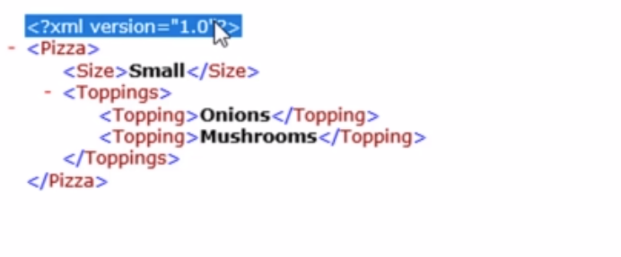
XML Data Format

Slide 14
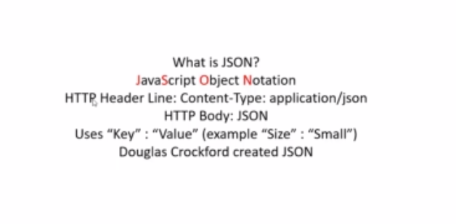
JSON Data format

Slide 15
Chrome web store

Slide 16
{ "Pizza" : [
{"Size": "Small",
"Toppings" : ["Onions", "Mushrooms"]
},
{"Size": "Large",
"Toppings" : ["Onions", "Mushrooms"]
}
]
}

Slide 17
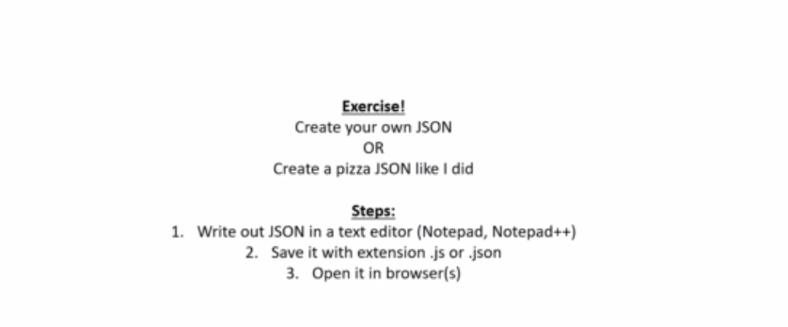

Slide 18
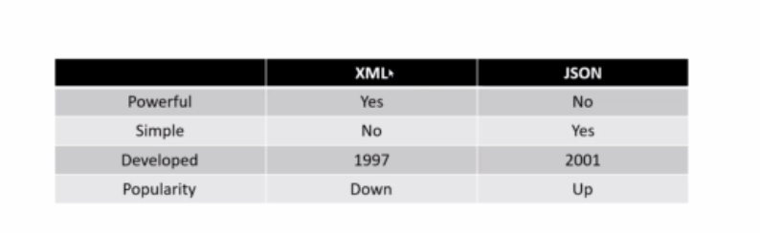

Slide 19
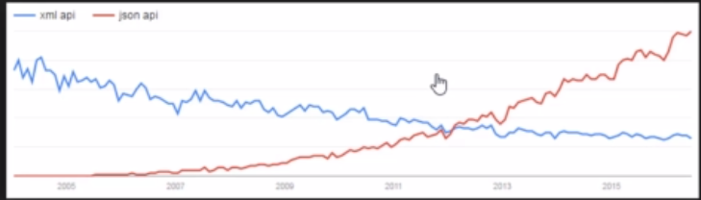
XML vs JSON

Slide 20
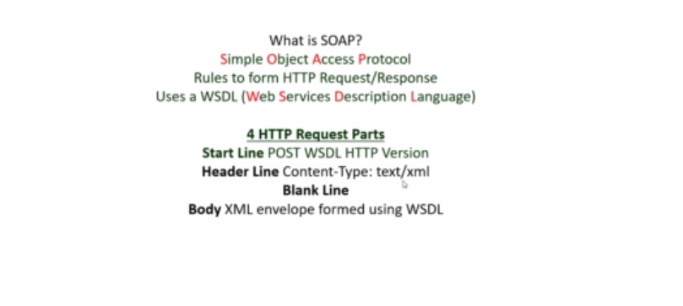
SOAP

Slide 21
REST
Modern technology

