Slide 1
https://edgeverve.udemy.com/course/learn-jmeter-from-scratch-performance-load-testing-tool/
10 hours

Slide 2
6 hours
https://edgeverve.udemy.com/course/learn-jmeter-m/

Slide 3
Introduction

Slide 4
Jmeter with java
After 2.3 functionality are fixed and for every release there might be bug fix etc

Slide 5
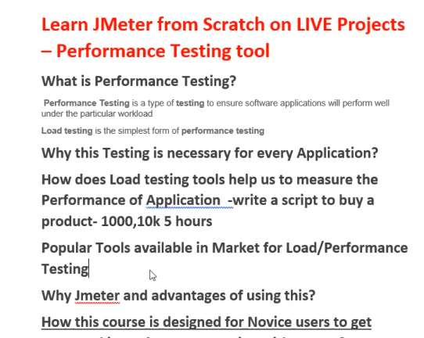

Slide 6
Functional testing: End to end testing of an application, for example selecting a product, updating address, confirming order. Testing and making sure an application will perform well for an user
Performance testing: It is a testing that an software application work well under a particular workload. For example 1000 user purchase a particular product, how does the server respond, it is different from when one user purchase
Testing a server with workload is a kind of performance testing
Continuously by product for 100 hour, check how server behave is performance testing

Slide 7
Different performance testing
Testing flow under some load
Load testing
Stress testing
Volume testing
Independence day sell where 1000 of user buy a product, server may go down, test that in advance
Huge investment for advertising, coding etc, performance testing is mandatory when traffic is coming in.

Slide 8
Performance testing team
Test different scenario
1000 users with different frequency sending orders, check the server behaviour

Slide 9
How does load testing tool help in performance test
Jmeter one load testing tool
Give the result how the system behave on different circumstances
Check how one flow work in java
Write a script to buy a product, UI will not be available, test in headless mode
1000, 10K users at a time, for 5 hours javascript work for one user, automate that with jmeter for load testing with available features
Load testing many users at a time
Stress testing, run for many hours
Get the metrics, measure the performance from load testing

Slide 10
Jmeter: open source
Load runner: competetor for jemeter, but paid one, graph
Selenium, for functional testing
Jmeter is build on java so it will work on any plateform, window, mac, linux

Slide 11
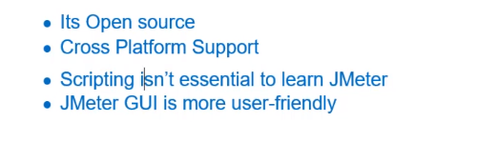
Lot of job on jmeter compare to other tools
Ecommerce has such big requirement

Slide 12
Jmeter overview
Eclipse or many platform allows multiple project to open, but jmeter allows to open one project at a time

Slide 13
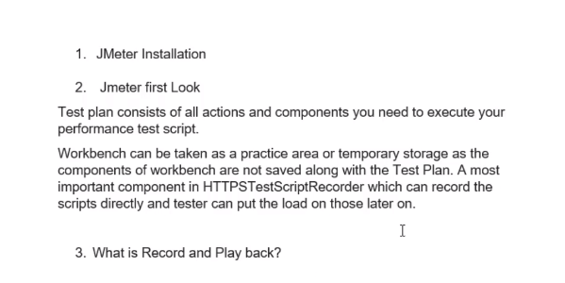

Slide 14
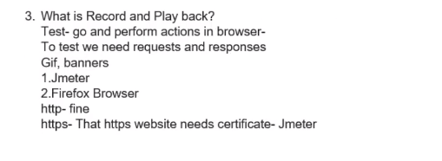

Slide 15
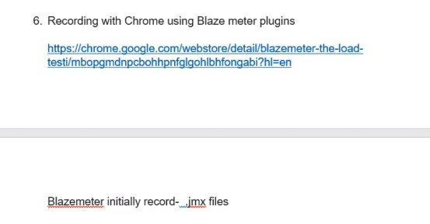
Blazemeter chrome extension

Slide 16
https://blazedemo.com/
Add extension to google chrome
Sign in or with google account
https://blazedemo.com/
This site can be tested

Slide 17
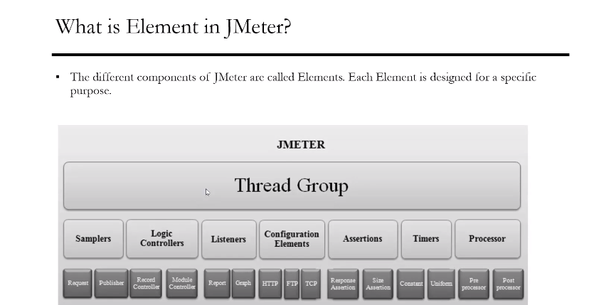

Slide 18
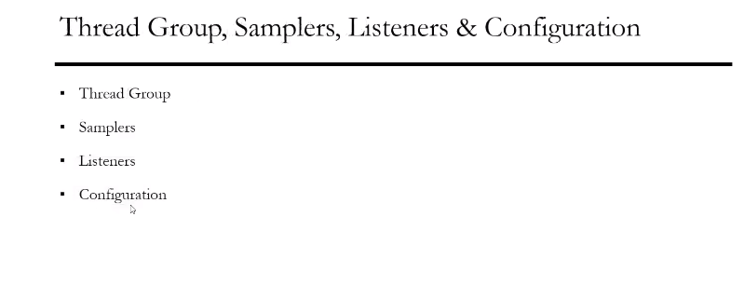

Slide 19
Thread Group
Thread group has thread/user executing the same scenario
A flow is one thread and many such group of thread can be given as user
Ramp Up for the whole thread group
Sampler
Listener is to present result
View result tree
Summary report
Aggregate report

Slide 20
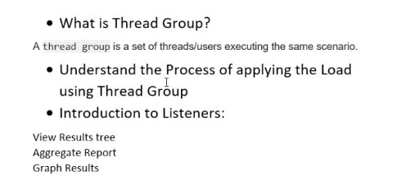

Slide 21
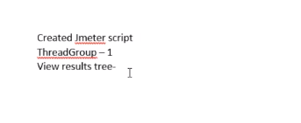

Slide 22
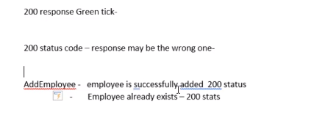

Slide 23
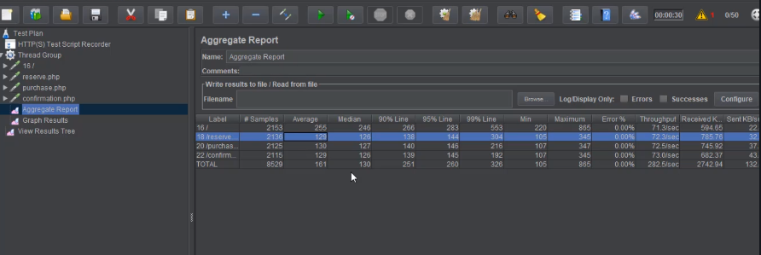

Slide 24
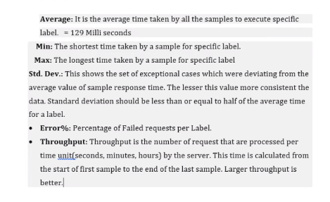

Slide 25
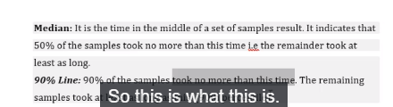

Slide 26
Concurrency thread group

Slide 27
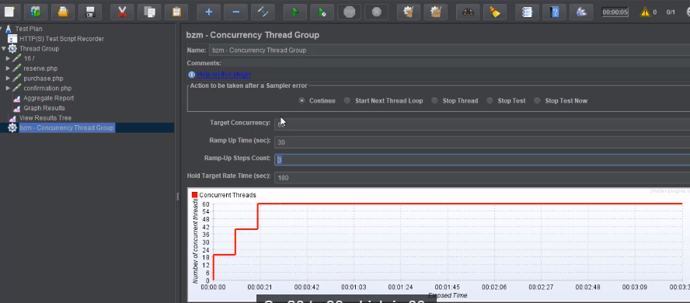

Slide 28
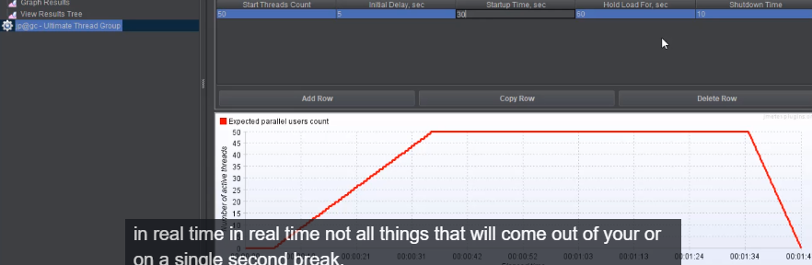

Slide 29
Cookie Manager
Website to test api
https://the-internet.herokuapp.com/login

Slide 30
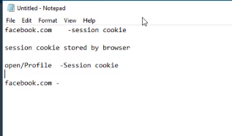

Slide 31
Timer

