Slide 1
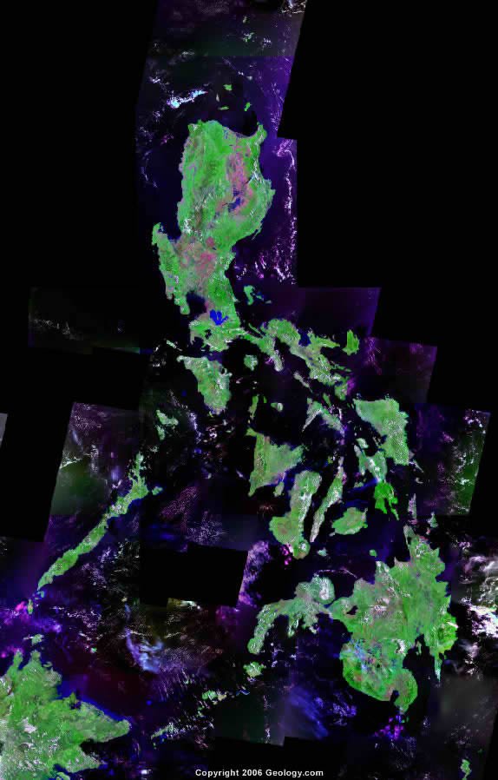
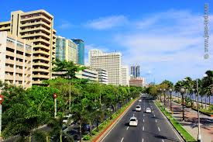

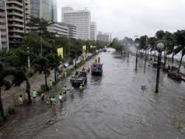
Spot the diference!
S
A
1. Flooded streets
2. Less trees
3. More buildings
4. Smog
G
I
P
Location: Roxas Boulevard, Pasay City
Social plugins

Slide 2
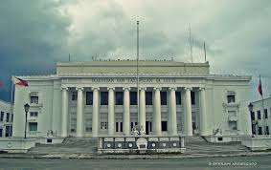
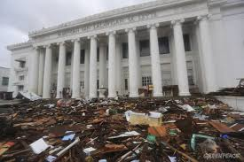
S
Spot the diference!
Social plugins
A
1. Mud and debris
2. Missing flagpoles
G
I
P
Location: City Hall of Leyte
Social plugins

Slide 3
S
Spot the diference!
Social plugins
A
1. Mud and debris
2. Missing flagpoles
G
I
P
Location: City Hall of Leyte
Social plugins

Slide 4
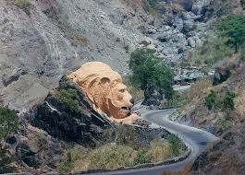
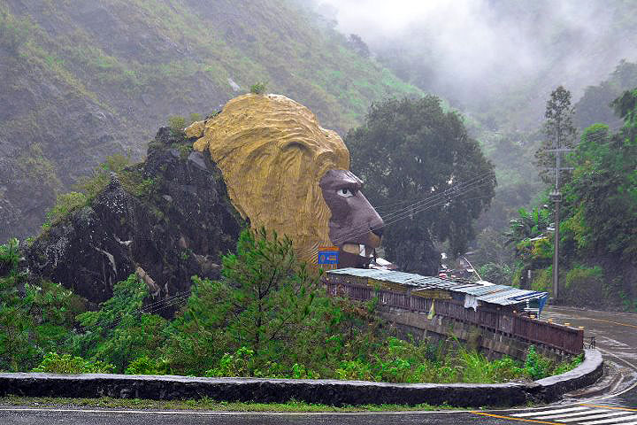
Spot the diference!
S
Social plugins
A
1.Trees and shrubs on the hills
2.Informal settlers
3.Road side barricades
G
I
P
Location:Baguio
Social plugins

Slide 5
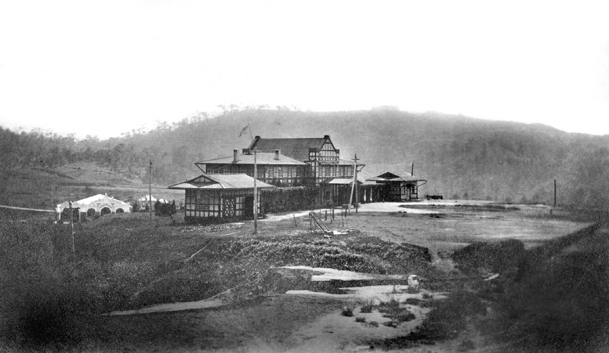
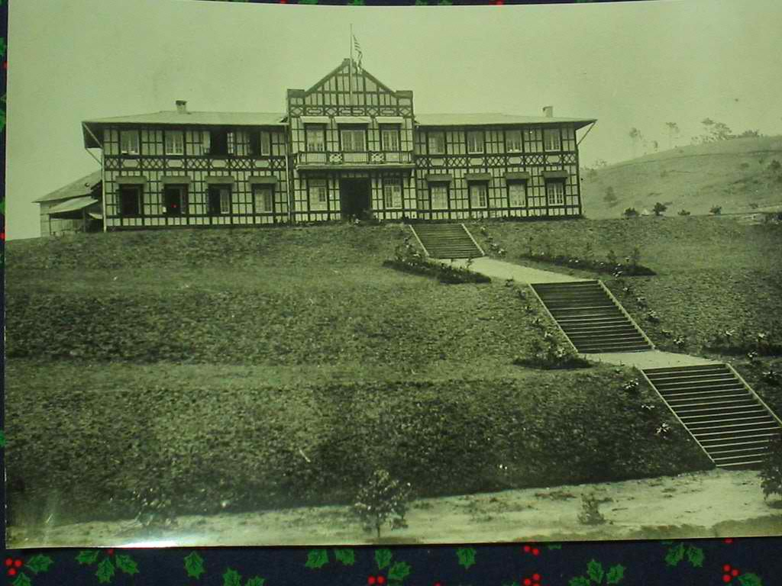
S
Spot the diference!
Social plugins
A
1. Elevation/slopes
2. Flattened hills
3. Stairs
G
I
P
Location: City Hall, Baguio
Social plugins

Slide 6
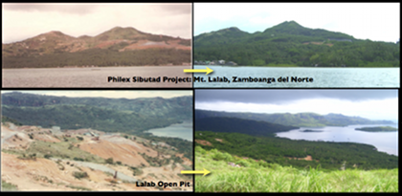
S
Spot the diference!
Social plugins
A
1. Denuded forest/mountain
2. Mining/open pit
3. Polluted ocean
G
I
P
Location: Sibutad, Zamboanga del Norte
Social plugins

Slide 7
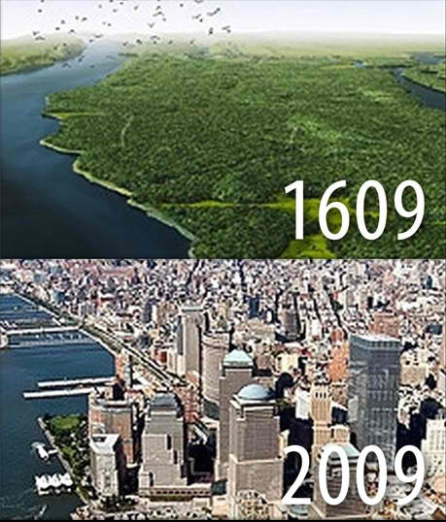


Social plugins
S
Got some thoughts?
Share them!
Social plugins
A
G
I
P
Location: Manhattan, USA
Social plugins

Slide 8
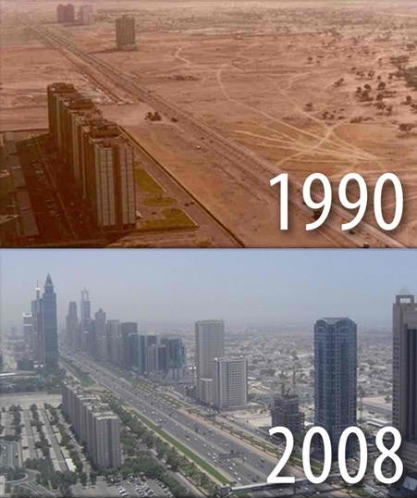
Social plugins
S
Social plugins
Got some thoughts?
Share them!
A
G
I
P
Location: Dubai
Social plugins

Slide 9
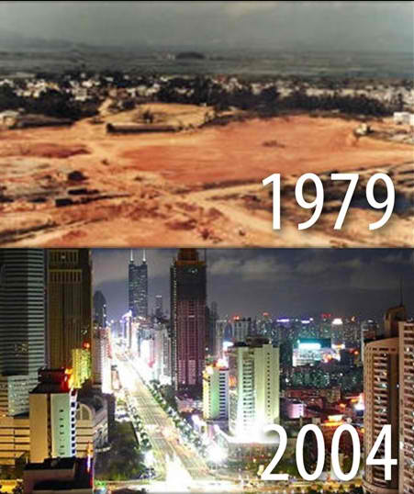
Social plugins
S
Social plugins
Got some thoughts?
Share them!
A
G
I
P
Location: Shenshen, China
Social plugins

Slide 10
Social plugins
S
Social plugins
Got some thoughts?
Share them!
A
G
I
P
Location: Shenshen, China
Social plugins

Slide 11
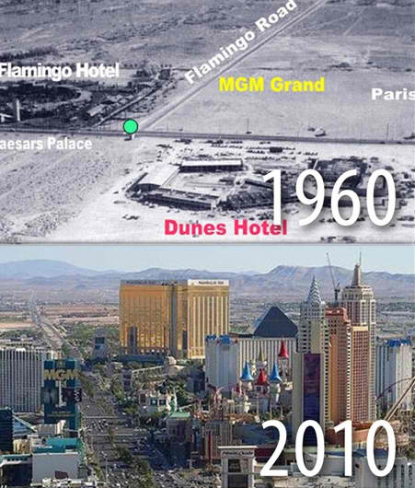
Social plugins
S
Social plugins
Got some thoughts?
Share them!
A
G
I
P
Location: Las Vegas, USA
Social plugins

Slide 12
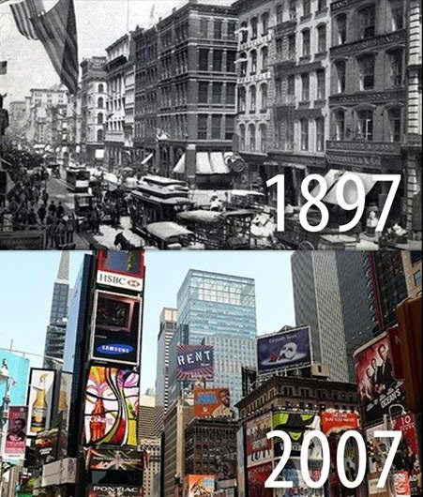
Social plugins
S
Social plugins
Got some thoughts?
Share them!
A
G
I
P
Location: Times square, New York
Social plugins

Slide 13
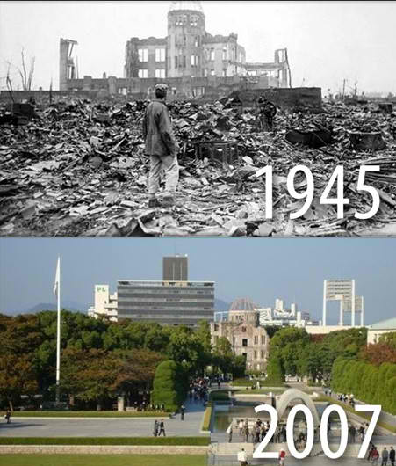
Social plugins
S
Social plugins
Got some thoughts?
Share them!
A
G
I
P
Location: Hiroshima, Japan
Social plugins

Slide 14
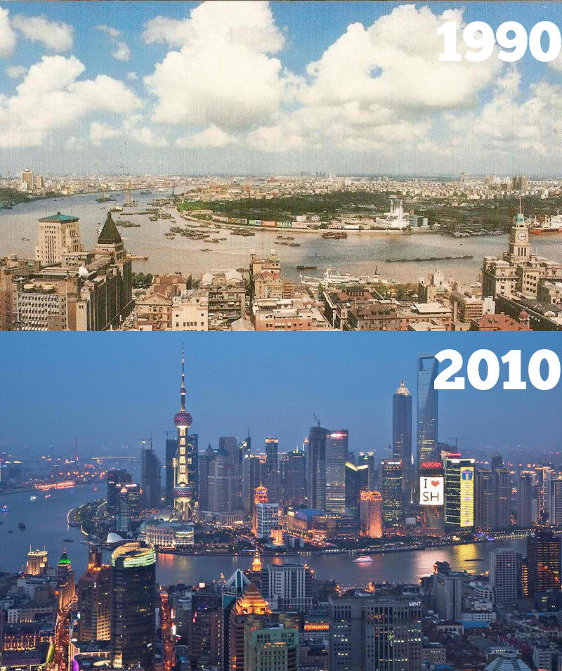
Social plugins
S
Social plugins
Got some thoughts?
Share them!
A
G
I
P
Location: Shaghai, China
Social plugins

Slide 15


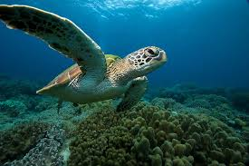
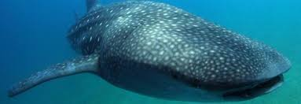
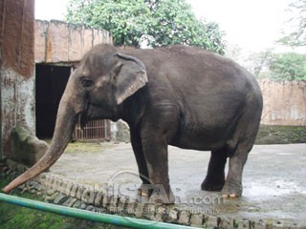
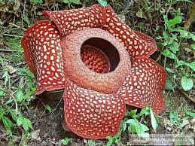
Floating Social plugins
QR Code
JOIN THE
S
A
G
I
P
CAMPAIGN
Link of the view:
Map of the philippines with traceable cooridnates
Analytics
Mechanics: Look for the QR codes in the designated locations where these endangered flora and fauna are found. Evaluate their conditions and help save these species from extinction. Join the SAGIP CAMPAIGN!

Slide 16
S
A
G
I
P

