Slide 1
Tesco Grocery 1.0 Dataset vs. Educational Attainment
For Data Experts in Education and Health

Slide 2

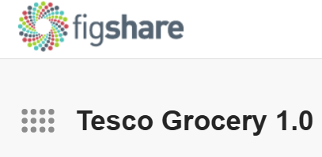
Introduction: Tesco Grocery 1.0 Dataset
The Tesco Grocery 1.0 dataset records 420M food items purchased by 1.6M Clubcard owners who shopped at the 411 Tesco stores in Greater London over 2015.
The dataset contains four geographic aggregation: LSOA, MSOA, Ward, Borough.
In this analysis, we work at borough level, covering 33 local authorities in London.

Slide 3
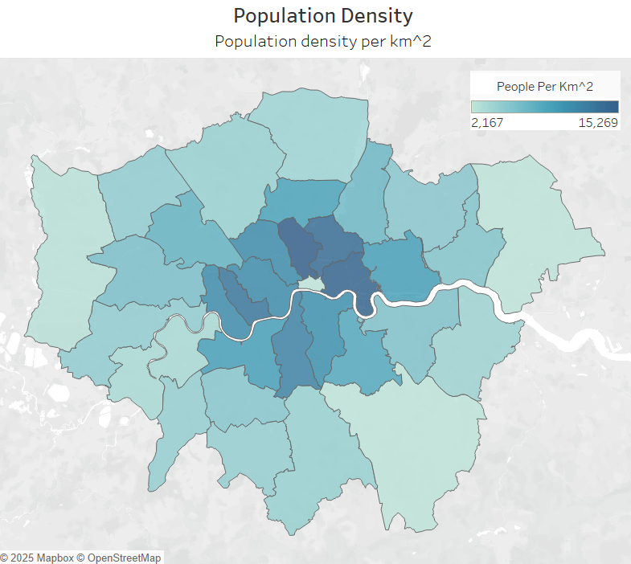
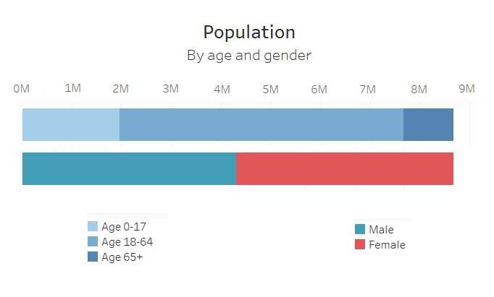
Population
City of London

Slide 4
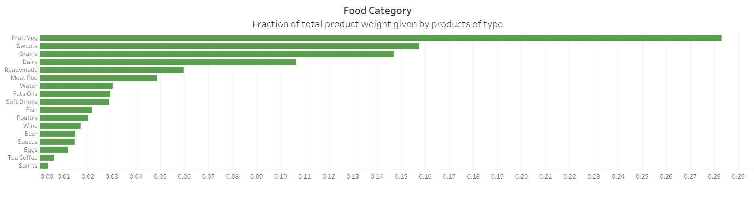
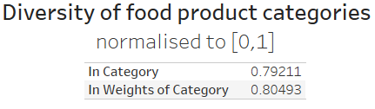
Food Category

Slide 5
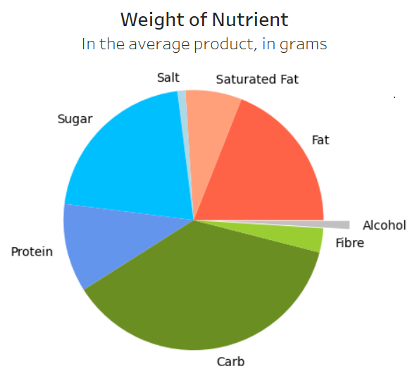
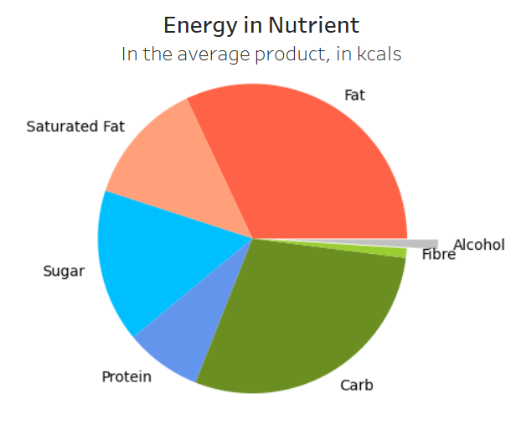
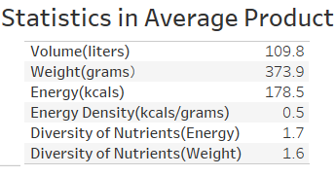
Nutrient

Slide 6
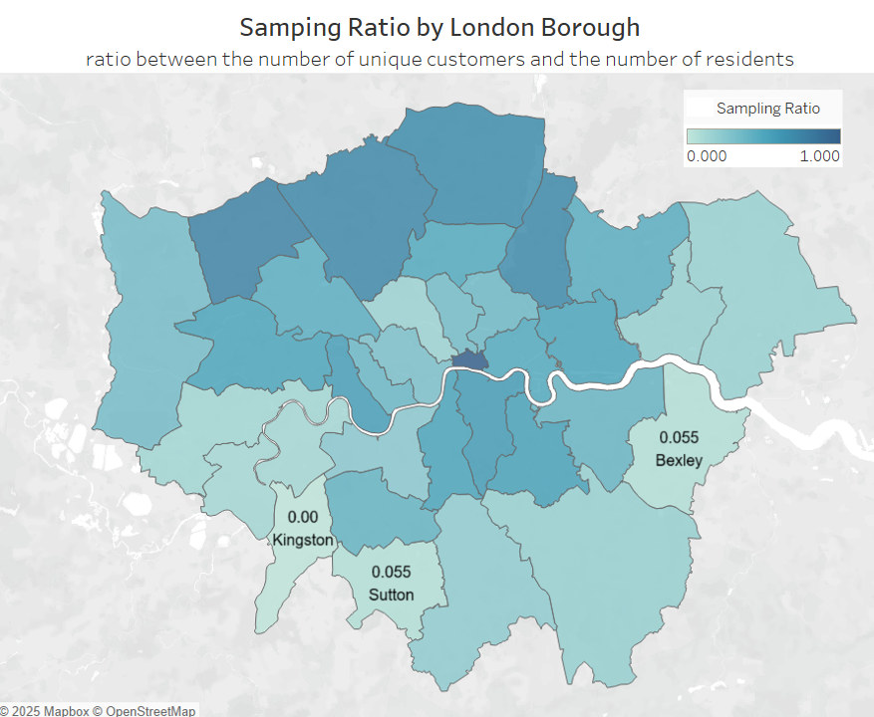
Limitation and assumption
Assumptions:
Sample size - assume 1000 is good enough.
Limitations:
The sample is not random.
Fewer Tesco stores in Southern London.
The data is averaged for each product.

Slide 7
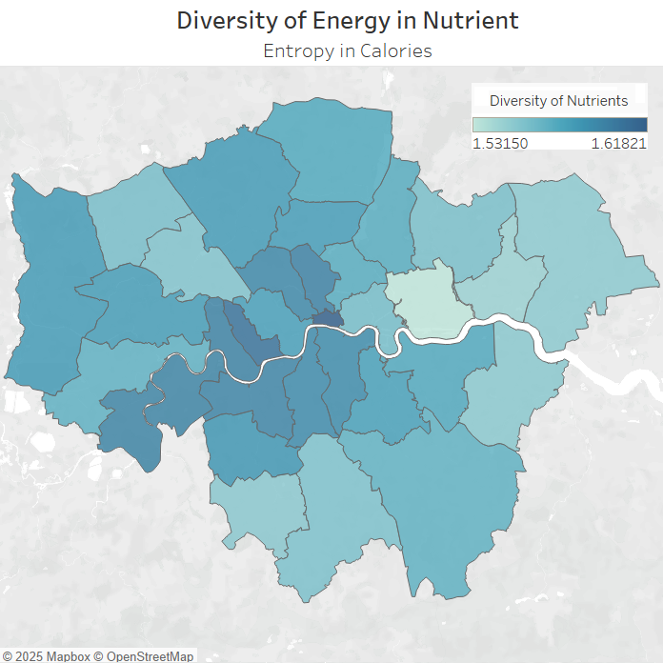
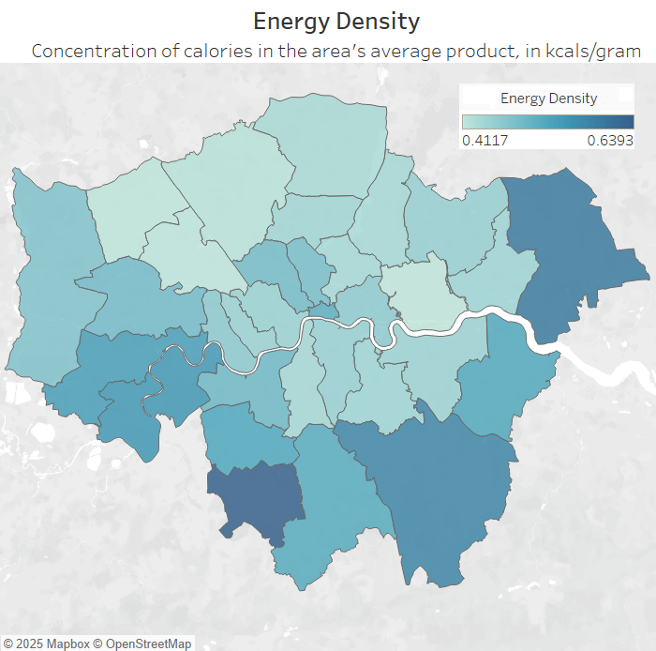
Insight: Diversity of Nutrient vs. Energy Density

Slide 8
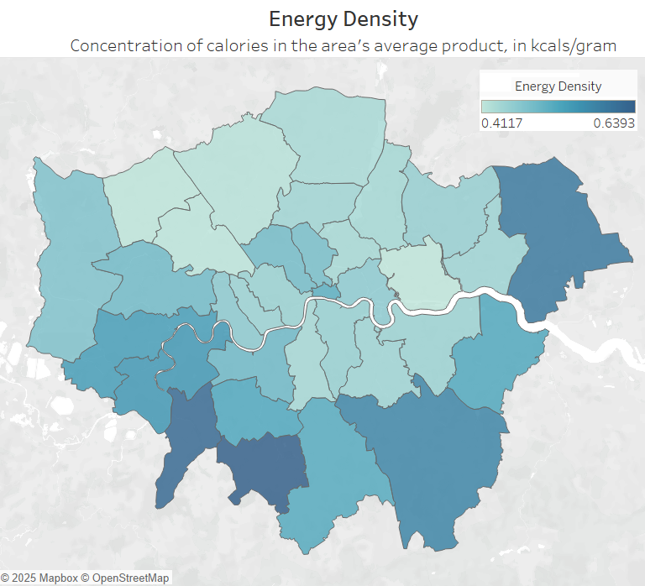
Insight: Diversity of Nutrient vs. Energy Density
People in Northern London care more about the diversity of nutrients, while in Southern London they prefer to buy food with higher energy density.

Slide 9
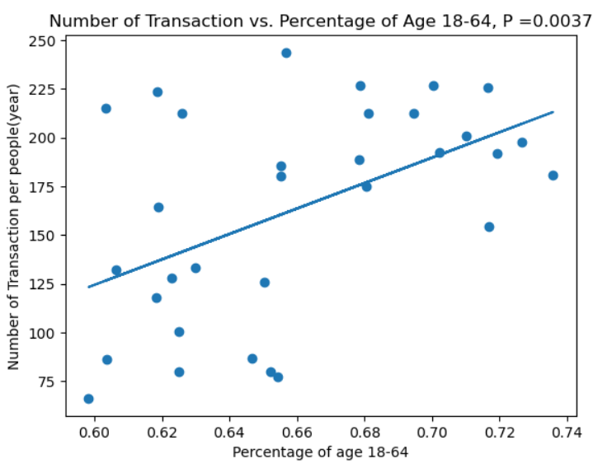
Insight: The Effect of Variance in Age Between Boroughs
The effect
Intuitively, the main consumption group are people aged 18 – 64.
Positive correlation between number of transactions and the percentage of age group 18 – 64.
If the variation is large, it may influence the consumption habits.

Slide 10
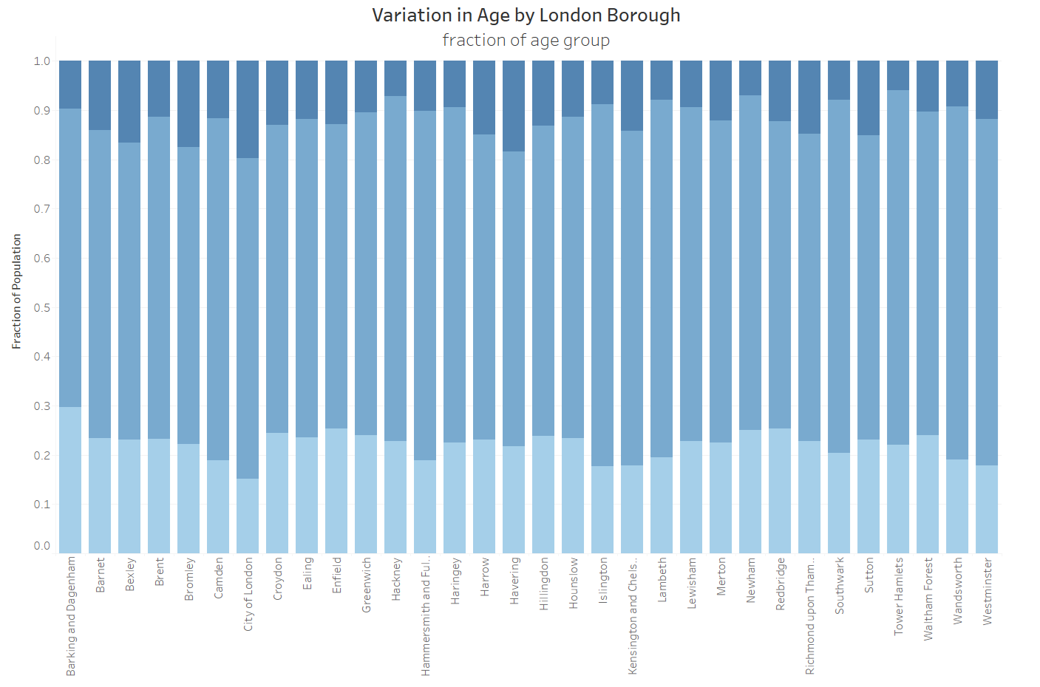
Insight: The Effect of Variation in Age Between Boroughs
From the graph, the variance in age group is acceptable.

Slide 11

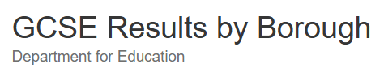
Introduction: Educational Attainment Dataset
Data on GCSE and equivalent entries and achievements at the end of Key Stage 4 by gender, ethnicity, first language, free school meal eligibility, special education needs, disadvantaged status and London boroughs, using the new 1-9 grading system.
Attainment 8 score measures pupils' average grade across eight subjects.
In this analysis, we use the average attainment 8 score per pupil for all students by borough,

Slide 12
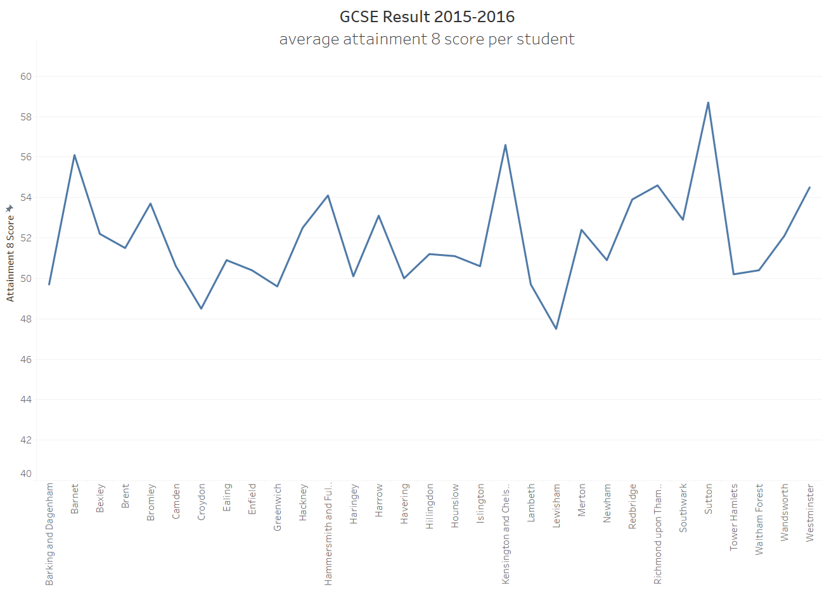
An insight of Education dataset

Slide 13

Limitation and Assumption
Limitations:
Mismatch in age:
Tesco: All age groups.
Education: Teenagers.
Mismatch in periods:
Tesco: 2015.01 – 2015.12
Education: 2015.09 – 2016.06
Missing data in city of London.
Only GCSE Results.
Assumptions:
Assume the food purchased from Tesco stores have a long-term effect.
The diabetes has effect on the GCSE result in the next year.

Slide 14

Analysis: Data cleaning and handling
Concatenate the Tesco 1.0 data from September 2015 to December 2015 and calculate its average.
1
Exclude the data in City of London and Kingston.
2
Link the Tesco 1.0 and GCSE result dataset by London Boroughs.
3

Slide 15
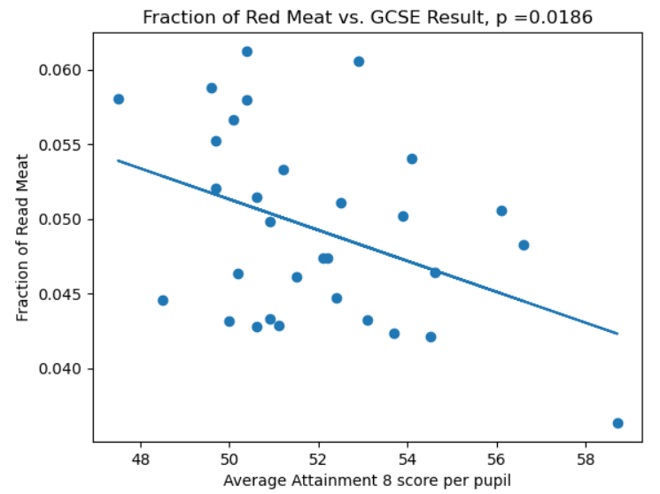
Analysis: Methodology and Statistics
For every dietary factor in Tesco 1.0, compute its regression coefficients with GCSE results by boroughs.
Test the significance of regression at 95% confidence interval.
The p value is calculated using Wald Test with t-distribution of the test statistic.
Null hypothesis: No correlation.
If p value <= 0.05, accept null hypothesis, otherwise reject and accept the alternative hypothesis: There is correlation.

Slide 16
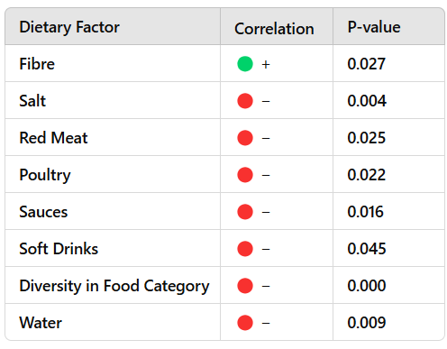
Analysis: Result

Slide 17

Support Literature
A paper suggested ‘young people with higher education generally have a lower BMI, a higher healthy nutrition index, and healthier habits’.
In other way, obesity leads to poor educational attainment.
The widely known causes of obesity: too much salt, fat, sugar, energy, and too little fibre.

Slide 18
Analysis: Result
Saturated Fat
Salt
Sugar

Slide 19

Conclusion
Positive Correlation: Fibre
Negative Correlation: Salt, Sugar, Fat
While most of the results are reasonable, there are few things to consider:
According to the paper, the diversity of nutrients should contribute to the educational behaviors, but the correlation is negative.
The correlations of fat, fruit & vegetable, oils and so on are not detected.
Water should not be correlated with educational attainment.
These errors may be caused by the limitations and bias mentioned earlier.

Slide 20
References
Aiello, L.M., Schifanella, R., Quercia, D., Del Prete, L., 2020, Tesco Grocery 1.0 [Online]. Figshare. Available from: https://doi.org/10.6084/m9.figshare.c.4769354.v2 [Accessed 23 February 2025].
Greater London Authority, 2024, Statistical GIS Boundary Files for London [Online]. London Datastore. Available from: https://data.london.gov.uk/dataset/statistical-gis-boundary-files-london [Accessed 23 February 2025]
Department for Education, 2025, GCSE Results by Borough [Online]. London Datastore. Available from: https://data.london.gov.uk/dataset/gcse-results-by-borough [Accessed 25 February 2016].
Sandri, E., Pardo J., Cantín Larumbe, E., Cerdá Olmedo, G., Falcó, A., 2024, Analysis of the influence of educational level on the nutritional status and lifestyle habits of the young Spanish population. Front Public Health.12(1341420). Available from: https://doi.org/10.3389/fpubh.2024.1341420 [Accessed 03 March 2016].

