Slide 1
Service Discovery using Consul

Slide 2
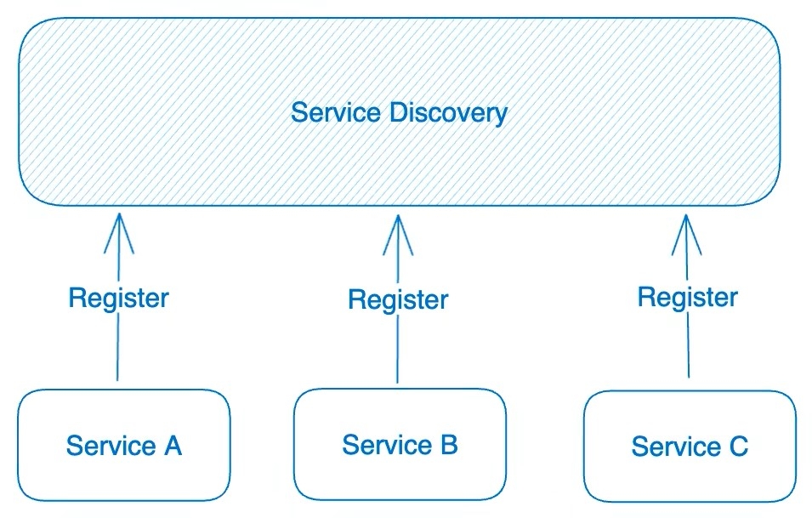
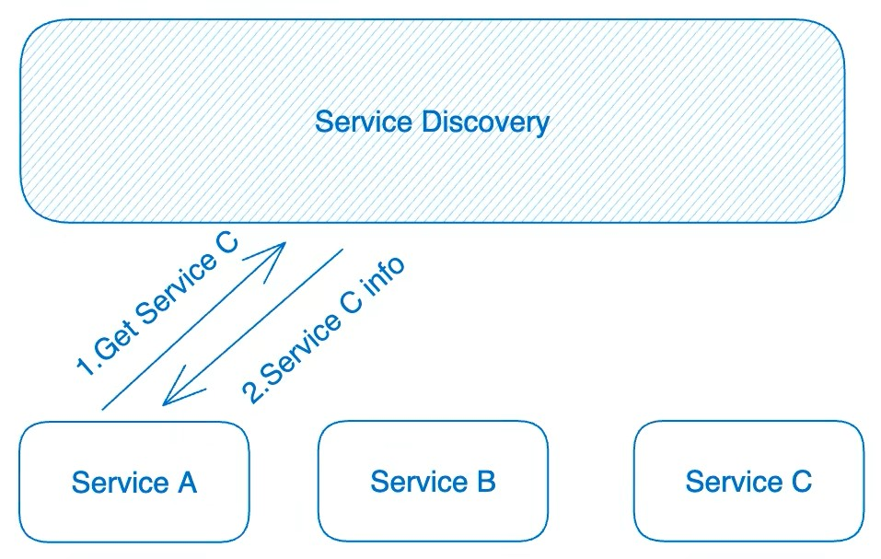
Service Discovery
Definition:
Service Discovery is a mechanism that helps services find and communicate with each other dynamically.

Slide 3
Service Discovery
Problems:
In microservices, services are dynamic (IPs keep changing)
Hardcoding IPs/ports
Need automatic service registration & lookup
It solves:
Manual configuration
Service scaling
Service failures
Load balancing
Health checking

Slide 4
Consul
Definition
Consul is a service discovery and service mesh tool by Hashi Corp.
Works on:
Virtual machines
Containers
Kubernetes
Key Features of Consul
Service Discovery
Health Checking
Key-Value Store
Load Balancing
Multi‑Datacenter
Service Mesh
How Service Discovery Works in Consul
Service starts.
Service registers itself with Consul.
Consul performs health checks.
Client queries Consul (DNS / API).
Consul returns healthy service instances.
Process:
Agents
Service Registration
Service Discovery

Slide 5
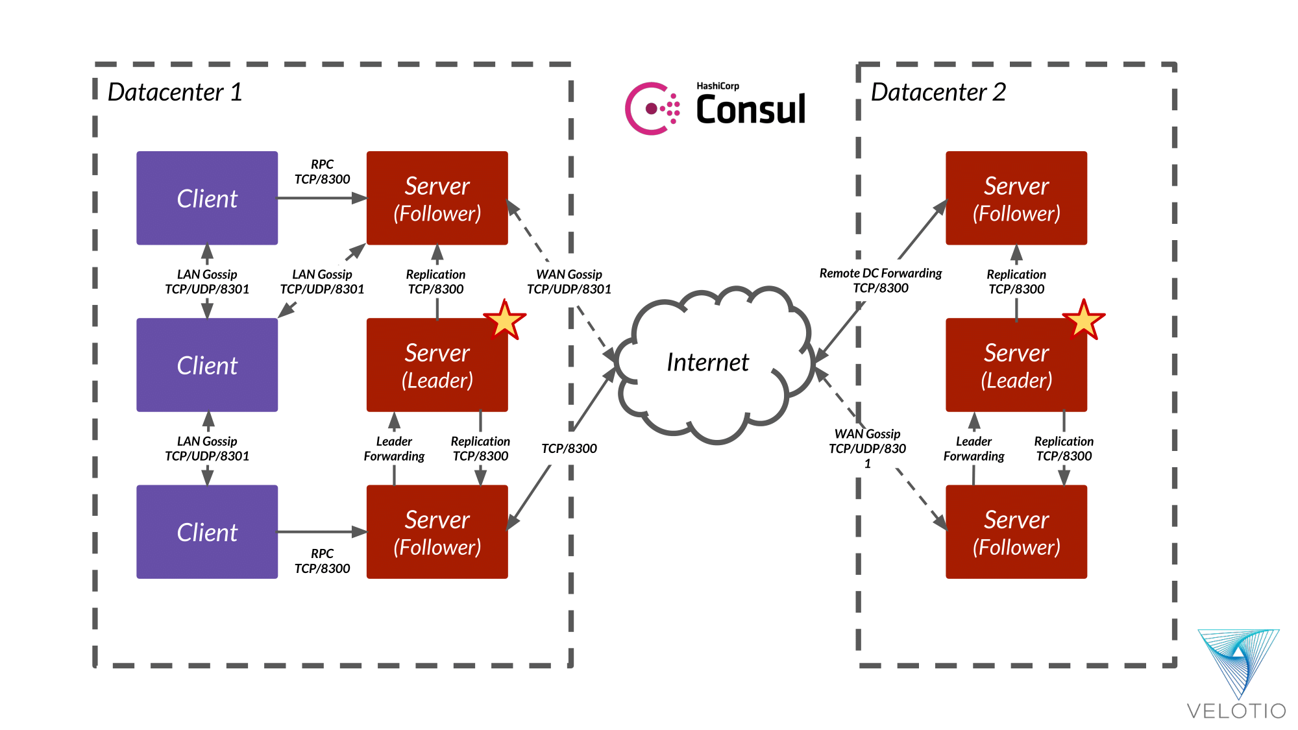
Consul Architecture

Slide 6
Service Discovery Using Consul
1. Start Consul
Run .\consul agent -dev
Open Consul UI: http://localhost:8500
2. Run a Sample Web Service
Start the simple web app (python app.py)
Service runs on localhost:8080
/health endpoint returns “OK”
3. Register the Service in Consul
In Consul UI → Services → Register Service
Name: web, Port: 8080
Health check: http://localhost:8080/health
4. Verify Service Status
Check Services → web
Status shows “Passing”
5. Show Health Check in Action
Stop the web service
Service turns “Critical”
Restart → becomes “Passing” again

Slide 7
THANK YOU!!

