Slide 1
SDLC

Slide 2
Client
Business Analyst
Requirements collection
BRS/SRS/URS
System Analyst
Requirement analysis
FRS
Design Architect
Design
HLD/LLD
Developers
Development
SCD
Testing Team
Testing
System testing
Devops
Deployment
Support/Maintenance

Slide 3
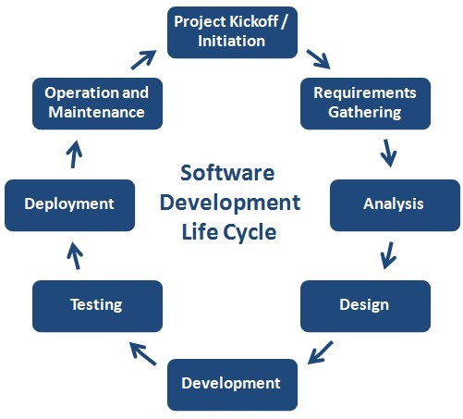
What is SDLC in software development?
How to develop application based on the client requirements within the time and cost that is called SDLC.

Slide 4
Requirement collection:
Client will give the requirement
Business analyst take the requirement
Now BA prepare a document as follows:
Business requirement specification -
Or
(SRS) system requirement specification
Or
(URS) user requirement specification
Once the BRS is completed then they do feasibility study
Cost/budget
Time
Customer expectations
If all the above are ok then BA while intimate the client
By REF(request for proposal ) to client.
If the client is ok with the conduction then
Client provide SLA (service level agreement) between the client and company

Slide 5
Requirement Analysis:
BRs document given to the system analyst.
System analyst will prepare one document that is called as FRS(functional requirement specification).
Then both BRs, FRS will be given to the design Architect.

Slide 6
Design
HDL
LLD
Some portion of application is called module diagram.
Then design is given to the coding.
Development:
In coding they develops the source code document after completion.
They hand over to the testing team.

Slide 7
Development:
In coding they develops the source code document after completion.
They hand over to the testing team.

Slide 8
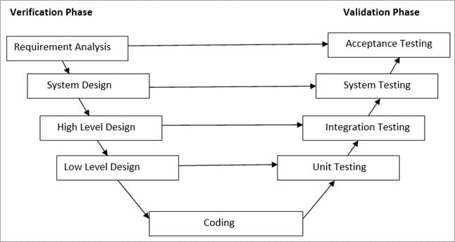
Development:
In coding they develops the source code document after completion.
They hand over to the testing team.

Slide 9
Testing team
Quality analyst will check code is according to client requirements or not.
If the code pass the test then it will be deployed or released.
If fail the requirement then it again go to the Coding.

Slide 10
Deployment:
In this phase the final app while hand over to the client.
In this phase they will be devops team will deploy the application.

Slide 11
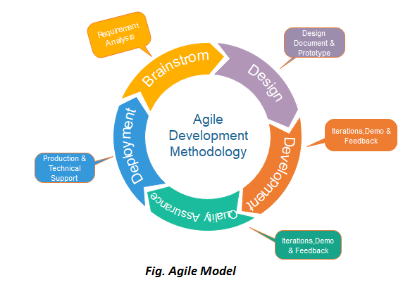
Agile Model:
The meaning of Agile is swift or versatile. "Agile process model" refers to a software development approach based on iterative development.

Slide 12
It is used to maintain the work flow of the given project.
It help us to know issues and problem while completing the task.
Agile Testing Methods:
Scrum
Dynamic Software Development Method(DSDM)
Advantage(Pros) of Agile Method:
Frequent Delivery
Face-to-Face Communication with clients.
Efficient design and fulfills the business requirement.
Anytime changes are acceptable.
It reduces total development time.

Slide 13
When to use the Agile Model?
When frequent changes are required.
When a highly qualified and experienced team is available.
When a customer is ready to have a meeting with a software team all the time.
When project size is small.

