Slide 1
ASC Student Simulation Challenge 2021
Machine Learning Application to Design Co-cure Processing of Energy-Efficient Honeycomb Sandwich Composite Structures
Nicholas Pagliocca, Kazi Zahir Uddin, Ibnaj Anamika Anni
Department of Mechanical Engineering
Rowan University
201 Mullica Hill Rd.
Glassboro, NJ, 08028, USA
Presenter: Nicholas Pagliocca
36th ASC Technical Conference
September 19-22, 2021

Slide 2
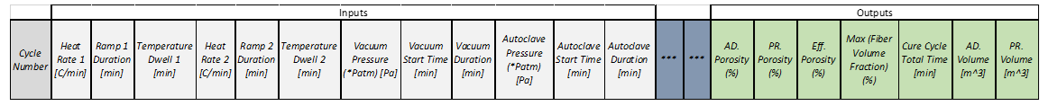



Introduction and Machine Learning Approach
(1)
A Multilayer Perceptron (MLP) is utilized to understand the correlations from the inputs and outputs for a regression type machine learning problem.
Trained network parameters are used to understand which process parameter impact the Co-cure cycle the most.
Optimal input parameters are determined via input tuning to maximize an objective function considering the face sheet consolidation level, bond line porosity, and total cure cycle time.
Input
Layer
x1
x2
x3
x4
*
Hidden
Layer
h1
h2
h3
$$\hat{y}=Wx+b$$
Output
Layer
o1
o2
ReLu
+
Batch
Normalization
*
$$\hat{y}=φ(BN(Wx+b))$$
(2)
*
*
Where $\hat{y}$ is the predicted layer output, W is the weight matrix, x are the layer inputs, b is the bias vector, BN is a batch normalization operation, and $φ$ is a nonlinear activation function. See source *.
Aston Zhang, et al. “Dive into Deep Learning”. arXiv preprint arXiv:2106.11342 (2021).

Slide 3
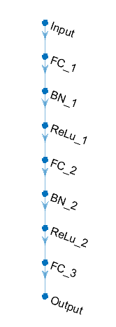
MLP Design Overview
The MLP architecture consists of a feature input layer , a fully connected layer mapping to a regression output layer and hidden layers. Neuron quantities are shown in Table A.
RMSE is the output for the regression layer.
The number of layers and width is determined from well documented empirical guidelines for effective Neural Networks (NN).
Hyperparameters are tuned to prevent overfitting and incentivize generalizability, with learning rate being dynamic. A summary is in Table B.
Adam optimization is used for its superior performance to other methods such as stochastic gradient descent.
(1)
Table A
Layer | Neurons
Input | 12
FC_1 | 10
FC_2 | 9
FC_3 | 7
Output | 7
*
Table B
Parameter | Value
Initial Learning Rate (LR) | 0.01
LR Drop Factor | 0.1
LR Drop Period | 5
Epochs | 10
Minibatch Size | 16
***
*
Jeff Heaton “Introduction to Neural Networks with Java”. Heaton Research, Inc., (2008).
**
Nitish Keskar et al., “On Large-Batch Training for Deep Learning: Generalization Gap and Sharp Minima”. Arxiv preprint arXiv:1609.04836 (2017).
***
Sebastian Ruder “An overview of gradient descent optimization algorithms”. Arxiv preprint arXiv:1609.04747 (2016).
**

Slide 4
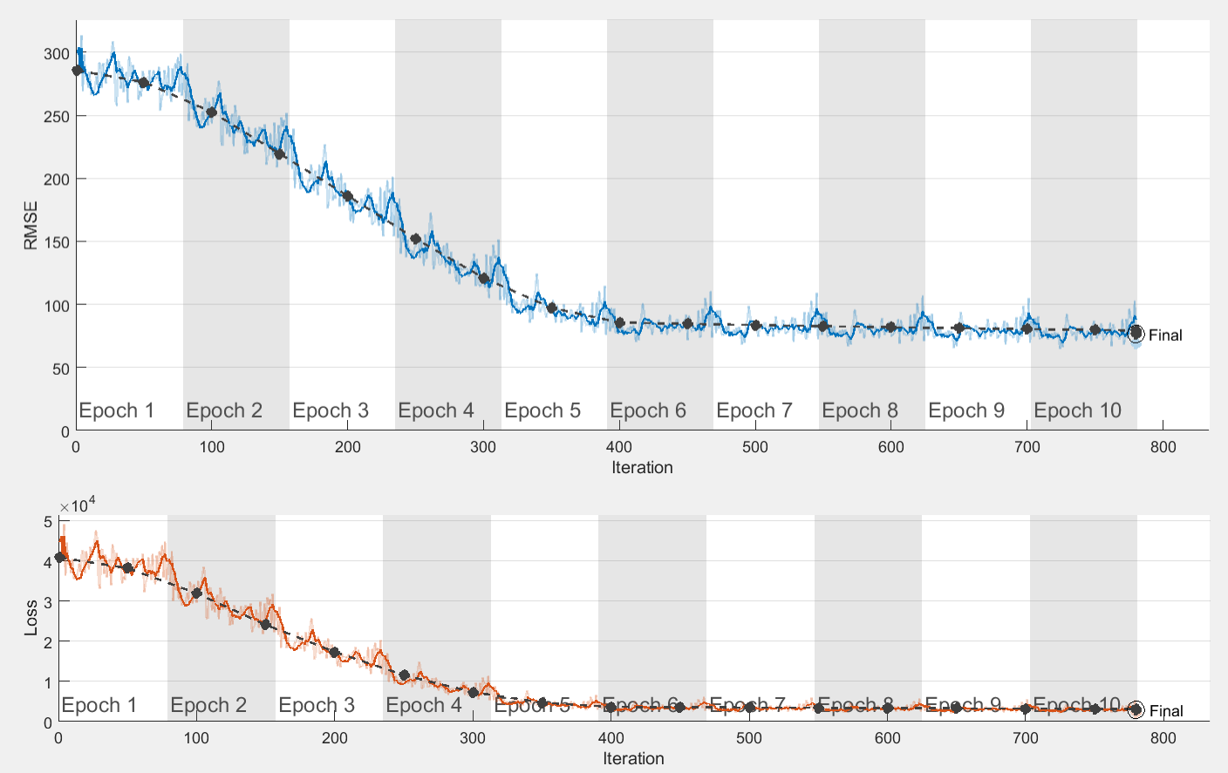
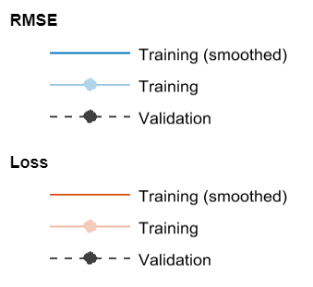
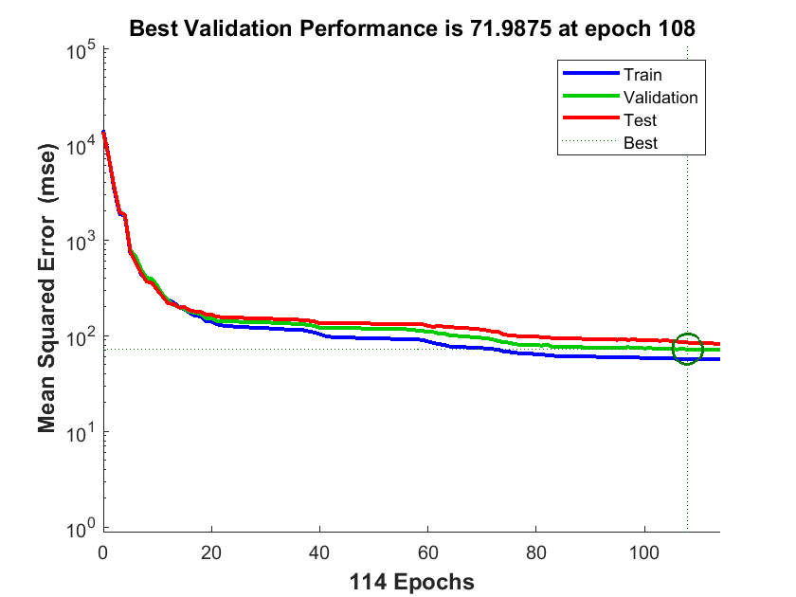
Model Training and Validation
Provided data is partitioned into training and testing datasets. The split is 70% training and 30% testing.
To help with generalizability all data is shuffled prior to input.
To validate that the script that is used for analysis is accurate, the data is also run using the built in Neural Network Fitting toolbox on the same training data, here 15% is used for validation and 15% is used for testing (189 samples each).
RMSE is very high in both charts, as an indicator, it can be misleading for target variables with large expected values but can also signal overfit. More data could help ameliorate any possible overfit.
(1)
(2)

Slide 5
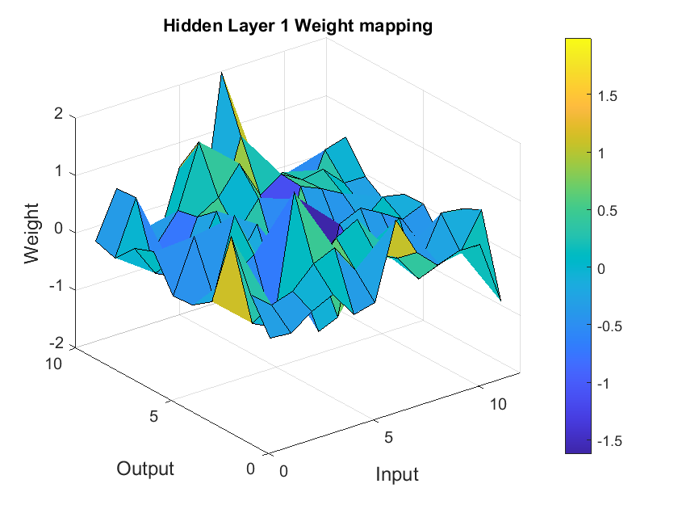
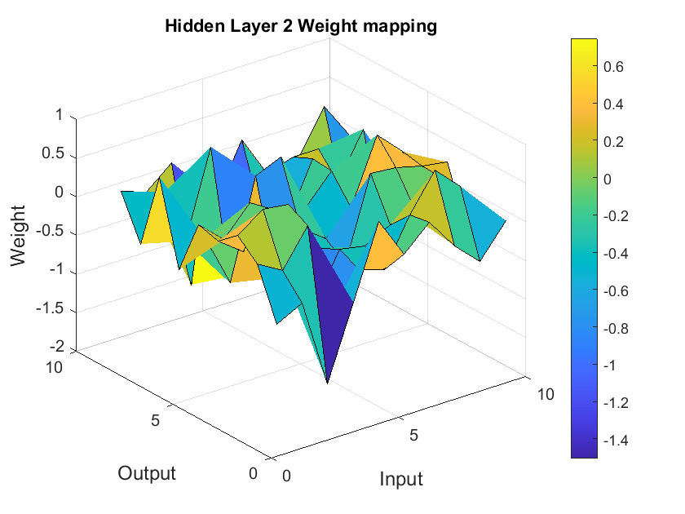
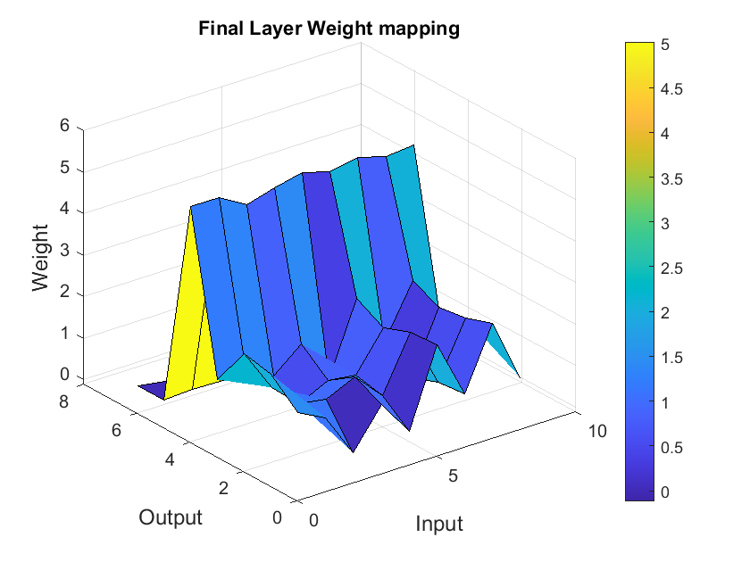



Analysis Methods
Weights from a Neural Network can be used to quantify how an input will change an output.
This method is applicable through all layers of a NN.
By Mapping the paths of inputs to outputs it is possible to see which input parameters influence the Co-curing process outputs and effect the governing processes.
Likewise, it is also possible to see which parameters have negligible effects.
Data Flow
(1)
(2)
(3)
$$\hat{{y_{FC}}_{1}}=φ_{1}(BN_{1}({W_{FC}}_{1}x_{in}+{b_{FC}}_{1}))$$
$$\hat{y_{FC_{2}}}=φ_{2}(BN_{2}({W_{FC}}_{2}\hat{{y_{FC}}_{1}}+{b_{FC}}_{2}))$$
$$\hat{{y_{FC}}_{3}}=φ_{3}(BN_{3}({W_{FC}}_{3}\hat{y_{FC_{2}}}+{b_{FC}}_{3}))$$

Slide 6

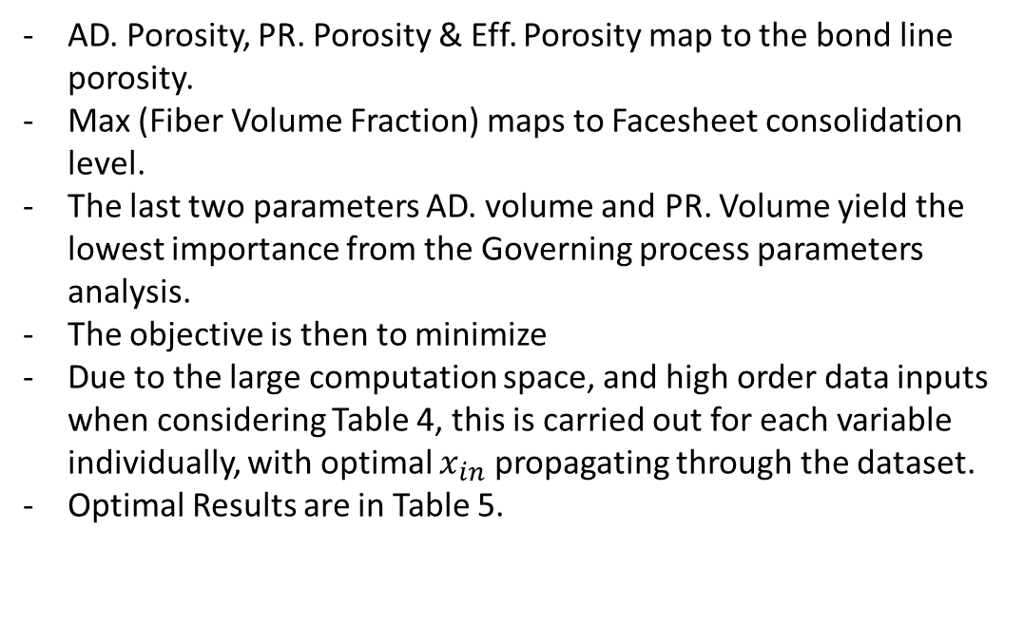
Determination of Optimal Process Parameters
Table 4
AD. Porosity, PR. Porosity & Eff. Porosity map to the bond line porosity.
Max (Fiber Volume Fraction) maps to Facesheet consolidation level.
The last two parameters AD. volume and PR. Volume yield the lowest importance from the Governing process parameters analysis.
The objective is then to minimize
Due to the large computation space, and high order data inputs when considering Table 4, this is carried out for each variable individually, with optimal $x_{in}$ propagating through the dataset.
Optimal Results are in Table 5.
Input Parameter | Range (Low : Step : High)
Heat Rate 1 [C/Min] | 0.5:0.35:4
Ramp 1 Duration [Min] | 20:10:120
Temperature Dwell [Min] | 40:10:140
Heat Rate 2 [Min] | 0:0.5:5
Ramp 2 Duration [Min] | 10:9:100
Temperature Dwell 2 [Min] | 0:16:160
Vacuum Pressure [Pa] | 0:0.1:1
Vacuum Start Time [Min] | 0:10:100
Vacuum Duration [Min] | 50:30:350
Autoclave Pressure [Pa] | 1:0.5:6
Autoclave Start Time [Min] | 1:9.9:100
Autoclave Duration [Min] | 100:25:350
$$\hat{{y_{FC}}_{3}}=φ_{3}(BN_{3}({W_{FC}}_{3}\hat{y_{FC_{2}}}+{b_{FC}}_{3}))$$
Table 5
Heat Rate 1 | Ramp 1 Duration | Temperature Dwell 1 | Heat Rate 2 | Ramp 2 Duration | Temp Dwell 2 | Vacuum Pressure | Vacuum Start Time | Vacuum Duration | Autoclave Pressure | Autoclave Start time | Autoclave Duration
3.65 | 110 | 130 | 4.5 | 91 | 144 | 0.9 | 90 | 320 | 5.5 | 90.1 | 325

Slide 7
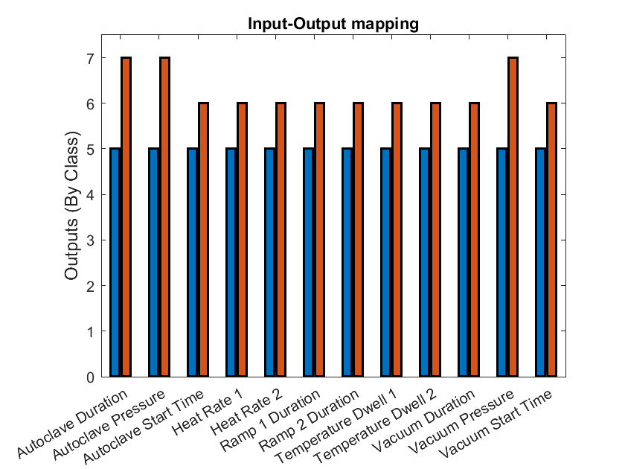
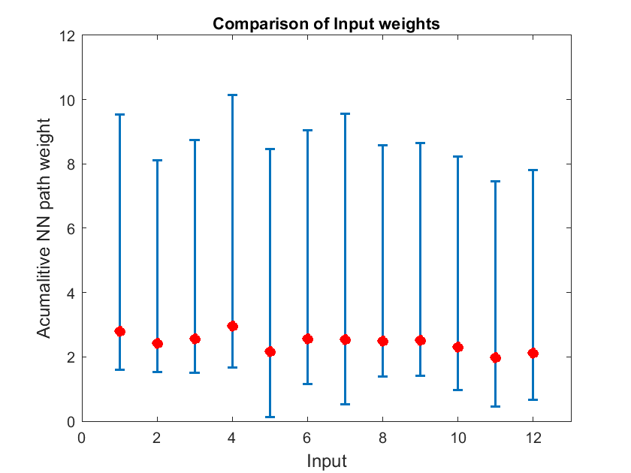
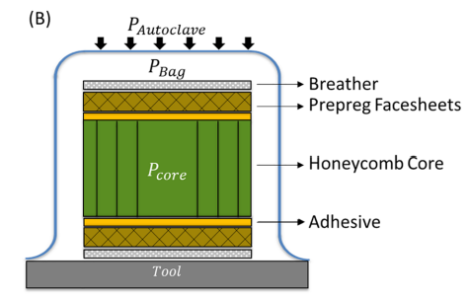
Governing Process Parameters
Processes | Heat Rate 1 | Ramp 1 Duration | Temperature Dwell 1 | Heat Rate 2 | Ramp 2 Duration | Temp Dwell 2 | Vacuum Pressure | Vacuum Start Time | Vacuum Duration | Autoclave Pressure | Autoclave Start time | Autoclave Duration
(A) Prepreg Facesheet Consolidation | - | + | - | + | - | + | + | O | + | + | O | +
(B) Bond-Line Fillet Formation | + | + | + | + | + | + | O | O | O | O | O | O
(C) Bond-Line Porosity | O | O | + | O | O | + | + | O | O | + | O | O
(D) Core Pressure Evolution | O | O | + | O | O | + | + | + | + | + | + | +
(A) Fiber volume fraction in prepreg increases as resin bleeds to the bond line.
(B) As system temperature increases fluctuations in adhesive viscosity can lead to fillet formation at the bond line.
(C) High temperature and low pressure can cause void formation in the adhesive fillet (bond line).
(D) Internal pressure fluctuations can occur from transfer of air from the core and to the core cell.
Max
+ = More/ Sensitive
- = Less
O = Other
Table 3
(2)
Min
(3)
(1)
Schematic from * to help with process visualization.
*
Navid Niknafs Kermani, Pavel Simacek, Suresh G. Advani “A Bond-line Porosity Model that Integrates Fillet Shape and Prepreg Facesheet Consolidation during the Equilibrated Co-cure of of Sandwich Composite Structures” Composite Part A: Applied Science and Manufacturing (2020)

Slide 8
Summary
A MLP based method was used to determine correlations between process parameters, and to find an optimal co-curing cycle.
A detailed description of the employed architecture and methods was presented.
Large RMSE shows that more data may be needed to form a more robust model.
Total cure cycle time is the highest correlated output and AD. volume, and PR. Volume are the least correlated.
The optimal cure cycle favors alternating magnitudes of temperature cycle parameters (ex. Temp Dwell 1, 2)., with larger pressure and vacuum, and synchronous application of Vacuum and autoclave, later in the overall cycle.
Assessment of the optimal Co-Cure process and relations between the input and output layer are used to identify, verify and discuss the governing processes parameters.
Thank you for your time!

