Slide 1

Improving Solar Forecasting using a Deep Learning Model for Efficient Hybrid Systems in Haldwani
Project Report
Submitted By:
Harikesh Pandey
B.Tech (I.T.), Third Year
College of Technology, GBPUAT, Pantnagar

Slide 2
Introduction & Motivation
The Energy Challenge
A dual global challenge: meet escalating energy demand while combating climate change.
The transition to clean energy, like solar, is imperative.
The Problem with Solar Power
Intermittency: Solar power generation is variable and unpredictable due to factors like weather and time of day.
The Solution: Hybrid Energy Systems
These systems combine renewables (like solar PV) with dispatchable sources (like diesel generators or batteries) to ensure a reliable power supply.
Crucial Element: The efficiency of a hybrid system depends on an accurate forecast of solar irradiance to manage energy sources effectively.

Slide 3
Problem Statement: The Haldwani Challenge
Study Area: Haldwani, located in the foothills of the Himalayas in Uttarakhand, India.
High Potential, High Variability: The region has significant solar potential but is subject to complex and dynamic microclimates.
Forecasting Difficulty: Rapid weather changes, seasonal monsoons, and winter fog lead to unpredictable fluctuations in solar irradiance.
The Consequence of Inaccuracy: Poor forecasting leads to an over-reliance on costly and polluting backup generators, defeating the purpose of the hybrid system.

Slide 4
Objectives of the Study
The primary goal is to design and validate a high-performance deep learning model for next-day, hourly solar irradiance forecasting in Haldwani.
Specific Objectives:
Data Curation: Collect and preprocess historical solar irradiance and meteorological data specific to Haldwani.
Model Design: Build a hybrid deep learning model combining a Convolutional Neural Network (CNN) and a Bidirectional Long Short-Term Memory (BiLSTM) network.
Training & Validation: Rigorously train the model and validate its performance against actual measured data.
Performance Evaluation: Quantitatively assess the model's accuracy using standard statistical metrics like MAE, RMSE, and R².

Slide 5
Literature Review: Evolution of Forecasting Models
Traditional Statistical Models (e.g., ARIMA):
Pros: Simple and computationally inexpensive.
Cons: Struggle with the non-linear and non-stationary nature of weather data.
"Shallow" Machine Learning (e.g., SVM, Random Forest):
Pros: Capable of capturing non-linear relationships.
Cons: Are "memoryless" and require extensive manual feature engineering to understand temporal context.
Deep Learning (e.g., LSTM, BiLSTM):
Pros: Specifically designed for sequential data, they have built-in "memory" to automatically learn from past data over long periods. This study leverages an advanced hybrid deep learning approach.

Slide 6
Methodology: The Proposed Architecture
A hybrid CNN-BiLSTM Model with an Attention Mechanism.
1. Convolutional Neural Network (CNN) Layer:
  Acts as an automated feature extractor. It scans the input weather variables to identify important local patterns and interactions (e.g., the combined effect of falling temperature and rising humidity).
2. Bidirectional LSTM (BiLSTM) Layer:
  The model's memory core. It processes data sequences forwards and backwards, giving it a complete contextual understanding of how weather patterns evolve over time.
3. Attention Mechanism:
  Adds a layer of intelligence, allowing the model to focus on the most influential time steps in the input data when making a prediction.

Slide 7
Methodology: Data & Features
Data Sources:
Historical Training Data: NASA Prediction of Worldwide Energy Resource (POWER) project.
Forecast Testing Data: Open-Meteo API, which aggregates multiple Numerical Weather Prediction (NWP) models.
Input Features:
Temporal: Month, Day, Hour.
Meteorological: Air Temperature, Relative Humidity, Dew Point.
Atmospheric & Astronomical: Cloud Amount, Solar Zenith Angle.
Target Variable:
Global Horizontal Irradiance (GHI) in
Wh/m².

Slide 8
Methodology: Model Training
Preprocessing:
Data cleaning and chronological alignment.
Min-Max Scaling: All numerical features were scaled to a common [0, 1] range to improve training stability.
Temporal Windowing: Data was structured into sequences where 6 hours of past data is used to predict the next 24 hours of solar irradiance.
Training Configuration:
Optimizer: Nadam, an advanced algorithm for faster and more stable convergence.
Loss Function: Mean Squared Error (MSE).
Hyperparameter Tuning: The Optuna framework was used to automatically find the optimal batch size (32).
Software Stack: Python, TensorFlow, Keras, Pandas, and Scikit-learn.

Slide 9
Results: Quantitative Performance
The model was evaluated on a held-out test set of historical data it had never seen before.
Mean Absolute Error (MAE): 26.39 Wh/m²
  The average hourly forecast is off by only this amount, indicating high precision.
Root Mean Squared Error (RMSE): 41.44 Wh/m²
  This low value confirms the model avoids large, frequent errors, ensuring reliability.
R² Score (Coefficient of Determination): 0.9778
  The model successfully explains
97.78% of the variability in solar irradiance, indicating an exceptional fit to the data.

Slide 10
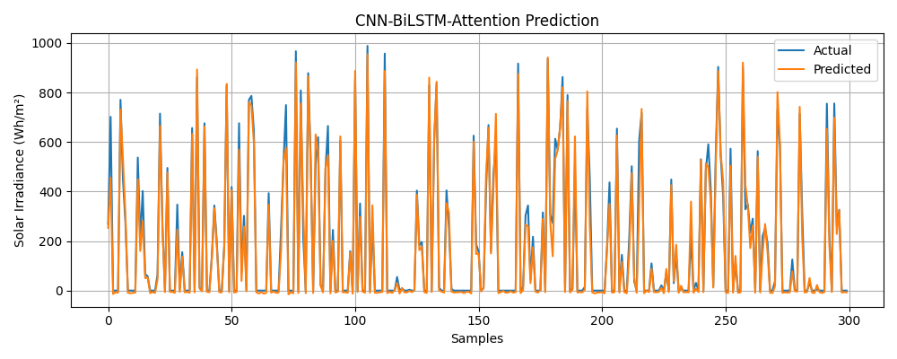
Figure 1. Actual (Historic) vs. Predicted Solar Irradiance

Slide 11
Case Study: Real-World Test (June 29 - July 4, 2025)
Scenario: The model's predictions were compared against a standard baseline forecast from the Open-Meteo service for a specific week.
Result: The CNN-BiLSTM model consistently outperformed the baseline forecast, especially in capturing the granular, intra-day fluctuations caused by dynamic cloud cover.
MAE Comparison (Wh/m²):
Date | MAE (Predicted vs Actual) | MAE (Forecasted vs Actual)
29 June | 57.14 Wh/m² | 42.14 Wh/m²
30 June | 37.74 Wh/m² | 29.38 Wh/m²
1 July | 45.30 Wh/m² | 51.28 Wh/m²
2 July | 36.21 Wh/m² | 31.25 Wh/m²
3 July | 43.08 Wh/m² | 49.28 Wh/m²
4 July | 27.61 Wh/m² | 37.83 Wh/m²

Slide 12
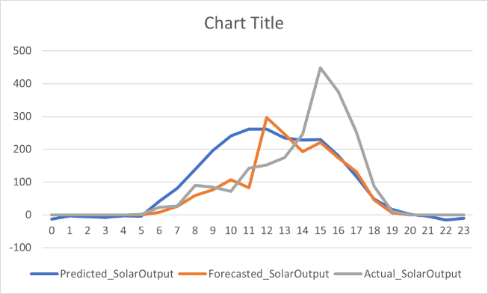
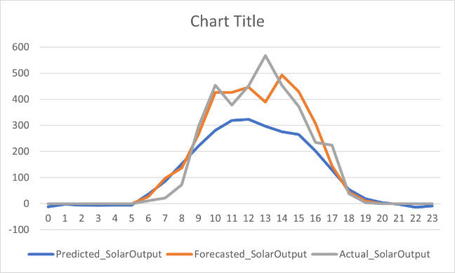
Case Study: Daily Performance Graphs
These graphs shows how our model's prediction (blue line) more closely tracks the actual solar irradiance (grey line) compared to the standard forecast (orange line), especially during the volatile midday period.
Fig. 2. Predicted vs. Forecasted vs. Actual Solar Irradiance Graph (29 June 2025)
Fig. 3. Predicted vs. Forecasted vs. Actual Solar Irradiance Graph (30 June 2025)

Slide 13
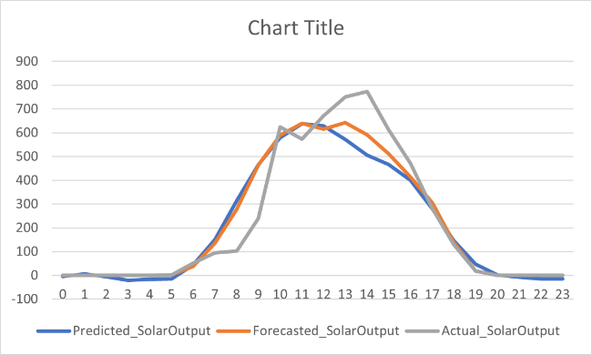
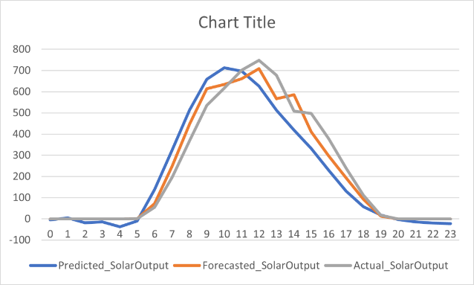
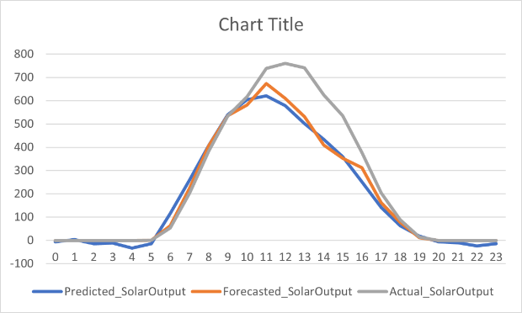
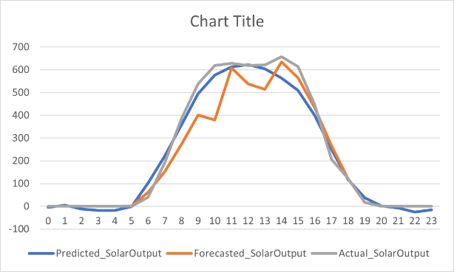
Fig. 4. Predicted vs. Forecasted vs. Actual Solar Irradiance Graph (01 July 2025)
Fig. 5. Predicted vs. Forecasted vs. Actual Solar Irradiance Graph (02 July 2025)
Fig. 6. Predicted vs. Forecasted vs. Actual Solar Irradiance Graph (03 July 2025)
Fig. 7. Predicted vs. Forecasted vs. Actual Solar Irradiance Graph (04 July 2025)

Slide 14
Seasonal Validation
To ensure year-round reliability, the model was validated on data from different seasons in 2016.
Summer MAE (May-June 2016): 22.63 Wh/m2
Winter MAE (Oct-Nov 2016): 15.22 Wh/m2
Conclusion: The model performs reliably throughout the year and is robust to seasonal weather variations.

Slide 15
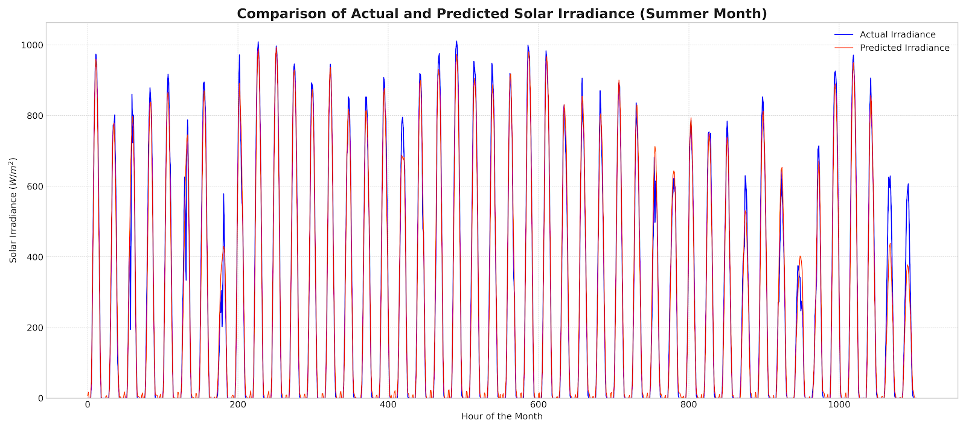
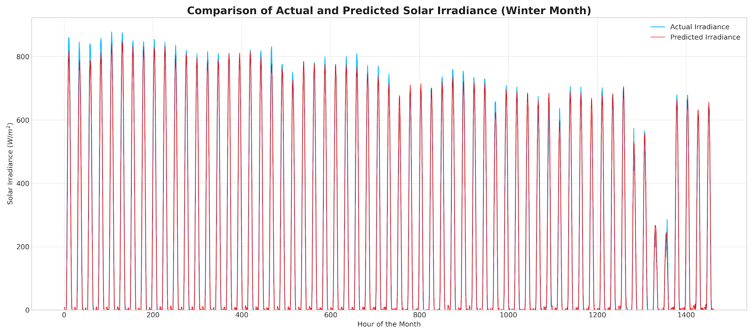
Fig. 8(a). Validation Graph for Summer
Fig. 8(b). Validation Graph for Winter

Slide 16
Practical Application: Web User Interface
To translate research into a practical tool, a web-based user interface was developed.
Functionality:
  A user uploads a CSV file containing the required input parameters for a future date.
  The backend runs the trained CNN-BiLSTM model to generate a 24-hour solar irradiance forecast.
  Results are displayed on an analytics dashboard and are available for download.

Slide 17
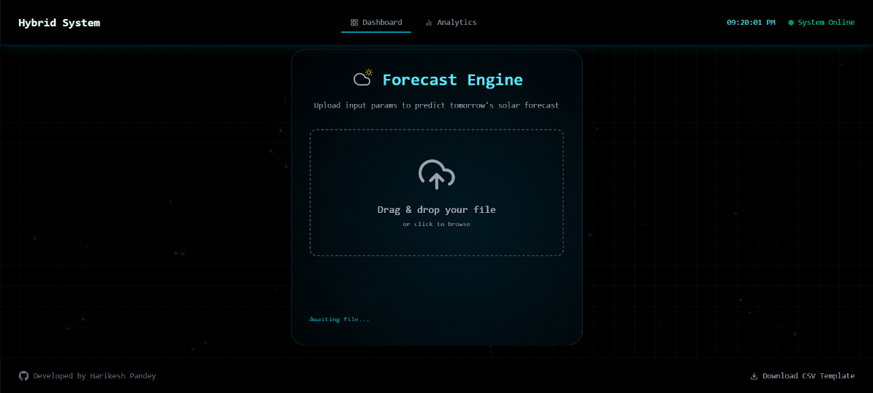
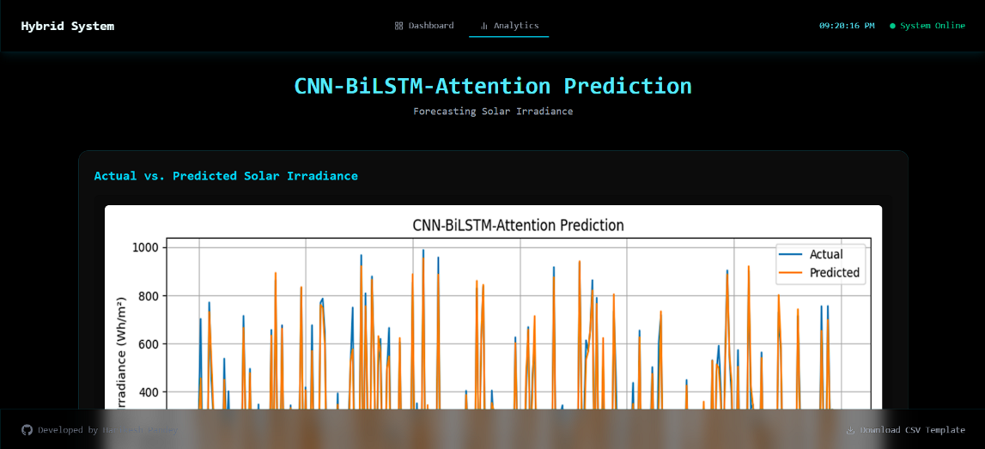
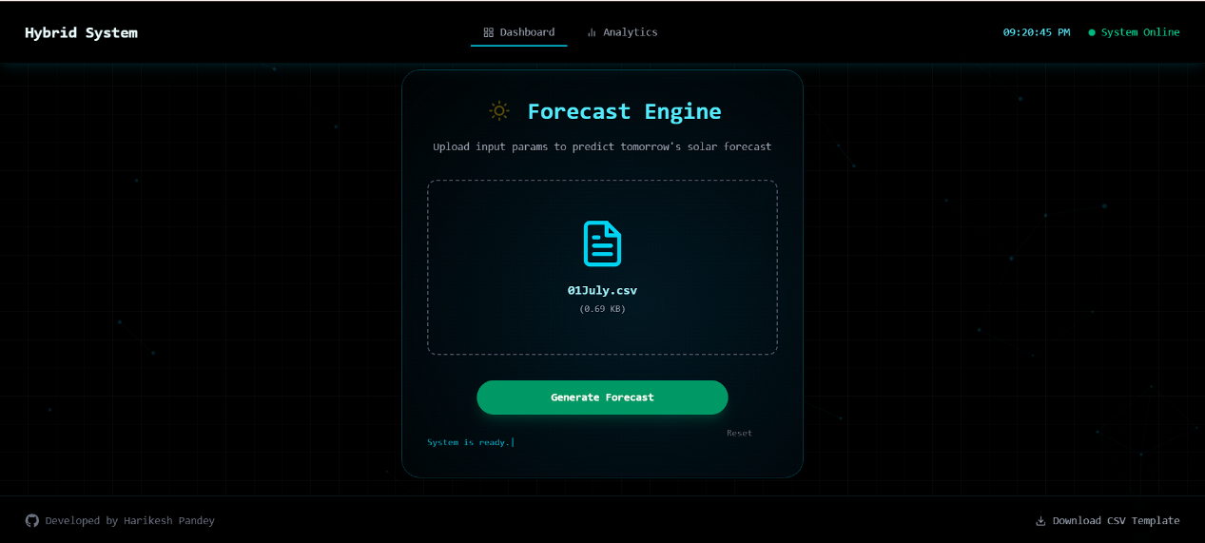
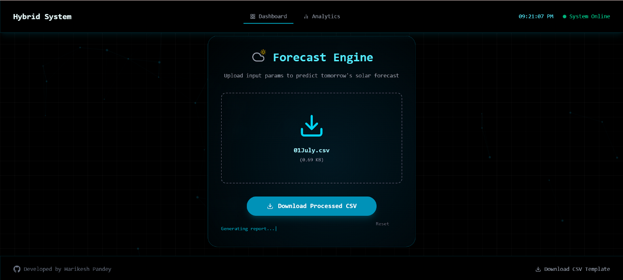
Fig. 9. Some Screenshots of User interface

Slide 18
Summary & Conclusions
Summary: This research successfully developed and validated a hybrid CNN-BiLSTM deep learning model to provide high-accuracy, short-term solar irradiance forecasts for the meteorologically complex region of Haldwani.
Key Findings:
The model is highly accurate, explaining over
97% of the variance in solar irradiance.
It demonstrates superiority over standard baseline forecasts, particularly in variable weather conditions.
The architectural design (CNN for feature extraction, BiLSTM for temporal modeling) proved highly effective.
Conclusion: Advanced AI models are a powerful and practical solution for enhancing the operational efficiency, cost-effectiveness, and sustainability of hybrid renewable energy systems.

Slide 19
Future Work
Building on the success of this project:
Incorporate Richer Data: Integrate real-time satellite imagery and on-site sensor data (pyranometers) to further improve accuracy.
End-to-End PV Output Model: Extend the model to predict the final AC power output (kW) of a specific PV plant by including panel-specific parameters.
Cloud Deployment: Deploy the system on a cloud platform (e.g., AWS, GCP) using Docker and FastAPI to create a scalable, real-time API for wider access.
Explore New Architectures: Experiment with state-of-the-art architectures like Transformer models to potentially capture more complex, long-range weather patterns.

Slide 20
Thank You

