Slide 1

COMPUTER VISION PROJECT: Image processing in C
Student: Pahaliah N’Guessan
Matricola:564858
A.Y. 2024/25

Slide 2

PROJECT GOALS
• Command-line tool for `.ppm` image processing
• Techniques: morphological filters, edge detection, circle detection, binarization
• Each filter triggered by a CLI flag (e.g. -gray, -sobel, -hough...)

Slide 3
PROGRAM STRUCTURE
main.c → exectution function based on input parameters
image.c → loadPPM, saveTransformation, savePPM (Image struct)
filters.c → toGrayscale, toBinary, sobelEdgeDetection, morphology (erosion, dilation,opening, closing,top hat, bottom hat)
hough.c → houghCircleDetection

Slide 4
HOUGH CIRCLE DETECTION
360°
R
r

Slide 5
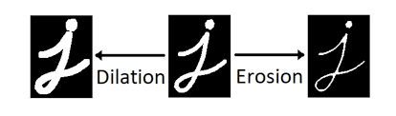
MORPHOLOGICAL FILTERS : ERODE & DILATE
• Erode (-erode): Shrinks white objects, useful for removing noise
• Dilate (-dilate): Expands white objects, useful for closing holes
• Can be combined for complex operations (e.g., opening, closing)

Slide 6

USE METHODS
COMPILATION:
EXECUTION:
INPUT PARAMETERS:
If
:specification of minimum, maximum radius for circle detection and threshold

Slide 7



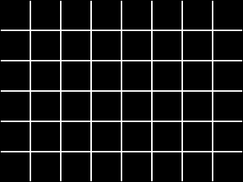
EXECUTION EXAMPLE 1
INPUT
-binary
-gray
-sobel

Slide 8




EXECUTION EXAMPLE 2
INPUT
-binary
-gray
-sobel

Slide 9






EXECUTION EXAMPLE 2
-erode
-dilate
-opening
-top
-closing
-bottom

Slide 10




EXECUTION EXAMPLE 3
INPUT
{
r_min=35
r_max=60
threshold=350
-gray
-sobel
-hough

Slide 11
THANKS FOR YOUR ATTENTION

