Slide 1

Project of Applied Robotics Technologies – AA 2025–2026
Mechanical Design, Kinematic and Dynamic Analysis of a 4-DOF Robot
Students: CHANDHAVATH DEEPAK ABHINAV(n.549976), ITENDI ALBAN LANDRY(n.564940), CAMPANI EMILIA(n.545149), N'GUESSAN PAUL-HENRI PAHALIAH(n.564858)
Professor: Hermes Giberti

Slide 2
Project Objectives
• Design of a 4-DOF anthropomorphic robot
• Kinematic and dynamic modeling in MATLAB
• Trajectory planning and workspace analysis
• Validation using Simscape Multibody

Slide 3
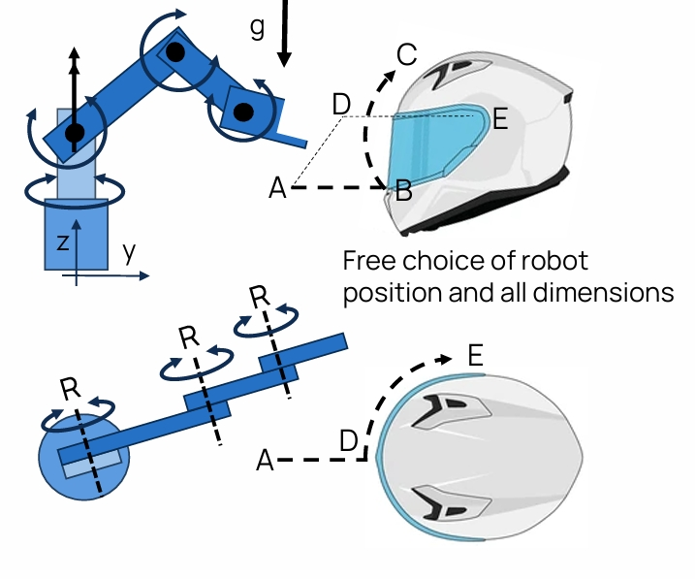
Robotic Task
• Visor opening and closing task
• Trajectory A–B–C–B–A
• Secondary trajectory A–D–E
• Payload: 0.5 kg

Slide 4
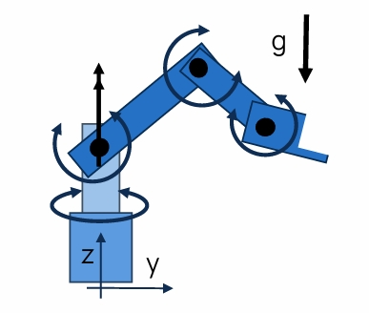
Robot Mechanical Structure
• Serial 4-DOF anthropomorphic manipulator
• Free choice of link lengths and joint limits
• Design optimized for task reachability

Slide 5
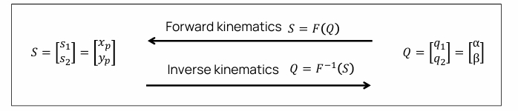
Kinematic Modeling
• Forward kinematics: ANTHROPOdir.m
• Inverse kinematics: ANTHROPOinv4lM1T5.m, • Joint positions: calculate_joint_positions_ANTHROPO.m

Slide 6
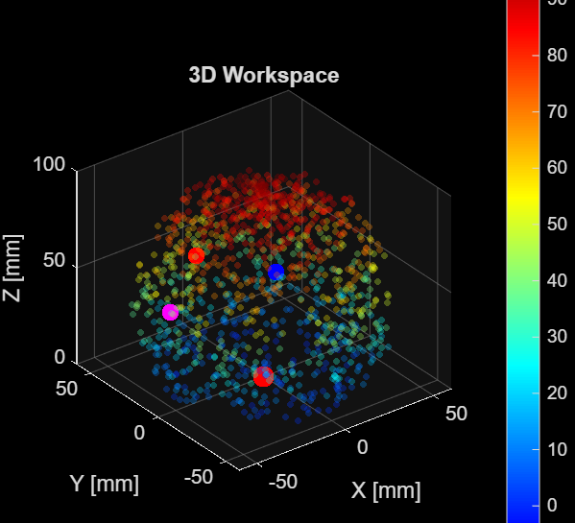
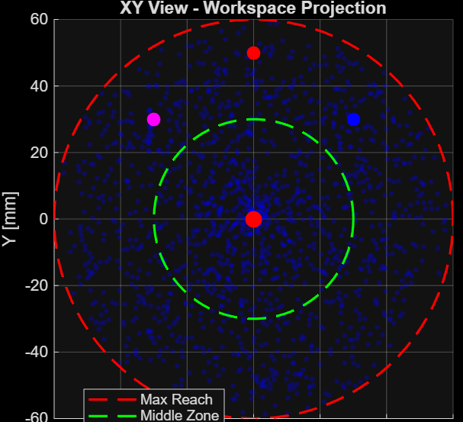
Jacobian and Workspace
• Jacobian: ANTHROPOJac.m, ANTHROPOJp.m
• Workspace mapping: ANTHROPOworkspace.m
• Kinematic quality evaluation

Slide 7
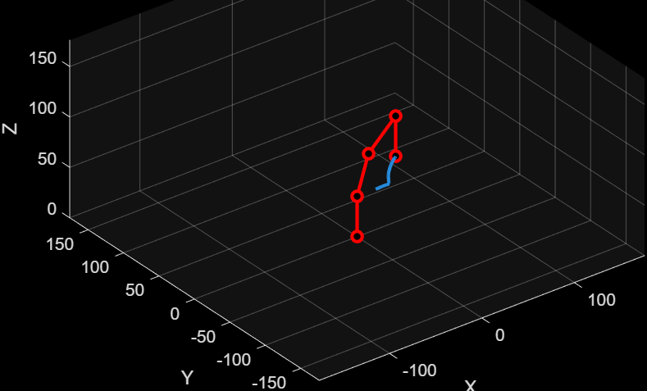
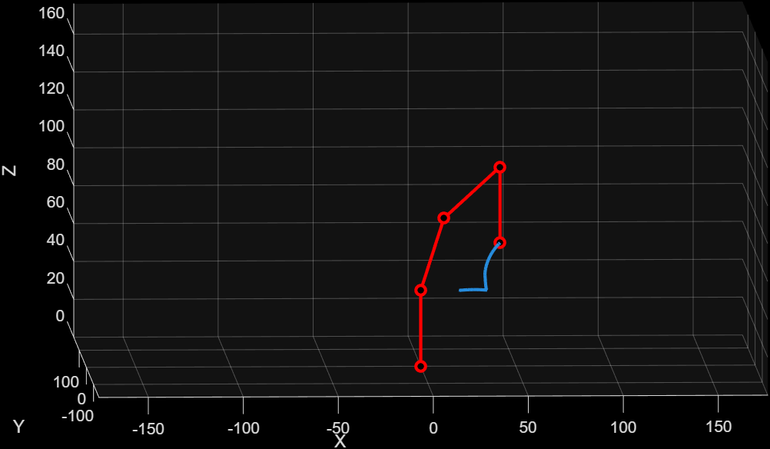
Trajectory Planning
• Lines and parabolas: LinesParabolas_mainAB_BC.m
• Boundary conditions: Limit_case.m

Slide 8
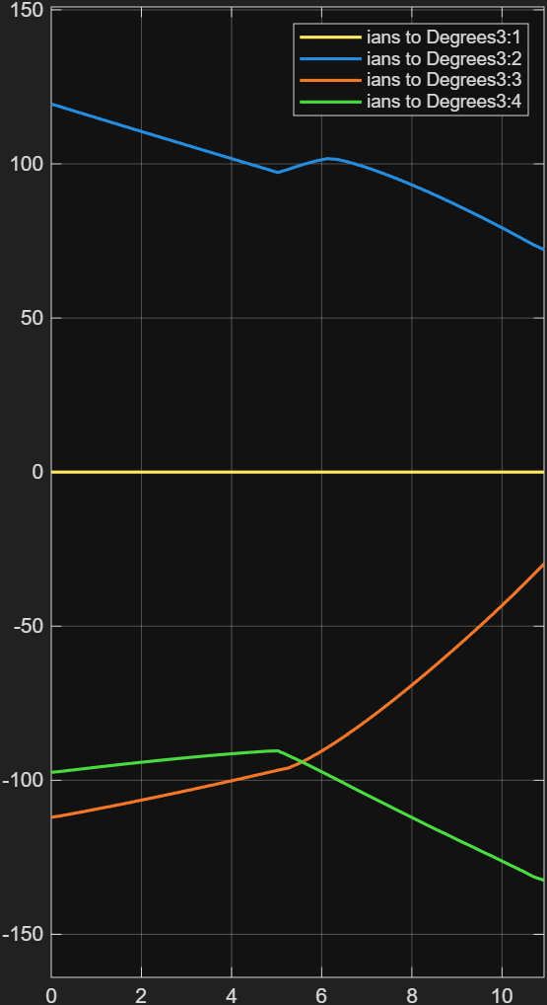
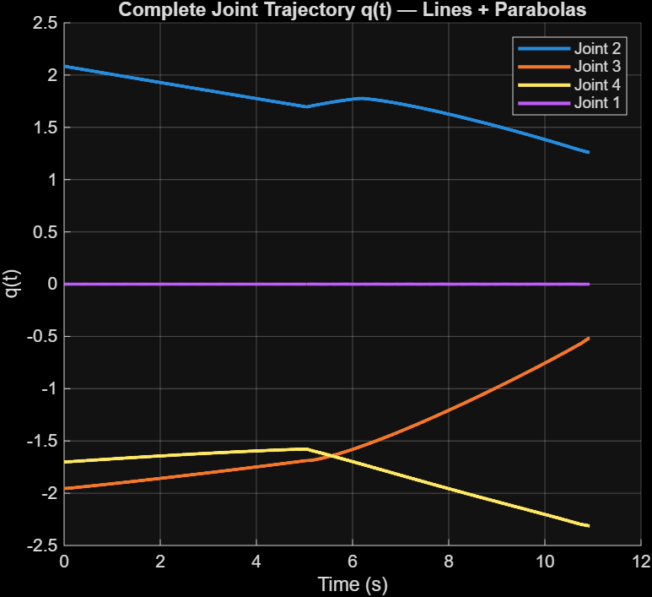
Trajectory Planning
• Lines and parabolas: LinesParabolas_mainAB_BC.m
Matlab | Vs | Simscape Multibody (direct)

Slide 9
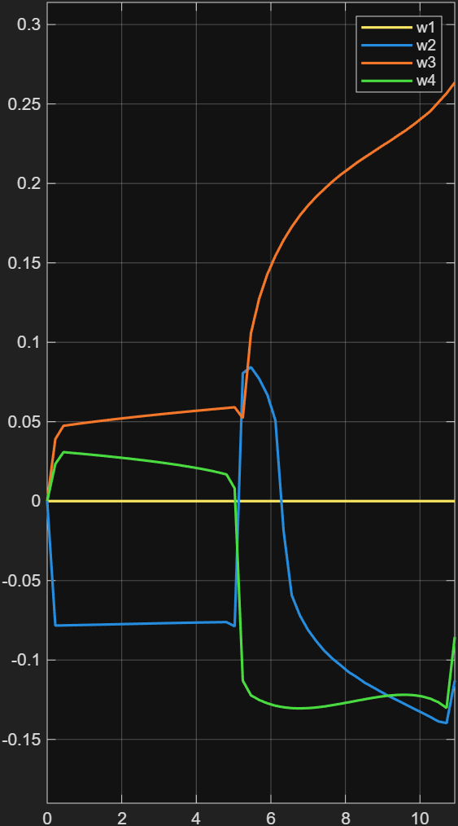
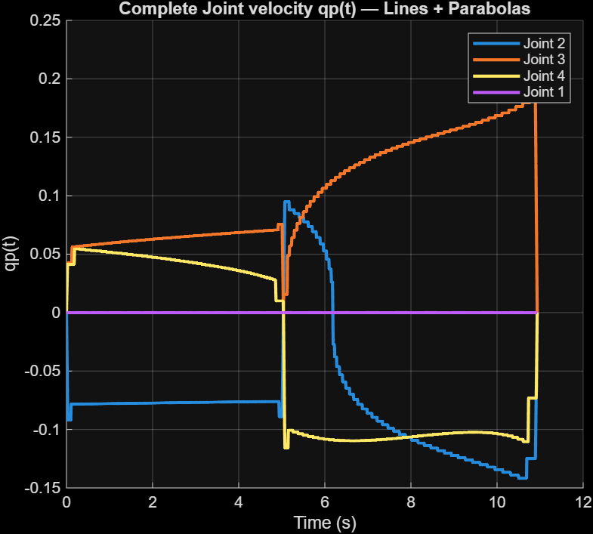
Trajectory Planning
• Lines and parabolas: LinesParabolas_mainAB_BC.m
Matlab | Vs | Simscape Multibody (direct)

Slide 10
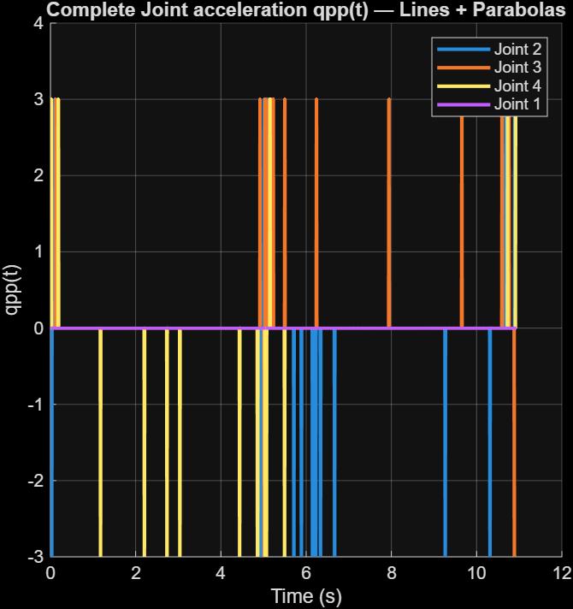
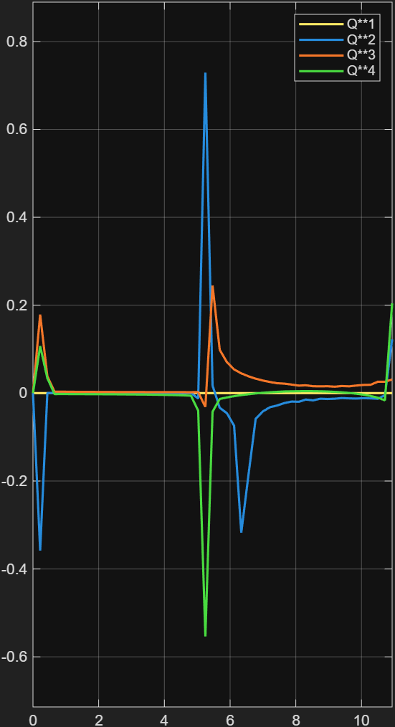
Trajectory Planning
• Lines and parabolas: LinesParabolas_mainAB_BC.m
Matlab | Vs | Simscape Multibody (direct)

Slide 11
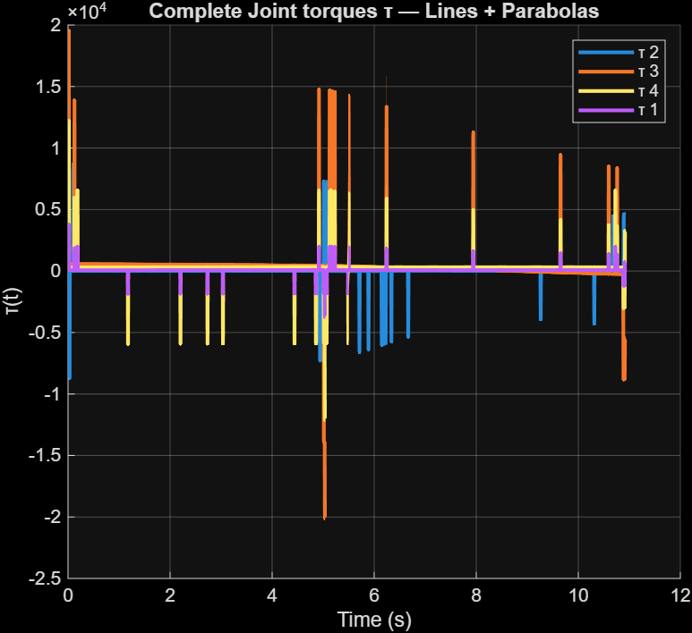
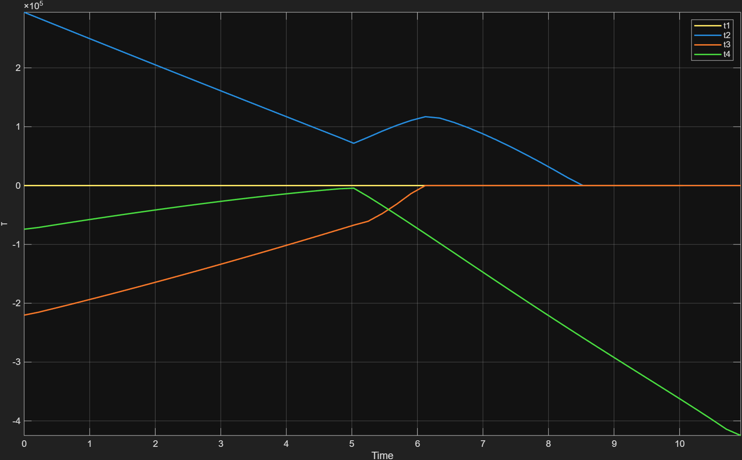
Trajectory Planning
• Lines and parabolas: LinesParabolas_mainAB_BC.m
Matlab | Vs | Simscape Multibody (direct)

Slide 12
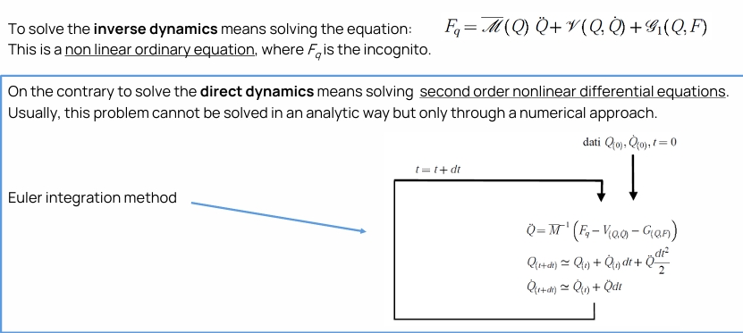
Dynamic Modeling
• Direct dynamics: Anthro4DOF_Direct_Dynamics.m
• Inverse dynamics: Anthro4DOF_Inverse_Dynamics.m
• Mass and gravity effects

Slide 13
Simscape Multibody Validation
• Parameters: simscape.m
• Models: Simscape_diret_5.slx
Simscape_diret_torc.slx
Simscape_invers_kinematics.slx

Slide 14
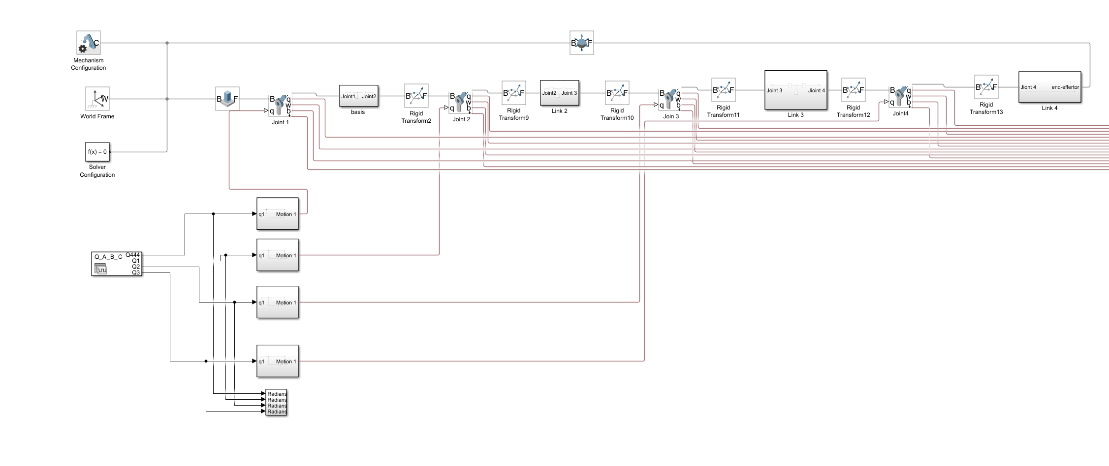
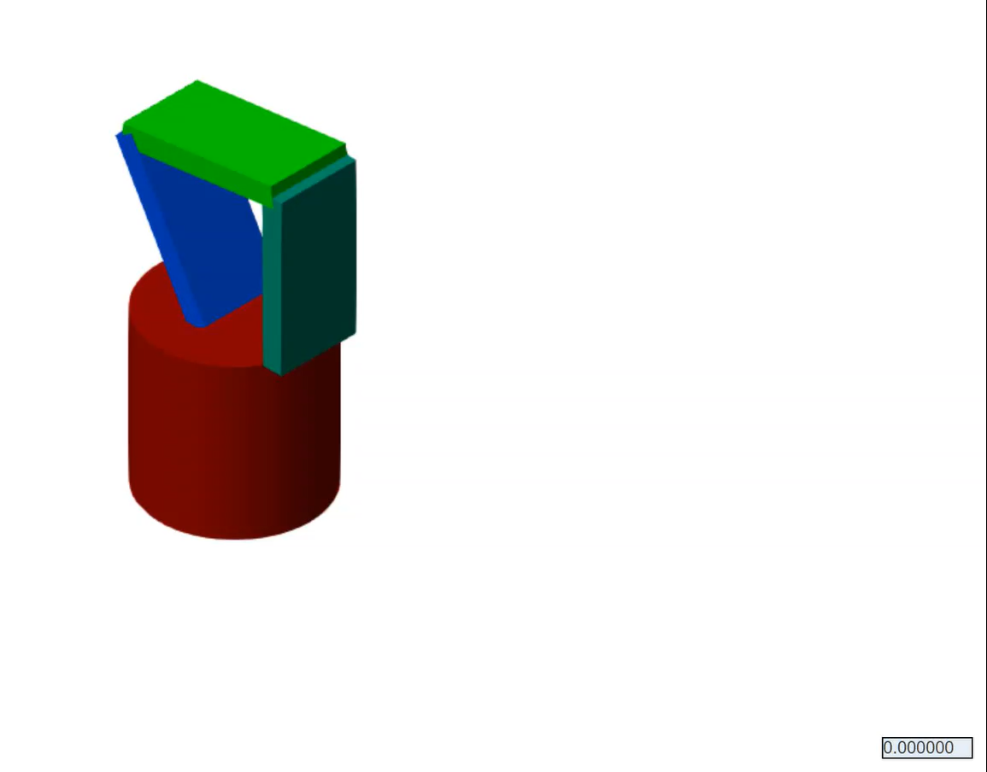
Simscape Multibody Validation
• Models: Simscape_diret_5.slx

Slide 15
Results
• Kinematic and torque plots: plotAll.m
• Link visualization: PlotAnthro4LOG.m
• MATLAB vs Simscape agreement

Slide 16
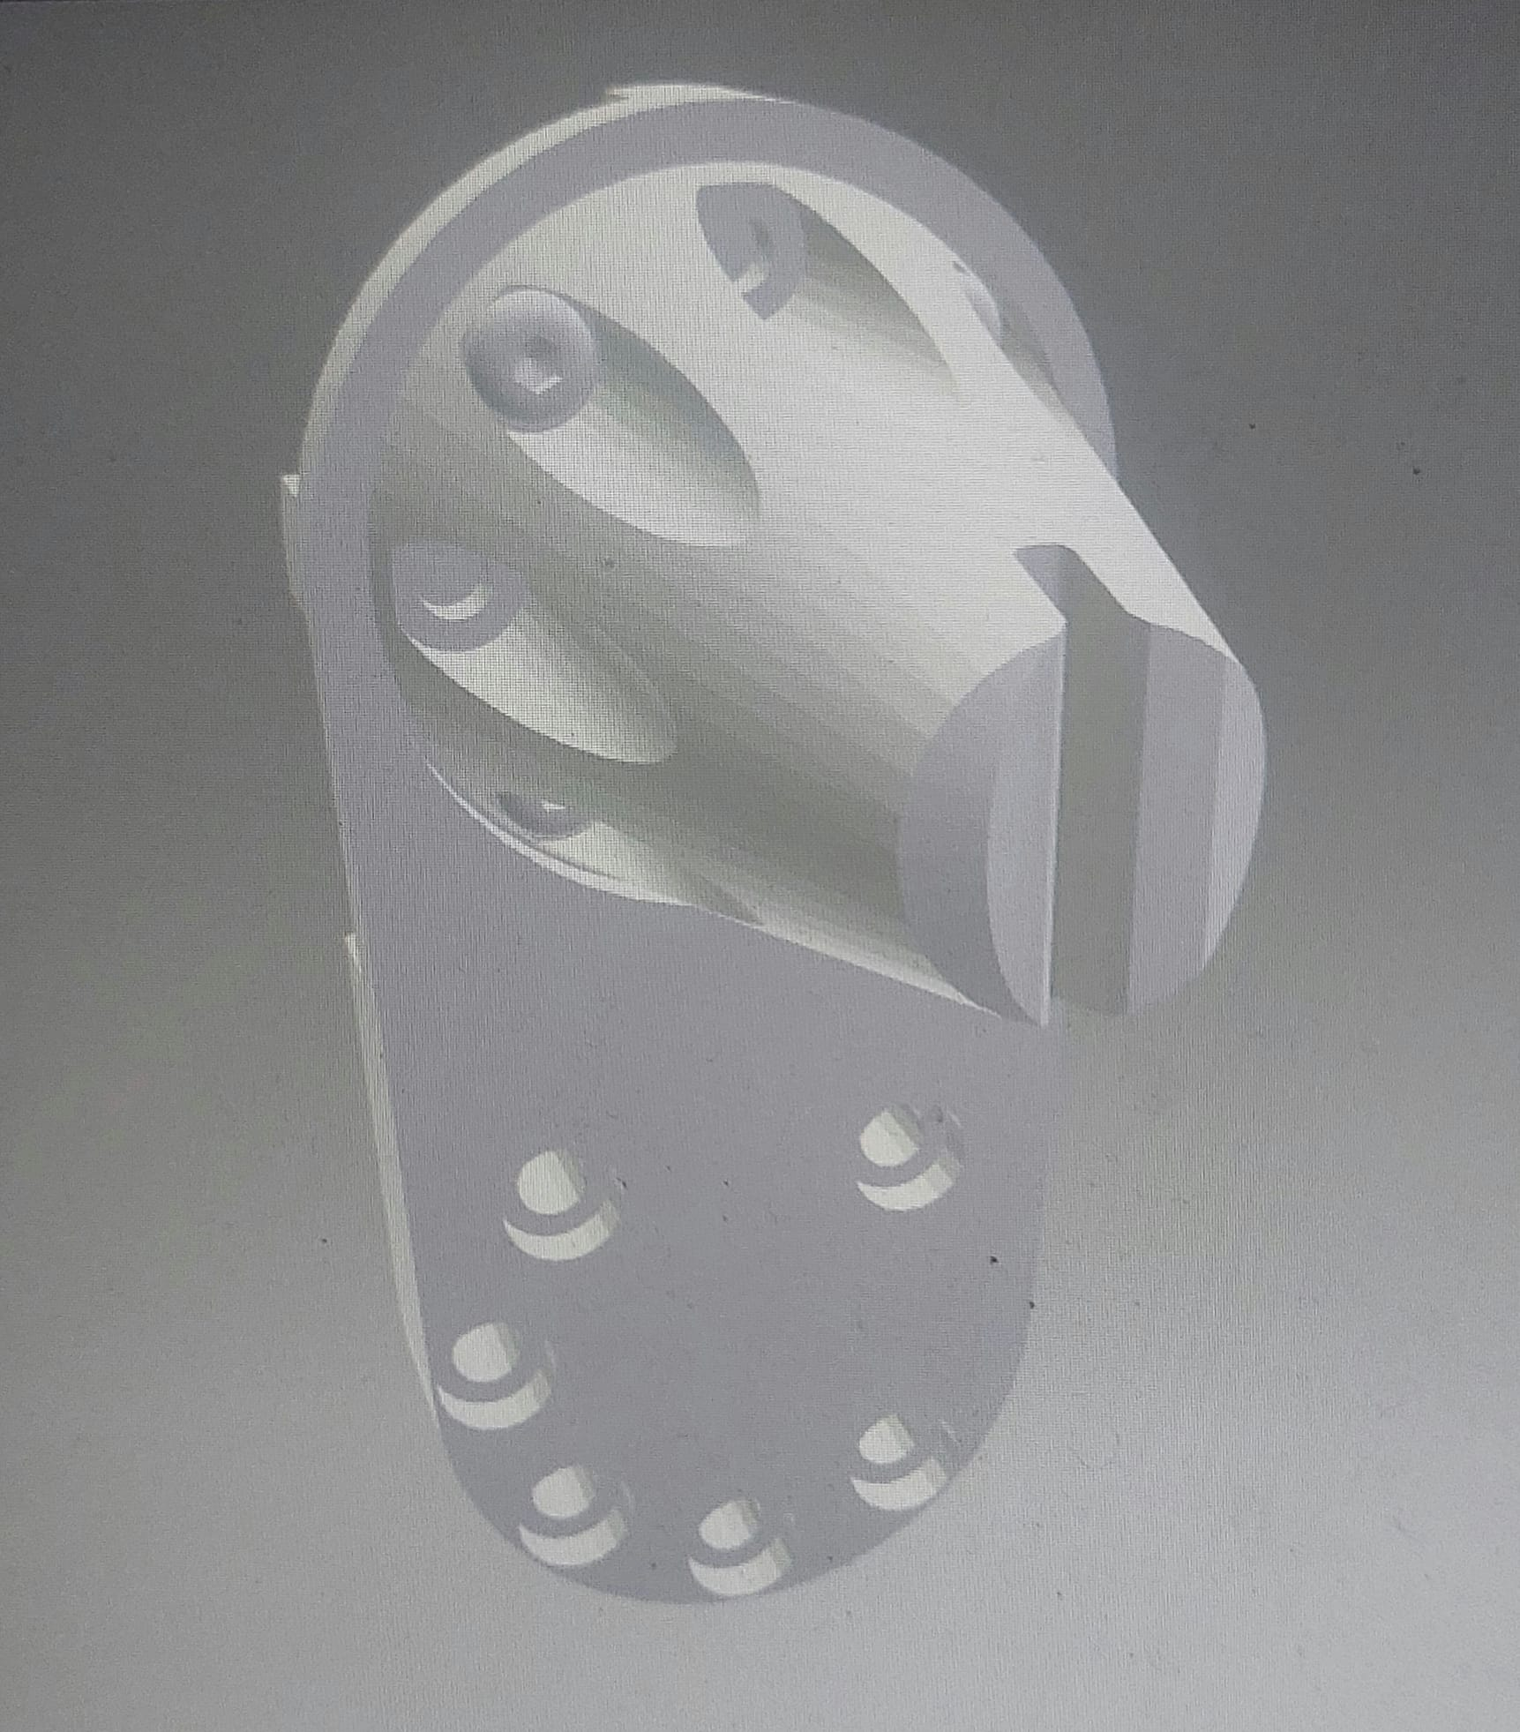
EOAT Design
• Passive end-effector
• 3D-printable design
• Suitable for durability tests

Slide 17
Conclusions
• project requirements satisfied
• Validated analytical and simulation models
• Basis for real robot implementation

Slide 18


ThaNK YOU FOR YOUR ATTENTION

