Slide 1
ISM 6404 - Intro to Business Analytics & Big Data Spring 2025 FINAL PROJECT PRESENTATION Uncovering Patterns in U.S. Homicide Data
Submitted By:
Pahuldeep Singh Dhingra
Krishna Sanjay Vaddi
David Louis

Slide 2

INTRODUCTION
Purpose: Analyze U.S. homicide data to uncover trends for public policy and safety.
Dataset: Murder Accountability Project’s SHR (1965–2023) with 874,958 cleaned records.
Tool Used: Power BI for interactive dashboards and data-driven storytelling.
Dashboards:
1. Homicide Trends Over Time
2. Geographic & Circumstantial Insights
3. Victim & Offender Demographics

Slide 3
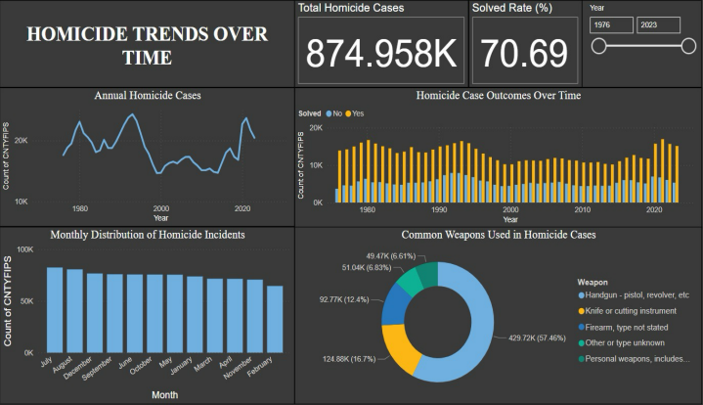
DASHBOARD 1 – Homicide Trends Over Time
Key Insights:
Decline since 1990s peak
Stable solved rate (~70%)
Summer spike in violence
Handguns used in ~47% cases

Slide 4
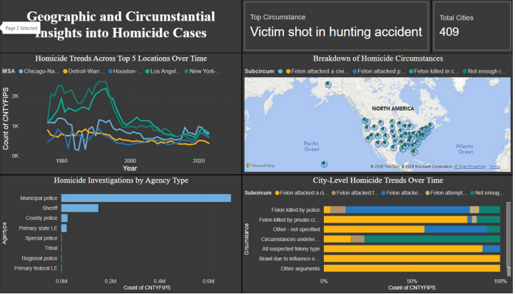
Dashboard 2 – Geographic & Circumstantial Insights
Key Insights:
Major cities show sharp decline since 1990s.
Municipal police solve majority of cases.
Some cities show lower police use of force.
High rates of felon-related homicides remain a challenge.

Slide 5
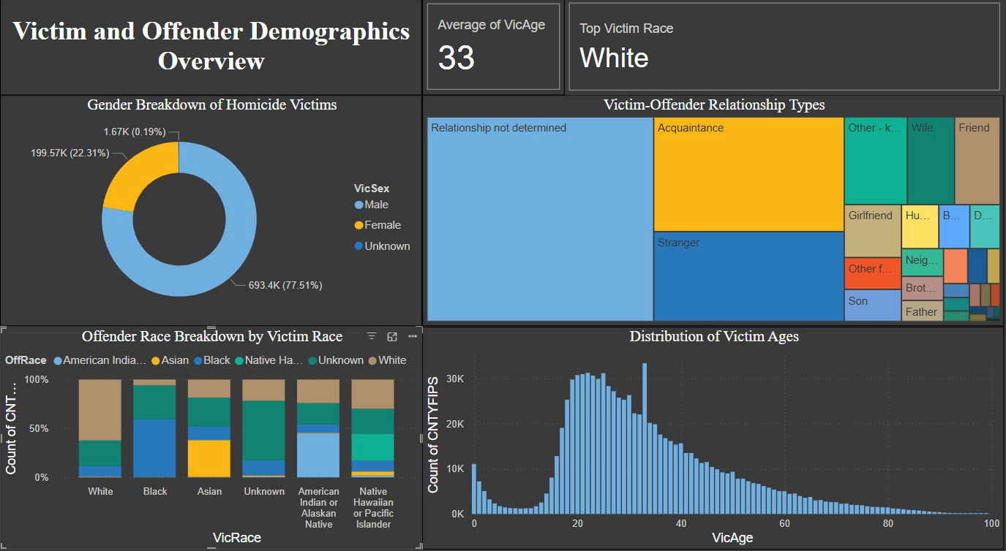
DASHBOARD 3 – VICTIM & OFFENDER DEMOGRAPHICS
Key Insights:
77.5% of victims are male.
Most victims knew their offender.
Young adults (20–40) most affected.
Gaps in relationship data remain.

Slide 6
CONCLUSION
Homicide rates have declined since the 1990s peak.
Municipal police play a key role in investigations.
Young males and summer months pose higher risks.
Reliable data enables informed policy and policing.
Recommendation: Focus on targeted interventions and continue leveraging data analytics.

