Slide 1

PathVis
An Interactive Pathfinding & Maze-Generation Visualizer
Pahulmeet Singh
Registration No. 12406443
B.Tech Computer Science & Engineering
Guide: Ms. Prerita Agarwal | CSES001 | Lovely Professional University
Notes:
Good [morning/afternoon]. My name is Pahulmeet Singh, registration number 12406443. Today I'll be presenting PathVis, an interactive pathfinding and maze-generation visualizer, built as my project for CSES001 under the guidance of Ms. Prerita Agarwal.

Slide 3
What We'll Cover
1
Problem Statement & Objectives
5
Algorithms Implemented
2
Scope of the Project
6
Maze Generation Approach
3
System Architecture
7
Testing & Results
4
Technology Stack
8
Limitations & Future Scope
A quick note before we start: I'm walking through this in order, but happy to jump to any section if you'd like to go deeper.
2
Notes:
Here's the roadmap — I'll go through the problem and objectives, the scope, how the system is architected, the tech stack, the algorithms, maze generation, testing and results, and finish with limitations and future work. Say this steadily; you don't need to elaborate on each point yet, just name them.

Slide 4

Problem Statement
Pathfinding algorithms are usually taught through static pseudocode and hand-traced diagrams.
A student can correctly say “A* visits fewer nodes than Dijkstra” as an exam fact — without ever having watched the two algorithms diverge on the same input.
PathVis turns that abstract claim into a visible, repeatable experiment.
From memorised fact
to observed behaviour
3
Notes:
The motivation is simple: pathfinding algorithms are normally taught on paper. You can memorise that A star explores fewer nodes than Dijkstra without ever seeing it happen. PathVis makes that a live, watchable experiment instead of a fact you take on faith.

Slide 5





Objectives
Four Algorithms, Done Right
Implement BFS, DFS, Dijkstra, and A* correctly and efficiently over a 2D grid graph.
Guaranteed-Solvable Mazes
Two randomized generation algorithms, each structurally guaranteed to produce a fully connected maze.
Animation From Real Control Flow
Every algorithm animates via its own step-by-step logic — not a separately authored replay.
Live Side-by-Side Comparison
Two algorithms run on an identical grid, synced to one clock, so divergence is witnessed directly.
Verified, Not Just Demonstrated
An automated test suite checks the correctness properties a course would expect to be formally proven.
4
Notes:
Five objectives: implement the four algorithms correctly, guarantee mazes are always solvable by construction, make the animation a genuine reflection of the algorithm's own logic rather than a fake replay, support live side-by-side comparison, and back all of it with automated verification.

Slide 6


Scope
In Scope
Out of Scope
Grid-based maze generation (2 algorithms)
User accounts, backend server, persistence
Manual wall drawing + draggable start/end
3D or non-grid-based mazes
4 animated pathfinding algorithms
A dedicated native mobile app
Side-by-side comparison mode
Live stats + adjustable speed & grid size
5
Notes:
Scope was deliberately bounded: in scope is everything about maze generation, editing, four animated algorithms, comparison mode, and live stats. Out of scope, on purpose: no accounts or backend, no 3D mazes, no native mobile app — it's a pure client-side single-page tool.

Slide 7
System Architecture
Pure logic is fully isolated from the React presentation layer.
App.tsx
Grid
Instrument
Control
Panel
Stats
Panel
Comparison
View
hooks/ — useGridEditor · useSolver · useMazeGenerator
lib/grid/
lib/algorithms/
lib/mazeGen/
Grid, neighbor logic, immutable edits
BFS, DFS, Dijkstra, A* (generator fns)
Randomized DFS, Randomized Prim's
Zero React imports in any of the three lib/ modules — each is independently unit-testable.
6
Notes:
The architecture is layered: App.tsx owns top-level state and renders four presentation components. Two custom hooks own all the mutable editing and animation state. Underneath, three completely framework-agnostic lib modules — grid, algorithms, and maze generation — have zero React imports, so they're independently testable and I can show the pathfinding logic without any UI code in the way.

Slide 8

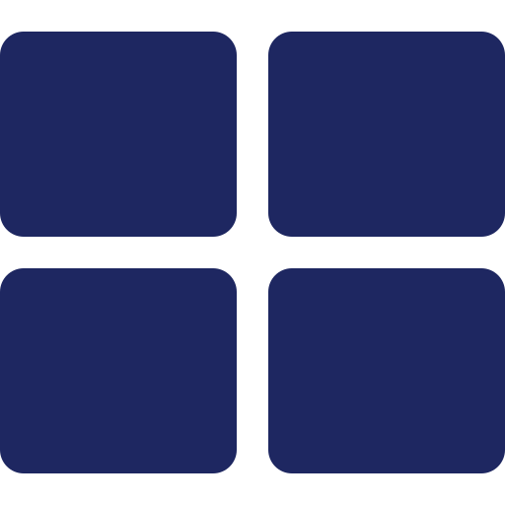


Technology Stack
React 19 + TypeScript
Tailwind CSS v4
HTML5 Canvas
Fast, industry-standard build tooling (Vite)
Utility-first, CSS-native design tokens
Smooth animation at scale vs. DOM nodes
Vitest
Vercel
56 Unit Tests
Native ESM, shares config with Vite
Zero-config static-site deployment
Across 5 files, all passing
7
Notes:
React 19 with TypeScript on Vite for the framework, Tailwind for styling, HTML5 Canvas for rendering — since a 40 by 40 grid can mean well over a thousand cells, Canvas performs better than that many DOM nodes. Vitest for testing since it shares Vite's config, and Vercel for zero-config deployment.

Slide 9
Algorithms at a Glance
Algorithm | Structure | Shortest Path? | Complexity
BFS | Queue | Yes (unweighted) | O(V + E)
DFS | Stack | No | O(V + E)
Dijkstra's | Priority Queue | Yes (weighted) | O((V+E) log V)
A* Search | PQ + Heuristic | Yes (admissible h) | O((V+E) log V)
All four are implemented as generator functions over a shared grid — detailed in the design highlight ahead.
8
Notes:
BFS and Dijkstra both guarantee shortest paths — BFS on unweighted grids by processing cells in order of distance, Dijkstra more generally via a priority queue. DFS makes no such guarantee — it's included deliberately as a contrast. A star adds an admissible heuristic on top of Dijkstra to explore fewer nodes while staying optimal.

Slide 10
Maze Generation
Both algorithms build a spanning tree over the grid — solvability is structural, not validated after the fact.
Randomized DFS
Randomized Prim's
(Recursive Backtracker)
Always extends from the most recently carved room, using an explicit stack.
Selects uniformly at random from the entire growing frontier — not just the latest room.
Produces long, low-branching corridors.
Produces shorter dead ends, more even branching.
9
Notes:
Both maze generators carve passages between rooms on a room-lattice grid, extending an already-connected spanning tree one carve at a time — that's what makes full connectivity a structural guarantee rather than something checked afterward. They differ only in how the next room to carve is picked: DFS always extends the latest room; Prim's picks uniformly from the whole frontier.

Slide 11
Design Highlight
One Generator Function, Three Ways to Run
Every algorithm — pathfinding and maze generation alike — yields one step at a time instead of returning a final answer.
function*
algorithm()
Instant
Animated
Synchronized Comparison
Drained in a tight loop — fastest speed setting.
Stepped via requestAnimationFrame, paced by a time accumulator.
Two generators stepped together in one handler — same-frame, by construction.
10
Notes:
This is the single design decision I'd most want to defend: every algorithm is written as a generator function that yields one step at a time. That one implementation is drained instantly for the fastest speed, stepped via requestAnimationFrame for the animated view, or run as two generators stepped together for comparison mode — so the animation can never drift from what the algorithm is actually doing.

Slide 12

Testing & Quality
56
5
100%
Automated Tests
Test Files
Passing
Automated Suite
Manual Checklist
Every property that's pure logic — independent of the DOM or mouse events — is covered by Vitest: maze connectivity, BFS/Dijkstra agreement, A* ≤ Dijkstra, graceful no-path handling.
Browser-dependent behaviour — wall dragging, layout at narrow widths, keyboard focus — is covered by a structured manual checklist instead.
11
Notes:
56 automated tests across 5 files, all passing. I split testing deliberately: anything that's pure logic — maze connectivity, whether BFS and Dijkstra agree, whether A star ever explores more than Dijkstra — is automated. Anything that's genuinely about the browser, like drag interactions, is a documented manual checklist instead, rather than pulling in a DOM-simulation library just to approximate what I can directly observe.

Slide 13
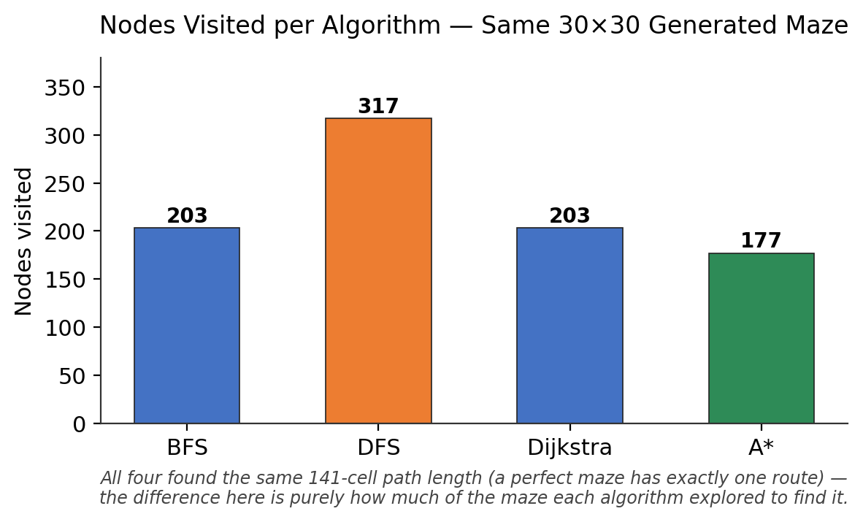
Results: Algorithm Comparison
Same 30×30 generated maze, identical start and end, all four algorithms.
All 4 found the same 141-cell path — a maze is a spanning tree, so there's only one route to find.
They differ only in how much they explored on the way there:
A*
177 nodes — fewest
BFS / Dijkstra
203 nodes — tied
DFS
317 nodes — most
12
Notes:
On an identical maze, all four algorithms returned the exact same path length — that's expected, since a maze built by these generators is a spanning tree with exactly one route between any two points. What differs is how much each algorithm explored to find it: A star visited the fewest nodes at 177, BFS and Dijkstra tied at 203 as expected on a uniformly-weighted grid, and DFS visited the most at 317, consistent with it having no distance-guided exploration.

Slide 14
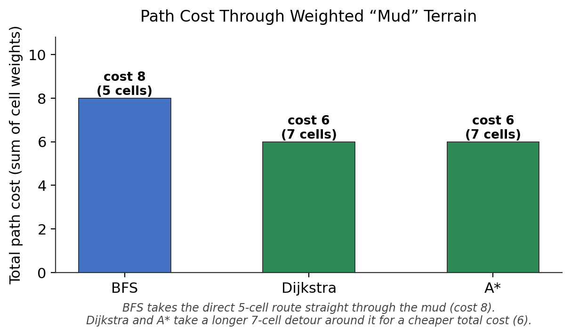
Results: Weighted Terrain
A small open grid with one weighted “mud” cell directly on the shortest route.
BFS has no concept of weight — it drives straight through the mud at cost 8.
Dijkstra & A* both route around it for a lower total cost of 6.
This is the behavioural divergence weighted terrain was built to make visible.
13
Notes:
A maze can't show this divergence, since it only has one route. So I built a separate small open-grid test with a weighted mud cell placed deliberately on the shortest path. BFS, which has no concept of edge weight, drives straight through the mud for a cost of 8. Dijkstra and A star both take a slightly longer route around it for a lower total cost of 6 — this is exactly the behaviour the mud terrain feature was designed to make visible.

Slide 15
Key Takeaways
BFS and Dijkstra agree exactly on unweighted grids — verified, not assumed.
They genuinely diverge once weighted terrain is introduced.
A* never explores more nodes than Dijkstra, while finding an equally optimal path.
Every claim above is checked by the automated suite across randomized inputs — not only the single runs charted here.
14
Notes:
So, stepping back: BFS and Dijkstra provably agree on unweighted grids, they genuinely diverge once weight enters the picture, A star is never worse than Dijkstra in nodes explored while staying just as optimal, and none of this rests on a single cherry-picked run — it's backed by the automated suite across randomized inputs.

Slide 16

Limitations
Stated plainly, not glossed over.
Performance designed for, not yet profiled
40×40 grid animation was engineered for — Canvas rendering, O(1) overlay lookups — but not directly measured for frame rate.
No diagonal movement
Only 4-directional; heuristic is Manhattan distance only.
No persistence
A generated or hand-edited maze can't be saved across sessions — a deliberate scope decision.
15
Notes:
Three limitations worth naming directly. First, the 40 by 40 grid performance target was designed for — Canvas rendering, O(1) overlay lookups — but I haven't directly profiled frame rate to confirm it holds at that size. Second, no diagonal movement. Third, no persistence — that one was a deliberate scope decision, not an oversight.

Slide 17

Future Enhancements
Identified during specification, deliberately deferred — not required for the core deliverable.
Save & load custom mazes via browser local storage
Export a completed run as a shareable animated GIF
Add Greedy Best-First Search to contrast against A*
8-directional movement (Chebyshev / Euclidean heuristic)
16
Notes:
Four extensions I identified but deliberately deferred since they weren't required for the core deliverable: saving and loading mazes, exporting a run as a GIF, adding Greedy Best-First Search specifically to contrast against A star's behaviour, and 8-directional movement, which would need switching the heuristic to Chebyshev or Euclidean to stay admissible.

Slide 18
Conclusion
PathVis set out to make pathfinding behaviour observable, not just memorised — and every algorithm, every animation, and every comparison in it is backed by an automated test, not just a demo.
56 tests · 4 algorithms · 2 maze generators · 1 shared design pattern
17
Notes:
To conclude: PathVis set out to make pathfinding behaviour something you observe rather than memorise, and I'd argue it does that — every algorithm, every animation, and every comparison is backed by an automated test, not just a live demo. That's the project in one line.

Slide 19
Thank You
Questions & Discussion
18
Notes:
Thank you — happy to take questions.

