Slide 1
Exact Values of Trigonometric Ratios
© P. A. Hunt

Slide 2
Lesson Objectives:
To be able to deduce trig. ratios of 30, 45 and 60 degrees respectively.
To know the relationships sin θ = cos (90-θ) and cos θ = sin(90-θ).
To be able to write trig. ratios as trig. ratios of acute angles.
To understand what is meant by ‘odd functions’ and ‘even functions’.

Slide 3
Recall These Exact Values?
 | 0 | 90 | 180 | 270 | 360
Sin | 0 | 1 | 0 | -1 | 0
Cos | 1 | 0 | -1 | 0 | 1
Tan | 0 | undefined | 0 | undefined | 0
Click for
answer
Click for
answer
Click for
answer
Click for
answer
Click for
answer
Click for
answer
Click for
answer
Click for
answer
Click for
answer
Click for
answer
Click for
answer
Click for
answer
Click for
answer
Click for
answer
Click for
answer

Slide 4
Exact Values of Trig. Ratios
Draw an equilateral triangle of side length 2.
Draw a square of side length 1.
1
2
2
1
1
2
1
Cut each shape in half as shown:

Slide 5
Exact Values of Trig. Ratios
1
2
2
1
1
2
1
Now draw the shaded triangles separately and label all sides and angles.

Slide 6
Exact Values of Trig. Ratios
2
1
1
1
Finally, use the triangles to deduce the values of:
Click for
answer
Click for
answer
Click for
answer
Click for
answer
Click for
answer
Click for
answer
Click for
answer
Click for
answer
Click for
answer

Slide 7
A useful relationship
Notice that:
In fact:
and

Slide 8
A useful relationship

Slide 9
The CAST Diagram
Recall
2nd Quadrant
1st Quadrant
90 < θ < 180
0 < θ < 90
Sin > 0
All > 0
Tan > 0
Cos > 0
3rd Quadrant
4th Quadrant
180 < θ < 270
270 < θ < 360

Slide 10
The CAST Diagram
Recall
2nd Quadrant
1st Quadrant
90 < θ < 180
0 < θ < 90
S
A
T
C
3rd Quadrant
4th Quadrant
180 < θ < 270
270 < θ < 360

Slide 11
Example 1
3rd quadrant
sin < 0
S
A
235◦
55◦
T
C

Slide 12
Example 2
2nd quadrant
sin > 0
S
A
135◦
45◦
T
C

Slide 13
Example 3
4th quadrant
tan < 0
S
A
315◦
45◦
T
So just use the ‘associated acute’ angle Φ, and note the sign.
C

Slide 14
Exercise 1
Write as trig. ratios of acute angles, giving the exact value where possible:
Solution
Solution
Solution
Solution
Solution
Solution
Solution
Solution

Slide 15
The CAST Diagram
2nd quadrant
sin > 0
S
A
104◦
76◦
T
C
Back to questions

Slide 16
The CAST Diagram
4th quadrant
cos > 0
S
A
300◦
60◦
T
C
Back to questions

Slide 17
The CAST Diagram
3rd quadrant
tan > 0
S
A
225◦
45◦
T
C
Back to questions

Slide 18
The CAST Diagram
2nd quadrant
tan < 0
S
A
109◦
71◦
T
C
Back to questions

Slide 19
The CAST Diagram
4th quadrant
sin < 0
S
A
315◦
45◦
T
C
Back to questions

Slide 20
The CAST Diagram
1st quadrant
cos > 0
S
A
390◦
30◦
T
C
Back to questions

Slide 21
The CAST Diagram
3rd quadrant
sin < 0
S
A
45◦
135◦
C
T
Back to questions

Slide 22
The CAST Diagram
2nd quadrant
tan < 0
S
A
1230◦
30◦
T
C
Back to questions

Slide 23
Exercise 2
Write as trig. ratios of acute angles (where θ is acute)
Solutions
Solutions
Solutions
Solutions
Solutions

Slide 24
3rd quadrant
sin < 0
cos < 0
tan > 0
S
A
(180+θ)◦
θ◦
T
C
Back to questions

Slide 25
1st quadrant
sin > 0
cos > 0
tan > 0
S
A
(360+θ)◦
θ◦
T
C
Back to questions

Slide 26
2nd quadrant
sin > 0
cos < 0
tan < 0
S
A
(180-θ)◦
θ◦
T
C
Back to questions

Slide 27
4th quadrant
sin < 0
cos > 0
tan < 0
S
A
(360-θ)◦
θ◦
T
C
Back to questions

Slide 28
4th quadrant
sin < 0
cos > 0
tan < 0
S
S
A
A
θ◦
C
T
C
T
Back to questions

Slide 29
Odd and Even Functions
A function is even if
A function is odd if
Sin is an odd function.
Cos is an even function.
Tan is an odd function.

Slide 30
A function is even if
A function is odd if
Sin is an odd function.
y = sin θ

Slide 31
A function is even if
A function is odd if
Cos is an even function.
y = cos θ

Slide 32
A function is even if
A function is odd if
Tan is an odd function.
y = tan θ

Slide 33
Exercise 3
Find the exact values of the following, where all angles are given in radians:
Solution
Solution
Solution
Solution
Solution

Slide 34
The CAST Diagram
2nd quadrant
sin > 0
S
A
T
C
Back to questions

Slide 35
The CAST Diagram
2nd quadrant
tan < 0
S
A
T
C
Back to questions

Slide 36
The CAST Diagram
4th quadrant
cos > 0
S
A
T
C
Back to questions

Slide 37
Note:
we could simply have used the fact that COS is an EVEN function!
Back to questions

Slide 38
The CAST Diagram
2nd quadrant
tan < 0
S
A
T
C
Back to questions

Slide 39
Back to questions

Slide 40
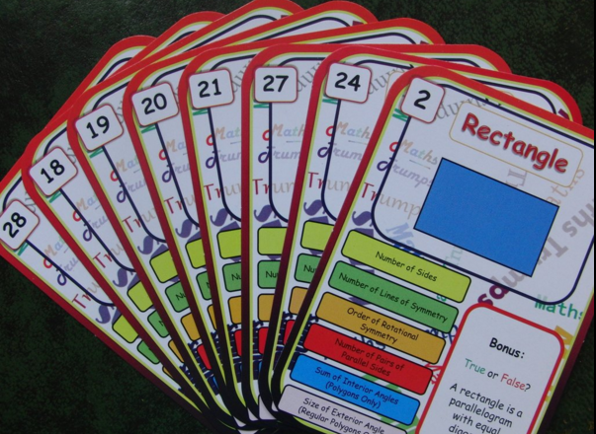
Maths Trumps!
Learn Maths the Fun Way With This Brilliant Educational Card Game
Have you tried…
"A great resource for teachers to review work done on 2D shapes, and also really useful for parents to play with the their children at home. Ideal for 11-16 year olds. I am looking forward to more of these on different topics.”
http://mathstrumps.weebly.com

