Slide 1


HR - ANALYTICS
Group_1_Team Members
1) Susmita Pahurkar 4) Nikhil Bangar
2) Prashantkumar Munje 5) Aliasghar Hasan
3)Kalyani Mali 6) Pranali Jadhav
Project P – 416
Mentor : Lakshmi Sirisha Pamidipati

Slide 2
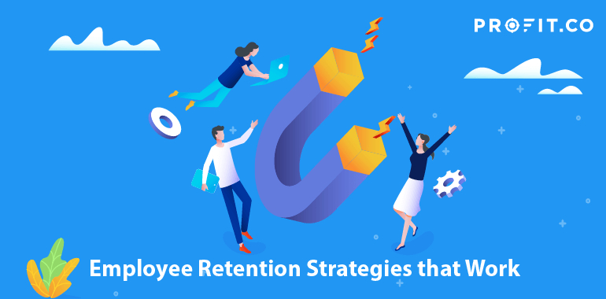
INDEX
Introduction
Problem Statement
Objectives
KPI
Dashboards
Results of Finding
Conclusion

Slide 3
INTRODUCTION
HR analytics involves the collection and analysis of HR-related data, including employee data, performance metrics, and other relevant data points like attrition, hourly rate, work life balance. By using advanced analytical tools and techniques, HR analytics provides valuable insights into HR processes and trends, enabling organizations to make more informed decisions about their employees and improve overall performance.

Slide 4
PROBLEM STATEMENT
Average attrition rate for all Departments
Average hourly rate of Male Research Scientist
Attrition rate Vs Monthly Income stats
Average working years for each Department
Job role Vs Work life balance
Attrition rate Vs Years Since last promotion

Slide 5
OBJECTIVES
The aim of this project is to analyze employee retention and attrition rates with the organization and provide insights to the HR team for developing effective retention strategies. Through data analysis and visualizations, we will identify factors that contribute to :
Employee turnover and attrition.
Evaluate the effectiveness of existing retention strategies.
To verify the satisfaction level of employee in the organization.
Provide recommendations to improve employee retention.

Slide 6
KPI 1 Average Attrition rate for all Departments
This KPI is to find out the
relationship between each
department and its attrition rate and here attrition rate is highest for Research & Development Department whereas lowest is for Hardware Department.

Slide 7
KPI 2 Average Hourly rate of Male Research Scientist
This KPI is to find out the average hourly rate of male research scientists which is 114.45.

Slide 8
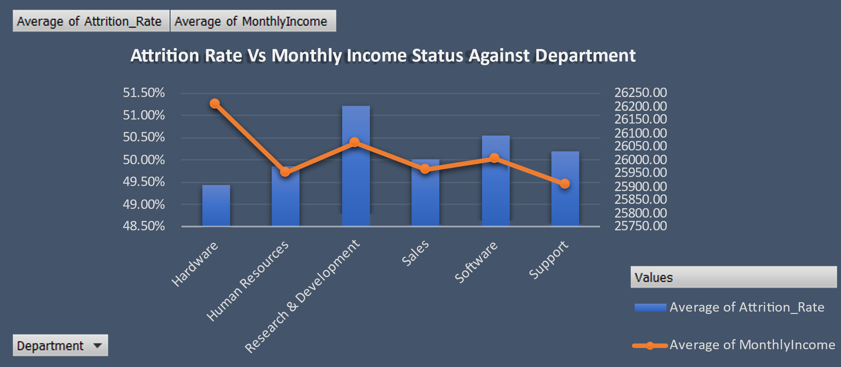
KPI 3 Attrition Rate Vs Monthly Income Stats
This KPI is to find out the relation the between monthly income and Attrition rate.

Slide 9
KPI 4 Average Working Years for each Department
In this KPI we can see the average working years in software department is high as compared to the rest of the departments and lowest is for Research & Development Department.

Slide 10
KPI 5 Job Role Vs Work Life Balance for Total Employees
From the analysis we can conclude that,
For Research directors and the laboratory technicians the work life balance is poor.
For human resources the work life balance is excellent.
Remaining job roles have good work life balance.

Slide 11
KPI 6 Attrition Rate Vs Years Since Last Promotion
In this KPI we can see highest attrition is from 0-5 years since last promotion. While the employees who have not got promoted for more than 20 years they shows more fluctuation the Attrition Rate vs since last year promotion against job role.

Slide 12
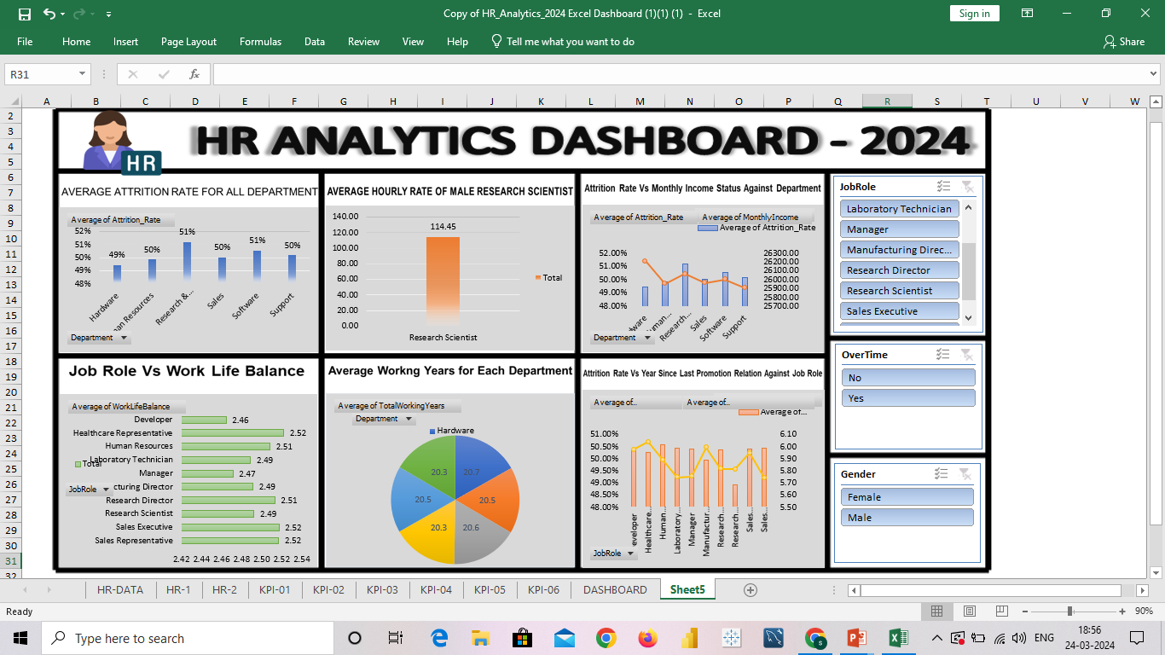
EXCEL DASHBOARD

Slide 13
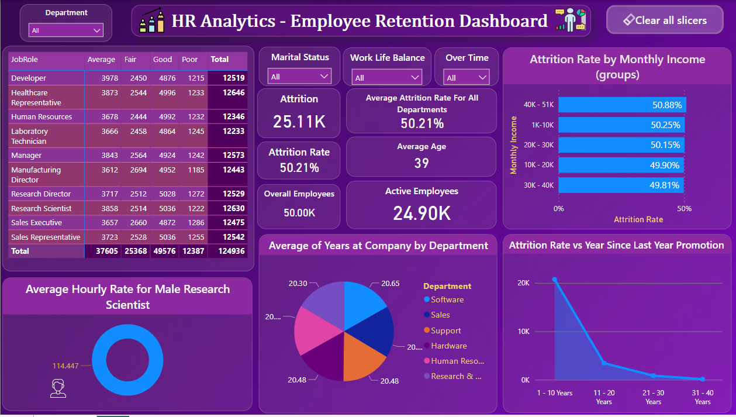
POWERBI DASHBOARD

Slide 14
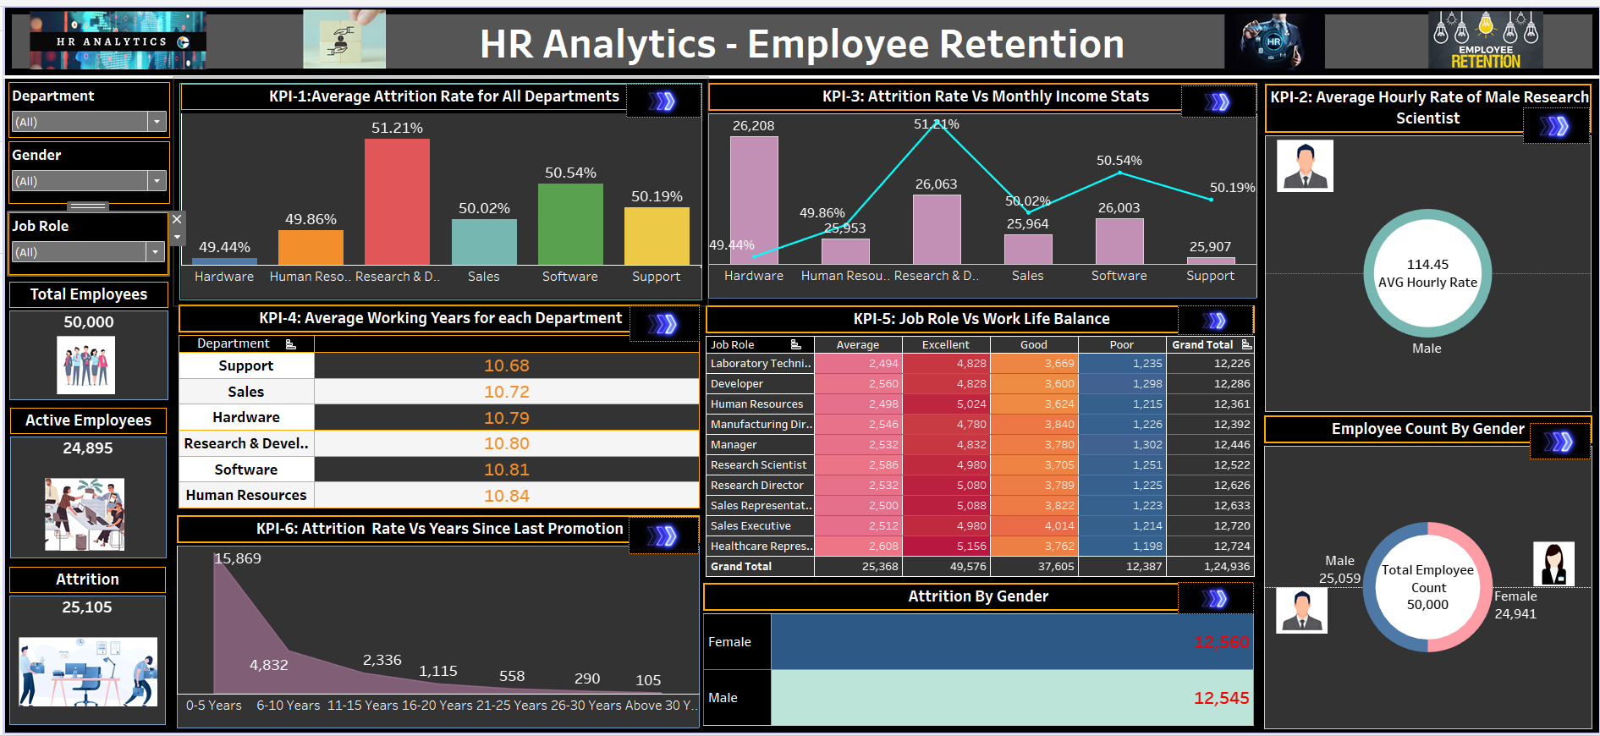
TABLEAU DASHBOARD

Slide 15
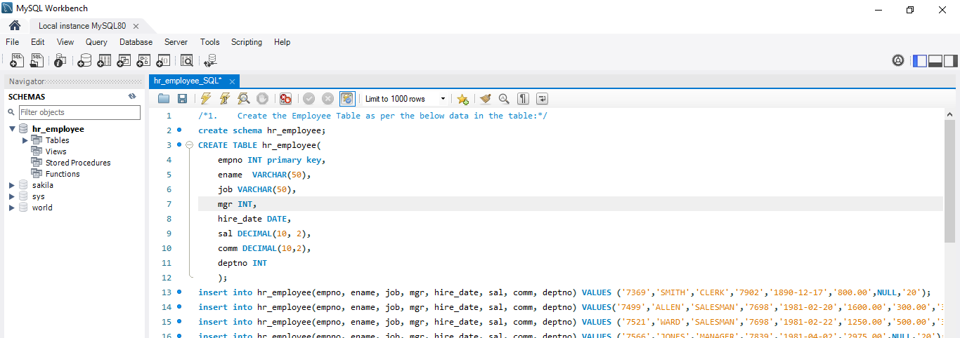
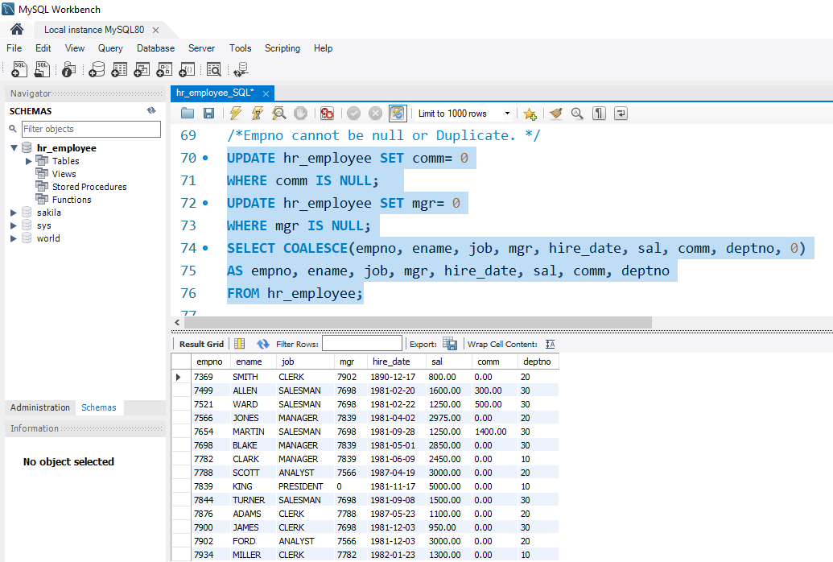
SQL KPI’s
KPI 1: Create the Employee Table as per the below data in the table:-
Output:

Slide 16
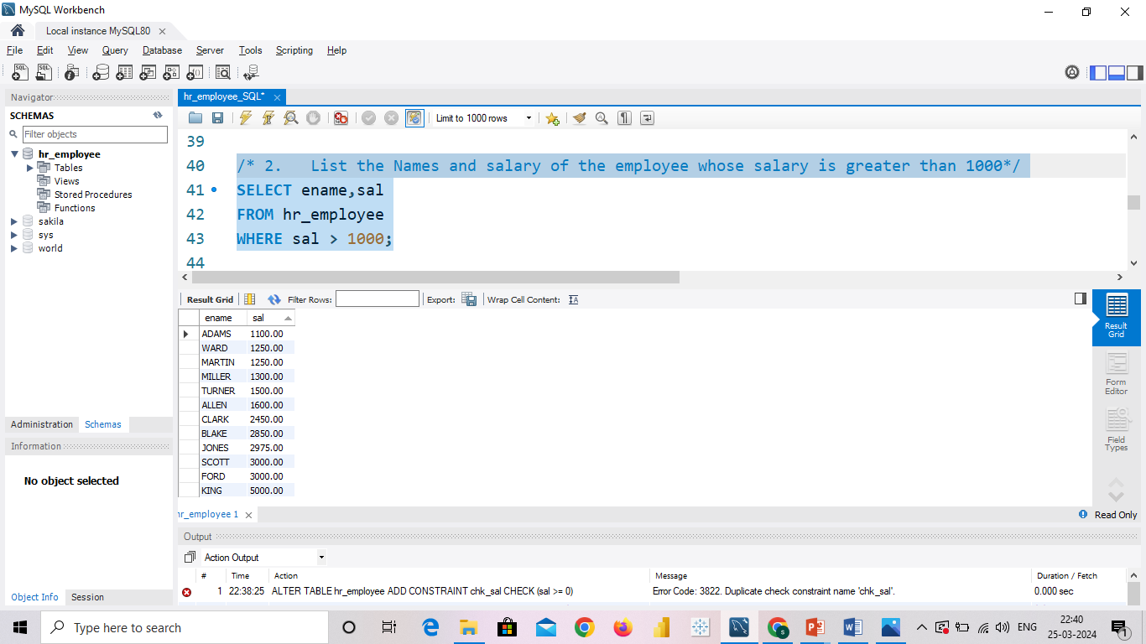
KPI_2: List the Names and salary of the employee whose salary is greater than 1000.
OUTPUT:

Slide 17
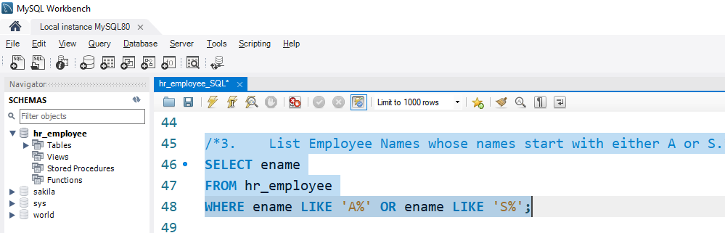
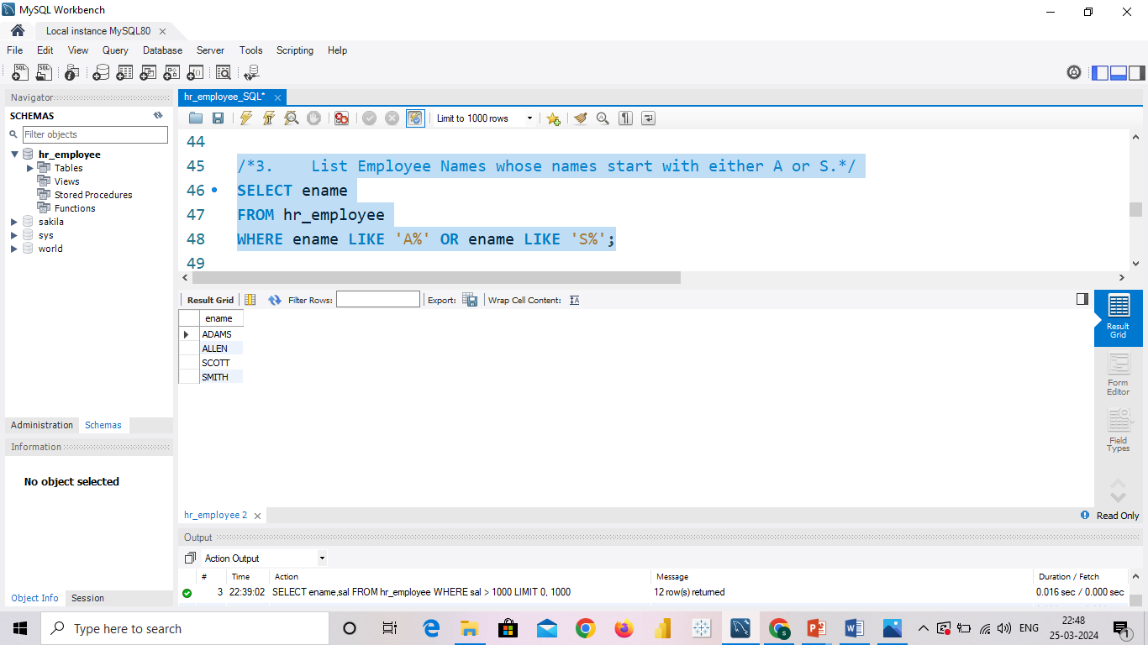
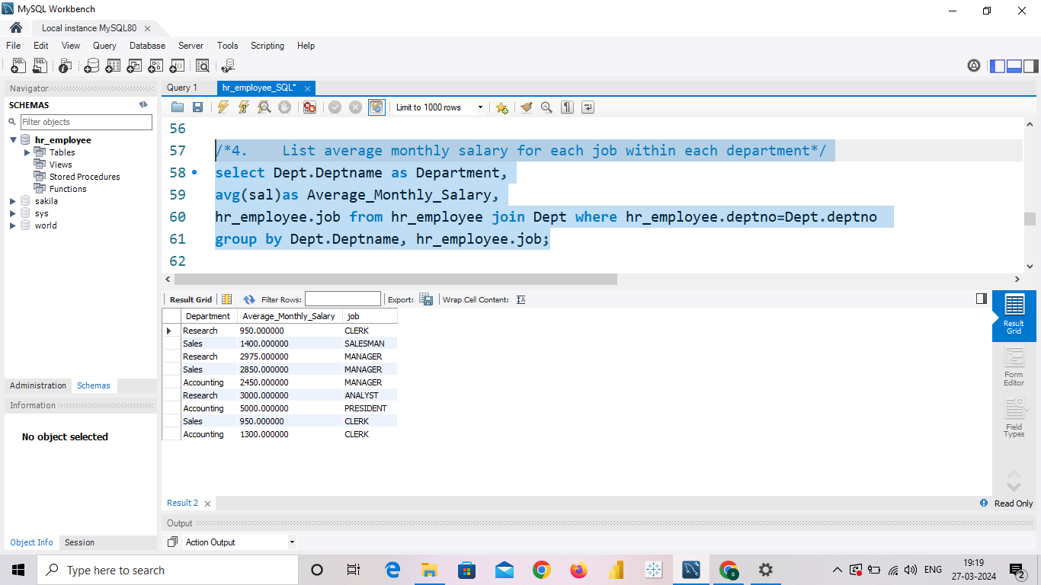
KPI_3: List Employee Names whose names start with either A or S.
OUTPUT:
KPI_4: List average monthly salary for each job within each department
OUTPUT:

Slide 18
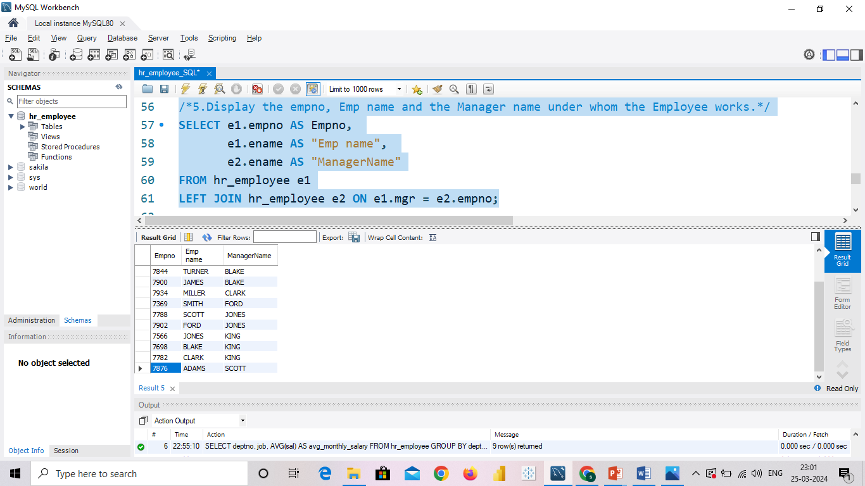
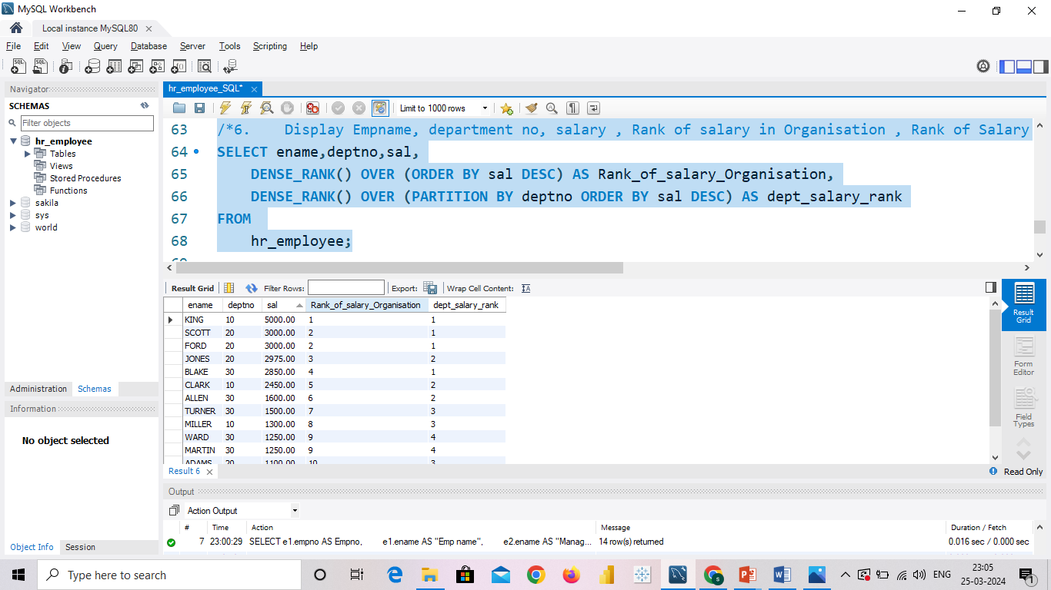
KPI_5: Display the empno, Emp name and the Manager name under whom the Employee works.
OUTPUT:
KPI_6: Display Empname, department no, salary , Rank of salary in Organisation , Rank of Salary in their respective department
OUTPUT:

Slide 19
RESULTS OF FINDING
Research &Development Department has “Highest attrition rate 51.21%” and Hardware Department has a “Lowest attrition with rate 49.44%”.
Minimum Hourly Rate is 30 and Maximum Hourly Rate is 200. AVG Hourly Rate of Male Research Scientist is coming as 114.45 While for Female its 115.93.
Minimum Salary is 1,001 and Maximum Salary is 50,999. Hardware Department has Highest Monthly Income 26,208 and Support Department has Lowest Monthly Income 25,907.
AVG Working year for Human Resources Department is Highest 10.84 and for Support Department its Lowest 10.68.
Laboratory Technician having lowest Work Life Balance and Healthcare Representative having Highest Work Life Balance.
Highest Attrition is from 0-5 years since last promotion. While the employees who have not got promoted for more than 20 years they shows more fluctuation.

Slide 20
Conclusion
Conduct stay interviews: Instead of exit interviews, conduct stay interviews with employees to gather feedback about the job.
Improve employee engagement: Implement initiatives to improve employee engagement, such as regular feedback, recognition and rewards programs, and opportunities for career growth.
Address workload issues: Ensure employees have manageable workloads by regularly monitoring and adjusting workloads to prevent burnout and overwhelm.
Create a positive work environment: Foster a positive work environment by promoting a culture of respect, inclusivity, and teamwork. Encourage open communication and collaboration among employees.
Address pay and compensation issues: Ensure that employees receive fair pay and compensation for their work and to find out what motivates an employee to continue to work in an organization.

Slide 21
THANK YOU …..!!!!

