Slide 1
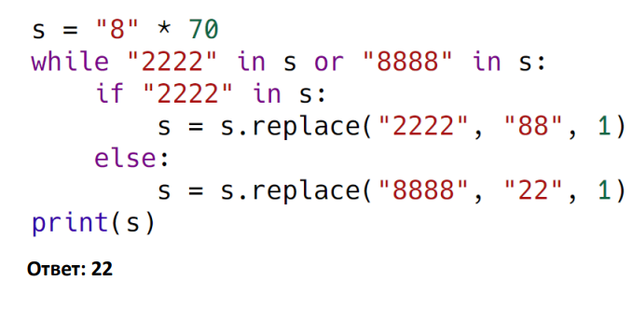
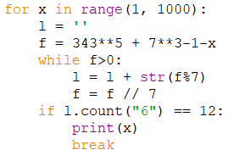
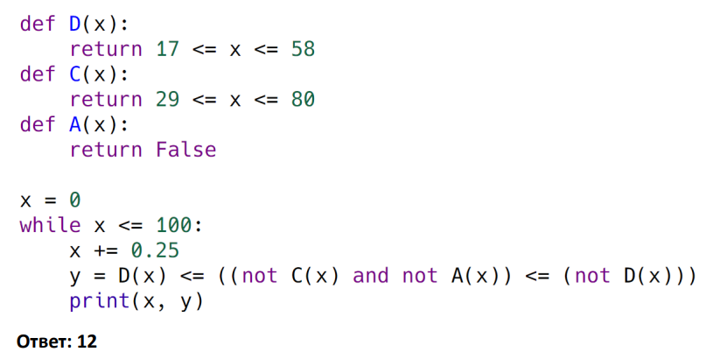
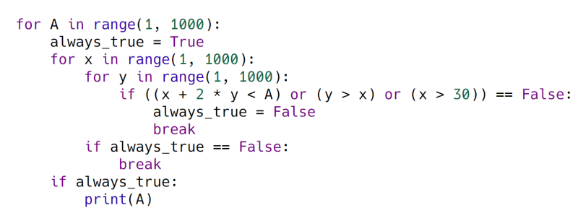
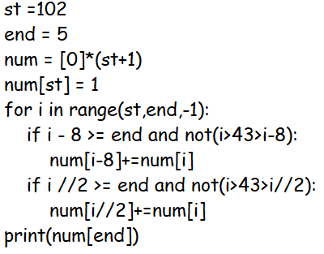

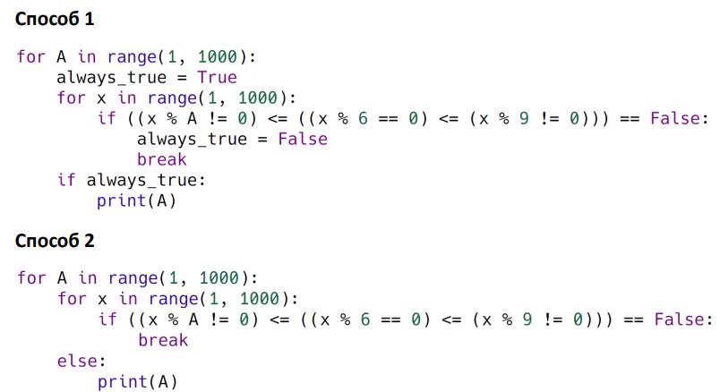
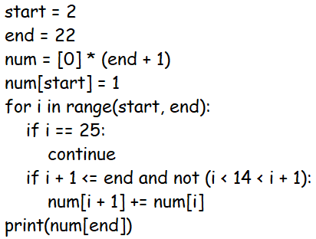

Slide 2
def move1(num):
return [num[0]+1, num[1]]
def move2(num):
return [num[0]*2, num[1]]
def move3(num):
return [num[0], num[1]+1]
def move4(num):
return [num[0], num[1]*2]
def win(num):
s = num[0] + num[1]
return s >= 107
def game20(state_num, num):
if state_num < 3 and win(num):
return False
elif state_num == 3:
return win(num)
if state_num % 2 == 0:
return game20(state_num + 1, move1(num)) or \
game20(state_num + 1, move2(num)) or \
game20(state_num + 1, move3(num)) or \
game20(state_num + 1, move4(num))
else:
return game20(state_num + 1, move1(num)) and \
game20(state_num + 1, move2(num)) and \
game20(state_num + 1, move3(num)) and \
game20(state_num + 1, move4(num))
def game21(state_num, num):
if (state_num == 1 or state_num == 3) and win(num):
return False
elif state_num == 2 and win(num):
return True
elif state_num == 4:
return win(num)
if state_num % 2 == 0:
return game21(state_num + 1, move1(num)) and \
game21(state_num + 1, move2(num)) and \
game21(state_num + 1, move3(num)) and \
game21(state_num + 1, move4(num))
else:
return game21(state_num + 1, move1(num)) or \
game21(state_num + 1, move2(num)) or \
game21(state_num + 1, move3(num)) or \
game21(state_num + 1, move4(num))
print("20:")
for i in range(1, 94):
if game20(0, [13, i]):
print(i)
print("\n21:")
for i in range(1, 94):
if game21(0, [13, i]):
print(i)
f = open("24.txt")
l = f.readline()
f.close()
cnt = 0
maxi = 0
i = 0
while i < len(l):
if (l[i] == "A" or l[i] == "C") and l[i + 1] == "B":
i += 2
cnt += 1
else:
maxi = max(cnt, maxi)
cnt = 0
i += 1
print(maxi)
f = open("24_1.txt", "r")
l = f.read()
i = 0
cnt = 0
maxim = 0
d_cnt = 0
d_pos = 0
while i < len(l):
if l[i] != "D":
cnt += 1
else:
d_cnt += 1
if d_cnt == 1:
d_pos = i
cnt += 1
if d_cnt > 1:
maxim = max(cnt, maxim)
cnt = 0
d_cnt = 0
i = d_pos
i += 1
print(maxim)
f.close()
f = open('24-179.txt', 'r')
l = ''
for line in f:
l += line
f.close()
norm = False
c_cnt = 0
d_cnt = 0
e_cnt = 0
for i in range(0, len(l) - 5):
if l[i] == 'C' and l[i+1] == "B" and (l[i+2] == "C" or l[i+2] == "D" or l[i+2] == "E") and l[i+3] == "B" and l[i+4] == "C":
if l[i+2] == "C":
c_cnt+=1
if l[i+2] == "D":
d_cnt+=1
if l[i+2] == "E":
e_cnt+=1
print("C =", c_cnt, "D =", d_cnt, "E=", e_cnt)
print(c_cnt+d_cnt+e_cnt)

