Slide 1
Side-Project: Single-Cycle MIPS Processor
Overview
RTL simulation analysis: - ADD - SW - LW - BEQ - SUBTRACT - JUMP

Slide 2


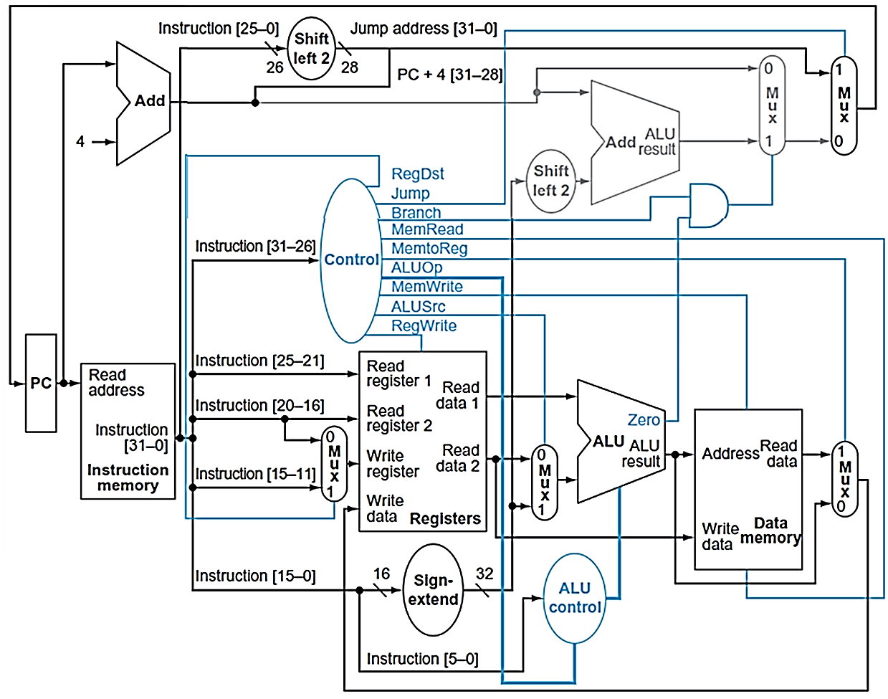


Design Overview
Design based on Computer Organization and Design, Patterson Hennessy
Implementation: https://github.com/Ash-Ran0/single_cycle_MIPS
Notes:
Peripheral Component Interconnect (PCI) is a standard interface for connecting peripheral devices to a computer's motherboard.
PCI 是一種連接電腦主板和外部設備的標準接口
highly integrated peripheral controller components是下面區塊
peripheral add-in cards 例如: audio card, graphic cards是右邊區塊
main functions:
communication: 允許主板與各種硬件設備（如顯卡、網卡、聲卡）之間進行通信。Provides a high-speed data transfer channel.
data transfer: 提供高速的數據傳輸通道。
Architecture and Design
Parallel Bus Architecture: Utilizes a parallel bus for data transmission.

Slide 3
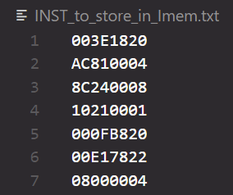
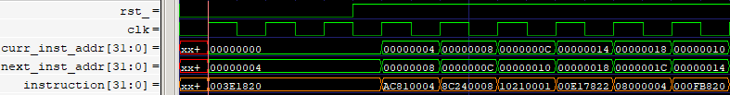

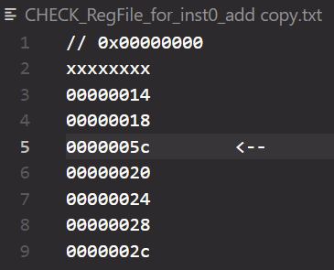
RTL simulation analysis
Testbench: ADD 003E1820 add R3, R1, R30
RegData: R1 =00000014 R30=00000048 ALUresult: 0000005C

Slide 4
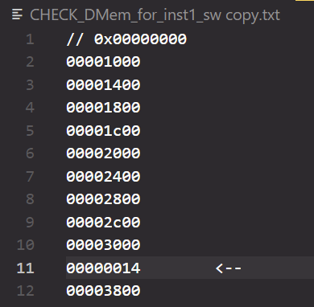


RTL simulation analysis
Testbench: STORE WORD AC810004 sw R1, 4(R4)
RegData: R4 =00000020, R1=00000014 offset: 00000004 target_DMem_addr: 00000024

Slide 5
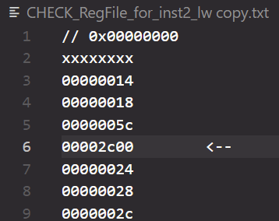


RTL simulation analysis
Testbench: LOAD WORD 8C240008 lw R4, 8(R1)
RegData: R1=00000014 offset: 00000008 target_DMem_addr: 0000001C

Slide 6


RTL simulation analysis
Testbench: BRANCH ON EQUAL 10210001 beq R1, R1, +1
RegData: R1=00000014 offset: 4 (1<<2) next_inst_addr: 00000010 target_inst_addr: 00000014

Slide 7
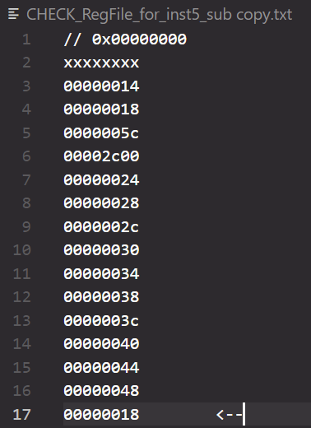


RTL simulation analysis
Testbench: SUBTRACT 00E17822 sub R15, R7, R1
branched
RegData: R7 =0000002C R1 =00000014 ALUresult: 00000018

Slide 8
RTL simulation analysis
Testbench: JUMP 08000004 j +4
jump to
inst_absolute_addr: 26’h4>>2=28’h10

Slide 9
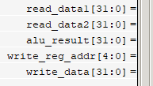
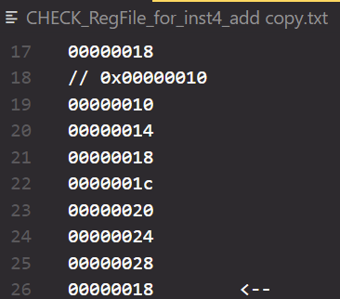
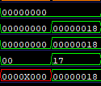
RTL simulation analysis
Testbench: ADD 000FB820 add R23, R0, R15
RegData: R0 = zero register R15= 00000018 ALUresult: 00000018

Slide 10
why can’t we reset memory?
https://electronics.stackexchange.com/questions/209224/how-to-reset-a-memory-array-in-verilog

