Slide 1
Cluster Introduction

Slide 2

About Computer Cluster
History of computer cluster
Computer Cluster Concept
Type of Cluster
How applied Cluster
HPC World

Slide 3

Computer Cluster
Computer cluster is a group of computer to work improve performance and/or availability over a single computer

Slide 4
History Computer Cluster
In late 1993, Donald Becker and Thomas Sterling began sketching the outline of a commodity-based cluster system designed as a cost-effective alternative to large supercomputers.
In early 1994, working at CESDIS under the
sponsorship of the HPCC/ESS project, the
Beowulf Project was started.

Slide 5
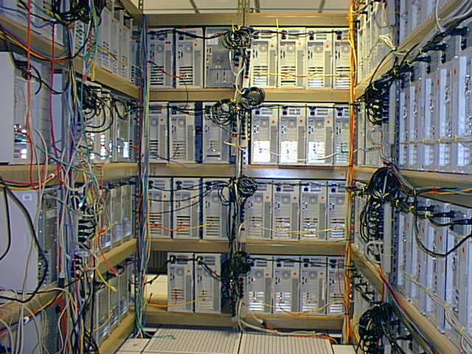


Why do Compute Cluster
One man show not work but Team Work!
  Research
    More complex and more amount data.
    Simulation.
Technical
  Can't scale
    heat problem
    hard to design
    price

Slide 6
Computer Cluster
Computer cluster is a group of computer to work improve performance and/or availability over a single computer

Slide 7
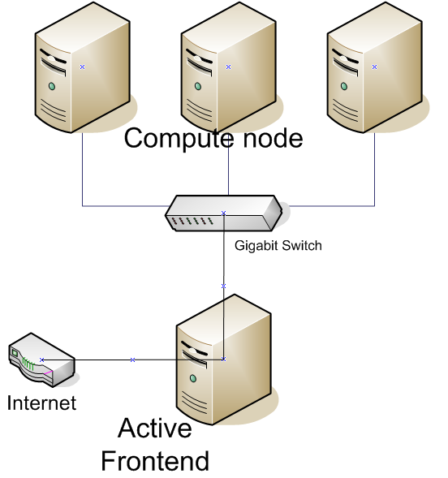
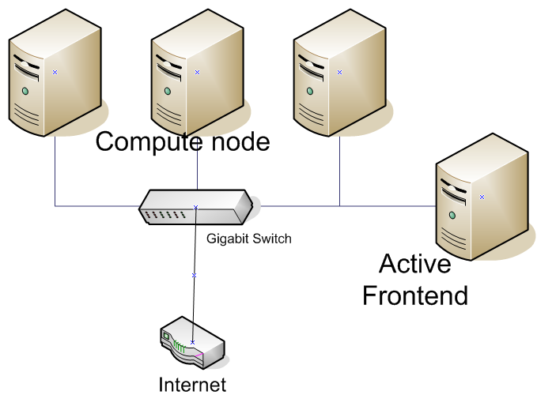

Cluster via connection
Close Cluster
Open Cluster

Slide 8
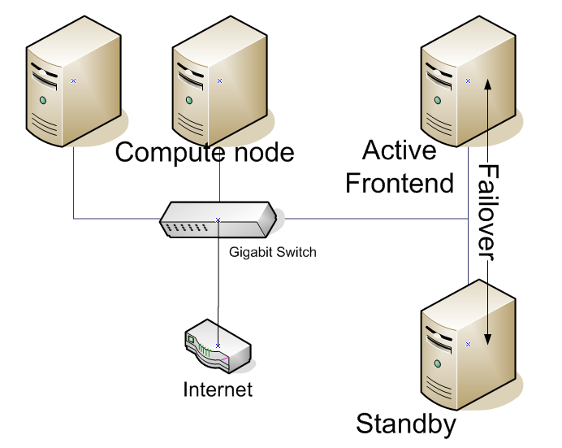
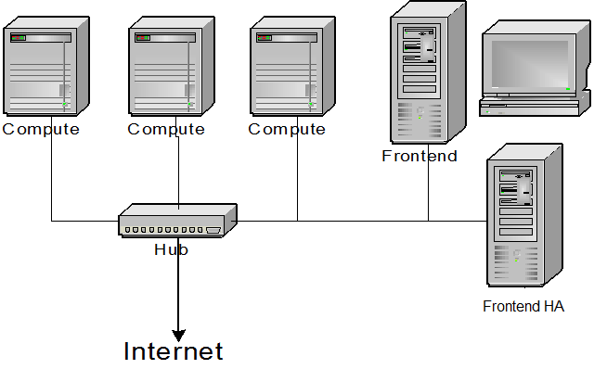

Cluster via usability
High Performance Cluster
High Availability Cluster and Load Balance

Slide 9
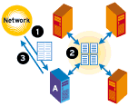
High-performance clustering
Link many computers together to team up and finish problem fasters by having multiple computer working on the same problem independently

Slide 10
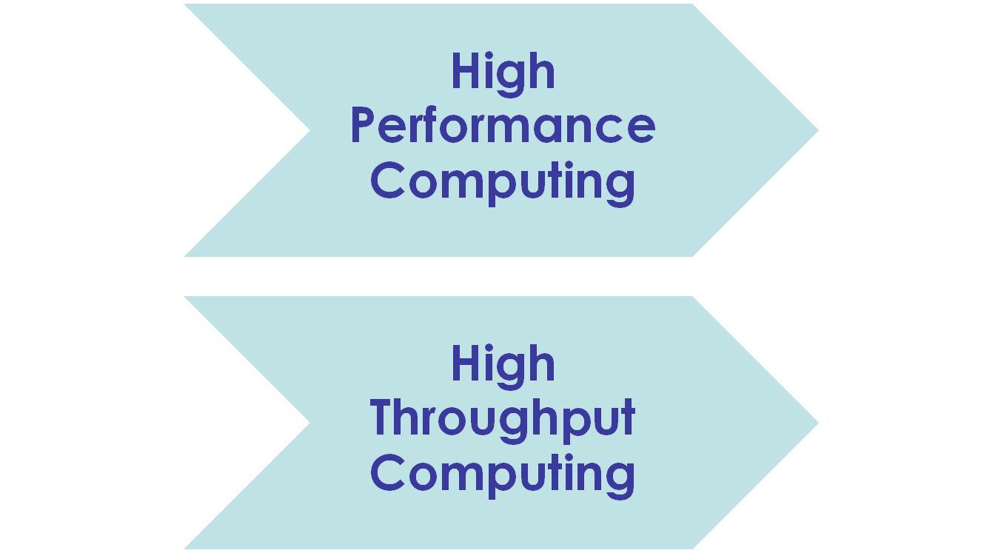
Type of Execution Job

Slide 11
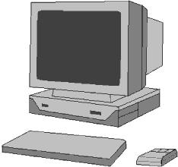
High Performance Computing
Big job
Sub task 1
Sub task 2
Sub task 3
Sub task 4

Slide 12
High Throughout Computing
Jobs Queue

Slide 13
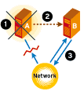
High-availability clustering
Make more reliable computer system by having many computers working together and takeover when any of them fail

Slide 14
Benefit of cluster
Low startup cost
Scalability
Rapid response, technology tracking
More user-driven configuration
Order of magnitude price-performance advantage

Slide 15
How applied to use cluster
High Performance Compute Cluster
High Throughput Compute Cluster
Render farm
HA Server
Load balance server
Cluster database
Web Cluster

Slide 16
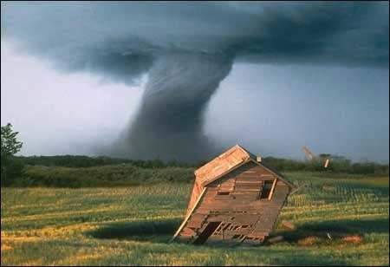
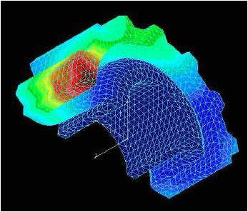
What cluster do ?
Aerodynamics
Air pollution prediction
Bioinformatics
Chemistry
Financial analysis
Graphic Rendering
Oil and gas
Weather prediction
CFD

Slide 17

Avatar Movie
http://www.thesun.co.uk/sol/homepage/showbiz/film/2760950/Avatar-week-in-The-Sun-3D-secrets-behind-the-300m-movie.html

Slide 18
Challenge of Avatar Movie
One frame of certain shots, it's 24 frames per second, took 100 computer hours to render. Just one second was 2,400 hours.
Weta operates a 10,000-square-foot facility that uses HP BL2x220c blades to process the effects for AVATAR and other films. The computing core contains some 40,000 processors and 104 terabytes of RAM.

Slide 19
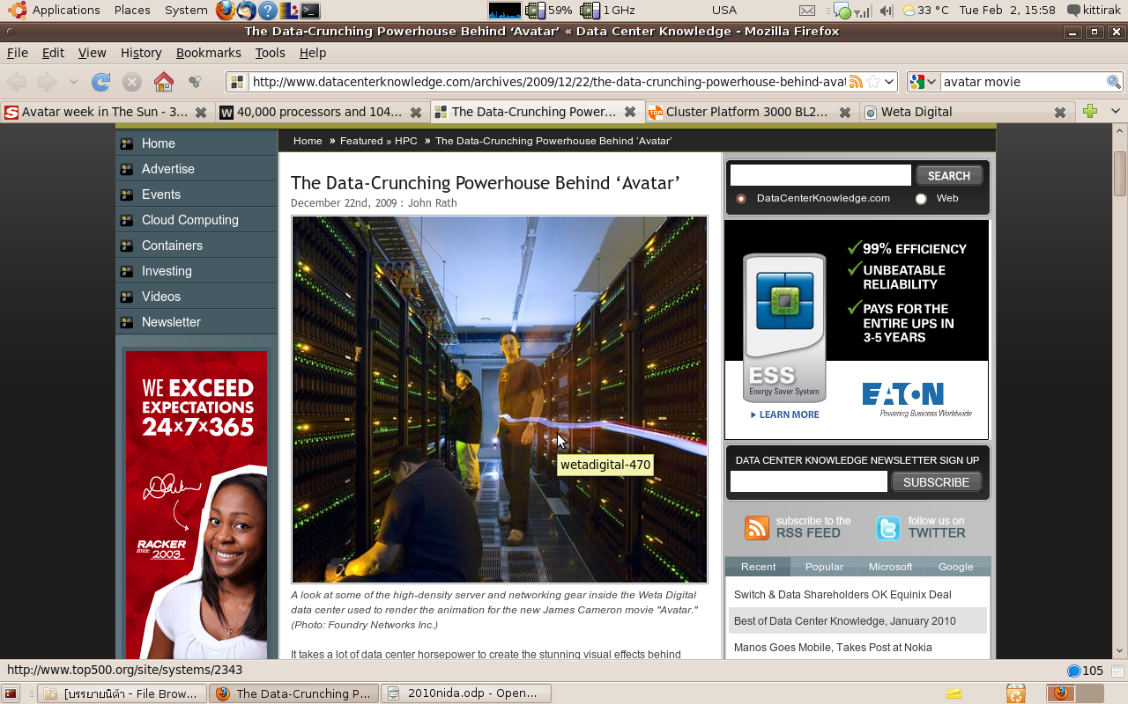
http://www.datacenterknowledge.com/archives/2009/12/22/the-data-crunching-powerhouse-behind-avatar/

Slide 20
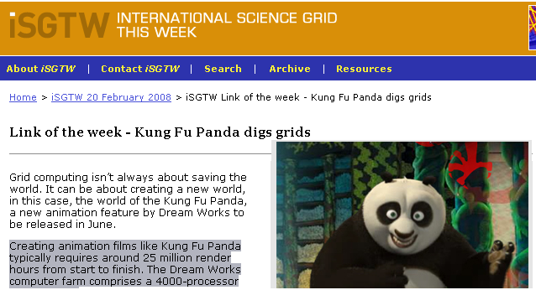
3D Animation

Slide 21
References
Shrek the Third
  http://www.linuxjournal.com/print/9653
Kung Fu Panda digs grids
  http://www.isgtw.org/?pid=1000931
Avatar
  Google Keyword "avatar movie render"

Slide 22
How applied to use cluster
High Performance Compute Cluster
High Throughput Compute Cluster
Render farm
HA Server
Load balance server
Cluster database
Web Cluster

Slide 23
How applied to use cluster
High Performance Compute Cluster
High Throughput Compute Cluster
Render farm
HA Server
Load balance server
Cluster database
Web Cluster

Slide 24
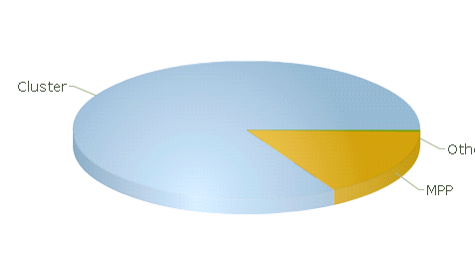
HPC World
Cluster 417 (83.40%)
Constellations 2 (0.40%)
MPP 81 (16.20%)
Data of 11/ 2009
http://www.top500.org/

Slide 25
HPC in Thailand
BIOTEC
  “Eclipse” 704 Cores
  Big Mac 96 Cores
Ramkhamhaeng University
  “Sila” 256 Cores
ThaiGrid
  “Tera” 800 Cores
  Windows cluster 33 nodes
Chula University
  88 processors called PAKSA at Chemical dep.
ThaiHPC Group
  32 nodes * 4 groups
GISTDA
  6 nodes pilot cluster.

Slide 26

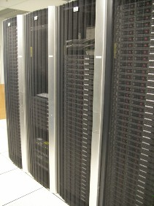
Apply HPC in Thai
Thai National Grid Center
  Tera Cluster
  Machines 200 nodes
has 800 cores
  Used computing the science
and engineering
  Provided Software
    Amber9
    Fluent
    ANSYS CFX

Slide 27

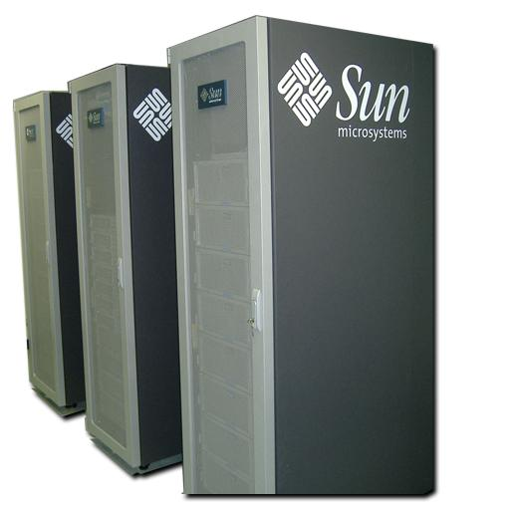
Apply HPC in Thai (cont’d)
Rankhamhaeng University
  Sila Cluster
  Machines 23 nodes
has 286 cores
  Used computing the
science
  Provided Software
    Autodock
    GAMESS
    Guassian

Slide 28

Apply HPC in Thai (cont’d)
BIOTEC
  Eclipse Cluster
  Machines 23 nodes
has 704 cores
  Used computing the
science
  Provided Software
    Autodock
    Amber
    Gaussian

