Slide 1
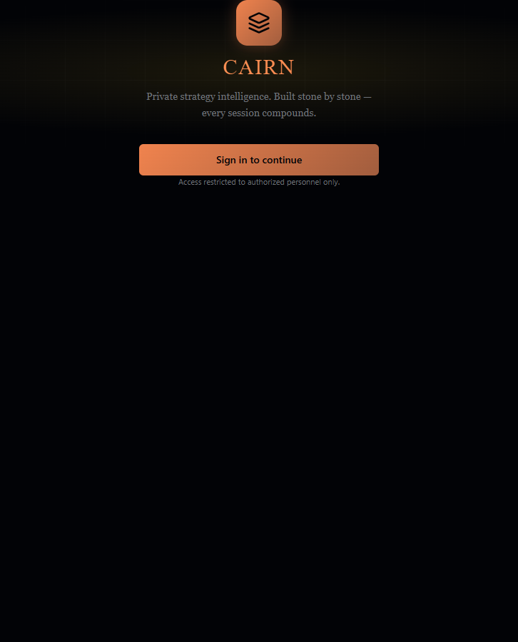
CAIRN
The strategy intelligence operating system
Private multi-company AI strategy platform where intake, reasoning, simulation, execution, memory, prediction, and calibration compound over time.
Built from local repo study - docs, routes, schema, agents, services, tests, and built UI bundle.
June 30, 2026

Slide 2
EXECUTIVE TAKE
What the app is
Cairn is not a chat wrapper. It is a governed strategy brain for an investor and portfolio companies: every claim is scoped, every model call is routed, every strategic assertion can become a prediction, and every outcome can feed calibration.
50+
40+
22
557
React page surfaces across company workspace, knowledge, intake, reasoning, simulation, execution, learning, portfolio, operations, help and admin.
tRPC router groups exposing a broad typed API surface from memory and MCP tools to connectors and simulations.
Drizzle/MySQL tables covering tenants, companies, sessions, memory, predictions, audit, export, connectors, digital twin and strategy tracking.
Tests reported in the recent consolidation notes after a 31-pass ultra-audit campaign and production build verification.
CAIRN strategy platform
02

Slide 3
PRODUCT MAP
A full strategy operating surface
Companies
Knowledge
Strategy intake
Portfolio companies
Onboarding
Projects
Memory
Connections
Ingest
Voice intake
Digital Twin
Brainstorm
Memo
Personas
Artifacts
Reasoning
Simulation
Execution
Diagnosis
Research
Frameworks
Options
Red team
Contradictions
War-game
Cross-company shock
Monte Carlo
Dual currency
Decompose
Pre-mortem
Drift
KPI library
Strategic tracker
Linear
Learning
Portfolio
Operations
Predictions
Calibration
Attribution
Audit
Playbooks
Patterns
Synergy scout
Distillation
Briefing
Cost
Audit log
Usage
Export
MCP
Users
CAIRN strategy platform
03

Slide 4
HOW STRATEGY WORK MOVES THROUGH CAIRN
The user loop
1. Onboard
2. Capture
3. Reason
Create a portco, project and starting context.
->
Ingest docs, use voice, run Digital Twin discovery, brainstorm or dictate a memo.
->
Diagnose first, then research, frameworks, options, contradictions and red-team.
4. Test
5. Execute
6. Learn
War-game options, run cross-company shocks and simulate financial outcomes.
->
Decompose to initiatives, KPIs, milestones, risks and Linear-linked work.
->
Record predictions, close outcomes, calibrate, mine patterns and promote playbooks.
The compounding effect comes from the loop, not from any single screen: memory improves diagnosis; predictions make reasoning measurable; outcomes teach calibration; playbooks turn repeated wins into reusable procedure.
CAIRN strategy platform
04

Slide 5
BUILD STATUS
Status: broad surface, phased gates
The feature matrix distinguishes code-shipped and unit-tested capabilities from phase gates that still depend on deploy metrics, external integrations, TTS/vision infrastructure, or accumulated real usage data.
Code-shipped capabilities
42
Partially shipped or data/infra gated
13
Not yet built or deferred
12
Completed foundation
Shipped beyond foundation
Gate nuance
Phase 0 is marked complete: tenancy, roles, memory schema, prediction ledger, LLM router, budget enforcer, redactor, cost dashboard, audit, usage events and export.
Phases 1-8 show many implemented surfaces: Digital Twin, GraphRAG, research, simulation, strategic tracker, calibration math, pattern mining, Linear and more.
Several phase gates remain open because they require real closed predictions, portfolio data, deploy observability, voice/TTS, vision, GPU or external connector work.
code shipped
partially gated
not built
CAIRN strategy platform
05

Slide 6
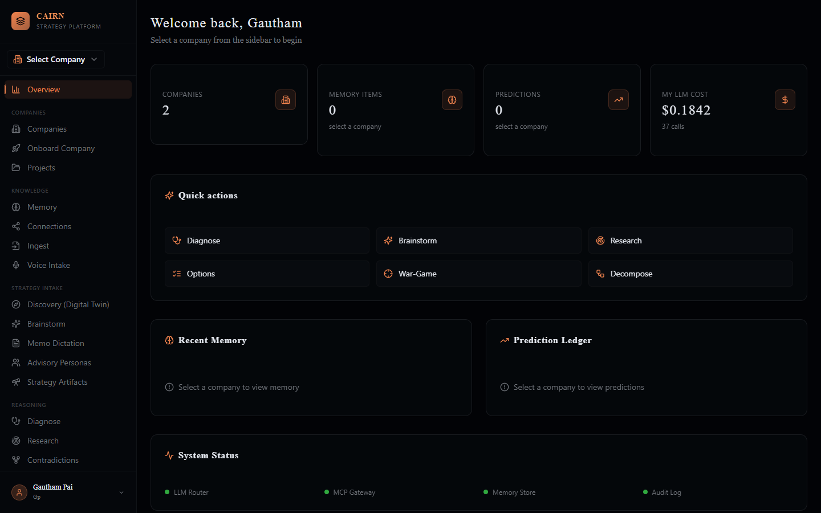
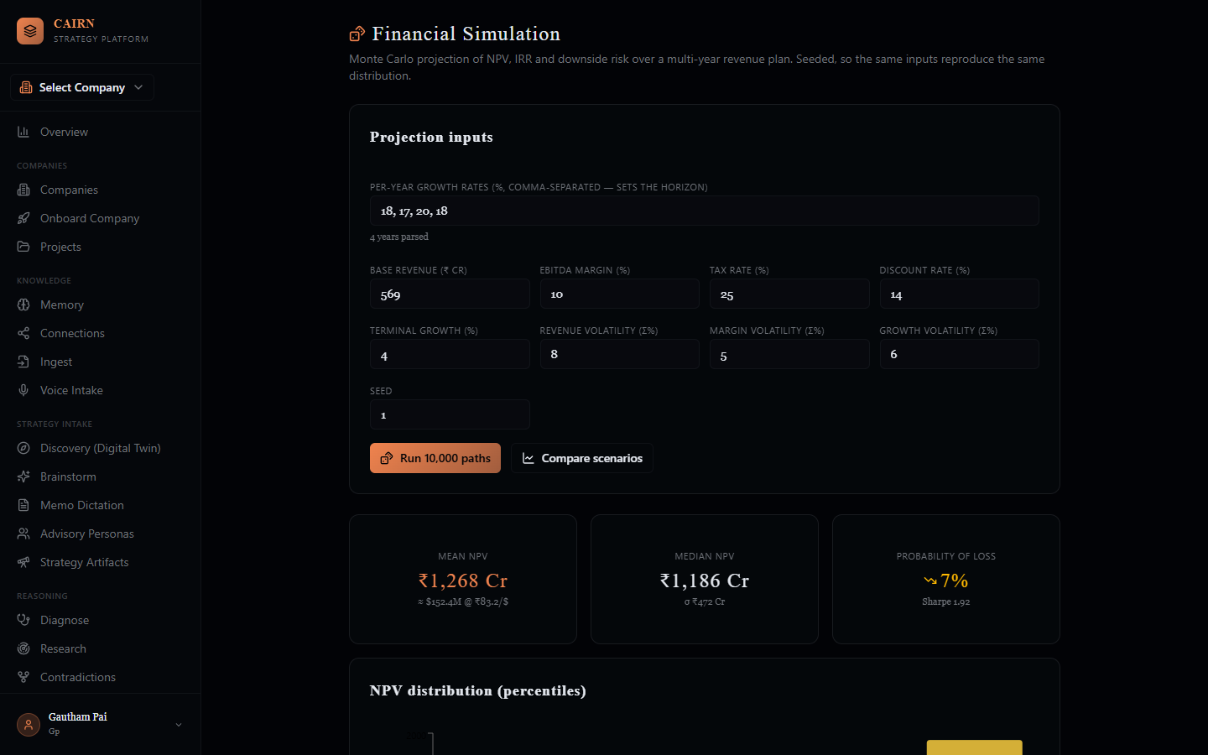
BUILT UI EVIDENCE
The actual operating shell
Left: authenticated overview shell with grouped navigation, health metrics, quick actions, memory, prediction ledger and system status.
Right: financial simulation surface showing 10,000-path Monte Carlo output, NPV metrics, downside risk and percentile distribution.
Screens captured from the local built bundle; demo API data was mocked only to render authenticated states.
CAIRN strategy platform
06

Slide 7
FOUNDATION
Security and tenancy are first-class
Scope
tenant -> company -> project -> session -> user; every row carries namespace context instead of relying on UI filters.
Roles
admin, GP, operator and portco_team with company access scoping; privileged portfolio surfaces are GP-only.
Audit
confidential reads and cross-company actions emit append-only audit entries with tier, trace and metadata.
Export
per-company encrypted archive export is GP-only and returns signed download URLs for board packs, portability or backups.
Connectors
Linear is implemented with encrypted credentials and issue push; Notion and Jira are present as controlled stubs.
Key design point
Cross-company intelligence is deliberately rare, explicit and logged. The app treats the portfolio boundary as a privilege boundary, not just a navigation boundary.
CAIRN strategy platform
07

Slide 8
LLM ROUTER
The AI control plane
Domain agent
Router
Redactor
Budget
Model config
Logs
diagnosis, research, red-team, strategic extract, Digital Twin, etc.
->
single model dispatch point: complete, embed, structured
->
SSN, credit cards, email, phone, bearer tokens, API keys and secrets
->
warn at 80%, block at 100%, hard-kill above 1.5x estimate
->
task-to-model mapping in models.yaml; no hardcoded provider choices
->
tokens, cost, latency, success, error, budget flag and trace ID
The important intelligence choice: every AI operation passes through the same choke point before touching a provider. That makes privacy, cost, observability, model routing and structured-output validation systemic rather than optional.
Structured output stance
Model output is treated as untrusted. Verdicts are computed by deterministic code from validated JSON, not accepted as model-provided booleans.
CAIRN strategy platform
08

Slide 9
COMPOUNDING KNOWLEDGE
The memory engine
Ingest
Trust
Normalize
Decide
Write
Retrieve
->
->
->
->
->
docs, text, URL, PDF, DOCX, voice and discovery inputs
source prior, quarantine and provenance cluster
canonical proposition before embedding
ADD / UPDATE / SUPERSEDE / NOOP
bi-temporal valid_at, invalid_at, ingested_at
dense + BM25 + graph hop + RRF + MMR
Why bi-temporal matters
Why dimensional tags matter
Strategy needs to know what was believed when a past decision was made. Cairn supersedes rather than destructively updating, preserving history for calibration and review.
Memory carries market, segment, product, geo, channel, tech, capability, framework and horizon tags so retrieval can be specific without dumping context into prompts.
This is the moat: the app is designed to remember, refine, contradict, decay, consolidate and retrieve strategic knowledge with provenance.
CAIRN strategy platform
09

Slide 10
MEASURABLE STRATEGY
Prediction ledger to learning loop
1
Claim emitted
agent produces strategic assertion with confidence, horizon and framework
2
Prediction recorded
same transaction, company-scoped, linked to user/project/session
3
Outcome closes
real or synthetic outcome is attached with evidence and measured date
4
Calibration scores
Brier and Murphy reliability / resolution / uncertainty
5
Patterns promote
recurring structures become playbooks when evidence clears the gate
Synthetic is separate
War-games and simulations are tagged synthetic so abundant cheap simulated outcomes never distort real-world calibration.
CAIRN strategy platform
10

Slide 11
FEATURE FAMILY
Strategy intake: multiple ways to feed the brain
Universal ingest
Discovery / Digital Twin
Brainstorm mode
Text, markdown, HTML, URL, PDF and DOCX are live; audio, video and image ingestion are explicitly pending.
Dimension-steered interview, graded coverage, funnel gates, persistence and AI transformation strategy synthesis.
Four-phase thinking surface with silent extractors for hypotheses, options, assumptions, risks and open questions.
Memo dictation
Advisory personas
Strategy artifacts
Monologue becomes a structured one-page memo, preserving a fast capture-to-artifact path.
Coach, challenger, devil's advocate and other roles let the same issue be interrogated from different angles.
External strategies become first-class inputs through recognition, Share-and-Apply and apply-war-game paths.
The intake layer is deliberately multimodal in concept, but rigorous in storage: capture is not value until it becomes scoped memory, artifacts, predictions or execution items.
CAIRN strategy platform
11

Slide 12
FROM QUESTION TO TESTED RECOMMENDATION
Reasoning mesh
Diagnose first
Research mesh
Frameworks
Reframe the question
Classify the situation
Avoid premature framework picking
Chief Strategist orchestrator
8 specialist agents
Grounded in company memory
Porter
Ansoff
JTBD
Wardley
3 Horizons
BCG
Blue Ocean
Disruption
Options + MCDA
Red team
Contradictions
Generate strategic options
Score trade-offs
Sensitivity analysis
Hostile personas
Failure modes
Deterministic verdict
Find conflicting beliefs
Review evidence
Resolve or quarantine
CAIRN strategy platform
12

Slide 13
TESTING THE STRATEGY
Simulation and financial intelligence
War-game
Cross-company shock
Four-arena simulation across customer, talent, capital and regulator lenses. Writes synthetic outcomes to the ledger.
GP-only simulation of one shock across multiple portcos with explicit cross-company safeguards.
Monte Carlo
Dual currency
Seeded NPV / IRR risk engine with mean, median, variance, P10-P90, probability of loss, VaR, CVaR and Sharpe.
Pure USD <-> INR-Crore conversion and formatting; live FX tool is a documented follow-up.
The key shift: strategy choices can be pressure-tested probabilistically and logged as evidence, rather than left as narrative confidence.
CAIRN strategy platform
13

Slide 14
OPERATOR LAYER
Strategy to execution bridge
Decomposer
Thesis -> initiatives -> OKRs -> tasks, making strategic intent executable.
Pre-mortem
Failure-first risk register before launch, so weak plans are challenged early.
Strategic tracker
AI extracts KPIs, milestones and risks from strategy context, normalizes them and writes tables.
Drift detection
Schedule, KPI and thesis drift detection with replan suggestions.
Linear connector
Encrypted credentials, connection test, teams, issue creation and initiative push.
Why this matters
CAIRN strategy platform
The app does not stop at advice. It tries to convert strategic reasoning into tracked operating objects: KPIs, milestones, risks, tasks, connectors and drift loops.
14

Slide 15
CROSS-COMPANY LEVERAGE
Portfolio intelligence
Synergy Scout
Pattern distillation
Briefing
Nine-axis cross-portfolio detector that can identify revenue, capability, customer, procurement, talent and technology synergies.
Anonymized pattern promotion with N>=3 publication gate, designed to learn from companies without exposing raw company data.
Daily or weekly text briefing builder that turns platform signals into a compact read; TTS audio remains pending.
Permission model
The portfolio thesis
Cross-company reads are GP-only, query-validated, UI-gated and audit-logged. Each memory search remains scoped to one company.
The app is built to let learning compound across portcos through distilled patterns and synergies, not by blindly mixing confidential raw memory.
CAIRN strategy platform
15

Slide 16
PERSISTENCE LAYER
Data model: 22 tables
Workspace
Memory
tenant
users
company
strategy_project
session
memory_item
contradiction
source_trust_register
Learning
Operations
prediction
outcome
decision
audit_log
usage_event
llm_call_log
export_job
Connectors
Digital Twin
connector_credential
connector_link
digital_twin
completeness_tracking
Execution
strategy_kpi
strategy_milestone
strategy_risk
The schema shows the product intent clearly: strategy work is not a transient chat. It is a persisted, namespaced, auditable system of claims, decisions, outcomes, memory, costs and execution objects.
CAIRN strategy platform
16

Slide 17
COST, AUDIT, TOOLS
Observability and governance
80%
100%
1.5x
4
budget warning threshold before a model call reaches the soft dollar cap.
soft cap block point. Calls are stopped server-side, not politely suggested client-side.
hard-kill above estimate with no override path, protecting the system from runaway usage.
registered MCP tools: web_search, web_fetch, edgar_filings and lookup_memory.
Tool gateway
Cost dashboard
External tools route through the MCP gateway. The gateway exposes a declarative registry and dispatch point instead of scattering tool calls across agents.
LLM calls log model, tokens in/out, cost, latency, trace, success/error and budget-enforced status for per-user, company and session review.
CAIRN strategy platform
17

Slide 18
JUNE 2026 CHANGES
Recent consolidation and quality bar
31
71
557
0003
ultra-audit passes over the prototype consolidation surface.
confirmed defects fixed across tenancy, finance, migration, logic, React/UX, cost/DoS and a11y areas.
tests reported passing after the campaign, up from 500 in the consolidation notes.
additive migration adding Digital Twin, completeness and strategy tracking tables.
What was salvaged
What was deliberately not ported
StrategyForge contributed Monte Carlo, dual-currency and structured-output auto-write. Dynamo contributed Digital Twin conversational intake. Both were hardened and integrated into Cairn.
Fake multi-model fallback, hardcoded roadmaps/ROI, cosmetic grounding and placeholder document processing were left behind for real implementations.
CAIRN strategy platform
18

Slide 19
ROADMAP HONESTY
What is still gated
Realtime voice
TTS playback
OpenAI Realtime / Gemini Live abstraction and persistent mini-player are not yet built.
War-game and briefing audio depend on TTS infrastructure.
Vision in/out
Live research UI
Slides, whiteboards, chart extraction and raster diagram export are still gated.
Research agents exist, but the streaming activity-tree view is not built.
Data-dependent learning
External connectors
Calibration resolver and portfolio dashboard need closed predictions and portfolio data.
Linear is live; Notion, Jira, KPI data connectors, Slack and live FX remain pending or stubbed.
This makes the deck credible: Cairn already has a very large code-shipped surface, while the remaining work is mostly live infra, data accumulation, richer multimodal UX and external integrations.
CAIRN strategy platform
19

Slide 20
POSITIONING
Why it is different
Not a chatbot
Not a static dashboard
The core product unit is not a conversation. It is a company-scoped strategic state: memory, claims, predictions, decisions, outcomes and execution artifacts.
Dashboards are one surface. Cairn also captures, reasons, researches, simulates, critiques, decomposes, tracks, audits and learns.
Not generic AI
The north star
The engine has domain-specific guardrails: diagnosis precedes frameworks, every model call is routed, every emitted claim can be measured, and portfolio learning is anonymized and gated.
A private strategy intelligence layer where every session compounds into better context, better calibration and better reusable playbooks for the next decision.
CAIRN strategy platform
20

Slide 21
APPENDIX
Capability catalog, part 1
Workspace
Overview, Companies, Onboarding, Projects
Knowledge
Memory, Connections, Ingest, Voice Intake
Intake
Digital Twin, Brainstorm, Memo, Personas, Strategy Artifacts
Reasoning
Diagnose, Research, Contradictions, Frameworks, Diagrams, Options, Red Team
Implementation pattern
Each surface generally maps route -> page -> tRPC router -> service or agent file. That makes the app navigable despite its breadth.
CAIRN strategy platform
21

Slide 22
APPENDIX
Capability catalog, part 2
Simulation
War-Game, Cross-Co War-Game, Financial Simulation
Execution
Decompose, Pre-Mortem, Drift, KPI Library, Strategic Tracker, Linear
Learning
Predictions, Calibration, Attribution, Constitutional Audit, Playbooks, Pattern Mining
Portfolio
Synergy Scout, Pattern Distillation, Briefing
Operations
Cost Dashboard, Audit Log, Usage Events, Export, Connectors, MCP Tools, Users, Manual
The breadth is already visible in the UI navigation, but the stronger story is underneath: controlled AI routing, bi-temporal memory, prediction-ledger measurement and portfolio-safe learning.
CAIRN strategy platform
22

