Slide 1

HEART DISEASE CLASSIFICATION

Slide 2
Project Background
Originally completed in Spring 2023 in Data Mining class
Worked with two other group members
Assignment
Explore and visualize data
Apply machine learning algorithms
Evaluate performance
Present findings

Slide 3
Motivation and Objectives
Why? 7.2% of Americans over 20 years old have heart disease, costing $240 billion annually¹
What? Use survey responses from individuals in the United States to predict if the person answers in the survey that they have heart disease
Used two survey questions combined into one feature to train supervised models:
(Ever told) (you had) angina or coronary heart disease? (CAD)
(Ever told) you had a heart attack, also called a myocardial infarction? (MI)

Slide 4
About the Data
Full dataset available for direct download on the Center for Disease Control website
438,693 participants (instances), 303 survey questions (features)
Data is consistent and highly structured with no major anomalies or NA values
Most responses are coded and requires heavy reference to BRFSS Codebook³
No names, addresses, phone numbers, or other personal information given to deduce who took the survey
Survey conducted by the Behavioral Risk Factor Surveillance System (BRFSS) administered in 2021²

Slide 5
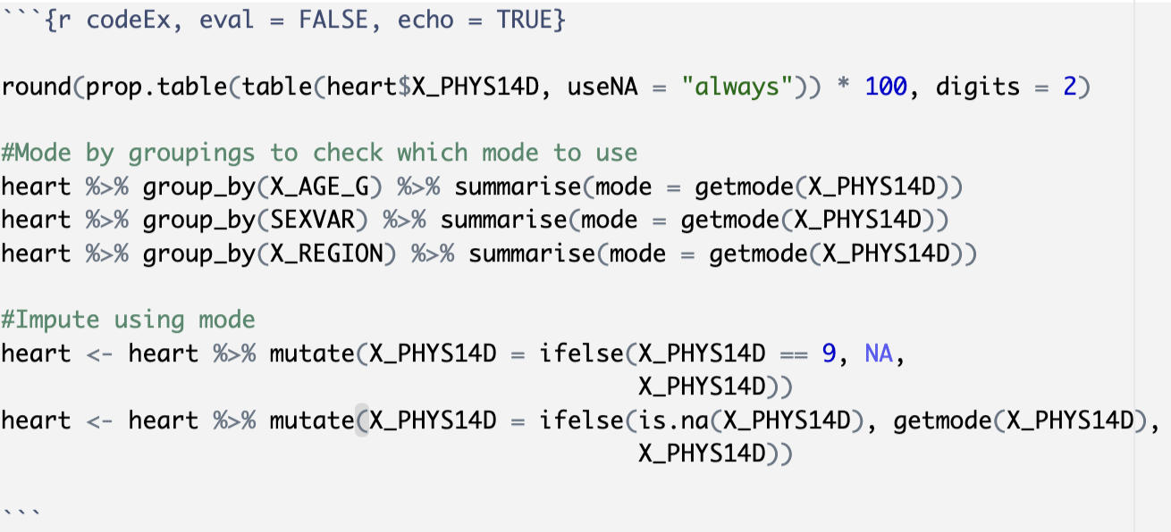
Original Assumptions
Selected features based on subject matter knowledge from the American Heart Association⁴
Imputed missing values based on mean, median, mode, grouped by age, sex, region
Replaced response “Don’t know” and “Refused” with “No”

Slide 6
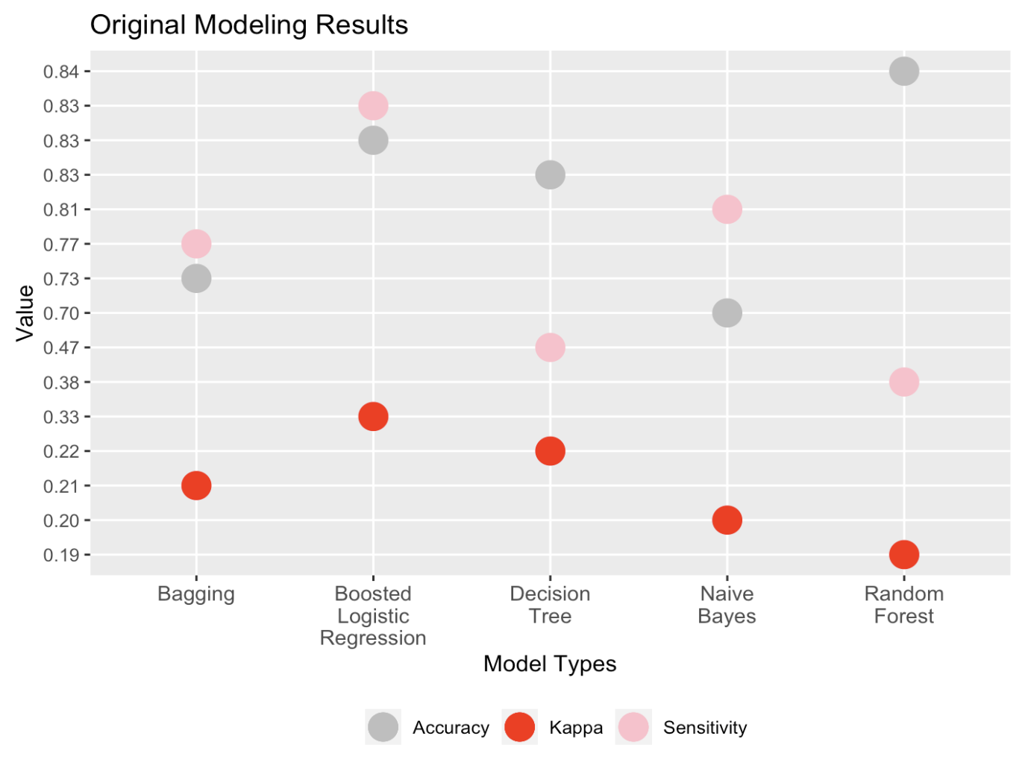
Initial Results
Chose sensitivity to evaluate models
Kappa considered because of class imbalance (8:92)
Trained five different machine learning algorithms
Logistic regression model gave the best outcome:
83% accuracy
10% less than no information rate (if you always guessed the person didn’t have heart disease)
83% sensitivity (true positive rate)
Kappa value 0.33 (adjusts accuracy to discount chance alone)

Slide 7
Goals for Improvement
Automate recoding process to reduce manual clean-up time
Leave ‘Don’t Know’ and ‘Not Sure’ responses to see if model performance improves
Begin with whole dataset and use decision tree to reduce number of features prior to modeling

Slide 8
303
48
Started with entire dataset
Removed all irrelevant variables (date interviewed, phone type, ID numbers, etc.)
Excluded variables with >50% missing
Removed non-core questions
100
70
16
Post-data cleaning: Decision Tree
Data Reduction, Revisited

Slide 9
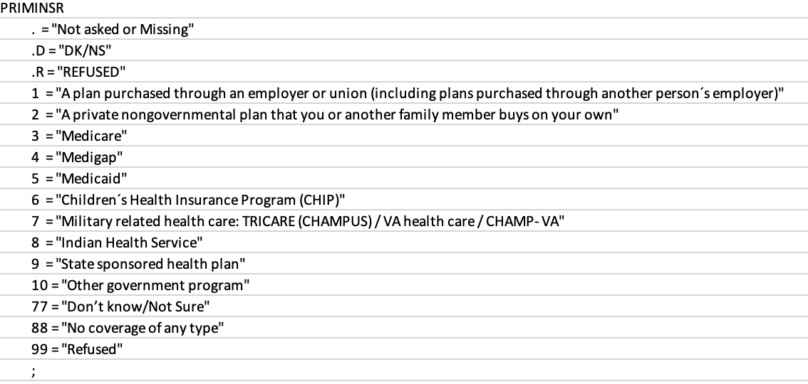
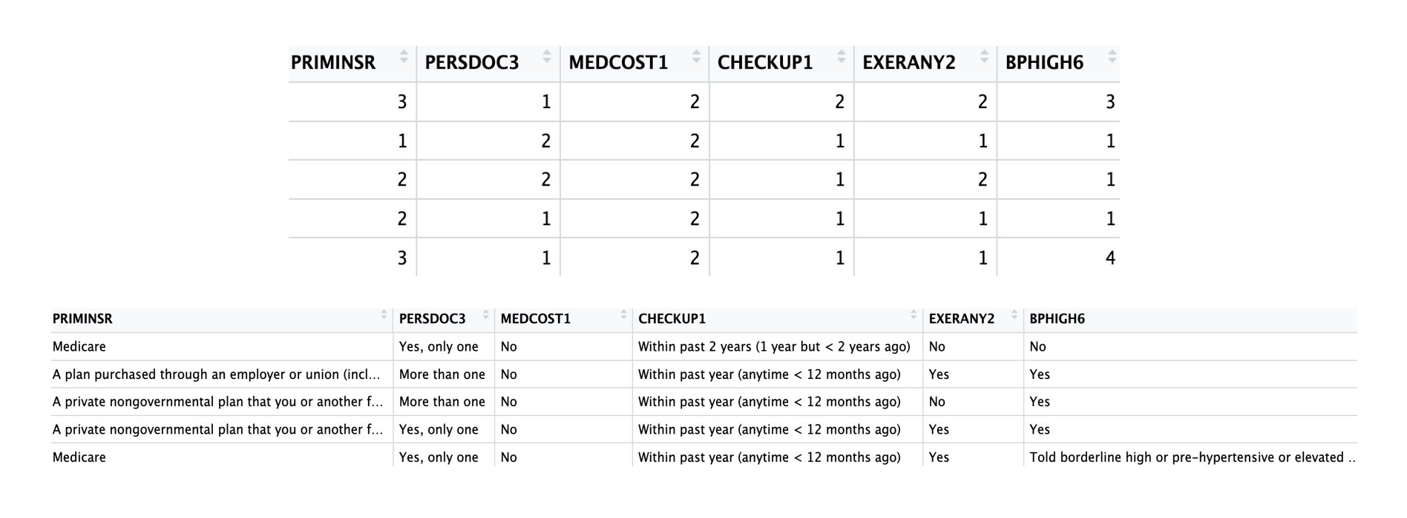
Automate Recoding Process
Code file:
Downloaded SAS file of variable codes and descriptions⁵
Cleaned code file
Created function to loop through data file and recode variables
Some variables still required manual cleaning
Results much easier to interpret
Very time consuming to design
Dataset pre/post recode:

Slide 10

Data Pre-Processing, Summarized
Major differences:
Started with entire dataset, rather than pre-selected variables
Converted everything to code descriptions rather than codes
Applied decision tree algorithm
Final dataset for modeling: 16 features, ~439k instances

Slide 11
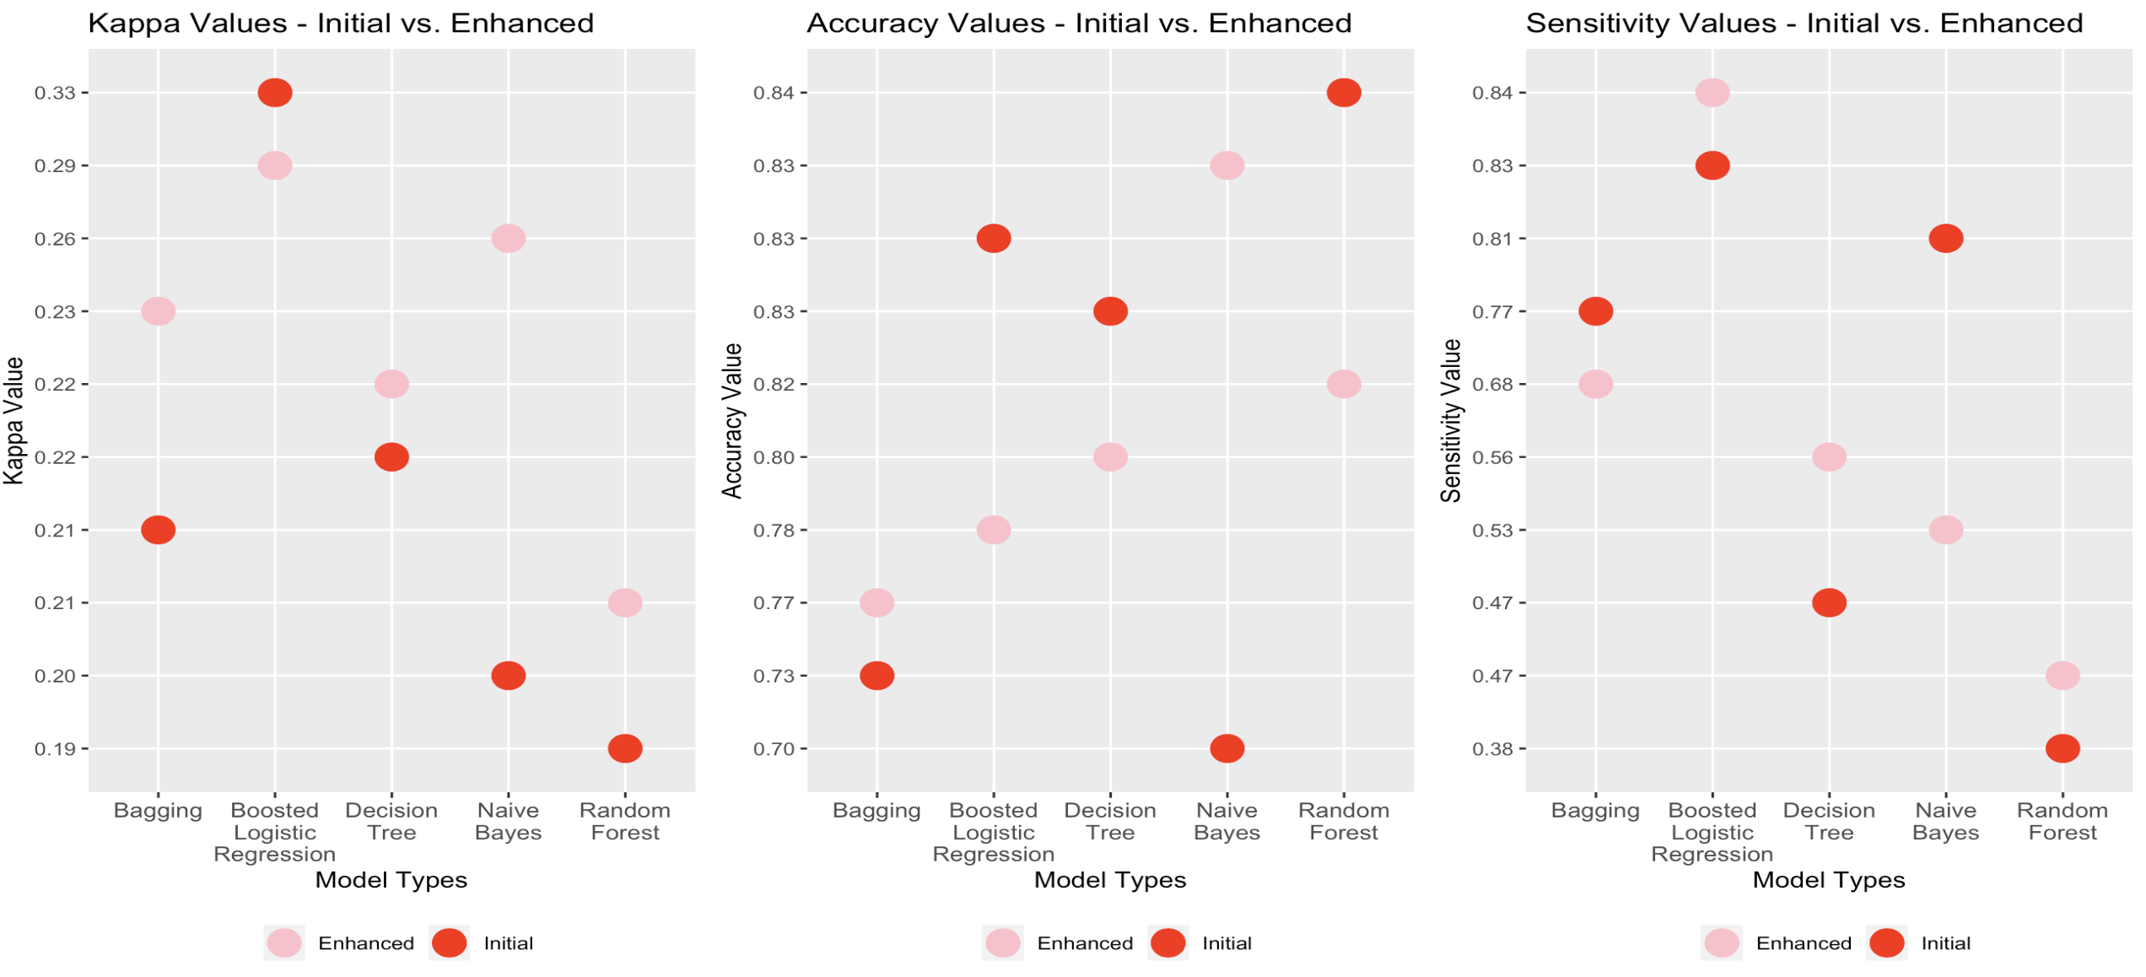
Model Results: Mixed Bag
Notes:
Kappa: 4/5 improved
Accuracy: 2/5 improved
Sensitivity: 3/5 improved

Slide 12

Conclusion, Challenges and Further Work
Re-coding automation was largely a success, but data cleaning still proves to be a major time sink in this dataset
Large dataset is still a computational issue
Need exposure to Big Data software or run processes on more powerful computer
Complex patterns in dataset may lead to “curse of dimensionality”
Rather than use data for predictions, visualization and descriptive analytics would be the best use of this dataset

