Slide 1
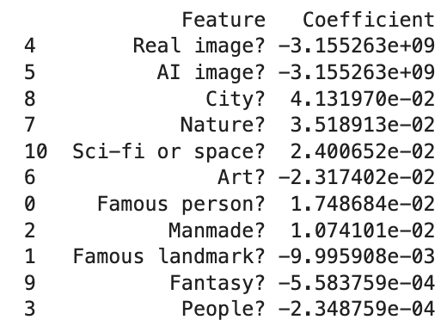
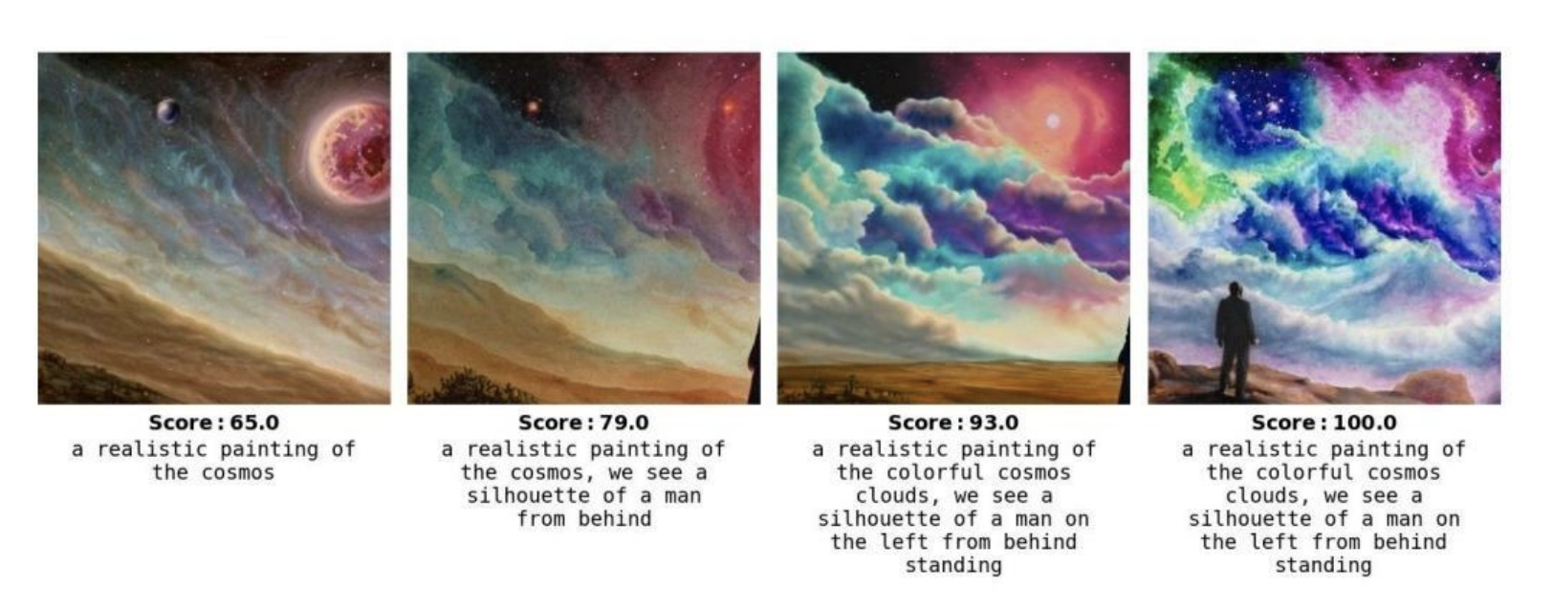
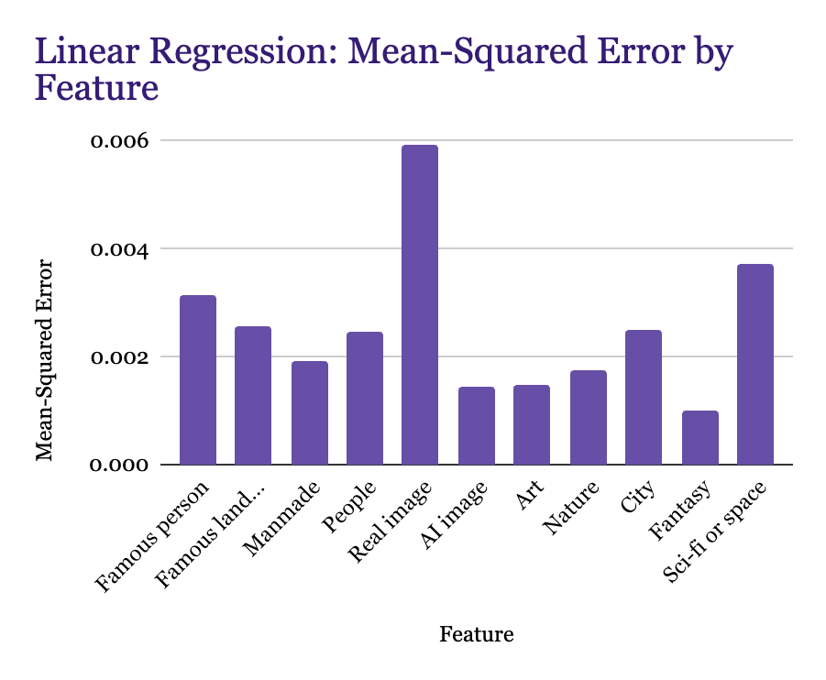
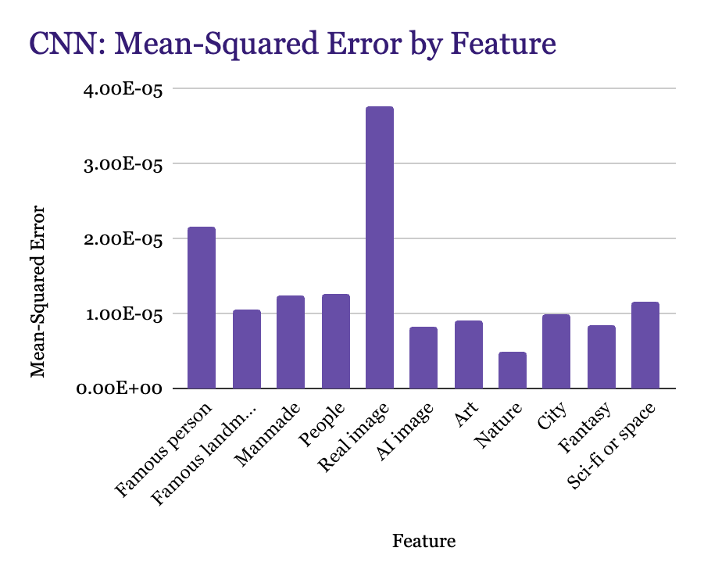
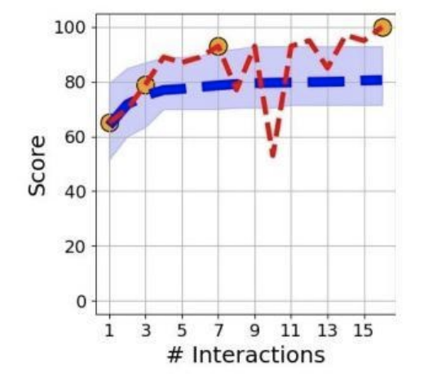
Exploring Generative AI: What Makes An Image Steerable?
Colgate University
Paige Blum, Emily Kociubes, Nyah Harrison
Introduction
Experimental setup
Summary + Conclusion
What makes an image steerable?
We are interested in how humans interact with AI tools. Steerability in the context of AI-generated images refers to the ability to guide or direct the generation process of a text-to-image model to create specific visual outputs based on detailed prompts.
Steerability makes AI image generators not just tools for creating random or generic images but powerful assistants for realizing specific artistic and visual concepts. Steerability scores also allow us to understand where there are holes in the models generative capabilities.
A high steerability score is achieved when the AI can accurately follow detailed and specific instructions, producing results that match with the user’s input, whereas a low score results from outputs that are not expected by the user.
Can a Convolutional Neural Network learn how to predict steerability based on an image?
We trained a linear regression model to predict scores based on a dataset with target images, scores, and discrete features. We are curious on how a CNN that is passed raw images will compare to that of the linear regression model. Will it perform better? Will we find new features that have yet to be discovered?
Methods
For the linear regression model, we ran the scripts included in the study to generate steerability scores. Those scores were added to the Art Whisperer dataset as a new column. The model was trained on the discrete features of the image along with steerability score.
For the CNN the images were transformed and resized to 128x128 pixels and normalized using standard deviation values across RGB channels, Pytorch data loaders are used to load data in batches, model is trained on 10 epochs, and an Adam optimizer was used with a learning rate of 0.001 for adjusting weights in the network
Datasets + Preprocessing
We used the Kalias/ArtWhisperer Hugging Face Dataset for the CNN the data is split first into a combined training and validation set and a separate test set with 10% of the data used for testing, the combined training and validation set is then split further into training and validation sets with approximately 20% of the data being used for testing
Models Evaluation Metrics
(1) Linear Regression MSE (for CNN and Linear Regression)
(2) CNN R² (for Linear Regression)
Main Conclusions
While both models were able to effectively predict steerability of a text-to-image model for a variety of images, we found that predictions made by the linear regression model, trained on discrete features, could be improved upon. The CNN, when fed instead raw images and left to discover new features, had significantly lower error.
Notably, an image being real and being created by AI were found to be equally negatively important in predicting steerability, but both models show a large discrepancy in error between predictions of steerability between the two groups of images.
These negative spikes in feature importance reveal places where this particular image-to-text model could be improved. Understanding which image content lowers a model’s steerability can help guide resources for future training examples, and in turn increase the potential for users’ creation with AI.
Limitations
Some limitations included the fact that CNNs, while good at capturing complex patterns in data, have a somewhat lack of interpretability making it difficult to understand why certain features affect steerability, as well as computational resources and time.
Background
Results
Future directions
Background Information
We based our approach off of the study, “ArtWhisperer: A Dataset for Characterizing Human-AI Interactions in Artistic Creations”. This study generated steerability scores for a series of target images by using the stopping time of an empirical Markov model and tracking how many times a user had to prompt a model until matching a desired target image. We used these steerability scores to train both the convolutional neural network and linear regression model.
Linear Regression: Feature Importance
Interesting Next Steps
Taking the next step of finding new features that affect steerability in images would be interesting because it could help advance AI interpretability and control. Researchers and developers could gain insights into the decision-making processes of AI models, particularly image-based. We could do this by consulting with domain expert to identify potential features that may influence steerability. Further we could do feature extraction with CNNs and apply feature selection techniques using Random forest models.
Data could also be gathered from human subjects asking them to interact with images and measure their steerability perceptions directly. From there we could move into testing specify hypotheses about features that may affect steerability. An example of an hypothesis could be that the brightness of colors in an image affects steerability.
After training a linear regression model to predict the steerability of each image using discrete boolean features, we extracted the weights learned as a measure of feature importance. The model weighted real and AI images negatively and most strongly in predicting a target image’s steerability.
Error Analysis by Feature
Both the linear regression and CNN models performed well, with overall MSE values of 0.002 and <0.0001, respectively. For regression, R-squared = 0.14.
References
Anonymous authors. (2024). ArtWhisperer: A Dataset for Characterizing Human-AI Interactions in Artistic Creations. Under review as a conference paper at ICLR 2024.
Despite differences in the scale of MSE values, the two models had very similar distributions of error across the subsets of images with each feature.
The highest error was in predicting steerability of real target images, while the steerability of art, nature, fantasy, and AI images was easier for the models to predict.
Notes:
References
Use APA format. But if you need to shorten some journal or conference names, thats fine in a poster!
Feel free to also reduce the font size if required.
Results
Main results in the paper.
Ideally you should not be talking about more than two or three main results. If you have more than that, prioritize!
This section should have the least amount of text. Use tables or graphs wherever possible!

