Slide 1

Get to know your team
CGCC 2021 - Day 6

Slide 2

CGCC Teams
Camper names removed.

Slide 3
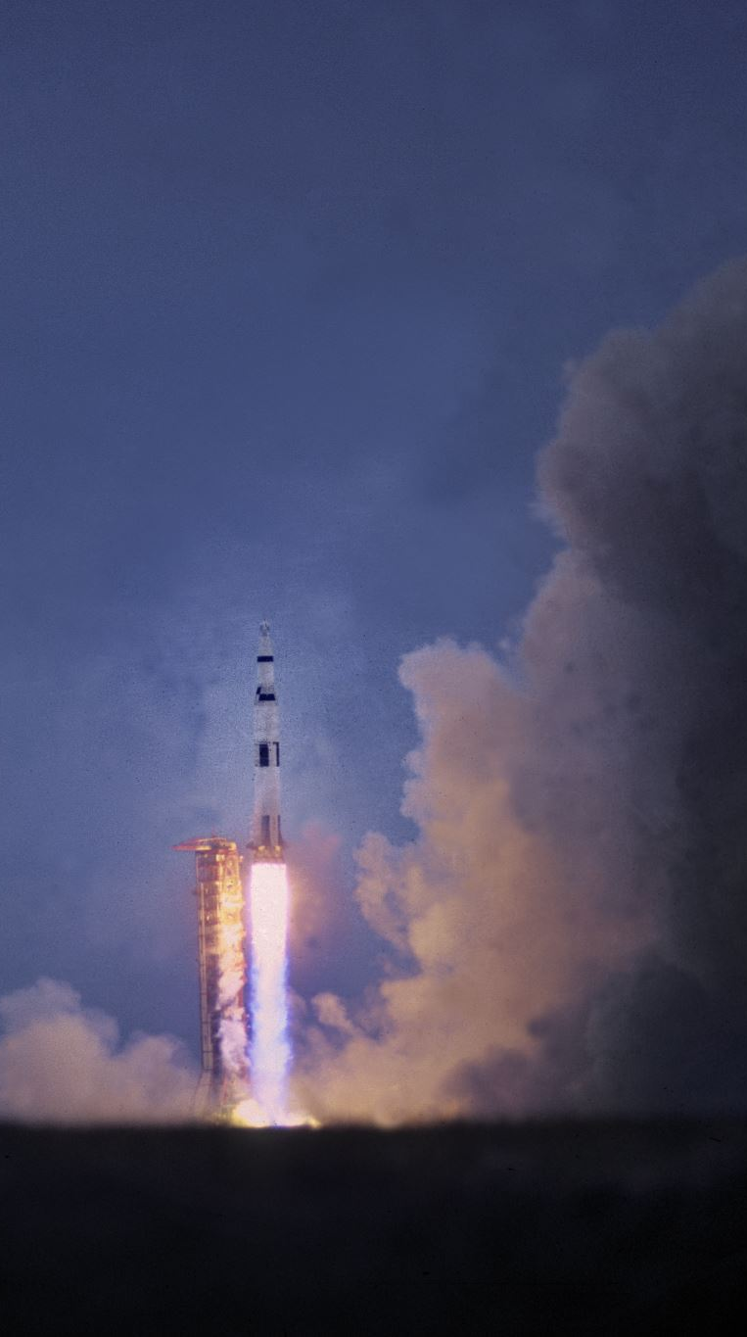
Let’s Interview your Team Members!

Slide 4
Instructions
One person at a time answers each question
Go in the order of first names alphabetically
E.g., Allan, Ben, Chad would all answer question #1 before moving onto question #2

Slide 5
General Get to know you Questions
Basic info
Name
What is your contact info (e.g. phone or email or Snapchat or Insta or Discord)? For backup purposes in case technology doesn't work.
Which grade are you in?
Who are the other members of your family? Do you live with them?
When can you work on the project outside of class?
As a team - negotiate mutually exclusive times to edit code

Slide 6
Computer Background Questions
What is your background with computers? What skills do you have?
What do you find most interesting about computers and how does this impact your future educational plans?
What kind of programming experiences have you had in the last 3 years?

Slide 7
Team Work Questions
How do you manage your time when you get busy with a lot of tasks?
Have you worked on a team project before? If yes,
How often did your team meet together?
Did your team have a leader? What did that leader do?
What was your role on the team?
How well did you get along with your teammates related to work, or related to non-work?

Slide 8
Other Fun Questions
What are your hobbies/interests/passions that are not related to this class?
Do you have any unique skills/tricks that you can show us now?
Who is your favorite teacher in school? What do they teach? Why are they your favorite?
What was the last non-software-related book you read and describe what it was about in 2 sentences.
What is the best movie you saw in last 3 years, and why was it your favorite?
Do you have a personal hero in your life? Who is it and why are they your hero?
Tell me about a trip you took that was far away from where you live?

