Slide 1
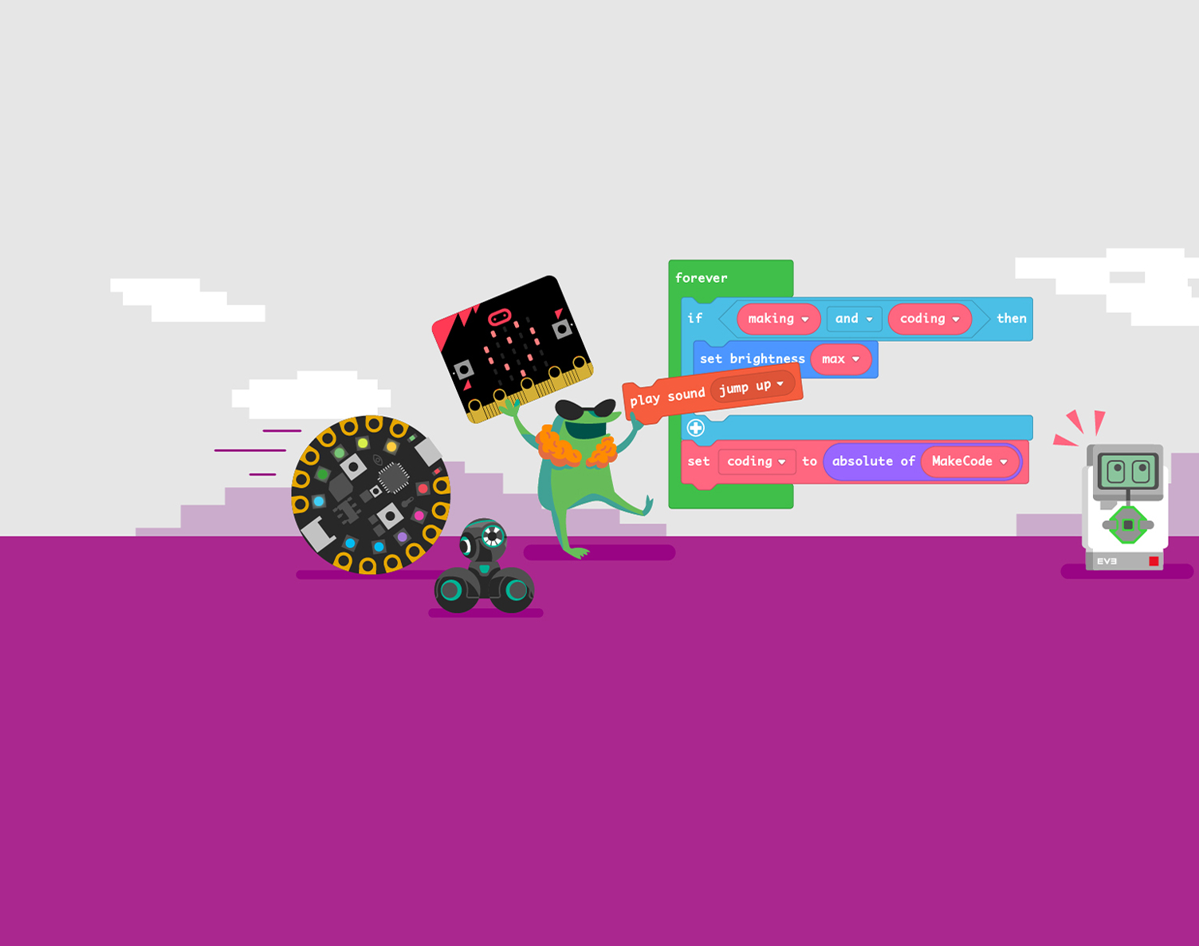
Welcome to the Computer Game Coding Camp 2021!

Slide 2
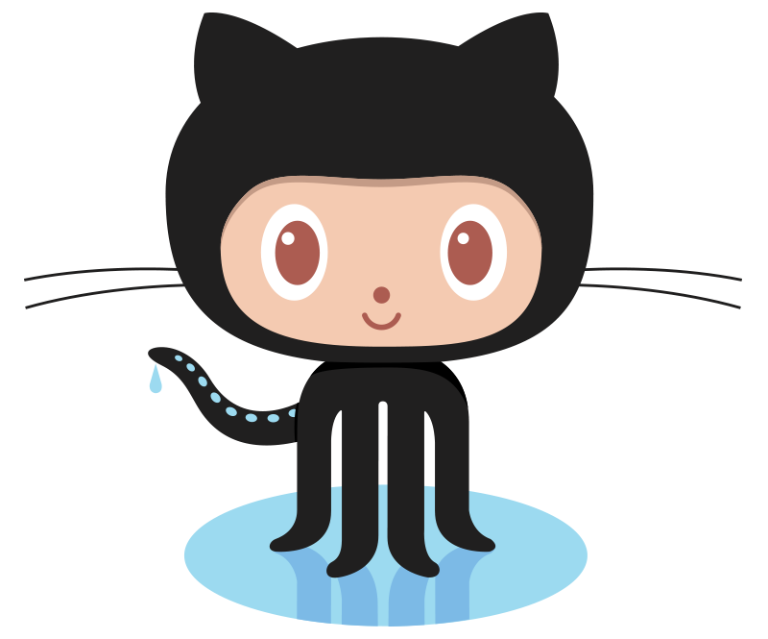
What is GitHub?
What is version control?
GitHub is a version control system

Slide 3

Godot
Game engine
Opensource
Games made in godot

Slide 4
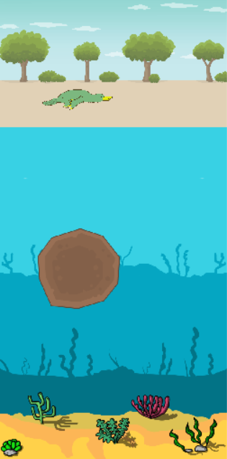
What makes a game?
Story
Goal

