Slide 1

Software Architecture Case Studies
Memi Lavi
www.memilavi.com

Slide 2
Why Case Studies?
Become a Better Software Architect!

Slide 3
Why Case Studies?
Practical Knowledge
Real World Architecture
Based on Actual Systems
Best Way To Learn

Slide 4
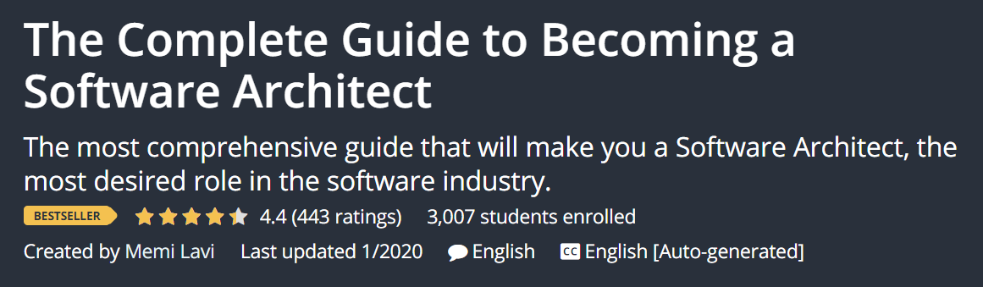
Built On…

Slide 5
Who Am I?
Senior Software & Cloud Architect
Memi Lavi
www.memilavi.com

Slide 6






My Clients

Slide 7










My Technology Stack

Slide 8

Azure Architect

Slide 9
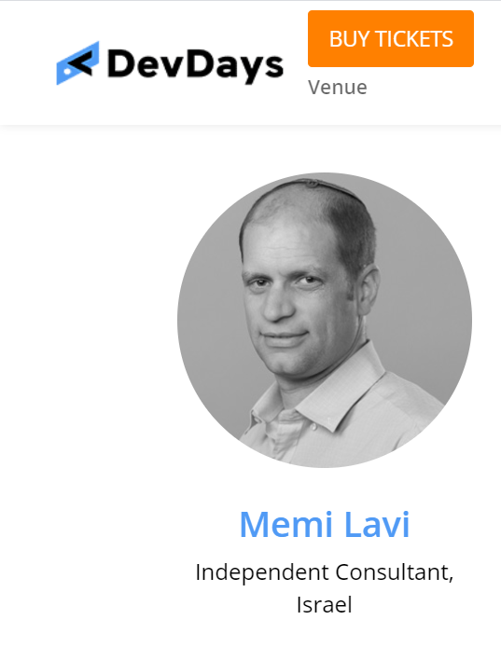

Speaker

Slide 10
Who Is This Course For?
Architects
Development Background
Developer, Team Leader, Dev Manager…
Preferably with some experience
Preferably with Backend Development Experience

Slide 11
Agenda
Welcome
The Architecture Process
Use the 3 Architecture Diagrams for your own systems!
Case Study #1
Case Study #2
Case Study #3
Case Study #4
Conclusion

