Slide 1

Conclusion
Memi Lavi
www.memilavi.com

Slide 2
What Did We See?
Classic Web App (with a twist…)

Slide 3

Dunderly
Logic Diagram
Users’ Browser
HTML Page
REST API / HTTP
Employees Service
Salary Service
Vacation Service
View Service
Queue
Data Store
Payment System
Payment Interface
Logging
File

Slide 4
What Did We See?
Classic Web App (with a twist…)
IOT Telemetry system

Slide 5
Muscar.auto
Logic Diagram
Cars
Telemetry gateway
Telemetry pipeline
Telemetry processor
Telemetry Viewer
Operational DB
Archive DB
Data Warehouse
BI Application

Slide 6
What Did We See?
Classic Web App (with a twist…)
IOT Telemetry system
Data collection app on a tablet

Slide 7


Logic Diagram
Lists Queue
Lists Receiver
Lists Service
Lists DB
Data Queue

Slide 8
What Did We See?
Classic Web App (with a twist…)
IOT Telemetry system
Data collection app on a tablet
Async file processing system

Slide 9


Logic Diagram
Logs
File Exporter
File Formatter
File Handler
File Formatter
File Calculation
File Formatter

Slide 10
Case Studies
Your system is probably similar to one of them
Or a combination…

Slide 11







Technology Stack

Slide 12
Case Studies
Want more case studies of other systems?
Contact me
Or go to the Facebook group

Slide 13
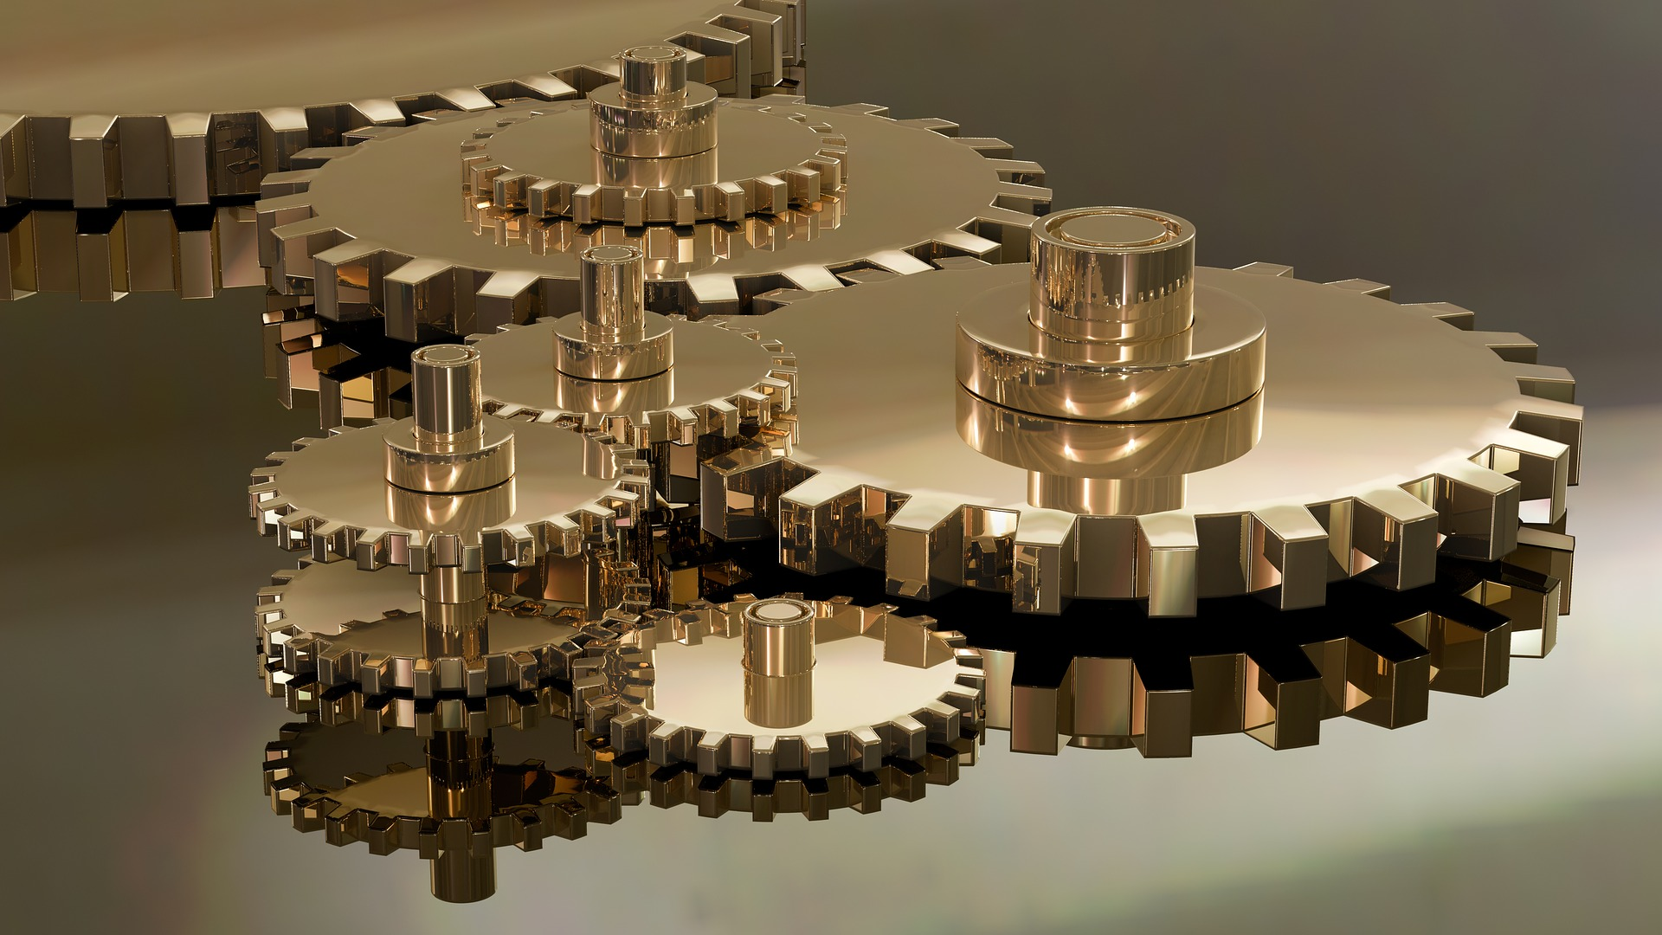
Thanks!

