Slide 1
HBO DATA ANALYSIS
By Paige Wamuyu

Slide 2
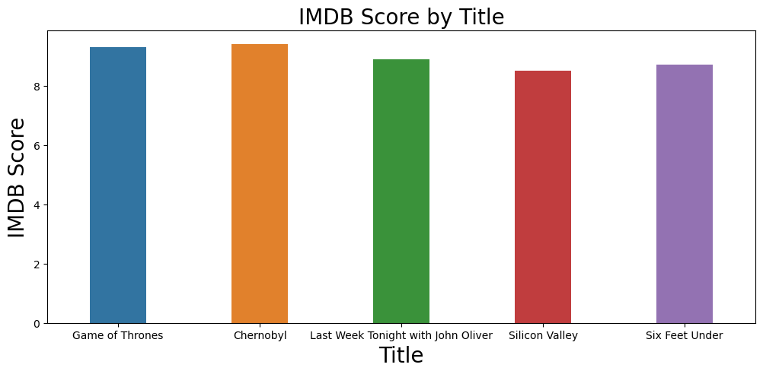
The interpretation of this bar plot would be that the IMDB score of a TV show or movie varies with the year it was released. The plot shows that the IMDB score is higher for a particular year, it means that the average IMDB score of TV shows or movies released in that year was higher than the average IMDB score of TV shows or movies released in other years.

Slide 3
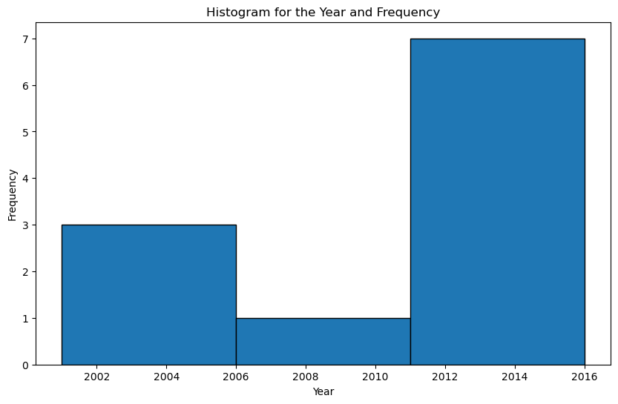
The highest distribution of the movies or tv shows was between 2011 and 2016
The lowest distribution was between 2016 and 2011

Slide 4
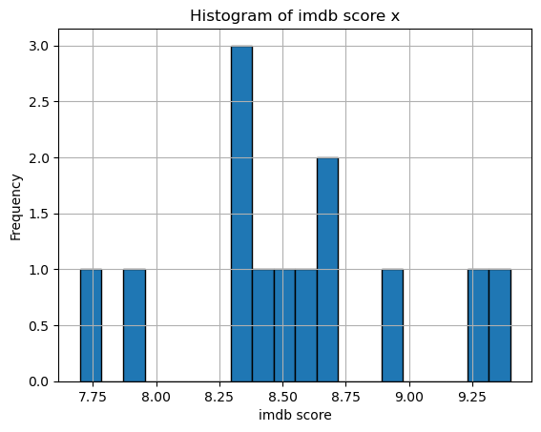
The highest distribution of movies or tv shows have an IMDB score slightly higher than 8.25.
The lowest distribution, however at a frequency of 1 is recurring at multiple IMDB scores

Slide 5
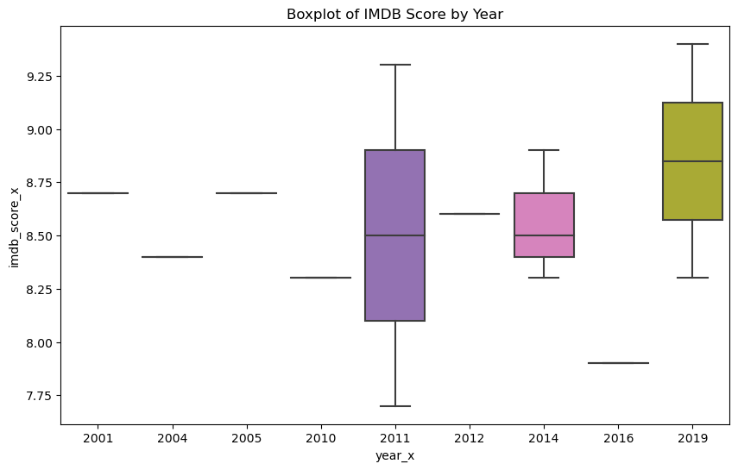
The line inside the box shows the median of IMDB score for each year. The box shows the interquartile range (IQR), which is the range between the 25th and 75th percentiles. This gives you a sense of the middle 50% of scores. The whiskers which extend from the box to show the range of the data. By default, they extend no more than 1.5 * IQR from the edges of the box, ending at the furthest data point within that interval. The outliers are plotted as individual points. These are data points that are more than 1.5 * IQR from the box. By comparing the boxplots for different years, you can see how the distribution of IMDB score has changed over time.

Slide 6
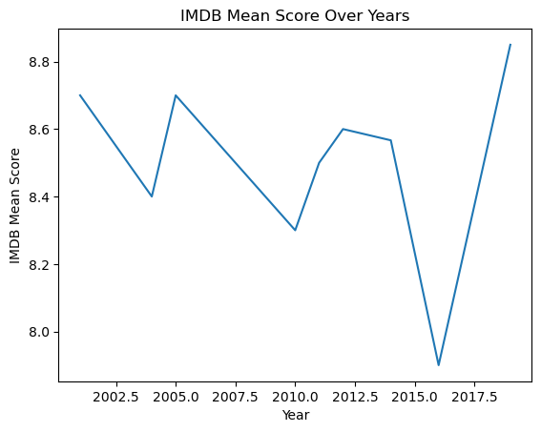
The line plot shows the trend of the IMDB mean score over time. The IMDB mean score seems to increase over time, reaching a peak around 2014 and then gradually decreasing. This could be interpreted as an increase in the quality of movies over time, followed by a decline.

Slide 7
Recommendations

Slide 8
Appendix
The data columns with multiple zeros would have been cleaned better
Exploration would have been done more in depth using Rotten score for comparison as well

