Slide 1
HBO DATA ANALYSIS
By Paige Wamuyu

Slide 2
PURPOSE OF THE ANALYSIS
The analysis was performed to examine the effect and relationship between the columns and their IMDB score.

Slide 3
Problem statement
The key factor considered to conduct the data exploration is to determine the nature of shows and their overall performance with audiences.

Slide 4
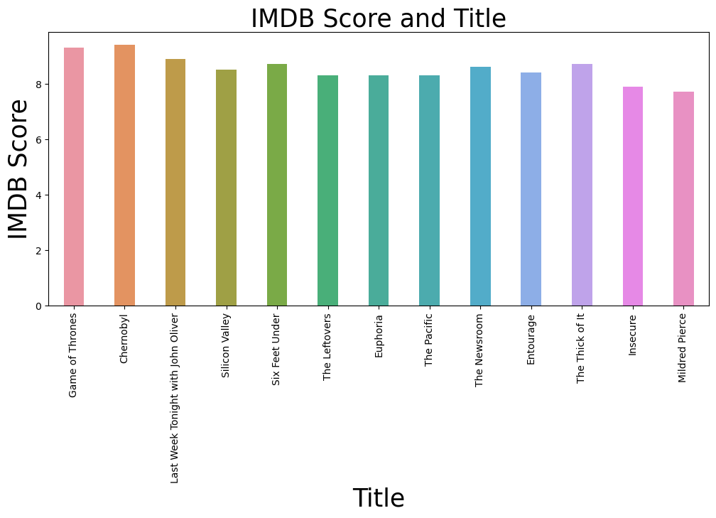
methodology
The best performing title is Chernobyl with the highest IMDB score while Mildred Pierce has the lowest IMDB score

Slide 5
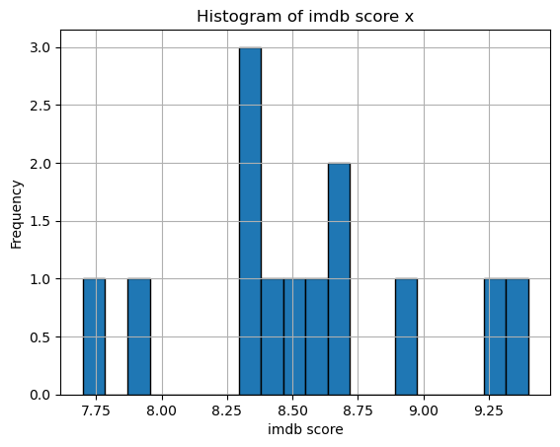
The highest distribution of movies or tv shows have an IMDB score slightly higher than 8.25.
The lowest distribution, however at a frequency of 1 is recurring at multiple IMDB scores

Slide 6
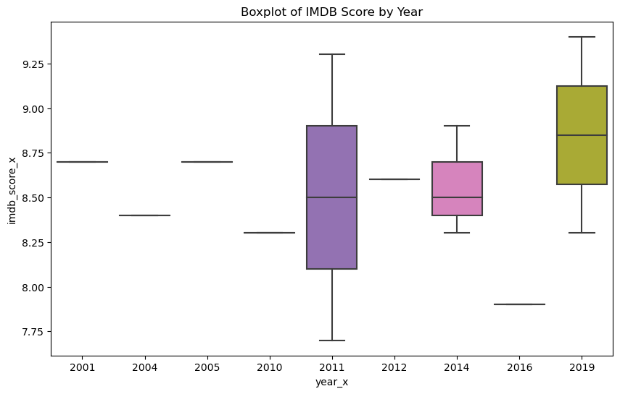
The line inside the box shows the median of IMDB score for each year. The box shows the interquartile range (IQR), which is the range between the 25th and 75th percentiles. This gives you a sense of the middle 50% of scores. The whiskers which extend from the box to show the range of the data. By default, they extend no more than 1.5 * IQR from the edges of the box, ending at the furthest data point within that interval. The outliers are plotted as individual points. These are data points that are more than 1.5 * IQR from the box. By comparing the boxplots for different years, you can see how the distribution of IMDB score has changed over time.

Slide 7
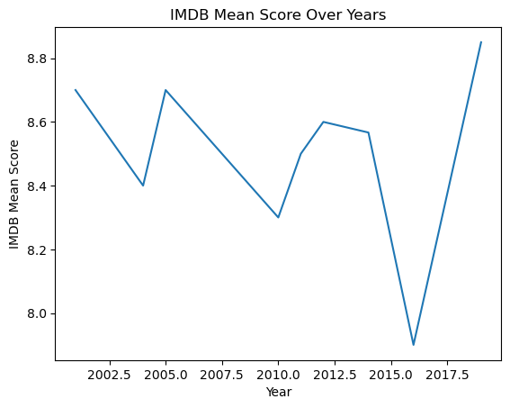
The line plot shows the trend of the IMDB mean score over time. The IMDB mean score seems to increase over time, reaching a peak around 2014 and then gradually decreasing. This could be interpreted as an increase in the quality of movies over time, followed by a decline.

Slide 8
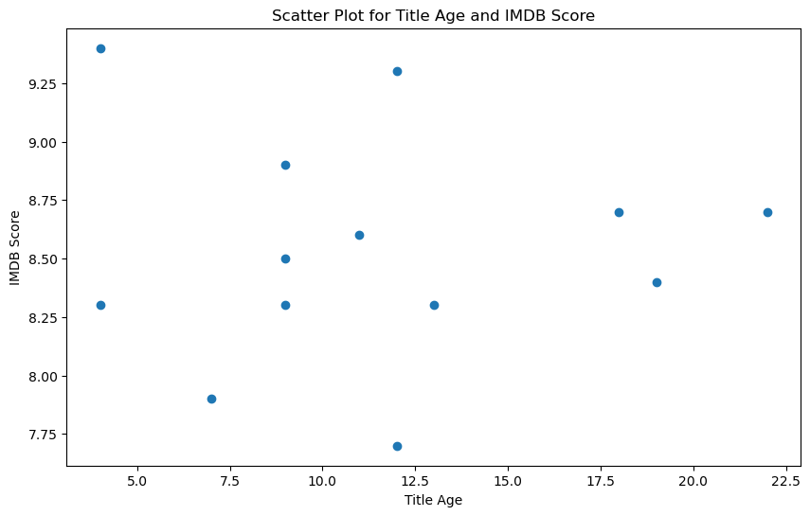
The scatter plot seems rather scarcely populated due to the low number of rows after cleaning the data.
The highest IMDB score is at the 2 year-mark meaning the movie or TV show is relatively new while the lowest IMDB score is at the 12 year-mark

Slide 9
Recommendations
The TV show Chernobyl has the highest IMDB score according to the bar plot for IMDB score and year implying the audience really likes it and hence more shows like it should be made.

Slide 10
The same bar plot indicates Mildred Pierce has the lowest IMDB score implying the audience did not particularly like it and hence less movies or shows like it should be made.

Slide 11
The peak mean IMDB score is in 2019 according to the line graph for mean IMDB score and year implying the audience enjoys relatively newer shows.

Slide 12
Conclusion
In conclusion, the success of TV shows is significantly influenced by audience feedback, as reflected in IMDb scores. Producers and creators can use this information to guide their decisions in terms of content creation, focusing on themes and styles that resonate positively with the audience while keeping an eye on current trends in the industry.

Slide 13
Additional work
The data columns with multiple zeros would have been cleaned better and the title column deleted as it contained multiple NaN values
Exploration would have been done more in depth using Rotten score for comparison as well

Slide 14
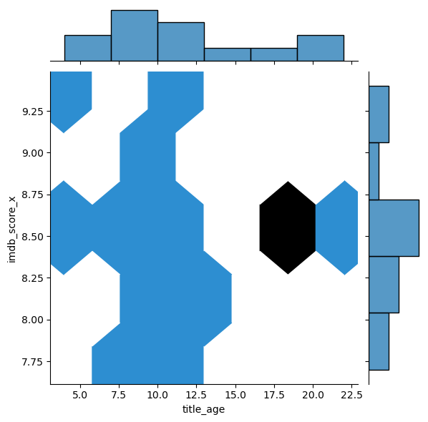
Appendix
The hexbin plot provides a visual representation of the distribution of IMDB score x for different title age values. The colour of each hexagon represents the density of the data points in that bin. Darker colours represent higher densities.

Slide 15
THANK YOU!

