Slide 1
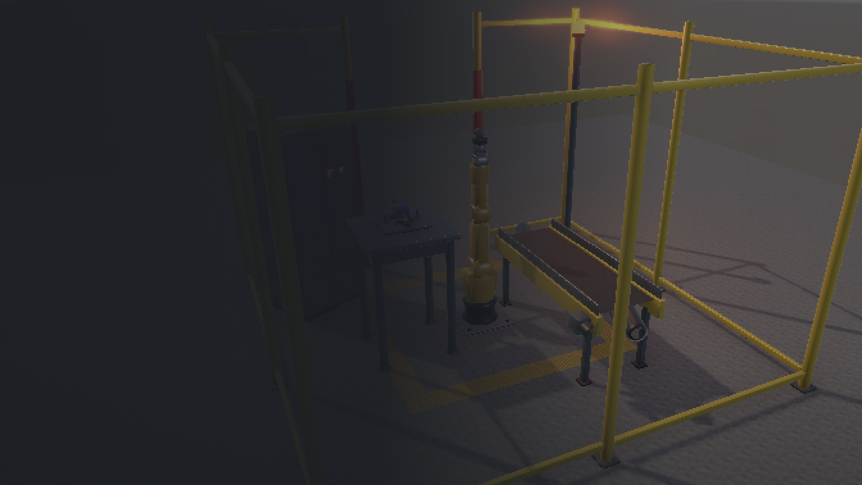
Virtual Teach Pendant Trainer
for Industrial Robot Programming in Virtual Reality
MTE 4442 Augmented Reality and Virtual Reality · Mini Project
Sriprada Bhat 230929312
Giridhar Pai 230929002
Nakhuda Mohammed Yusuf 230929320
Mohammed Zayn 230929186
Guide: Dr Asha C S
Department of Mechatronics Engineering
Manipal Institute of Technology, MAHE, Manipal
Notes:
Title slide. Introduce the team, the course and the guide, then state the one line idea: a VR trainer for teach pendant programming that measures the trainee.

Slide 2
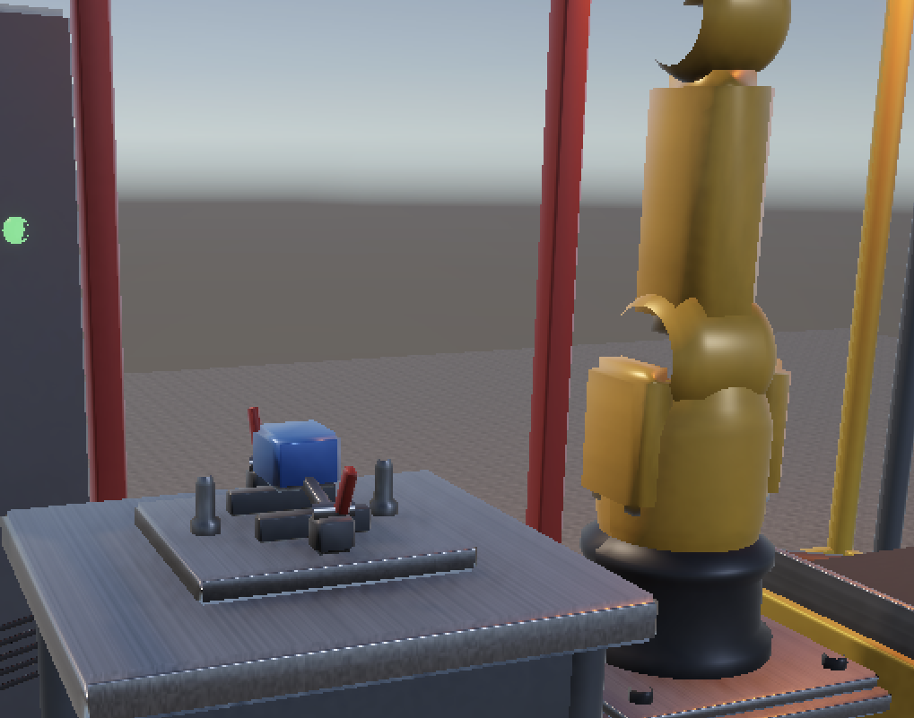
Introduction and background
Industrial robots are programmed on the shop floor with a handheld teach pendant, one joint at a time
A six axis cell with fixtures and fencing costs several lakhs of rupees, and a wrong jog can damage the arm or the fixture
Students therefore learn robot programming in theory and meet a real pendant for the first time in industry
In virtual reality a trainee stands in a full scale cell, holds a pendant, and makes mistakes that cost nothing
One of us worked with a FANUC robot and its real pendant at Future Robotics, which shaped this design
The fixture the trainee picks from, as modelled in the trainer
Sriprada Bhat
Notes:
Lead with the cost, then the consequence: no hands on practice. Mention the Future Robotics internship as the reason we knew the real workflow.

Slide 3
Problem statement, motivation and objectives
Objectives
Problem statement
Physical cells are expensive, limited and easy to break. Existing virtual tools either lack immersion or chase digital twin accuracy rather than training, and almost none record the trainee's own performance.
O1
Immersive cell with a six axis robot using real joint limits and speeds
O2
Virtual pendant: joint select, deadman jog, speed override, teach, playback
Motivation
O3
Coordinated joint motion, as a real controller runs a J move
Close the distance between simulation driven with a mouse and operation driven with a pendant in a real cell, and make the practice measurable rather than a matter of opinion.
O4
Pick and place from a machine fixture to a conveyor
O1 to O5 delivered. O6, the user study, was not carried out before submission
O5
Automatic logging of collisions, limits, cycle time and completion
O6
Compare practice in the trainer against written instructions
Sriprada Bhat
Notes:
State the problem, then the motivation, then run the six objectives quickly. Be upfront that O6 was not carried out.

Slide 4
Literature review and existing approaches
3
Foundational
Immersion and presence, and the simulator sickness questionnaire
Gaps identified
No immersive trainer puts the real pendant workflow in the trainee's hands
Performance is almost always measured by an observer with a stopwatch
Training effect for robot programming specifically is under tested
8
Applications
VR training for robots, assembly and maintenance
4
Technology
Unity digital twins for FANUC, ABB and KUKA arms
3
Specific
Virtual pendants, end effector exchange, perceptual aids
What the evidence says
Plain VR adds nothing over conventional training (Nathanael et al., 2016). Targeted feedback helps, but over assistance makes performance worse afterwards (Wolfartsberger et al., 2023). So the trainer must report consequences, not answers.
2
Reviews
Scoping and systematic reviews of AR and VR training
Nakhuda Mohammed Yusuf
Notes:
Twenty papers in five categories. The key finding is that copying the cell into VR is not enough; the trainer has to tell the trainee something the real cell does not, which is where our measurement layer comes from.

Slide 5
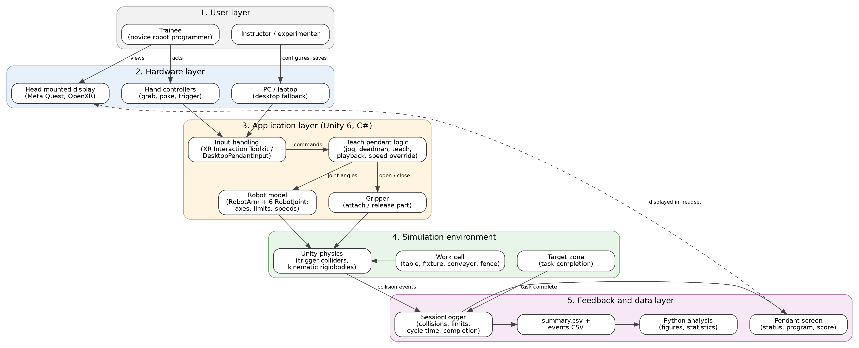
Methodology and system architecture
Five layer architecture: user, hardware, application, simulation, and feedback and data
Nakhuda Mohammed Yusuf
Notes:
Walk the five layers bottom up. The design decision worth calling out is that the pendant logic never reads hardware directly: keyboard and VR controller drive the same interface, so the whole trainer was built and tested on a laptop.

Slide 6
Tools, technologies and data
Unity 6
No external dataset
6000.x LTS with the Universal Render Pipeline, chosen for headset frame rate
The project generates its own measurement data at run time. Each session writes one row to summary.csv plus a timestamped event file, which the Python script reads directly. Nothing is downloaded and no third party dataset is used.
C#
Fourteen runtime scripts and four editor scripts, about 2,700 lines
OpenXR, XR Toolkit
Headset and controller support, exercised through the XR Device Simulator
All geometry is generated in code
Three primitives build the whole cell: a lathe that revolves a profile, a bevelled box with chamfered edges, and a textured quad. Textures come from deterministic noise. Nothing is downloaded, there is no asset licence, and the cell rebuilds from one menu item on any machine.
Python
pandas, matplotlib and scipy for the analysis and the figures
Meta Quest
Target headset for the VR layer, with a desktop keyboard fallback
Giridhar Pai
Notes:
Keep this brisk. The two points that matter are that there is no external dataset, and that the geometry is generated rather than downloaded, which makes the project reproducible with no licence question.

Slide 7
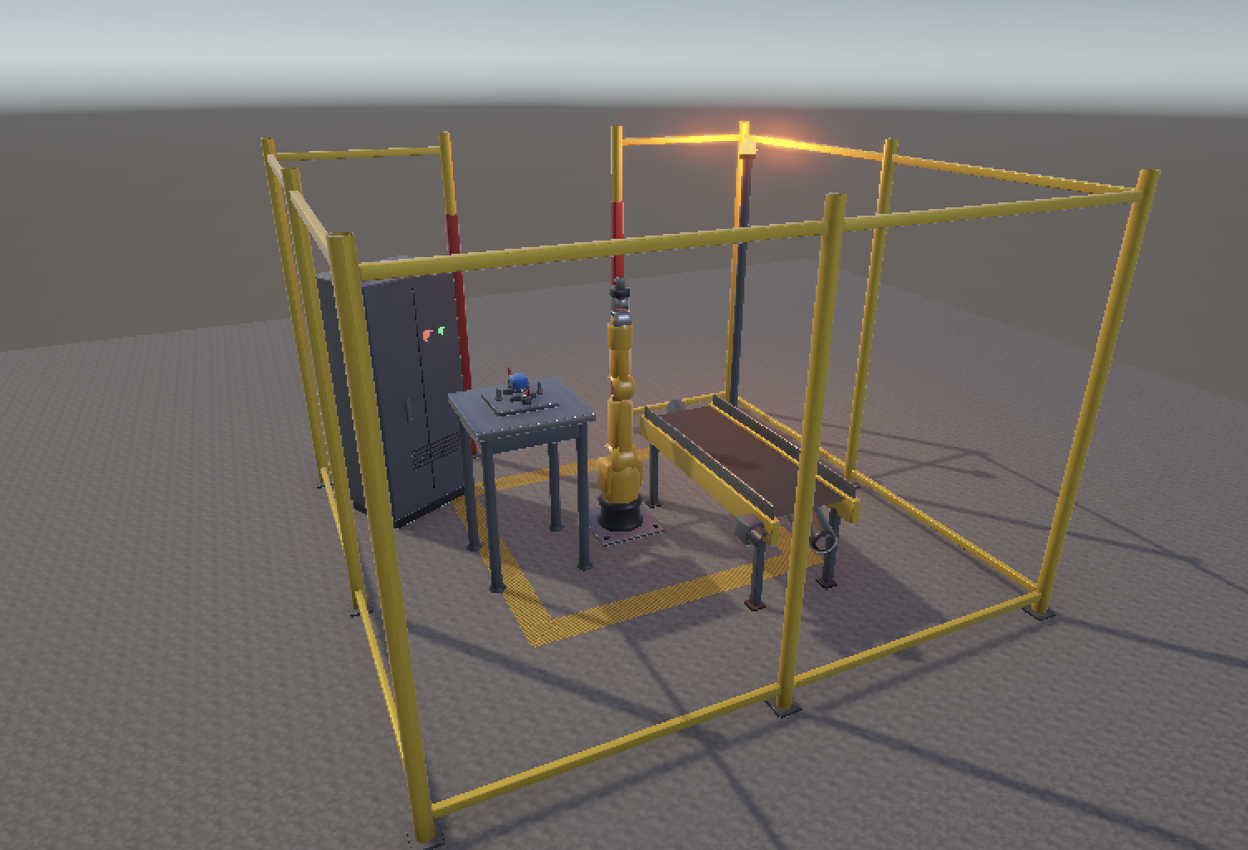
Implementation: the cell, and a kinematic defect
The part was out of reach
0.590 m
the wrist centre's reach from the shoulder
0.680 m
where the wrist had to be for a straight down pick
90 mm
short, so no amount of jogging could reach it
Found by solving the kinematic chain numerically, not by trial and error. Corrected by raising the robot onto a 0.40 m pedestal and lowering the table to 0.60 m. Every taught point now sits at 81 to 87 percent of the wrist's reach, so the arm keeps a visible bend. A real LR Mate cell uses a pedestal for the same reason.
Robot on its pedestal, machine table with fixture, belt conveyor, wire mesh fencing, cabinet and beacon
Giridhar Pai
Notes:
This is the strongest engineering story. The part was literally unreachable for a top down pick, we proved it by solving the chain, and fixed it with the pedestal.

Slide 8
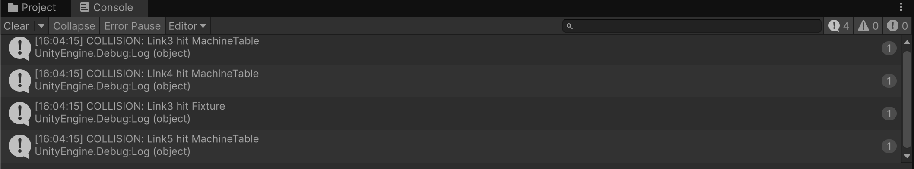
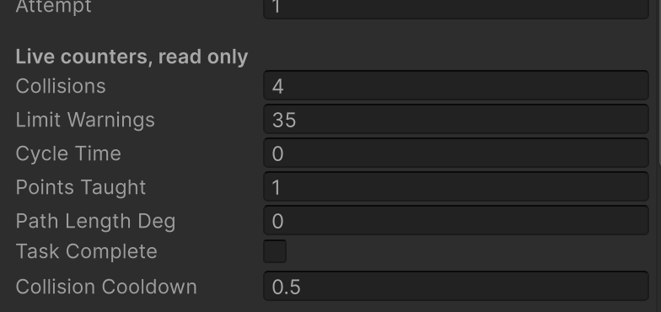
Implementation: pendant workflow and measurement
1
Select a joint
Collisions
Joint limits
Cycle time
keys 1 to 6, as on a real pendant
Hold the deadman
Points taught
Joint travel
Task complete
2
nothing moves unless it is held
3
Jog into position
with a speed override saved per point
4
Teach the point
six joint angles plus a gripper action
Each collision names the link and the object struck, with a timestamp
5
Play it back
all six joints start and finish together
Ten quantities are logged per session, with no observer present
Counters update live during a run
Mohammed Zayn
Notes:
Walk the five steps, then the measurement. The gap in the literature was that nobody measures the trainee automatically; this is our answer to it.

Slide 9
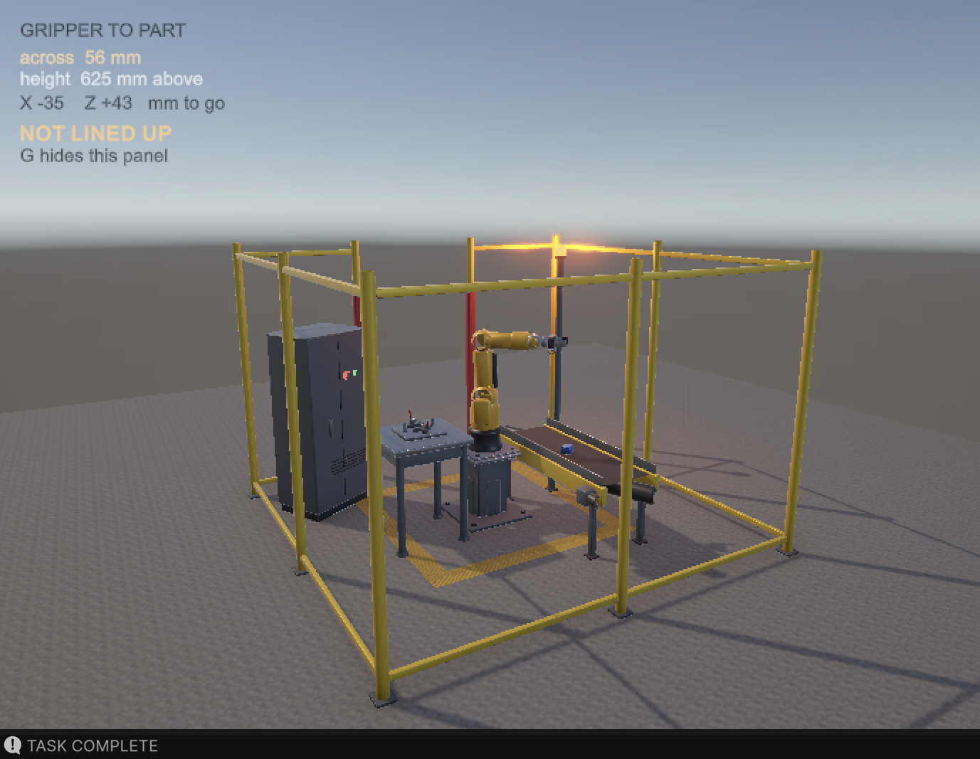
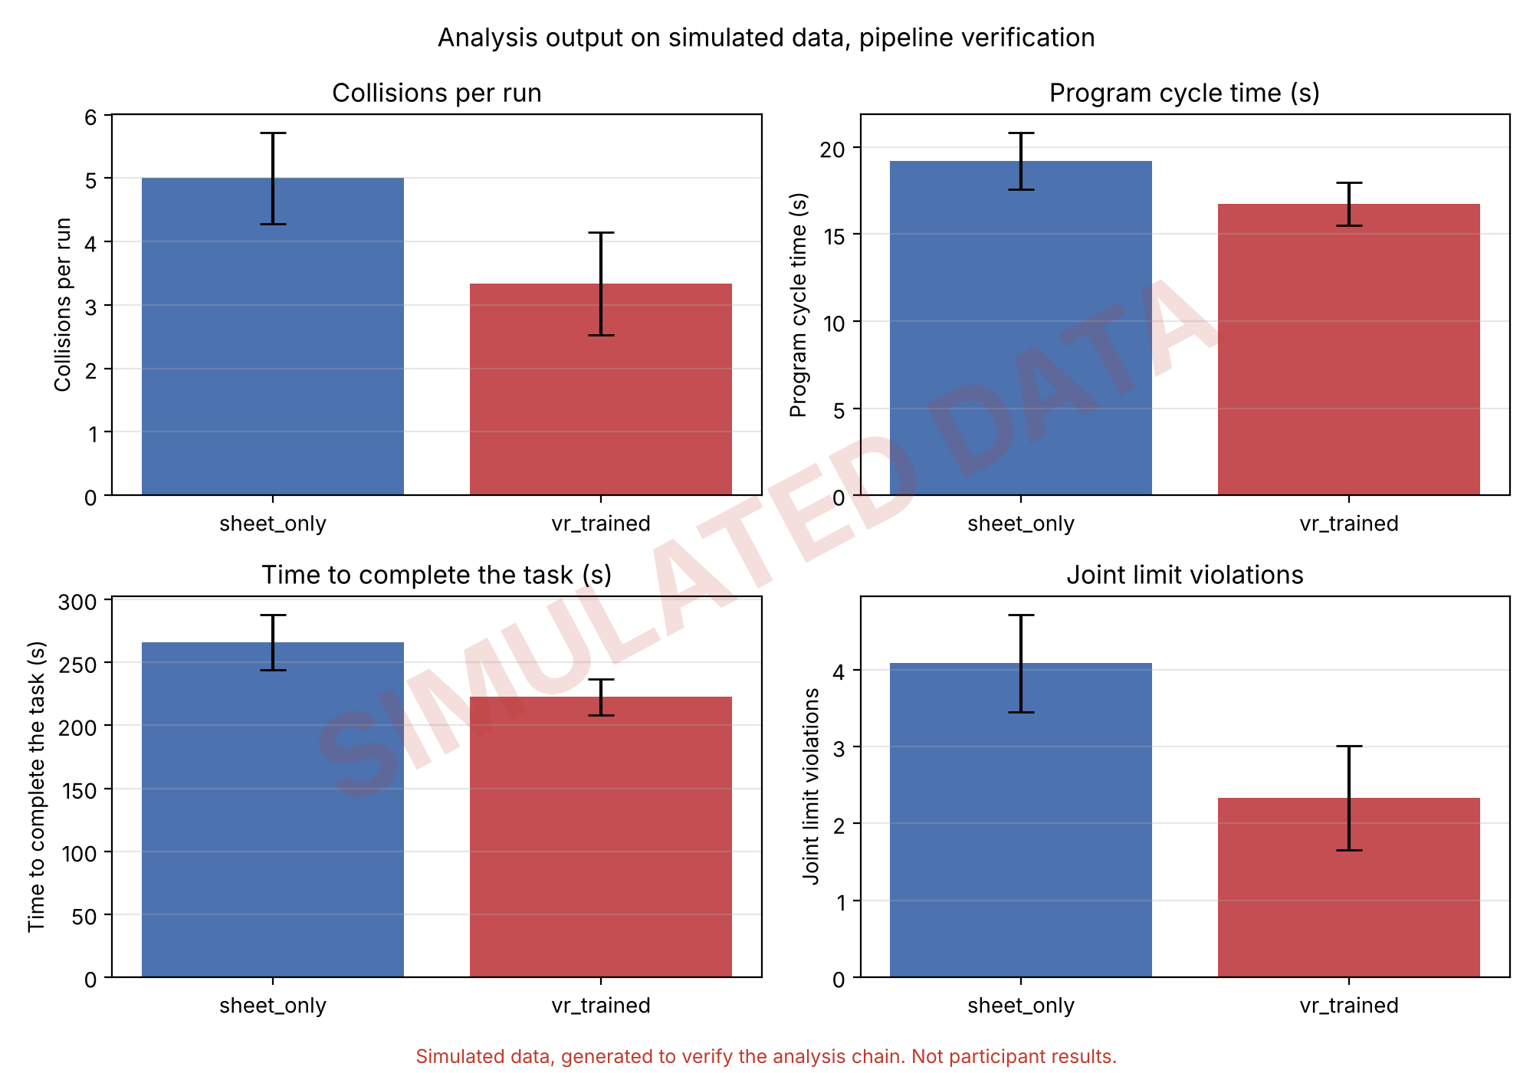
Results, testing and demonstration
Deadman released mid jog
Arm stopped instantly
Joint driven past its limit
Stopped at the limit, counted
Link driven into the table
Collision named and counted
Gripper closed on the part
Picked up and carried
Released over the conveyor
Dropped onto the belt
Task completed: part placed on the conveyor
Session saved
summary.csv and event file written
Cycle time repeatability
Not performed before submission
Nine of ten test cases passed
A logged pilot run recorded 4 collisions and 35 joint limit warnings while the arm was jogged towards the fixture. A high limit count is an operator holding a joint against its stop, which is the behaviour the trainer exists to surface. Developer pilot runs, not participant data.
The analysis chain verified end to end. Simulated data, not participant results
Mohammed Zayn
Notes:
Nine of ten passed, and we list the one that was not run as not run. The pilot numbers are ours, not participants'. The analysis figure is watermarked because the data behind it is simulated, used only to verify the chain.

Slide 10
Individual contributions
Sriprada Bhat 230929312
Giridhar Pai 230929002
Problem definition and objectives; literature review of the robot training studies; RobotJoint, RobotArm and TeachPendant; diagnosed and specified the fix for the reach defect; report Chapters 1, 2, 3 and 7
Requirements and technology selection; Unity project setup and the repository; MeshKit, TextureKit, AssetForge and the two cell builders; rebuilt the geometry procedurally; OpenXR setup and the progress screenshots
Nakhuda Mohammed Yusuf 230929320
Mohammed Zayn 230929186
Literature review of the assembly, maintenance and review papers; the architecture, use case, activity and flow diagrams; CellSafety, SessionLogger, TargetZone and analyse.py; the CSV export and the provenance watermarking
Test planning and execution of the ten cases; the experimental protocol and participant materials; DesktopPendantInput and PickAssist; pilot sessions; verified the logger schema against the analysis script
All members
Notes:
Each member speaks to their own card for fifteen seconds. Be ready to be asked about any module listed against your name.

Slide 11
Conclusion and future scope
Delivered
Future scope
Cell, robot model, pendant logic, pick and place, measurement layer, CSV export, analysis pipeline. Nine of ten test cases passed.
Run the twelve participant study and report the result, with no development work needed
Build the handheld pendant object with a world space screen and validate on a headset
Use the generated mesh geometry for collision instead of per link box volumes
Add an inverse kinematics solver so linear moves can be taught alongside joint moves
Measure cycle time repeatability across repeated playbacks, test T9
Add further tasks and cell layouts so transfer between tasks can be measured
Partly done
The VR layer runs in the device simulator. The handheld pendant object and headset validation were not built.
Not carried out
The user study. Protocol, instrument and analysis are complete and verified; no participants were run before submission.
The research question, whether a short period of practice measurably improves first time robot programming, remains open. What the project establishes is that it can now be answered cheaply and objectively, because the instrument exists and has been verified.
All members
Notes:
Close on what is finished, what is partial and what was not done, then the future scope. The honesty is deliberate and defensible.

Slide 12
References, repository and demonstration
Key references
GitHub repository
Nathanael, D., Mosialos, S., & Vosniakos, G.-C. (2016). Development and evaluation of a virtual training environment for on-line robot programming. Int. J. Industrial Ergonomics, 53, 274-283.
Monetti, F. M., et al. (2022). An experimental study of the impact of virtual reality training on manufacturing operators on industrial robotic tasks. Procedia CIRP, 106, 33-38.
Wolfartsberger, J., et al. (2023). Analyzing the potential of virtual reality-supported training for industrial assembly tasks. Computers in Industry, 147, 103838.
Kovac, J., Malega, P., & Vaulin, P. (2026). Development and laboratory feasibility validation of a virtual reality simulation model for robotic end-effector assembly training. Modelling, 7(4), 125.
Pratticò, F. G., & Lamberti, F. (2021). Towards the adoption of virtual reality training systems for the self-tuition of industrial robot operators. Computers in Industry, 129, 103446.
The full list of 20 references appears in Chapter 7 of the project report.
ADD REPOSITORY LINK HERE BEFORE SUBMITTING
Source code, README with run instructions, Unity project, analysis script, and the demonstration video and audio in the Media folder.
Demonstration video
In the Media folder of the repository above.
Thank you
Sriprada Bhat · Giridhar Pai · Nakhuda Mohammed Yusuf · Mohammed Zayn
Questions welcome
Notes:
Close the deck. Have ready: why no inverse kinematics, why the gripper parents the part, where the joint limits came from, and why the visual meshes carry no colliders. Open the repository link if asked.

