Slide 1
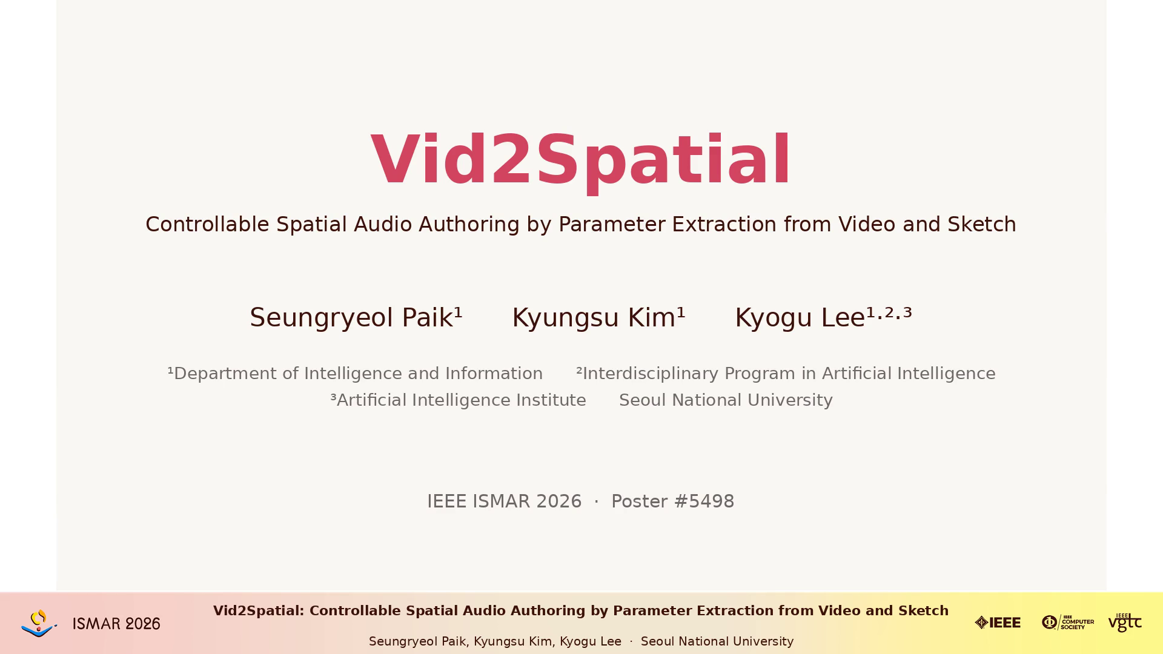
Vid2Spatial: Controllable Spatial Audio Authoring by Parameter Extraction from Video and Sketch
Seungryeol Paik, Kyungsu Kim, Kyogu Lee — Seoul National University

