Slide 1
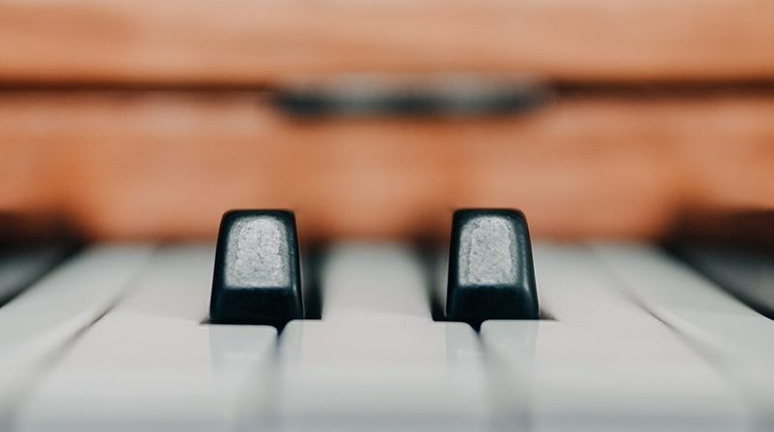
E-Piano
By:Pai Liu ,Xinyu Liu,Wenjun Ma

Slide 2
Our Motivation
The one of the best way to practice and learn the sense of music
Easy to make with code and software
First time try with hardware and logic gate

Slide 3
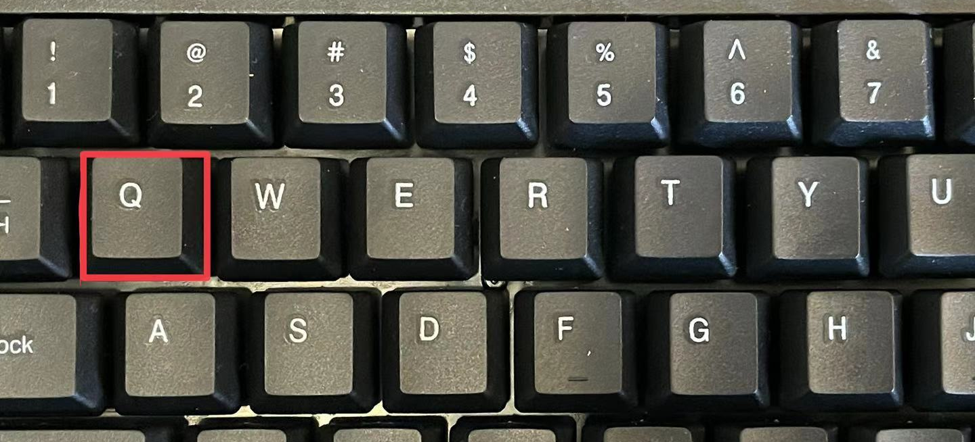
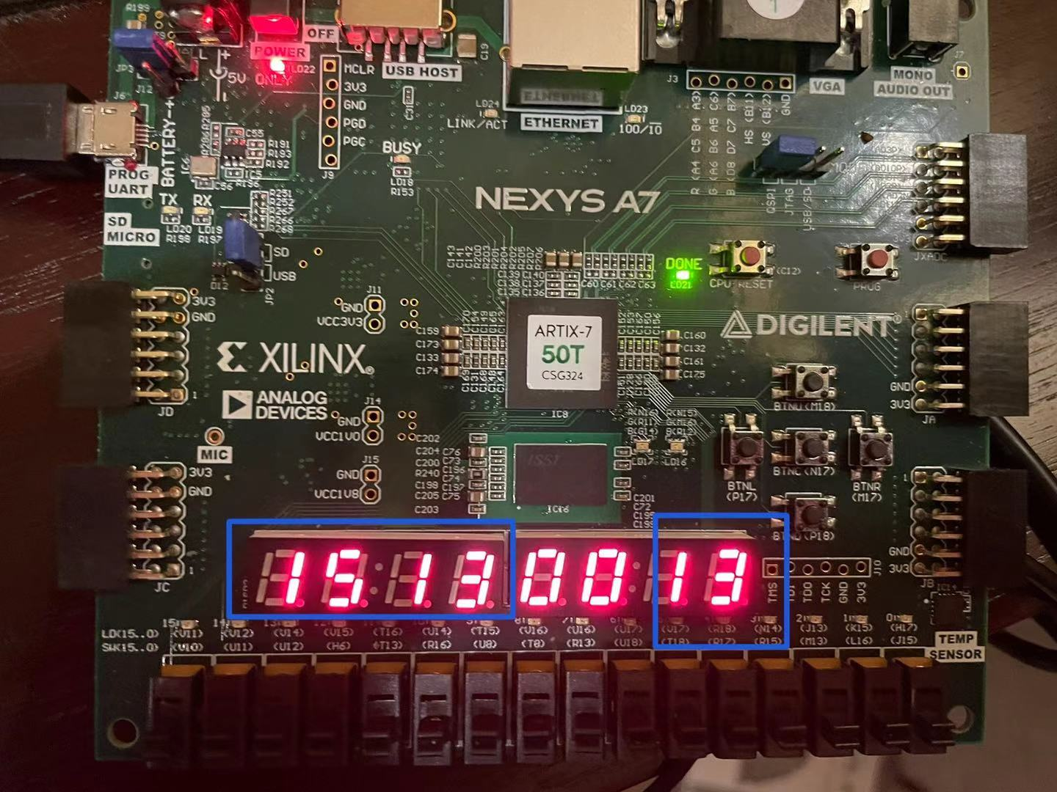
Functionality
Press the key on keyboard
Display
Sound

Slide 4
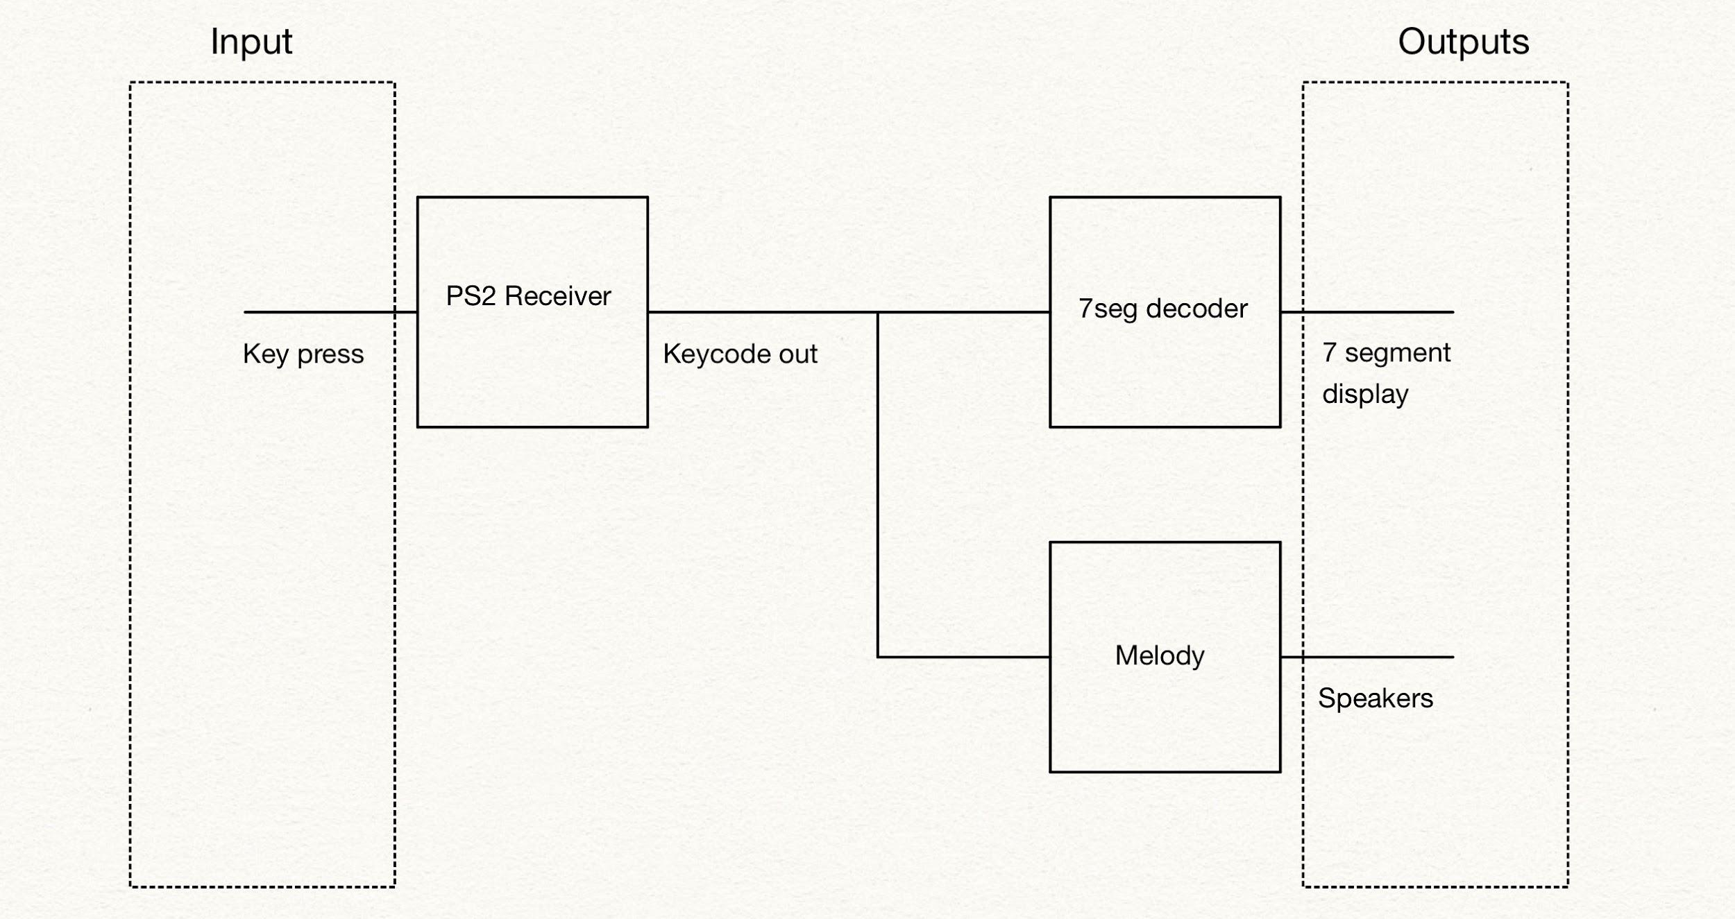
Block Diagram

Slide 5
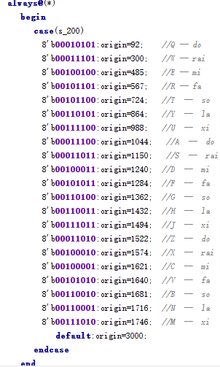
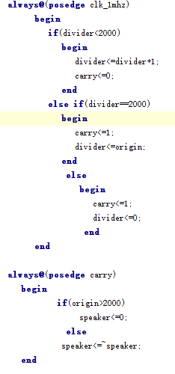
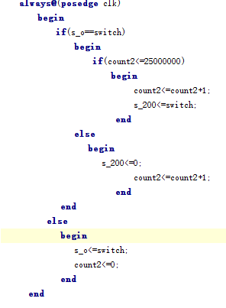
Code snippet--1 Melody

Slide 6
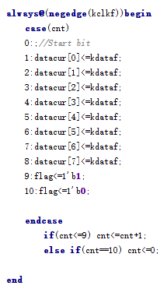
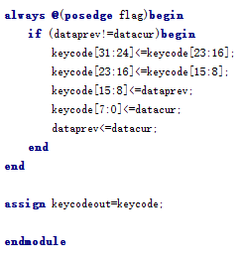
Code snippet--2 PS2 Receiver

Slide 7
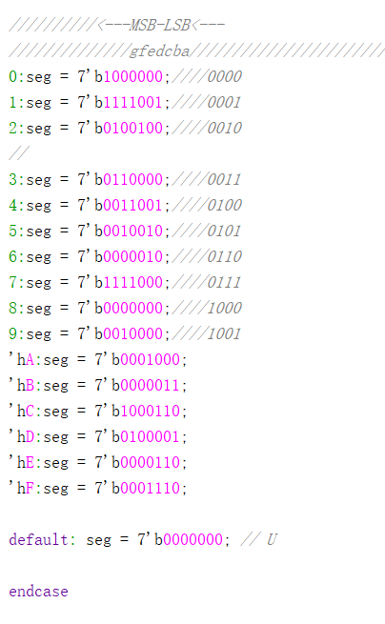
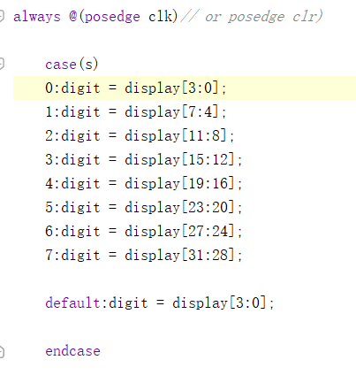
Code snippet--3 7-segment display

Slide 8
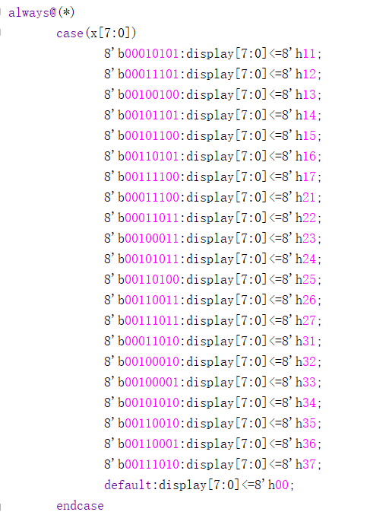
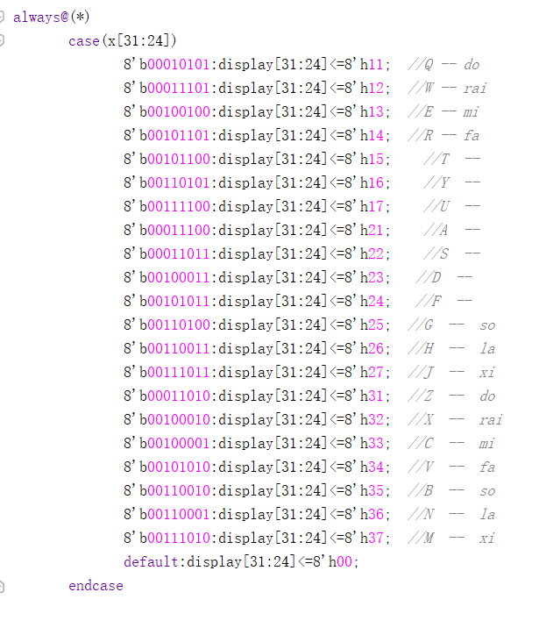

Slide 9
Successes
Previous lab: 7 Segment display, speaker, and clock.
What’s New: keyboard, and PS2 decoder.

Slide 10

Failure
The harmony of two key at same time is not functional
The 3rd and 4th digit of 7-segment display will show “00” instead of the key that user click before.

Slide 11
Future Plan
Additional mode: Learning Mode
The 7 segment display will tell the user which key need to push next, and finally end up with a song.
Memory Mode:
FPGA will play back what you just play.

Slide 12
Demo
finalppt2.mp4

Slide 13
BE HEALTHY & BE SAFE
THANKS!

