Slide 1

DEPARTMENT OF ELECTRONICS AND COMMUNICATION DESIGN OF REAL TIME SPEECH RECOGNITION SYSTEM VIII SEMESTER SESSION: JAN – JUN 2017
SUBMITTED BY: GUIDE:
DHANANJAY KUMAR K L (1PI13EC030) Dr.MANIKANDAN J
KARAN G BARHANPUR (1PI13EC039) Professor, ECE Dept
KIRAN UDAY PAI (1PI13EC041)

Slide 2
METHODOLOGY

Slide 3
END POINT DETECTION
The Speech Recognition system first addresses the issue of finding the endpoints of speech in a waveform.
The algorithm finds the start and end of speech in a given waveform
This algorithm gives the entire region where speech exists in an input signal.

Slide 4
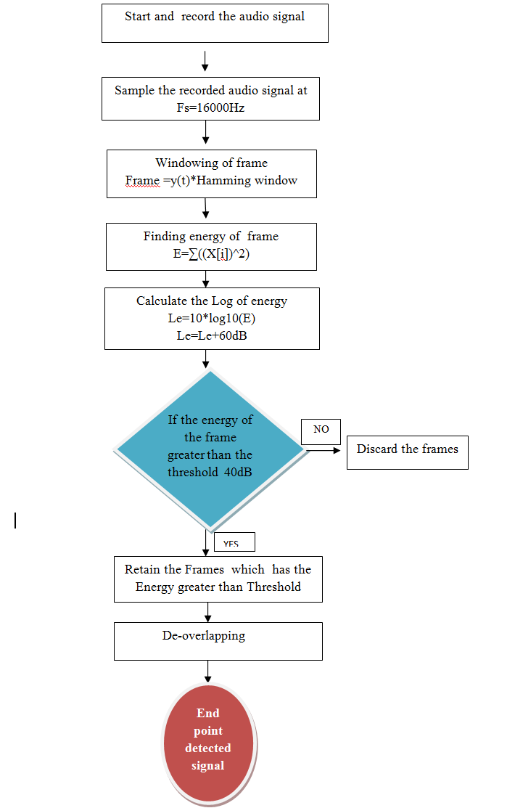
END POINT DETECTION FLOWCHART

Slide 5
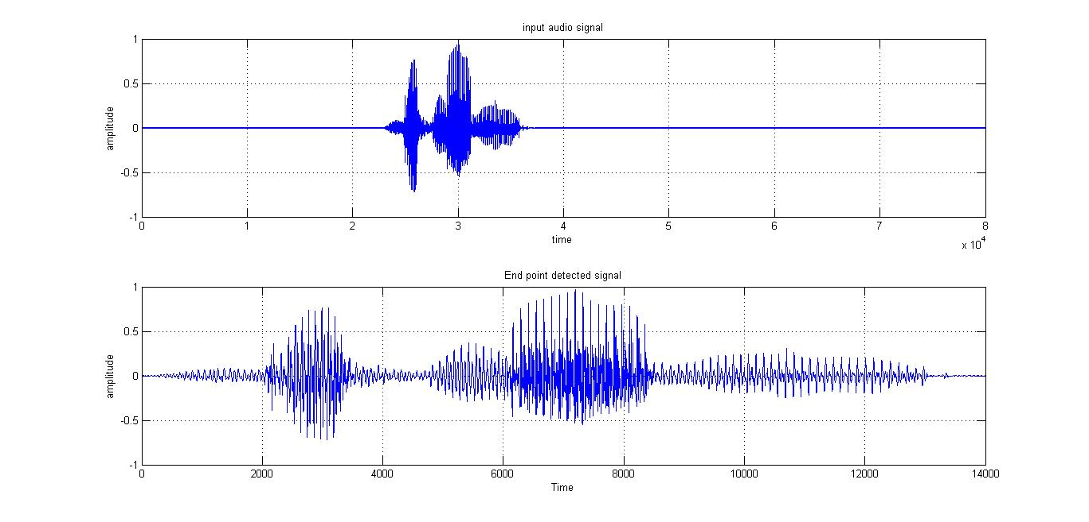
END POINT DETECTION

Slide 6
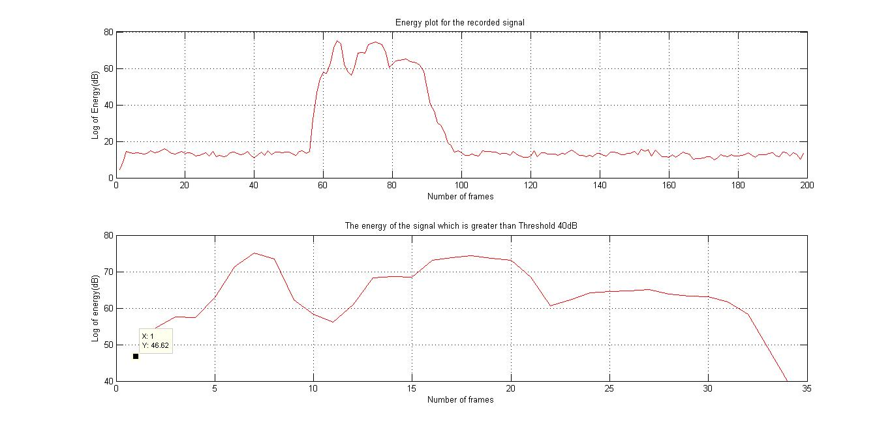
END POINT DETECTION

Slide 7
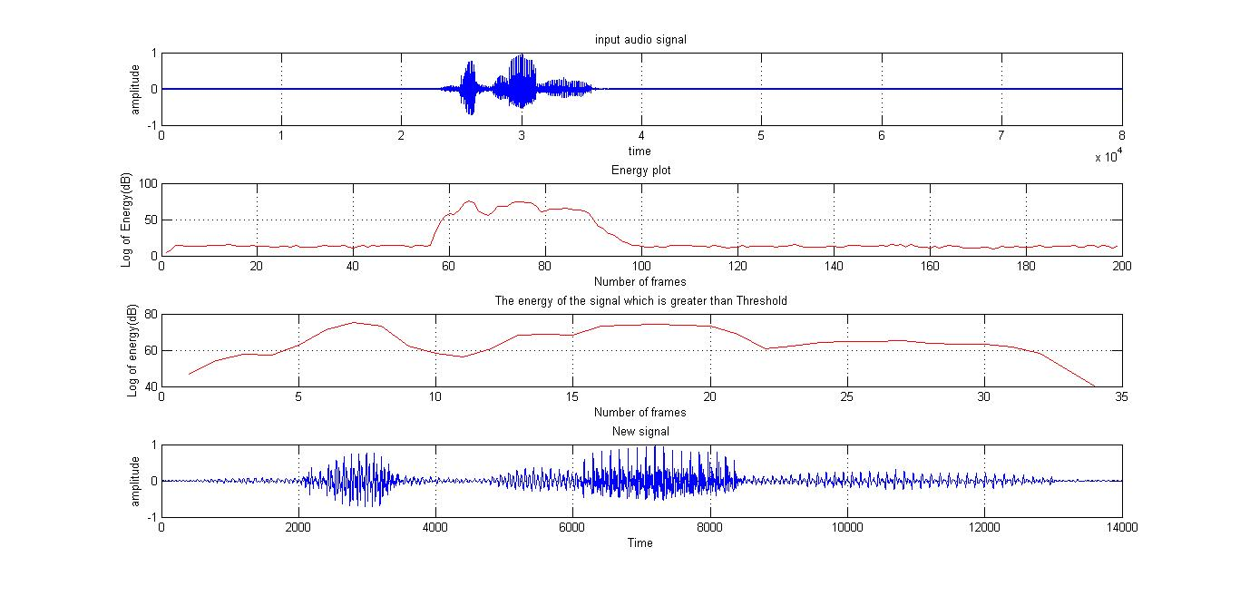
END POINT DETECTION

Slide 8
FEATURE EXTRACTION
MFCC
Frame the signal into short frames.
For each frame calculate the periodogram estimate of the power spectrum.
Apply the Mel filter bank to the power spectra, sum the energy in each filter.
Take the logarithm of all filter bank energies.
Take the DCT of the log filter bank energies.
Keep DCT coefficients 2-13, discard the rest.

Slide 9
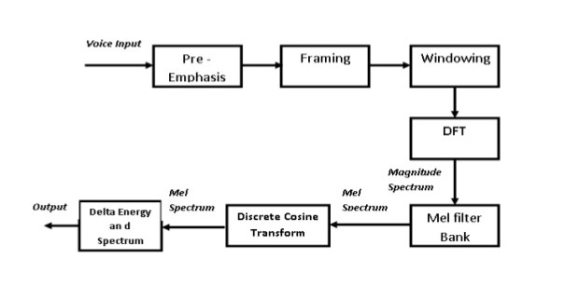
MFCC FLOWCHART

Slide 10
PRE-EMPHASIS
Designed to increase the magnitude of some higher frequencies
In lower frequency components it improves the overall signal-to-noise ratio
The equation for the filter is given by
Y[n]= X[n]-0.95X[n-1]

Slide 11
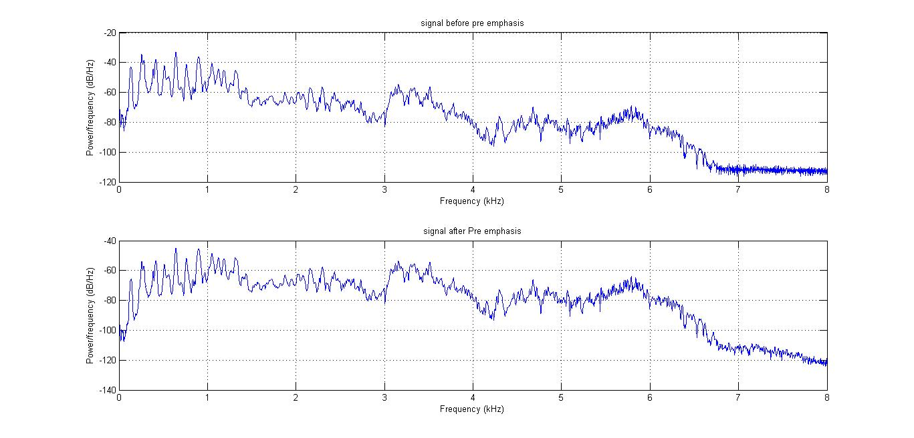
PRE-EMPHASIS PLOT

Slide 12
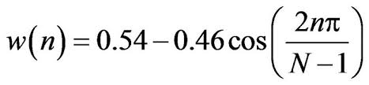
FRAMING AND WINDOWING
We frame the signal into 25ms frames with 10ms of overlapping.
Windowing is done using Hamming window.
Each frame is multiplied with the window.
Signal in a frame is denoted by
Y [n], n = 0,…N-1
Then the signal after Hamming windowing is,
Y [n] × w[n]
where w [n] is the Hamming window defined by

Slide 13

DFT
Windowed signal is further converted into frequency domain using DFT
where h(n) is an N sample long analysis window (e.g. hamming window), and K is the length of the DFT
S_{i}(k)=
1

Slide 14

POWER CALCULATION
The periodogram-based power spectral estimate for the speech frame s_{i}(n) is given by
P_{i}(k)=
The absolute value of the complex fourier transform is taken and squared.
A 512 point FFT is performed but only the first 257 coefficents are kept.

Slide 15
DESIGN OF MEL FILTER BANKS
Mel spaced filter bank is a set of 26 triangular filters that we apply to the periodogram power spectral estimate.
The formula for converting from frequency to Mel scale is:
M(f)=1127 ln(1+f/700)
To go from Mels back to frequency:
M⁻¹(f)=700[exp(m/1127)-1]

Slide 16
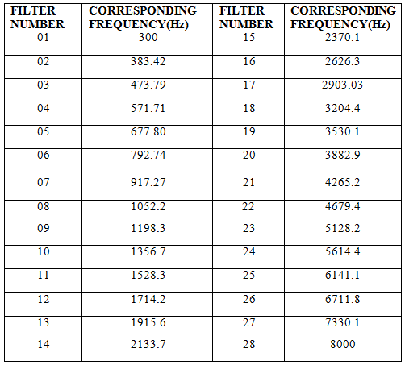
MFCC FILTER BANKS AND THEIR CORRESPONDING FREQUENCIES

Slide 17
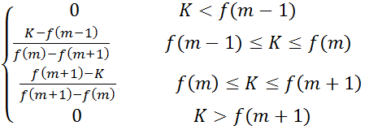
DESIGN OF MEL FILTER BANKS
Formula to create filterbanks
where M is the number of filters we want, and f( ) is the list of M+2 Mel-spaced frequencies.
Hm (K)=

Slide 18
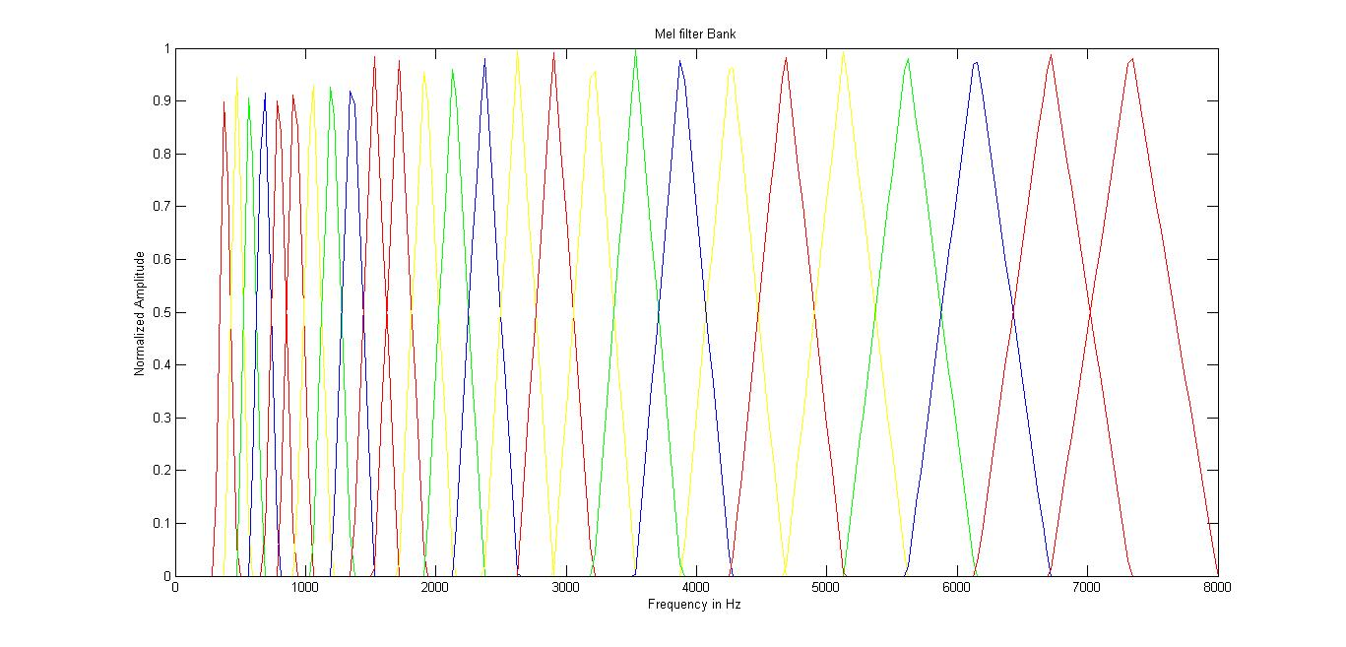
MEL FILTER BANK

Slide 19
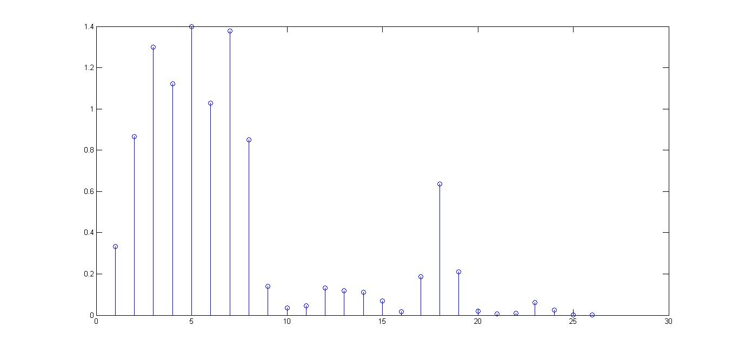
POWER IN FILTERBANKS
Multiply periodogram power spectral estimate with Mel filter banks.
Our filter bank comes in the form of 26 vectors of length 257.

Slide 20
DISCRETE COSINE TRANSFORM
The Discrete Cosine Transform (DCT) of the 26 log filter bank energies is taken to give 26 cepstral coefficients.
For ASR, only the lower 12-13 of the 26 coefficients are kept.

Slide 21
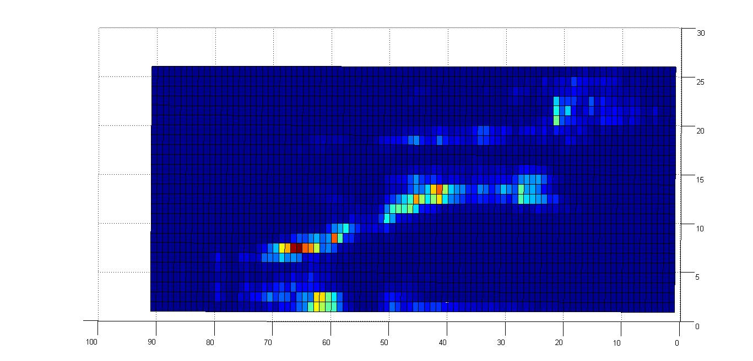
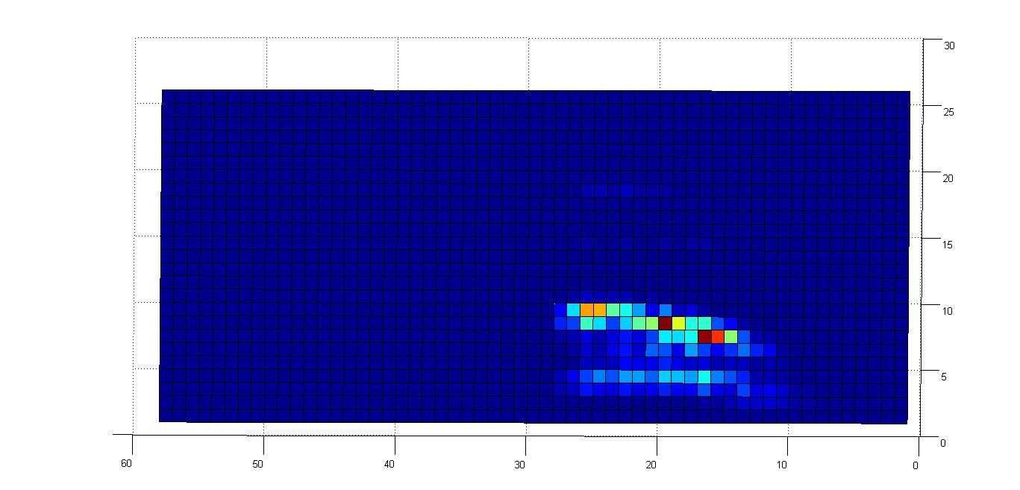
SURF PLOT FOR DIGIT ZERO
SURF PLOT FOR DIGIT ONE

Slide 22
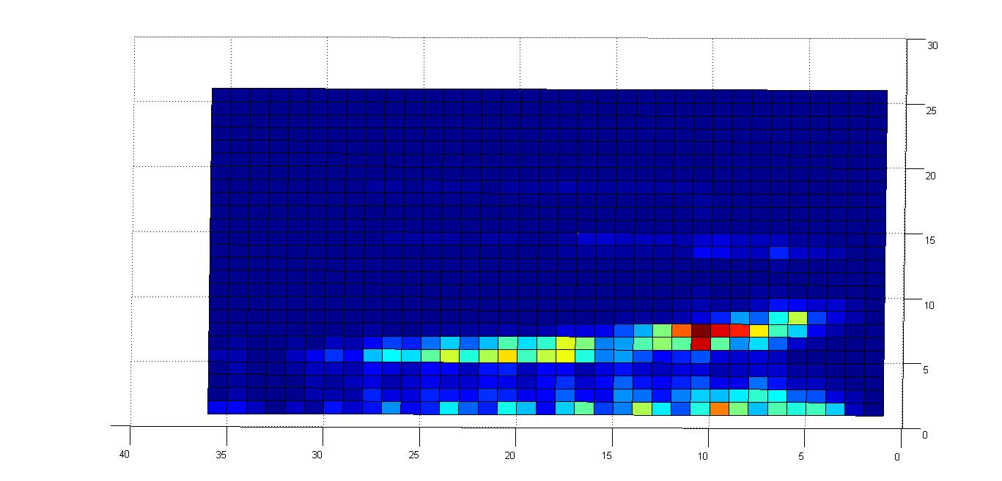
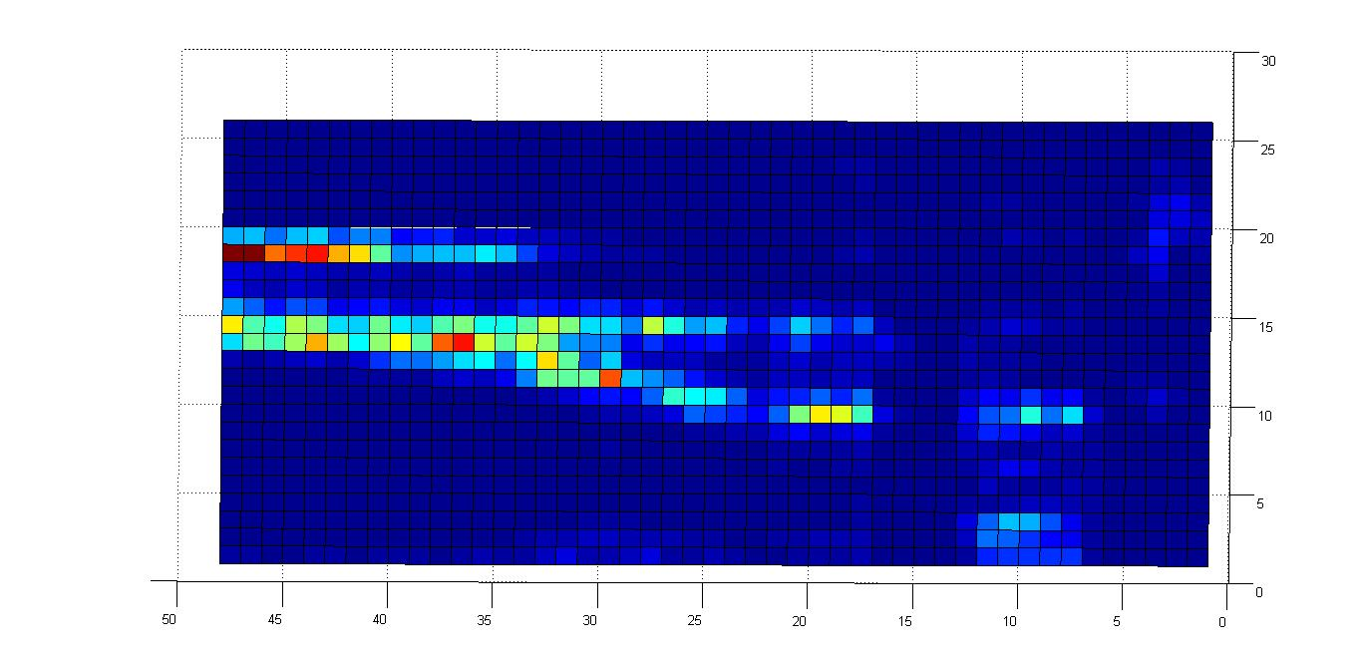
SURF PLOT FOR TWO
SURF PLOT FOR THREE

Slide 23
THANK YOU

