Slide 1

DEPARTMENT OF ELECTRONICS AND COMMUNICATION DESIGN OF REAL TIME SPEECH RECOGNITION SYSTEM VIII SEMESTER SESSION: JAN – JUN 2017
SUBMITTED BY: GUIDE:
DHANANJAY KUMAR K L (1PI13EC030) Dr.MANIKANDAN J
KARAN G BARHANPUR (1PI13EC039) Professor, ECE Dept
KIRAN UDAY PAI (1PI13EC041)

Slide 2
METHODOLOGY

Slide 3
FEATURE EXTRACTION
MFCC
Frame the signal into short frames.
For each frame calculate the periodogram estimate of the power spectrum.
Apply the Mel filter bank to the power spectra, sum the energy in each filter.
Take the logarithm of all filter bank energies.
Take the DCT of the log filter bank energies.
Keep DCT coefficients 2-13, discard the rest.

Slide 4
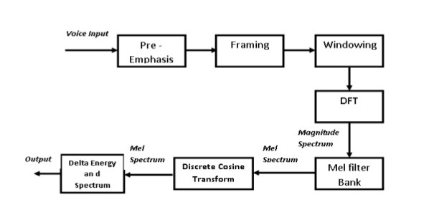
MFCC FLOWCHART

Slide 5
DISCRETE COSINE TRANSFORM
The Discrete Cosine Transform (DCT) of the 26 log filter bank energies is taken to give 26 cepstral coefficients.
For ASR, only the 12 of the 26 coefficients are kept.

Slide 6
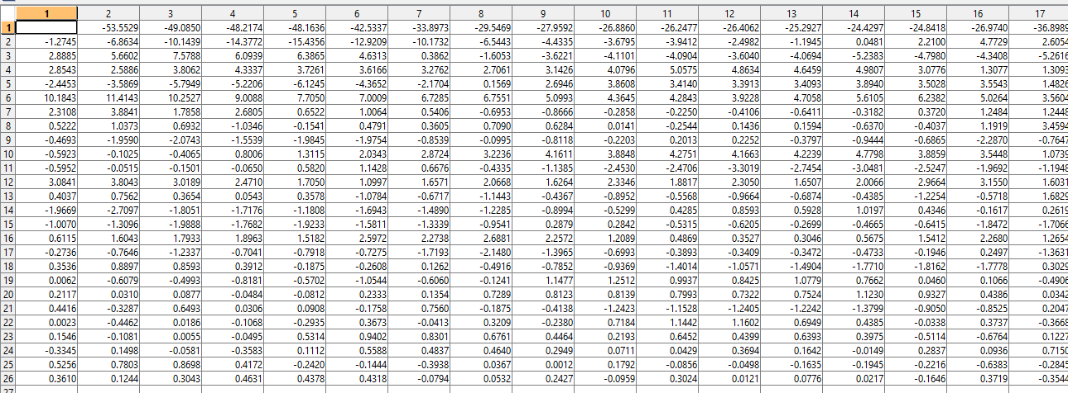
DCT COEFFICIENTS FOR DIGIT ZERO

Slide 7
DELTA COEFFICIENTS CALCULATION
Delta coefficients are calculated using the formula
c^{t}_{i} =c^{t+1}_{i} - c^{t-1}_{i}
where i varies from 1 to 26 and t represents frame number

Slide 8
DIFFERENT APPROACH OF CLASSIFICATION
Three different ways
Euclidean Classifier using Filter banks
SVM classifier using Filter banks
SVM classifier using MFCC and Delta coefficients

Slide 9
EUCLIDEAN CLASSIFIER USING FILTERBANKS
Filter bank which has maximum power for each Frame is computed.
For every frame if the power is above some threshold we retain the filter bank number.
Else set the filter bank number to zero.
Now this data is stored as a array of frames.
We use this array as the reference matrix

Slide 10
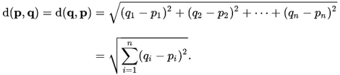
EUCLIDEAN CLASSIFIER USING FILTERBANKS
Euclidean distance is calculated using the formula
The obtained array is compared with the reference matrix.
The index of the array with minimum distance is displayed.
The efficiency was found to be 65-70%

Slide 11
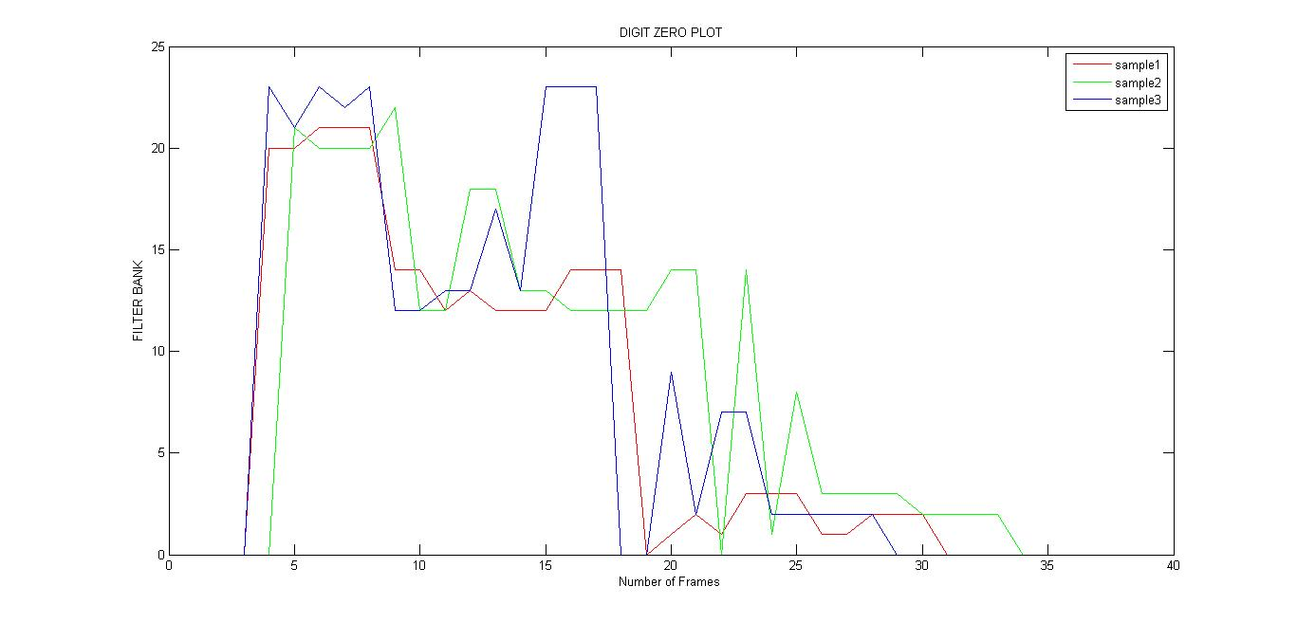
FILTERBANK ARRAY FOR DIGIT ZERO

Slide 12
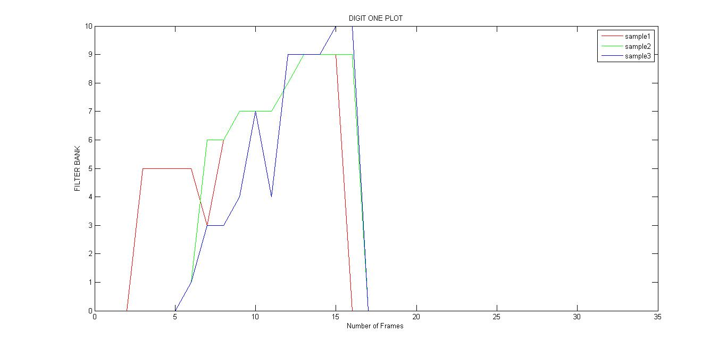
FILTERBANK ARRAY FOR DIGIT ONE

Slide 13
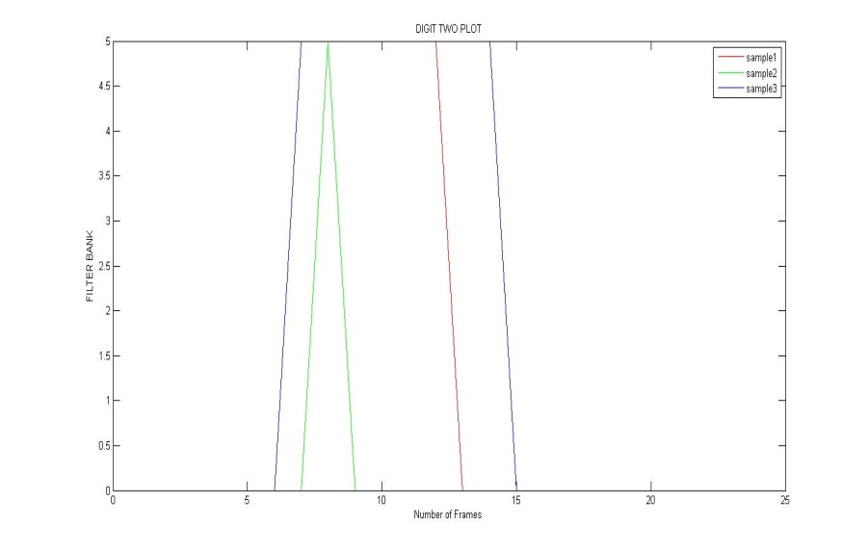
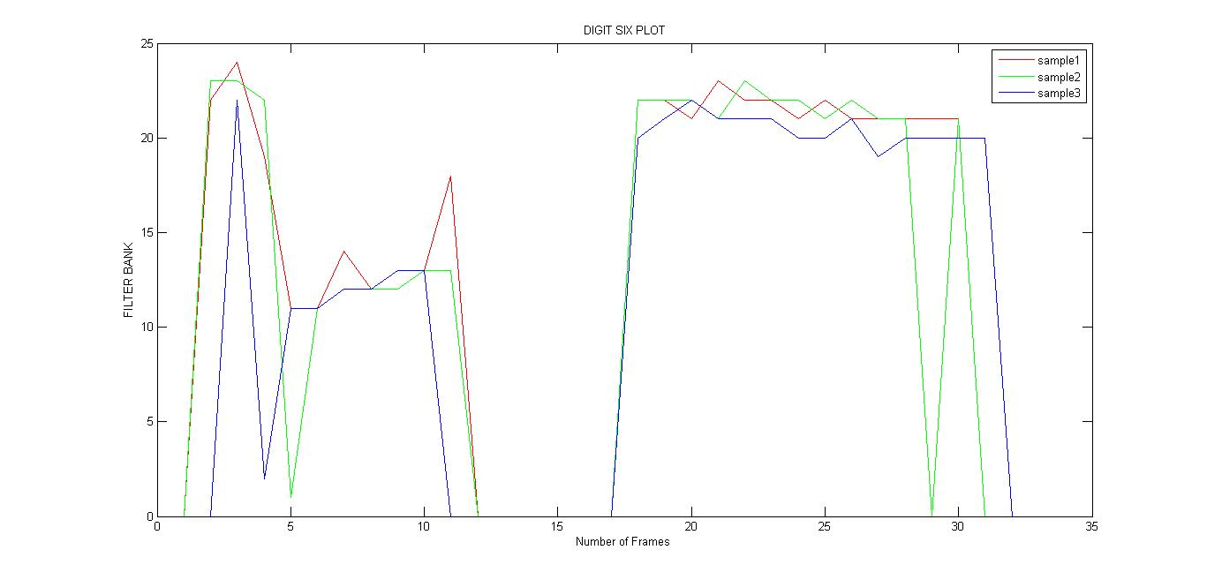
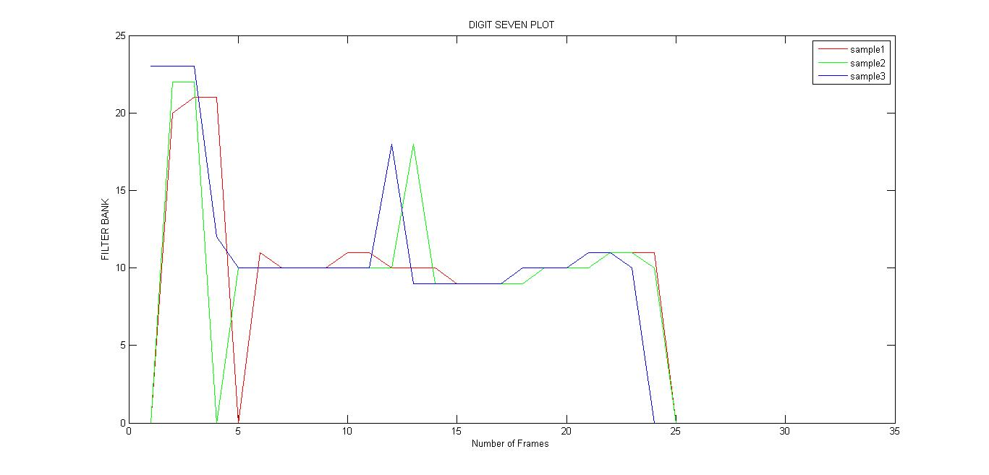
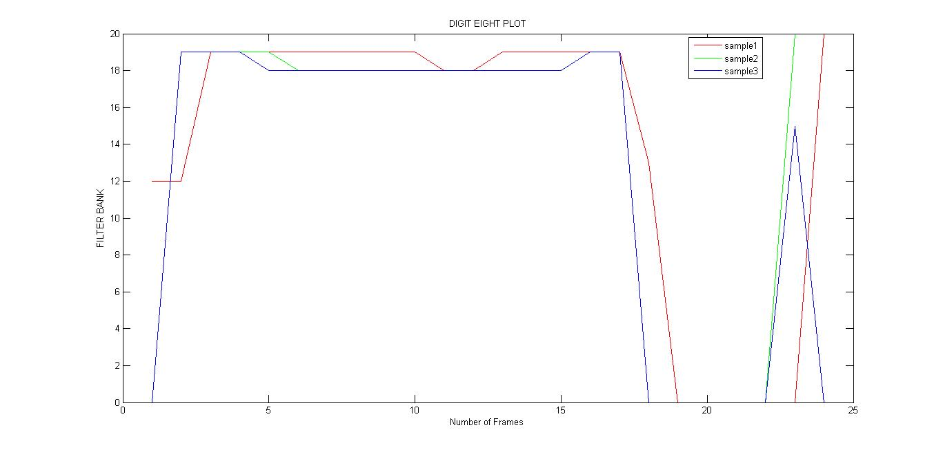
FILTERBANK ARRAY FOR OTHER DIGITS

Slide 14
SUPPORT VECTOR MACHINE(SVM)
SVM is a supervised learning model
A Support Vector Machine is a discriminative classifier formally defined by a separating hyper plane. In other words, given labeled training data (supervised learning), the algorithm outputs an optimal hyper plane which categorizes new examples.

Slide 15
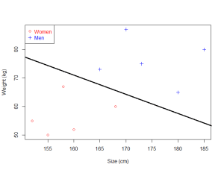
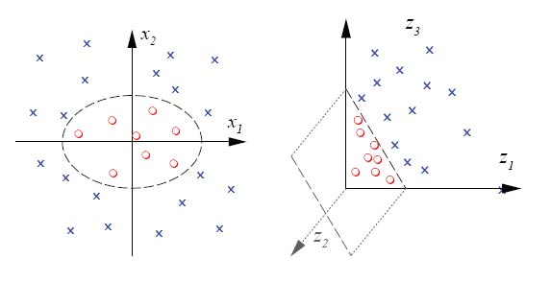
SVM MODEL LINEAR AND NON-LINEAR DATASETS

Slide 16
SVM classifier using Filter banks
Filter bank which has maximum power for each Frame is computed.
For every frame if the power is above some threshold we retain the filter bank number
Then we trained the dataset with SVM classifier

Slide 17
PHONEMES
A Phoneme is a unit of sound in speech.
when you put phonemes together, they can make words.
The third technique is based on this approach

Slide 18
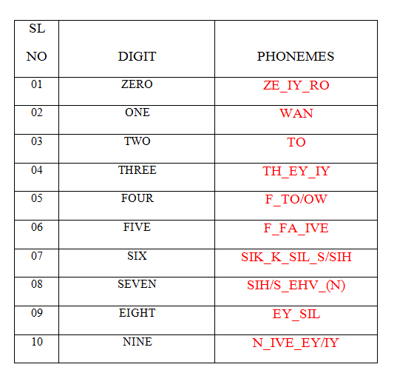
PHONEMES FOR DIGITS

Slide 19
DIGIT RECOGNITION USING PHONETIC APPROACH
Here we use two SVM classifiers.
One to extract the phonemes.
Second to detect the digits based on the extracted phonemes.
A total of 17 phonemes are detected for digits 0 to 9.
Our first classifier detects the phonemes from the speech.
Second classifier then detects the digits based on the phonemes obtained.

Slide 20
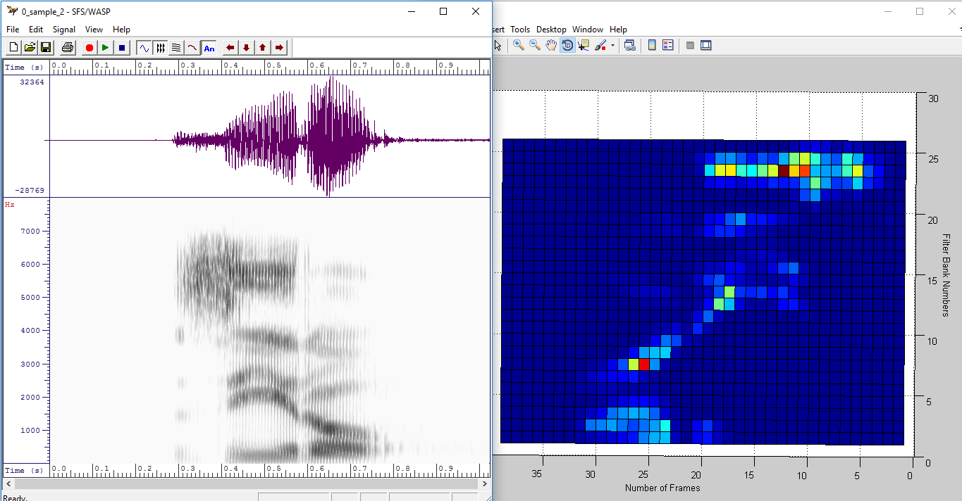
PHONEMES EXTRACTION
ZERO=ZE_IY_RO

Slide 21
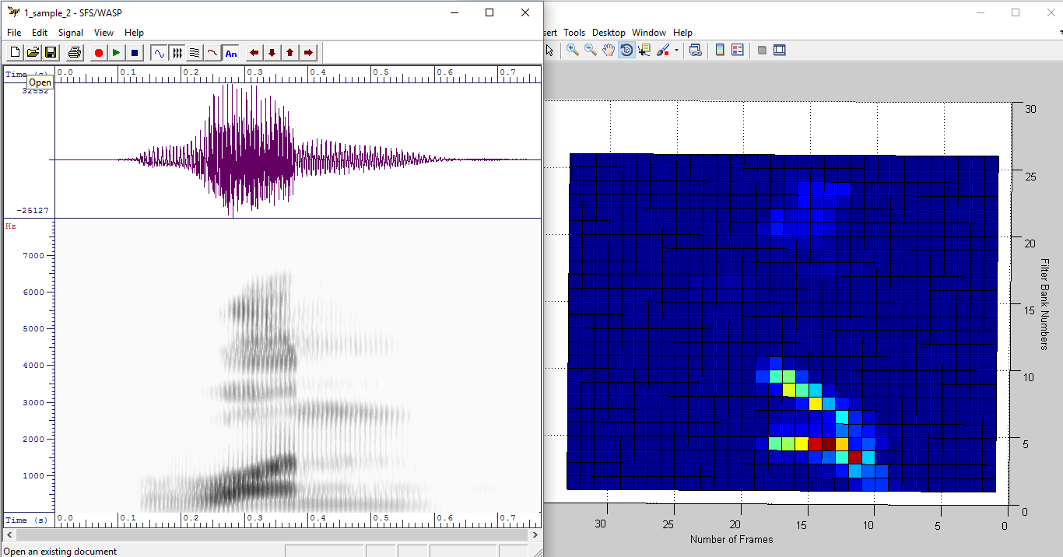
ONE

Slide 22
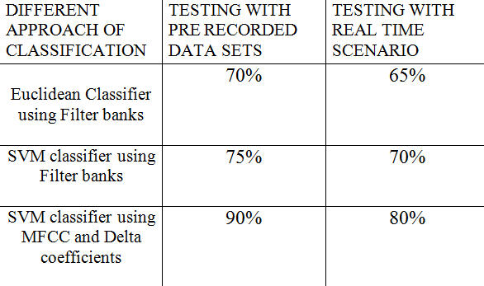
EFFICIENCY DIFFERENT APPROACH OF CLASSIFICATION

Slide 23
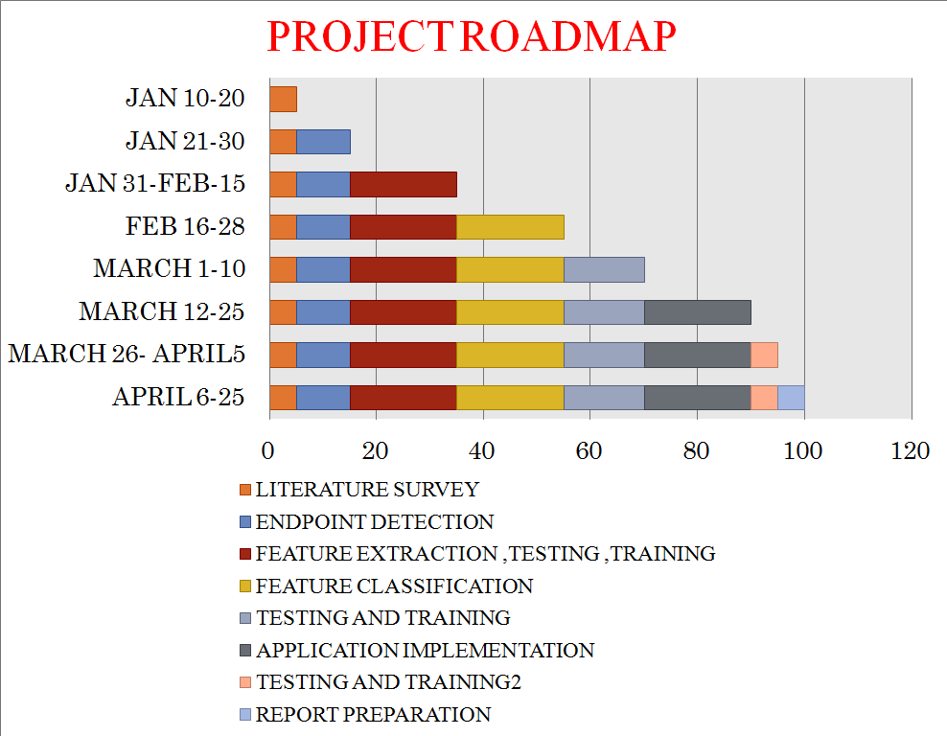

Slide 24
THANK YOU

