Slide 1

DEPARTMENT OF ELECTRONICS AND COMMUNICATION DESIGN OF REAL TIME SPEECH RECOGNITION SYSTEM VIII SEMESTER SESSION: JAN – JUN 2017
SUBMITTED BY: GUIDE:
DHANANJAY KUMAR K L (1PI13EC030) Dr.MANIKANDAN J
KARAN G BARHANPUR (1PI13EC039) Professor, ECE Dept
KIRAN UDAY PAI (1PI13EC041)

Slide 2
METHODOLOGY

Slide 3
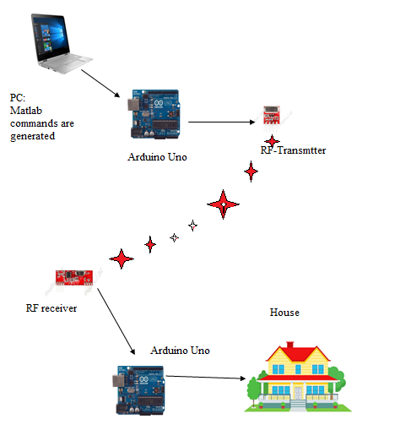
INTERFACE DIAGRAM

Slide 4
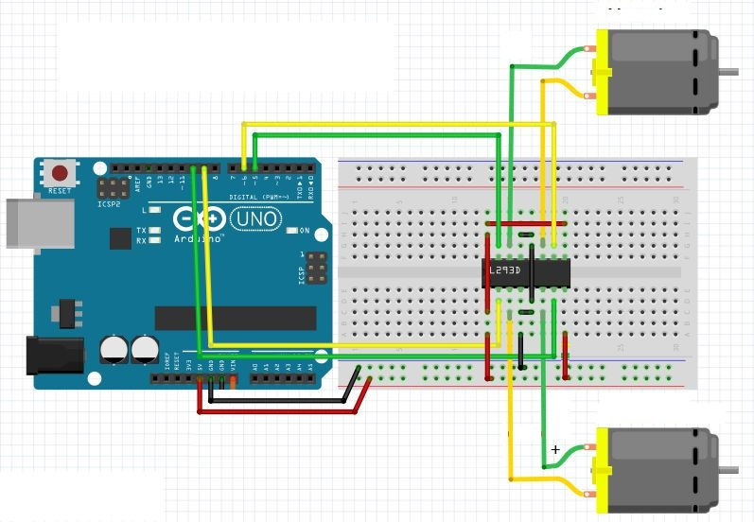
CIRCUIT DIAGRAM

Slide 5
HARDWARE COMPONENTS
Arduino Uno Board
RF Tx-Rx module
ICL293D :
Dc Motor
LED
Connecting wires

Slide 6
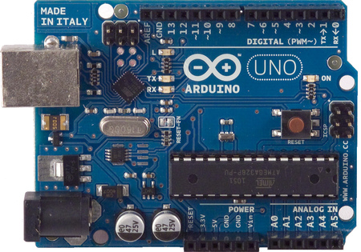
Arduino Uno :
1.The Arduino Uno is a microcontroller board based on
the ATMEGA328
2.It has 14 digital input/output pins & 6 analog inputs.
3.The board can operate on an external supply of 6 to 20
volts

Slide 7
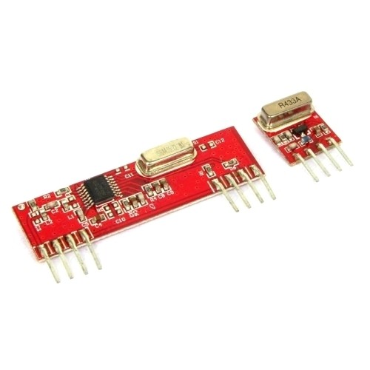
RF Tx-Rx module:
1. 433 MHz frequency
2. Operating voltage 5V
3.. Range approx 100 meters

Slide 8
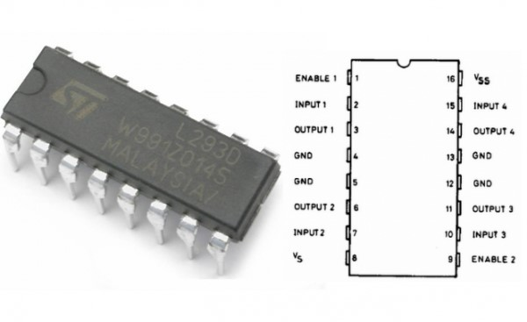
ICL293D :
1.L293D is a typical Motor driver or Motor Driver IC which allows DC motor to drive on either direction.
2. L293D is a 16-pin IC which can control a set of two DC motors simultaneously in any direction.

Slide 9
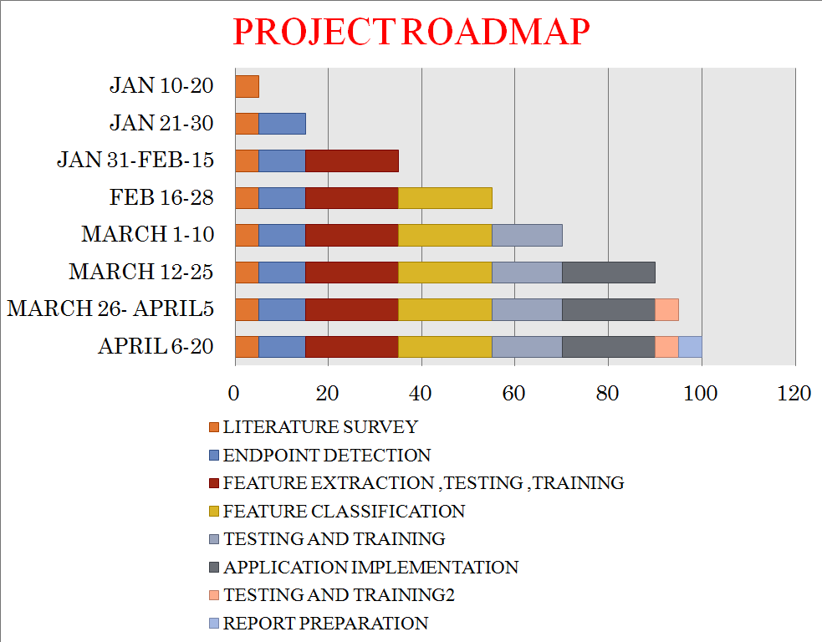

Slide 10
THANK YOU

