Slide 1

DEPARTMENT OF ELECTRONICS AND COMMUNICATION DESIGN OF REAL TIME SPEECH RECOGNITION SYSTEM VIII SEMESTER SESSION: JAN – JUN 2017
SUBMITTED BY: GUIDE:
DHANANJAY KUMAR K L (1PI13EC030) Dr.MANIKANDAN J
KARAN G BARHANPUR (1PI13EC039) Professor, ECE Dept
KIRAN UDAY PAI (1PI13EC041)

Slide 2
Objective
To develop an automatic speech recognizer.
To critically review literature related to Speech recognition.
To implement an isolated word speech recognizer that is capable of recognizing and responding to speech.
To develop real time speaker recognition system using feature extraction algorithms.
To design a real time home automation model.

Slide 3
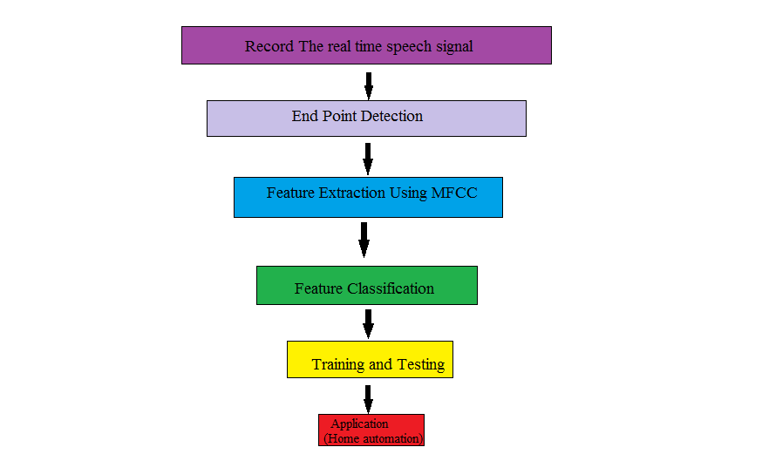
Methodology

Slide 4
END POINT DETECTION
The Speech Recognition system first addresses the issue of finding the endpoints of speech in a waveform.
The algorithm finds the start and end of speech in a given waveform
This algorithm gives the entire region where speech exists in an input signal.

Slide 5
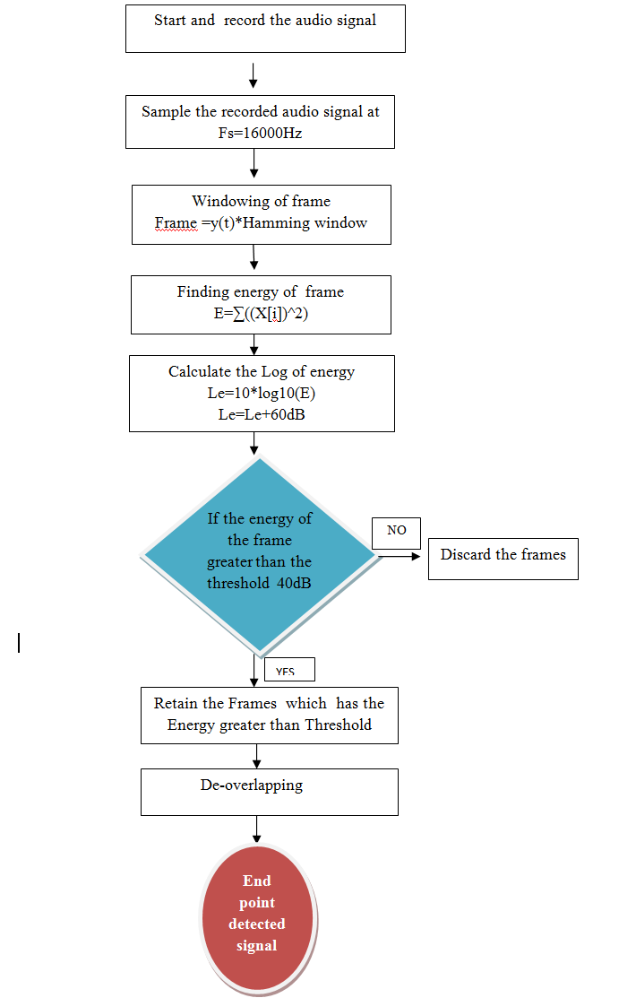
END POINT DETECTION FLOWCHART

Slide 6
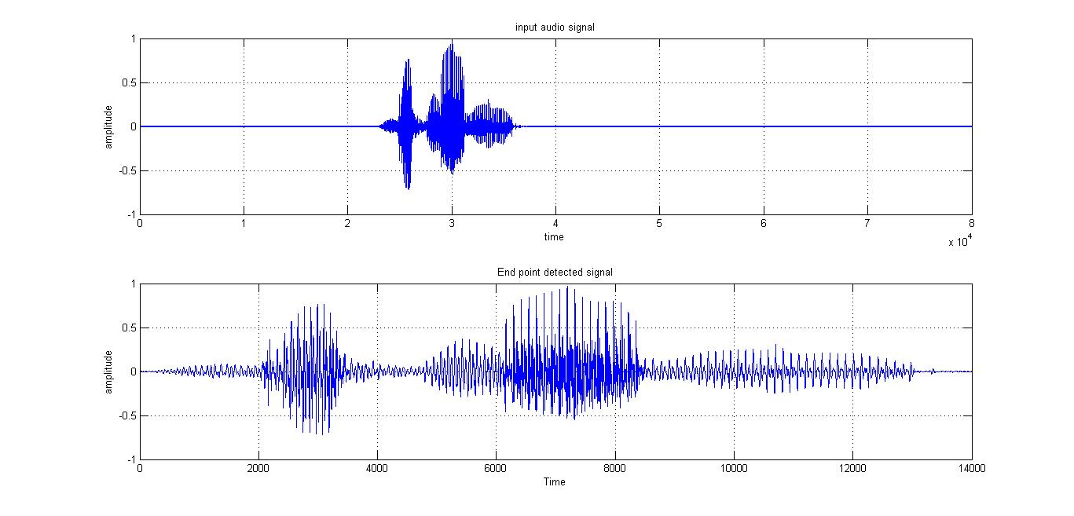
End Point Detection Waveforms

Slide 7
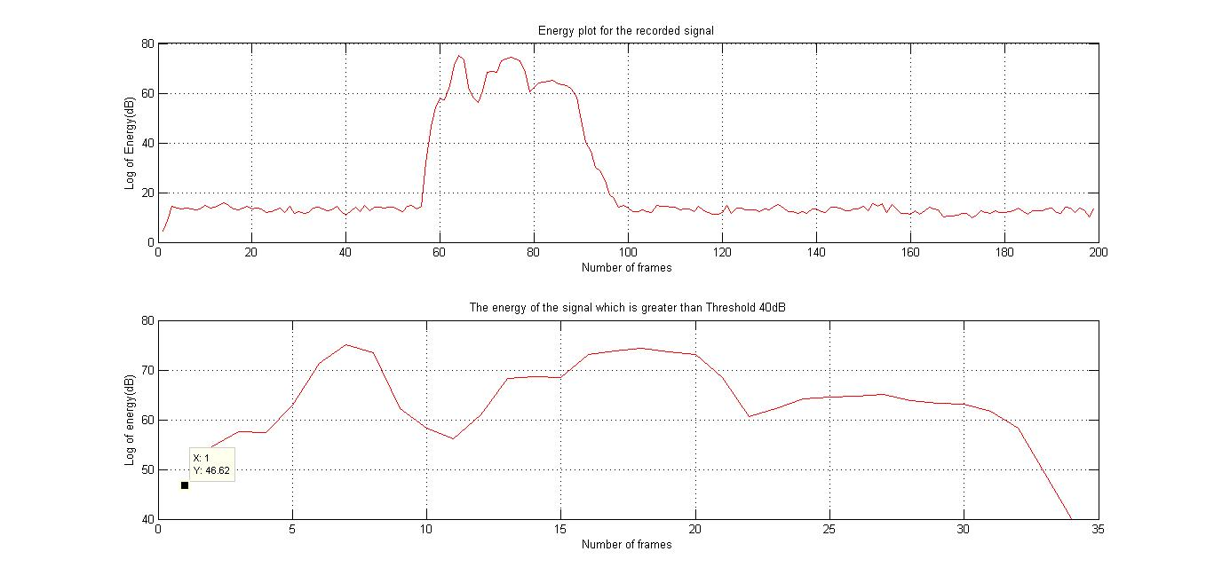
End Point Detection Waveforms

Slide 8
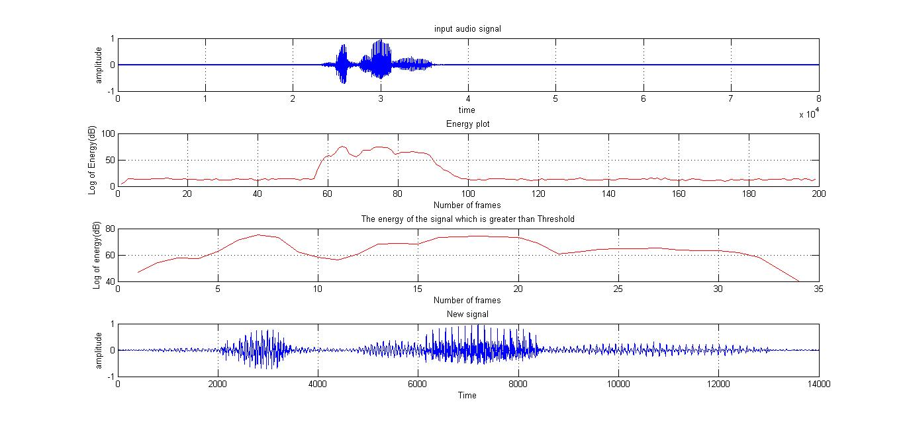
End Point Detection Waveforms

Slide 9
FEATURE EXTRACTION
MFCC
Frame the signal into short frames.
For each frame calculate the periodogram estimate of the power spectrum.
Apply the mel filterbank to the power spectra, sum the energy in each filter.
Take the logarithm of all filterbank energies.
Take the DCT of the log filterbank energies.
Keep DCT coefficients 2-13, discard the rest.

Slide 10
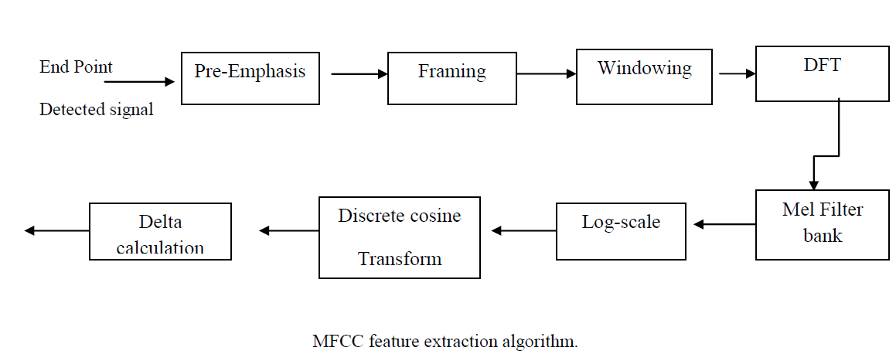
MFCC FLOWCHART

Slide 11

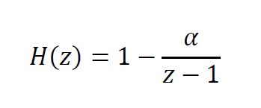
PRE-EMPHASIS
Designed to increase the magnitude of some higher frequencies
In lower frequency components it improves the overall signal-to-noise ratio
The equation for the filter is given by
Y[n] is output signal and α will be 0.9 to 1
Z transformation found to be

Slide 12
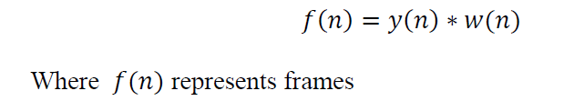

FRAMING AND WINDOWING
We frame the signal into 25ms frames with 10ms of overlapping.
Windowing is done using Hamming window.
Each frame is multiplied with the window.
Signal in a frame is denoted by
f[n], n = 0,…N-1
Then the signal after Hamming windowing is,
where w [n] is the Hamming window defined by

Slide 13
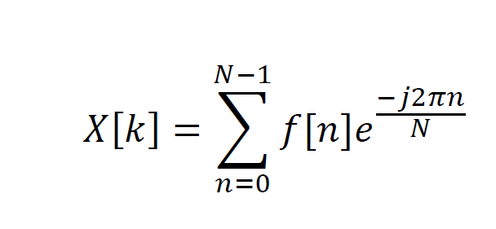
DFT
Windowed signal is further converted into frequency domain using DFT
where f(n) represents n number of frames and K is the length of the DFT

Slide 14

POWER CALCULATION
The periodogram-based power spectral estimate for the speech frame s_{i}(n) is given by
The absolute value of the complex fourier transform is taken and squared.
A 512 point FFT is performed but only the first 257 coefficents are kept.

Slide 15
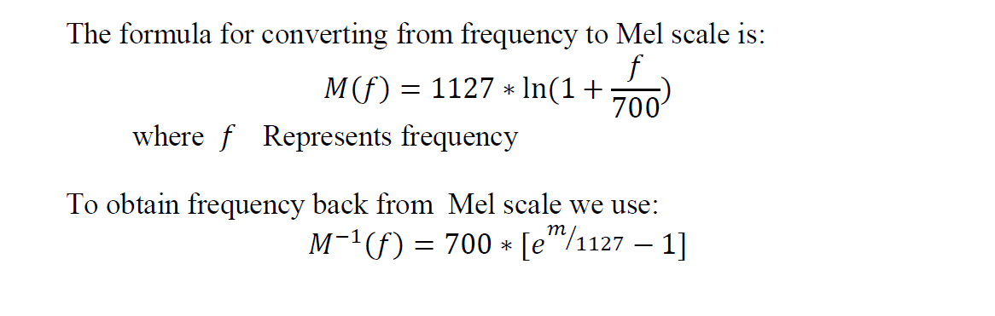
DESIGN OF MEL FILTER BANKS
Mel scale relates perceived frequency of a pure tone to its actual measured frequency.
Mel spaced filter bank is a set of 26 triangular filters.
It is a representation of the short-term power spectrum of a sound.

Slide 16
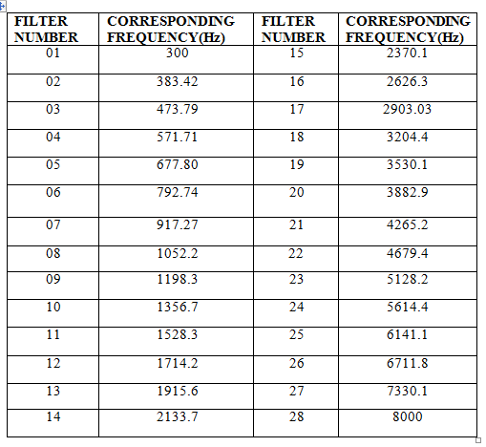
MFCC FILTER BANKS AND THEIR CORRESPONDING FREQUENCIES

Slide 17
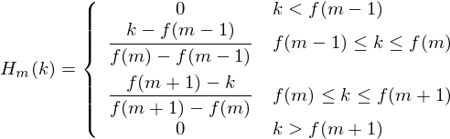
DESIGN OF MEL FILTER BANKS
Formula to create filter banks
where m is the number of filters we want, and f( ) is the list of m+2 Mel-spaced frequencies.

Slide 18
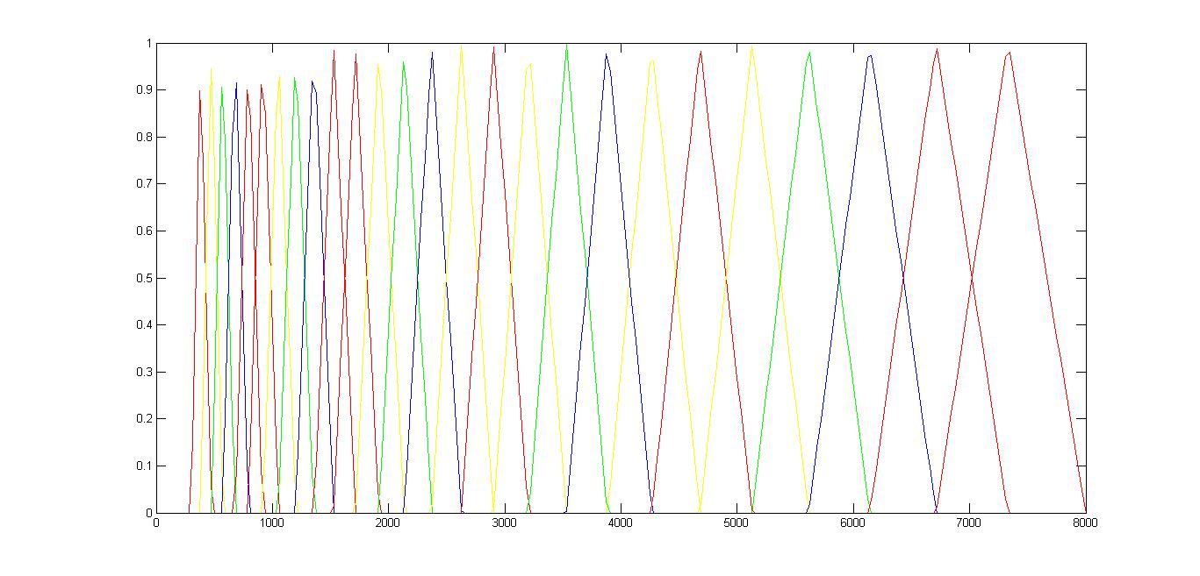
MEL FILTER BANK

Slide 19
MFCC Coefficients
Multiply periodogram power spectral estimate with mel filter banks.
After multiplication we have a matrix of number of frames vs 26 coefficients,i.e each frame has 26 coefficients

Slide 20
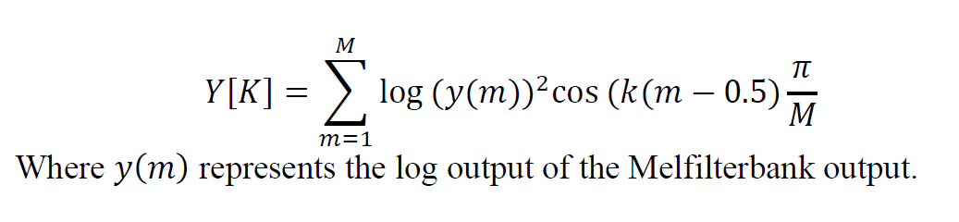
DISCRETE COSINE TRANSFORM
The Discrete Cosine Transform (DCT) of the 26 log filter bank energies is taken to give 26 cepstral coefficients.
In our project we keep 12 of the 26 coefficients are kept.

Slide 21

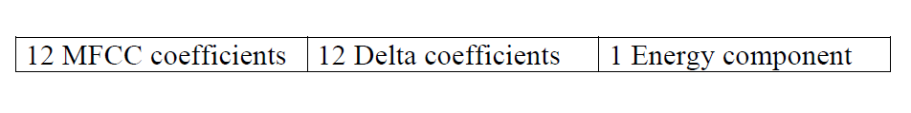
DELTA COEFFICIENTS CALCULATION
Delta coefficients are calculated using the formula
where i varies from 1 to 26 and t represents frame number
At last we have 25 features

Slide 22
FILTER BANKS AS FEATURE
Filter bank which has maximum power for each Frame is computed.
For every frame if the power is above some threshold we retain the filter bank number.
Else set the filter bank number to zero.
Now this data is stored as a array of frames.
We use this array as the reference matrix

Slide 23
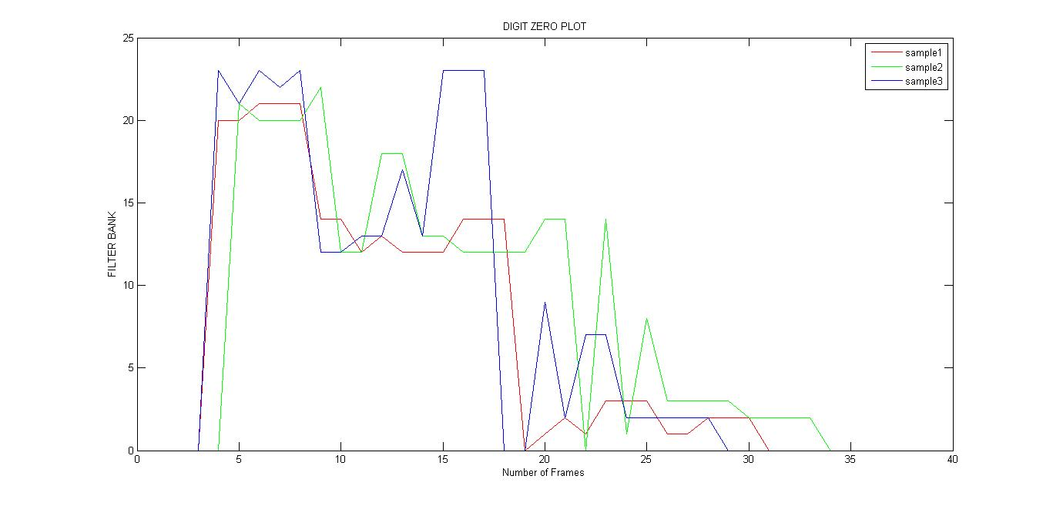
FILTERBANK ARRAY FOR DIGIT ZERO

Slide 24
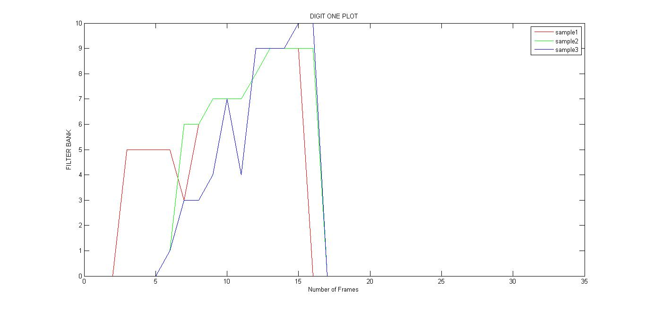
FILTERBANK ARRAY FOR DIGIT ONE

Slide 25
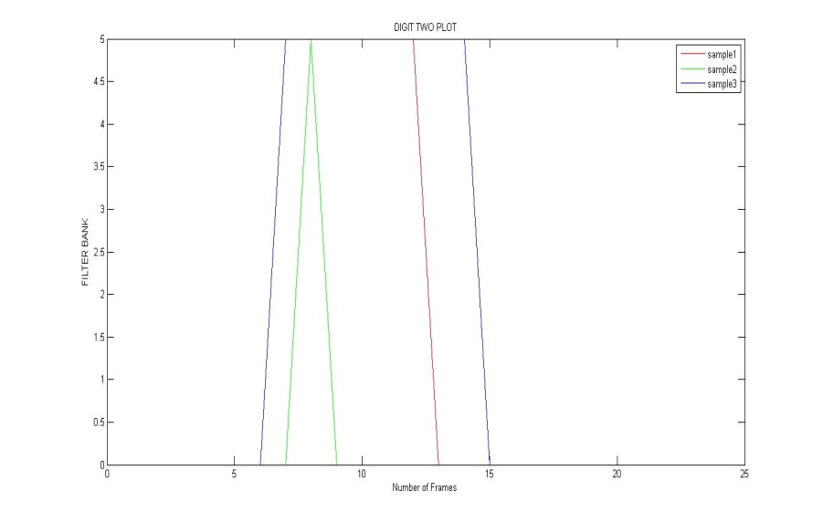
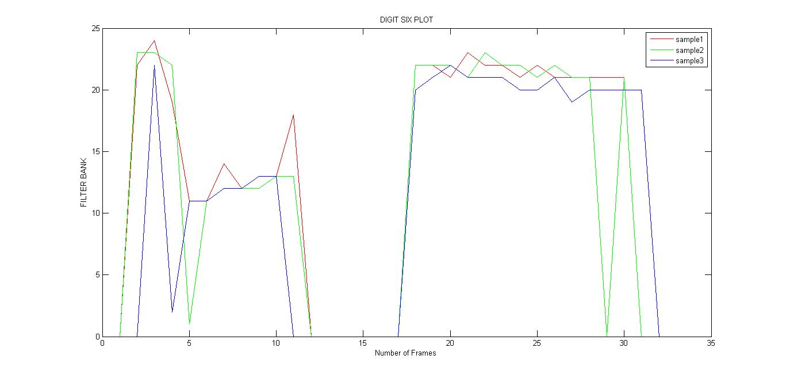
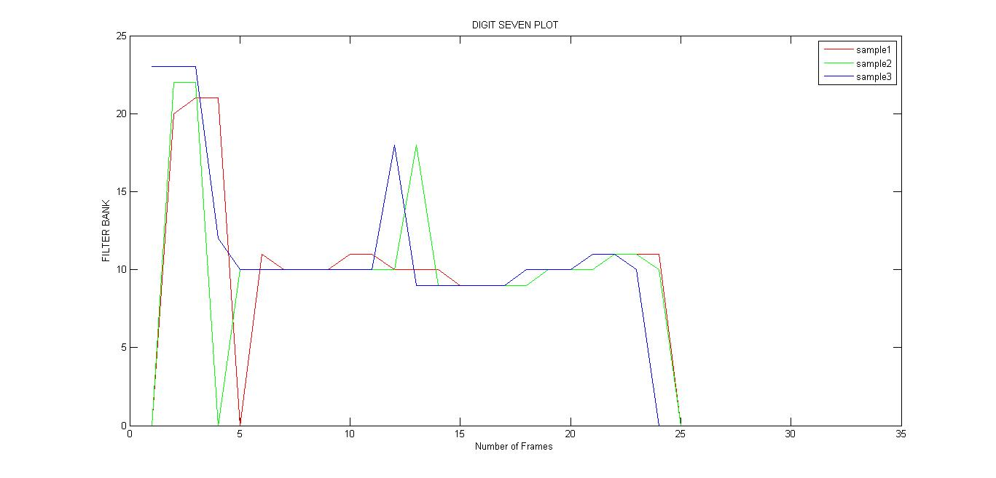
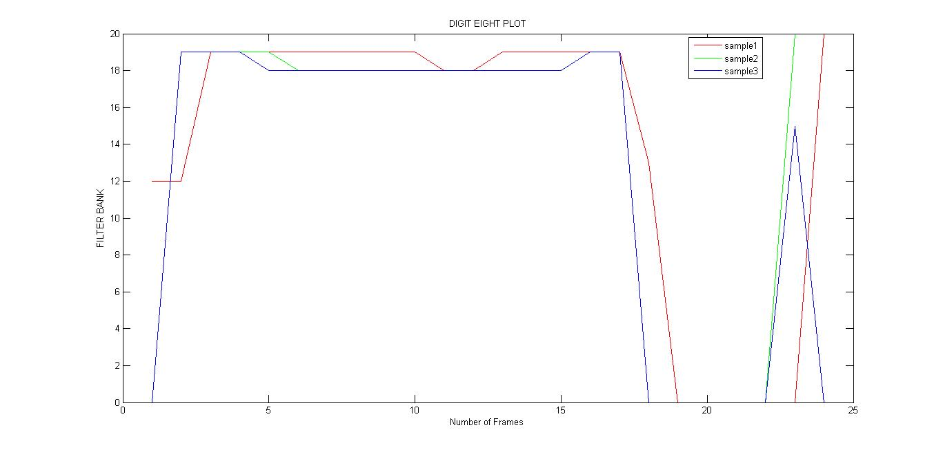
FILTERBANK ARRAY FOR OTHER DIGITS

Slide 26
Feature classification Using SVM
SVM is a supervised learning model
A Support Vector Machine is a discriminative classifier formally defined by a separating hyper plane. In other words, given labeled training data (supervised learning), the algorithm outputs an optimal hyper plane which categorizes new examples.

Slide 27
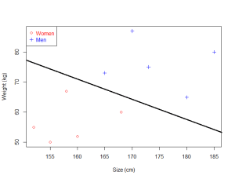
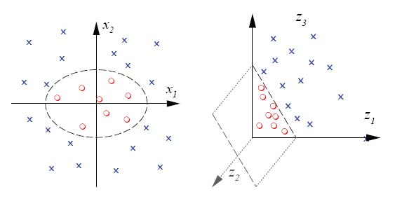
SVM MODEL LINEAR AND NON-LINEAR DATASETS

Slide 28
PHONEMES
A phoneme is a unit of sound in speech.
A phoneme doesn't have any inherent meaning by itself.
But when you put phonemes together, they can make words.
The third technique is based on this approach

Slide 29
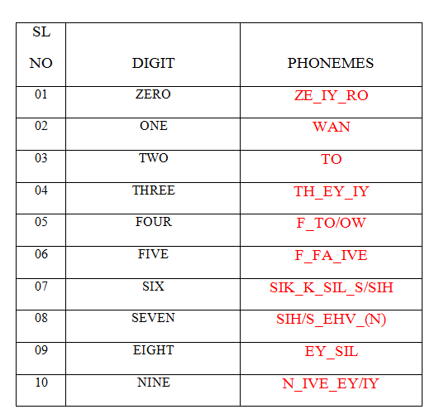
PHONEMES FOR DIGITS

Slide 30
DIGIT RECOGNITION USING PHONETIC APPROACH
Here we use two SVM classifiers.
One to extract the phonemes.
Second to detect the digits based on the extracted phonemes.
A total of 17 phonemes are detected for digits 0 to 9.
Our first classifier detects the phonemes from the speech.
Second classifier then detects the digits based on the phonemes obtained.

Slide 31
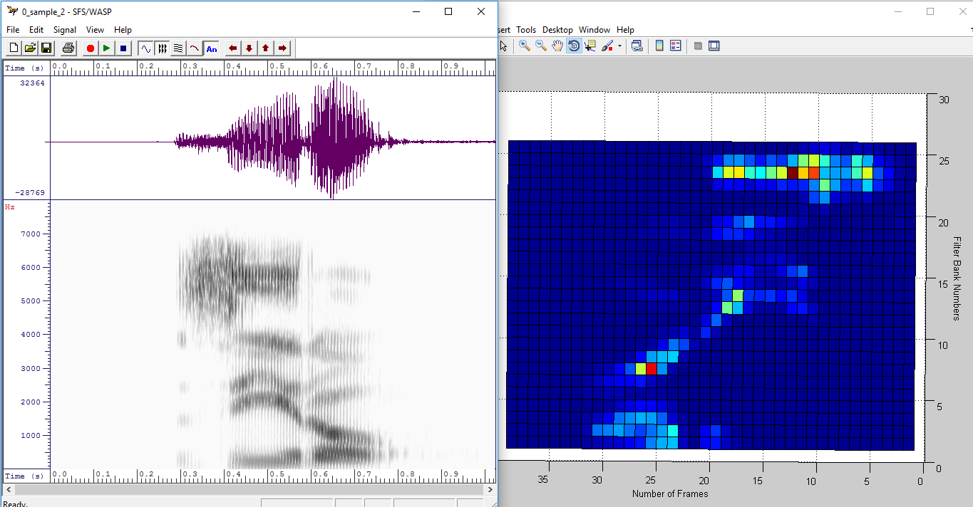
PHONEMES EXTRACTION PROCEDURE
ZERO=ZE_IY_RO

Slide 32
Phoneme Extraction procedures
The pre recorded audio signal is played in both wasp and matlab.
The small section of input audio signal is played in wasp software and corresponding frequencies are noted.
we store 25 features like 12 MFCC, 12 Delta, 1 Energy of respective frames .
For each phoneme we have 20 different samples

Slide 33
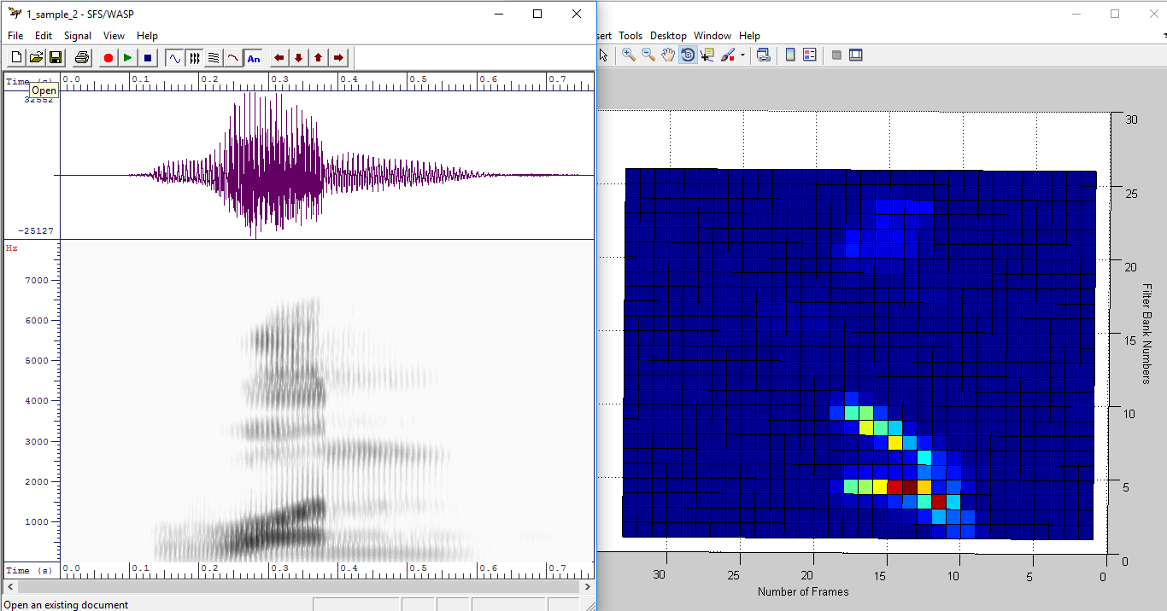
ONE

Slide 34
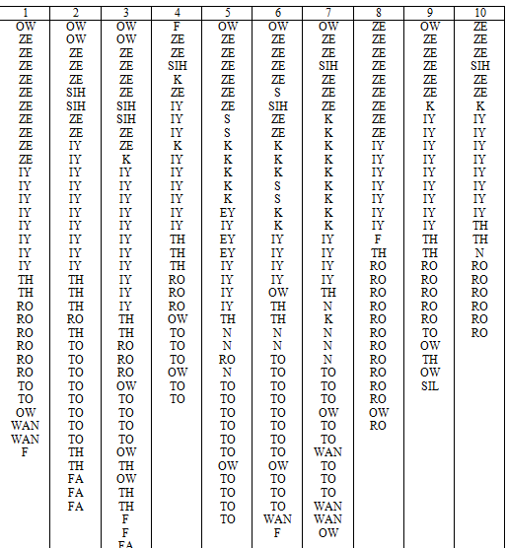
Phonemes pattern for digit Zero for ten Utterances

Slide 35
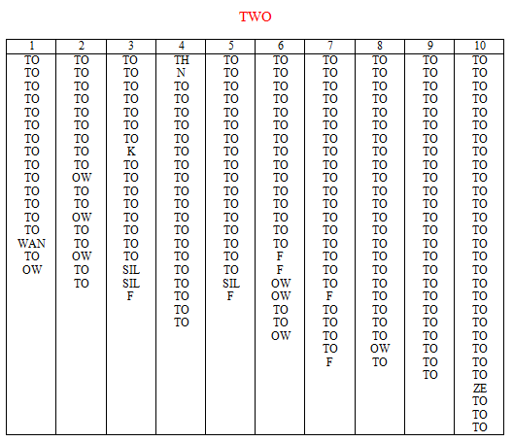
TWO

Slide 36
APPLICATION
We Extended the approach for home automation commands
BLUE LIGHT ON
BLUE LIGHT OFF
RED LIGHT ON
RED LIGHT OFF
FAN ON
FAN OFF
HELLO
TIME

Slide 37
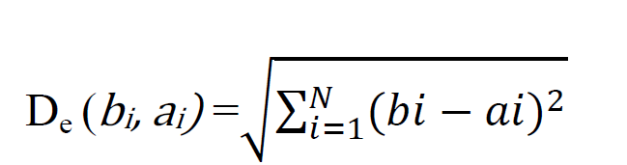
Training and Testing
EUCLIDEAN CLASSIFIER USING FILTERBANKS
Euclidean distance is calculated using the formula
The obtained array is compared with the reference matrix.
The index of the array with minimum distance is displayed.
The efficiency was found to be 65-70%

Slide 38
SVM classifier using Filter banks
Filter bank which has maximum power for each Frame is computed.
For every frame if the power is above some threshold we retain the filter bank number
Then we trained the dataset with SVM classifier

Slide 39
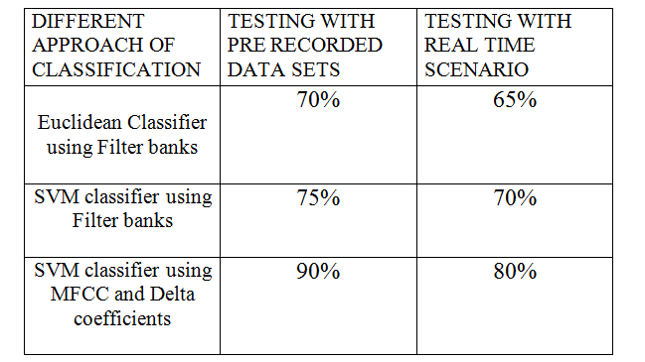
Accuracies of different approaches

Slide 40
HARDWARE COMPONENTS
Arduino Uno Board
RF Tx-Rx module
ICL293D :
Dc Motor
LED
LCD
RTS module
Connecting wires

Slide 41
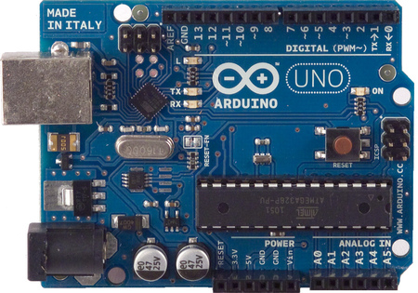
1)Arduino Uno :
1.The Arduino Uno is a microcontroller board based on
the ATMEGA328
2.It has 14 digital input/output pins & 6 analog inputs.
3.The board can operate on an external supply of 6 to 20
volts

Slide 42
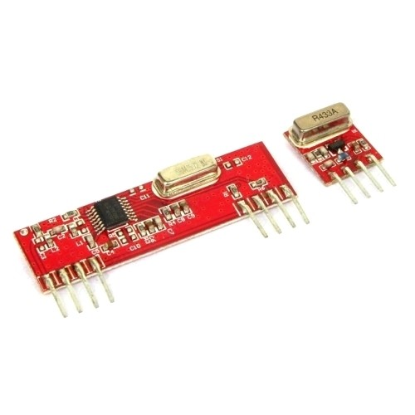
2)RF Tx-Rx module:
1. 433 MHz frequency
2. Operating voltage 5V
3.. Range approx 100 meters

Slide 43
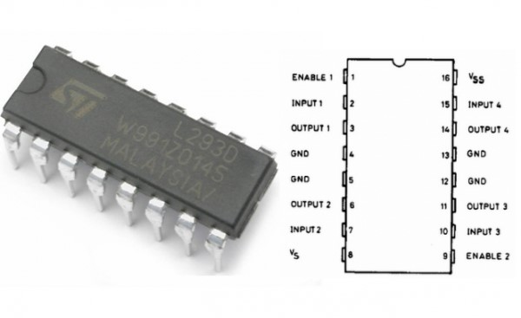
3)IC L293D
1.L293D is a typical Motor driver or Motor Driver IC which allows DC motor to drive on either direction.
2. L293D is a 16-pin IC which can control a set of two DC motors simultaneously in any direction.

Slide 44
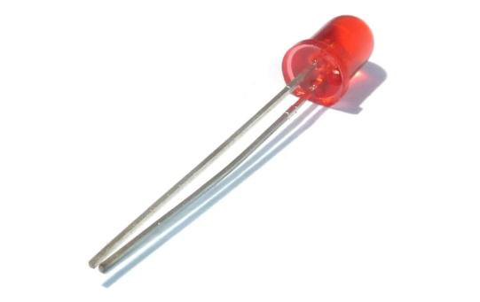
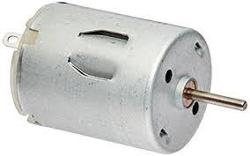
4)LEDs and DC motor
We have used a DC motor in our home automation part to act as a Fan.
LEDs of two different colours are used for two different commands

Slide 45
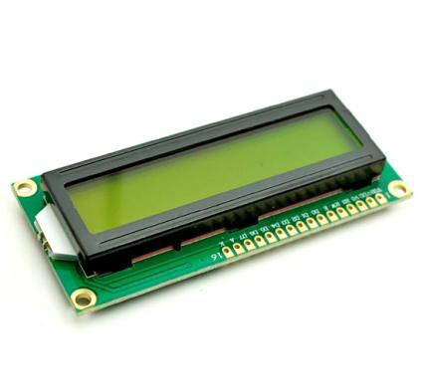
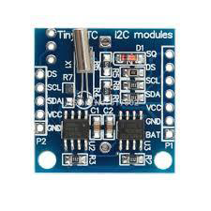
5)LCD and RTC module
LCD is used to display the date and time for the home automation part of our project.
It is also used to display the command spoken by the user
RTC module keeps accurate time for years using a tiny coin-cell

Slide 46
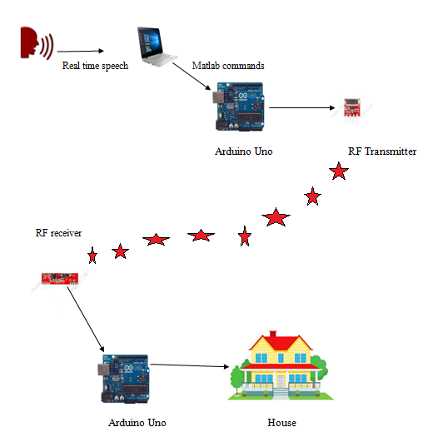
INTERFACING DIAGRAM
The Interfacing part of our project has two divisions:
1.The transmitter end.
2.The receiver end.

Slide 47
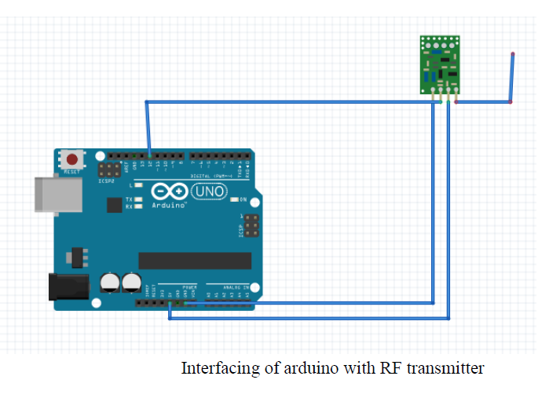
TRANSMITTER END

Slide 48
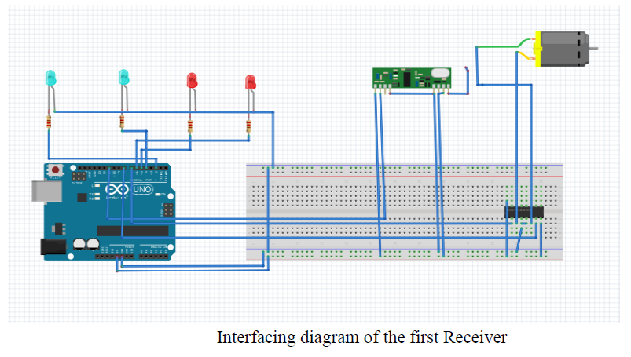
RECEIVER 1 CONNECTIONS

Slide 49
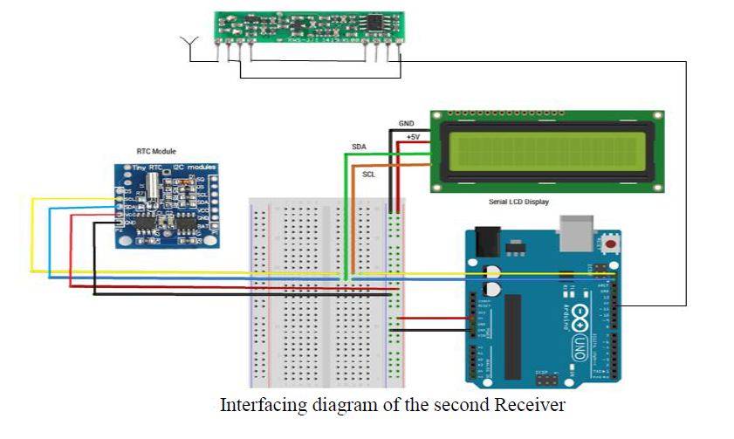
RECEIVER 2 CONNECTIONS

Slide 50
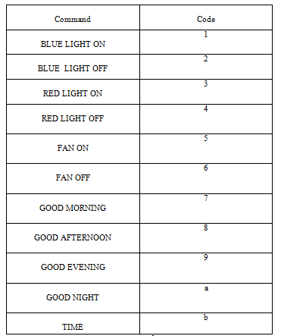
Commands and their respective Codes:

Slide 51
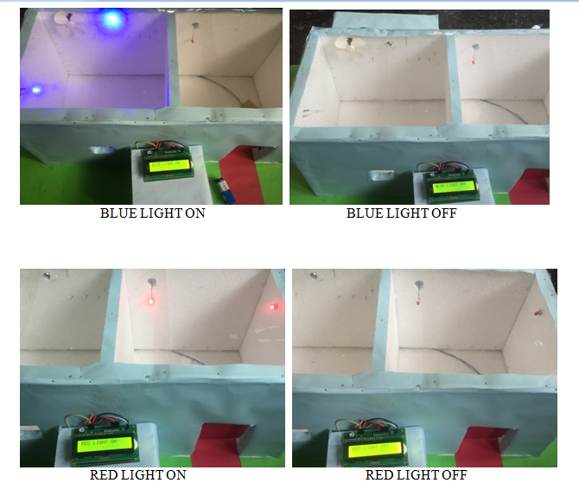
RESULTS

Slide 52
RESULTS
The images show us the output observed when the respective commands are spoken .
The command spoken is displayed on the LCD .
When the HELLO command is spoken the system replies back with GOOD MORNING ,GOOD AFTERNOON……

Slide 53
THANK YOU

