Slide 1

DEPARTMENT OF ELECTRONICS AND COMMUNICATION DESIGN OF REAL TIME SPEECH RECOGNITION SYSTEM VIII SEMESTER SESSION: JAN – JUN 2017
SUBMITTED BY: GUIDE:
DHANANJAY KUMAR K L (1PI13EC030) Dr.MANIKANDAN J
KARAN G BARHANPUR (1PI13EC039) Professor, ECE Dept
KIRAN UDAY PAI (1PI13EC041)

Slide 2
Objective
To develop an automatic speech recognizer.
To critically review literature related to Speech recognition.
To implement an isolated word speech recognizer that is capable of recognizing and responding to speech.
To develop real time speaker recognition system using feature extraction algorithms.
To design a real time home automation model.

Slide 3
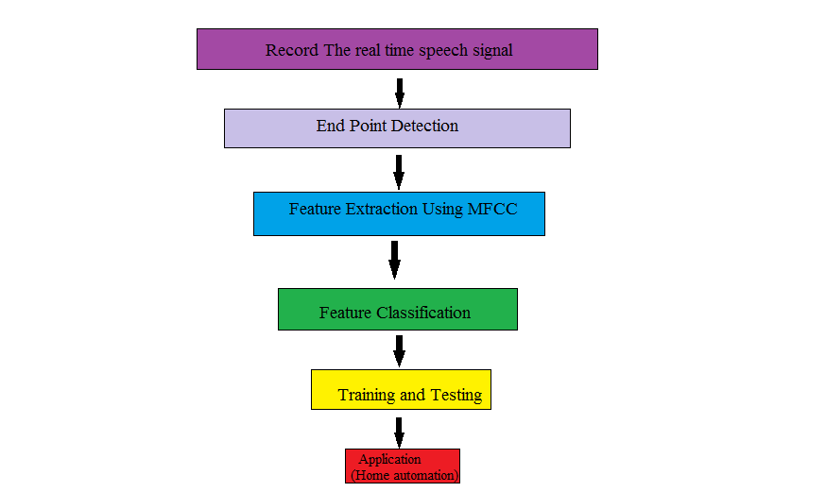
Methodology

Slide 4
END POINT DETECTION
The Speech Recognition system first addresses the issue of finding the endpoints of speech in a waveform.
The algorithm finds the start and end of speech in a given waveform
This algorithm gives the entire region where speech exists in an input signal.

Slide 5
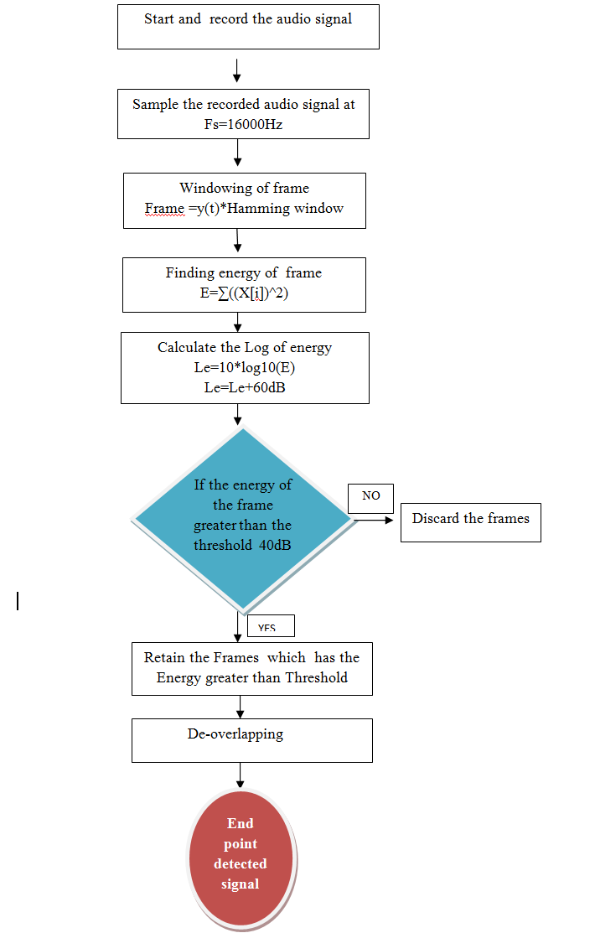
END POINT DETECTION FLOWCHART

Slide 6
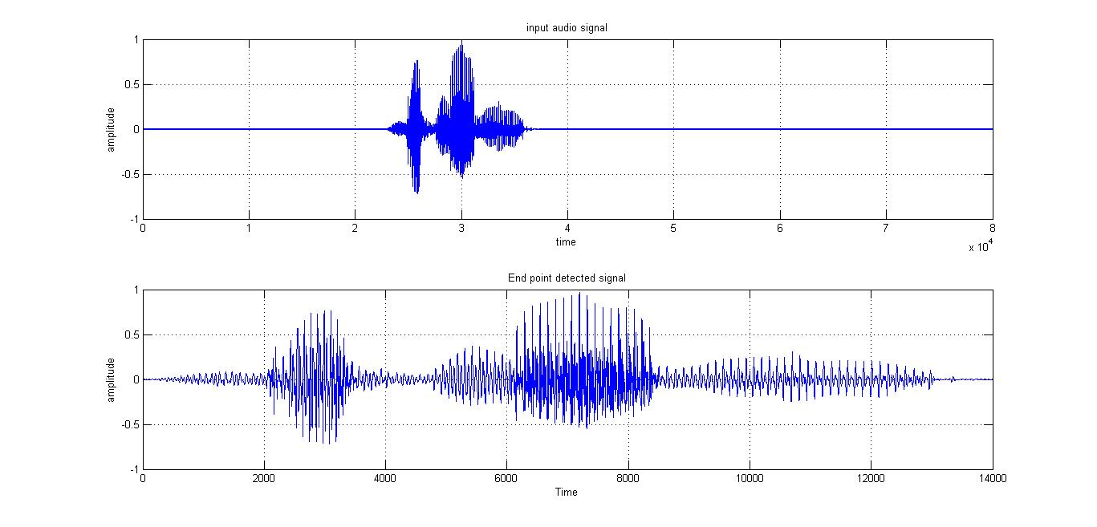
End Point Detection Waveforms

Slide 7
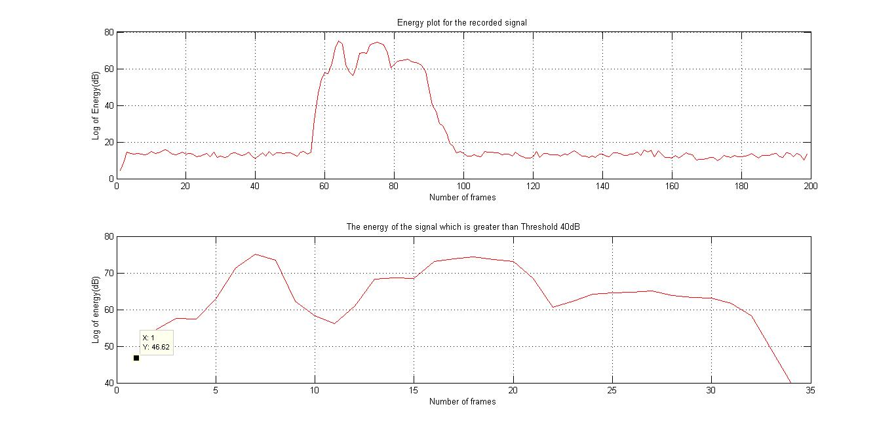
End Point Detection Waveforms

Slide 8
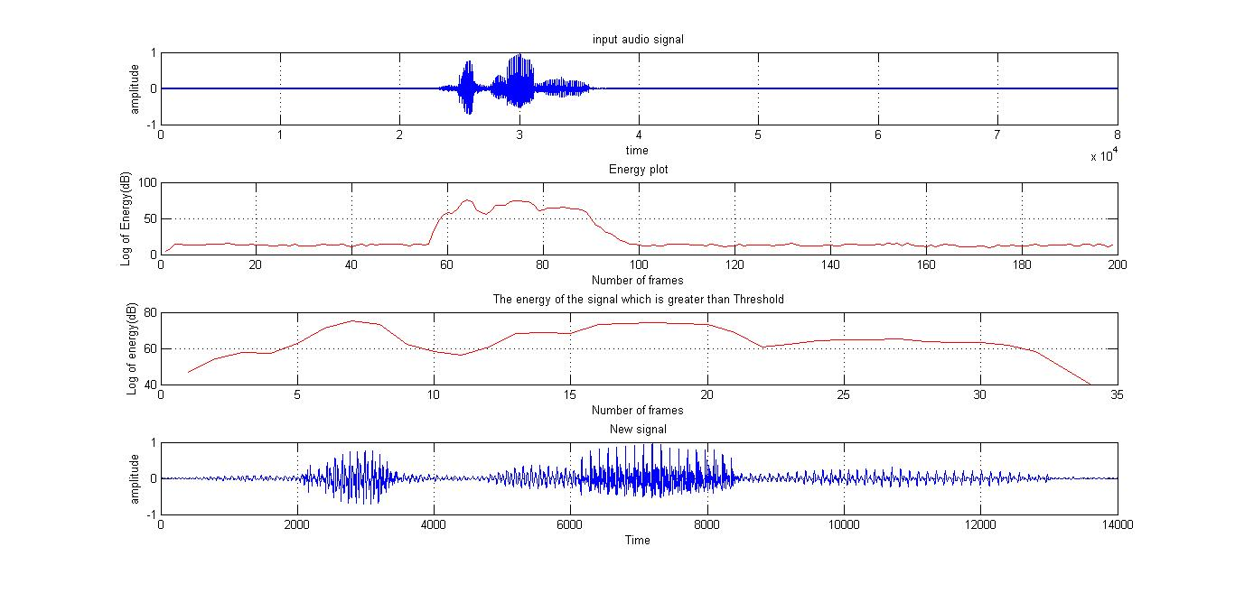
End Point Detection Waveforms

Slide 9
FEATURE EXTRACTION
MFCC
Frame the signal into short frames.
For each frame calculate the periodogram estimate of the power spectrum.
Apply the mel filterbank to the power spectra, sum the energy in each filter.
Take the logarithm of all filterbank energies.
Take the DCT of the log filterbank energies.
Keep DCT coefficients 2-13, discard the rest.

Slide 10
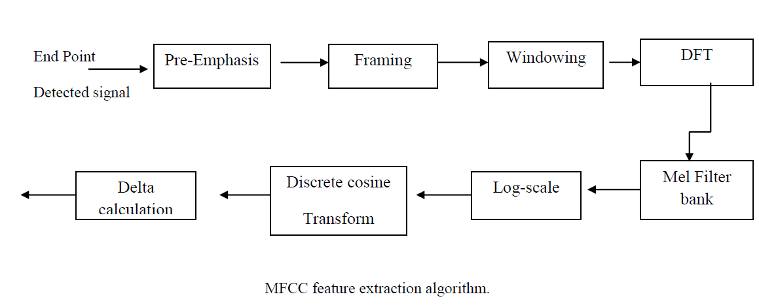
MFCC FLOWCHART

Slide 11
PRE-EMPHASIS
Designed to increase the magnitude of some higher frequencies
In lower frequency components it improves the overall signal-to-noise ratio
The equation for the filter is given by
Z transformation found to be

Slide 12
FRAMING AND WINDOWING
We frame the signal into 25ms frames with 10ms of overlapping.
Windowing is done using Hamming window.
Each frame is multiplied with the window.
Signal in a frame is denoted by
Y [n], n = 0,…N-1
Then the signal after Hamming windowing is,
where w [n] is the Hamming window defined by

Slide 13
DFT
Windowed signal is further converted into frequency domain using DFT
where h(n) is an N sample long analysis window (e.g. hamming window), and K is the length of the DFT

Slide 14

POWER CALCULATION
The periodogram-based power spectral estimate for the speech frame s_{i}(n) is given by
The absolute value of the complex fourier transform is taken and squared.
A 512 point FFT is performed but only the first 257 coefficents are kept.

Slide 15
DESIGN OF MEL FILTER BANKS
Mel scale relates perceived frequency of a pure tone to its actual measured frequency.
Mel spaced filter bank is a set of 26 triangular filters that we apply to the periodogram power spectral estimate.
The formula for converting from frequency to Mel scale is:
To go from Mels back to frequency:

Slide 16
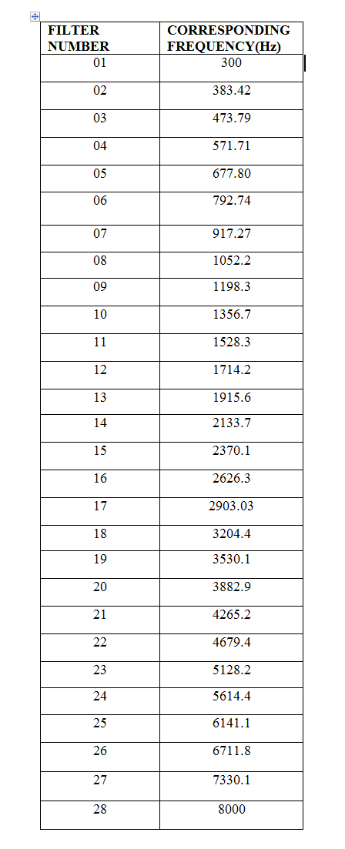
MFCC FILTER BANKS AND THEIR CORRESPONDING FREQUENCIES

Slide 17
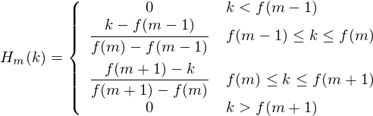
DESIGN OF MEL FILTER BANKS
Formula to create filterbanks
where M is the number of filters we want, and f( ) is the list of M+2 Mel-spaced frequencies.

Slide 18
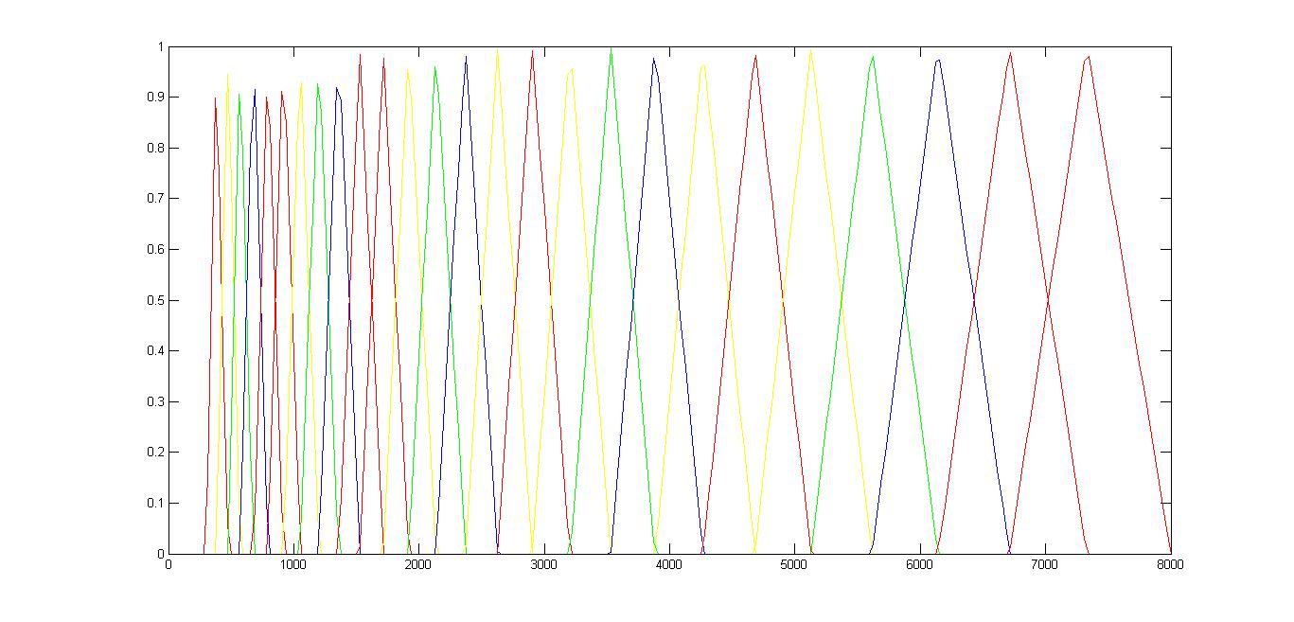
MEL FILTER BANK

Slide 19
POWER IN FILTERBANKS
Multiply periodogram power spectral estimate with mel filter banks.
Our filterbank output after multiplication comes in the form of 26 vectors of length 257.

Slide 20
DISCRETE COSINE TRANSFORM
The Discrete Cosine Transform (DCT) of the 26 log filter bank energies is taken to give 26 cepstral coefficients.
For ASR, only the 12 of the 26 coefficients are kept.

Slide 21
DELTA COEFFICIENTS CALCULATION
Delta coefficients are calculated using the formula
c^{t}_{i} =c^{t+1}_{i} - c^{t-1}_{i}
where i varies from 1 to 26 and t represents frame number

Slide 22
PHONEMES
A phoneme is a unit of sound in speech.
A phoneme doesn't have any inherent meaning by itself.
But when you put phonemes together, they can make words.
The third technique is based on this approach

Slide 23
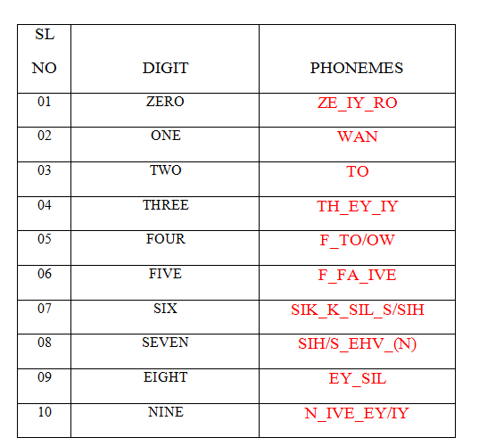
PHONEMES FOR DIGITS

Slide 24
DIGIT RECOGNITION USING PHONETIC APPROACH
Here we use two SVM classifiers.
One to extract the phonemes.
Second to detect the digits based on the extracted phonemes.
A total of 17 phonemes are detected for digits 0 to 9.
Our first classifier detects the phonemes from the speech.
Second classifier then detects the digits based on the phonemes obtained.

Slide 25
APPLICATION
We have trained the system for 6 commands
BLUE LIGHT ON
BLUE LIGHT OFF
RED LIGHT ON
RED LIGHT OFF
FAN ON
FAN OFF

Slide 26
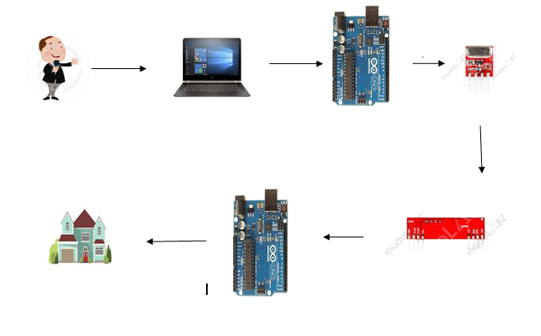
INTERFACING DIAGRAM

Slide 27
THANK YOU

