Slide 1
Data Science
Intro
Past – Inspiration
Present – Getting Practice
Future

Slide 2
What Is Data Science To Me?
Applying statistics to data
Lots of data means data engineering (Petabytes at Chevron)
Insights → Business Decisions

Slide 3
Past: Why I Chose Data Science
Many applications across industries/companies
Uncover new personal interests

Slide 4
Past: Applications
Finance
Most sciences: Environmental, Social, Biological
Predict equipment failures
Finding oil and gas based on sensors/geology
“Where’s the next best place to drill for oil? Or next best customer service to target?” - Data Analytics: Mark Miller; Chevron Youtube (Sept 2014)

Slide 5
Past: New Interests
“Facilities engineering encompasses all of the engineering disciplines that are associated with the design and construction of facilities required to produce our energy”
- Offering Opportunities for Engineering Graduates, Chevron Youtube (Feb 2013)

Slide 6
Present: What I’m Doing Now
Small projects to practice with
Super Rugby Database

Slide 7
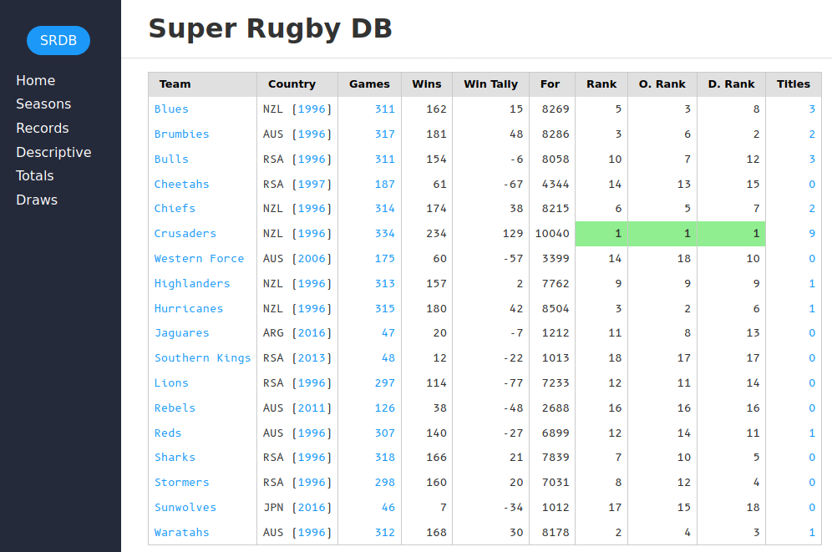
Present: Super Rugby DB

Slide 8
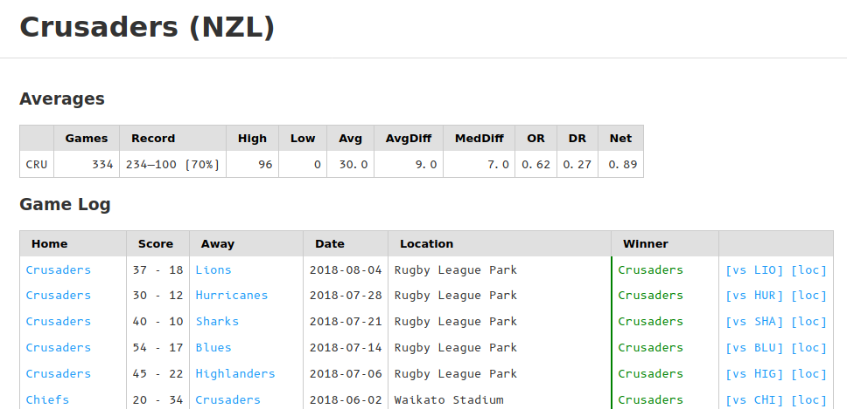
Present: Super Rugby DB

Slide 9
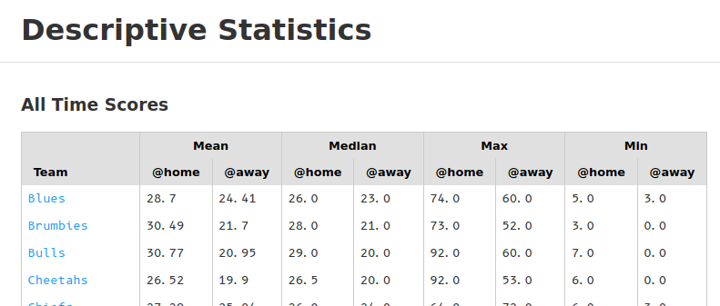
Present: Super Rugby DB

Slide 10
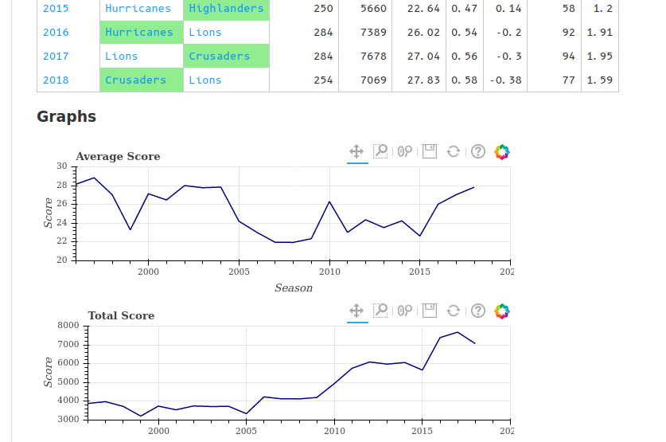
Present: Super Rugby DB

Slide 11
Present: Super Rugby DB
Simple Data Engineering (Wikipedia → database)
Working with limited stats knowledge
Working with limited data
Balance Information and Brevity

Slide 12
Future: How I Will Improve
Using what I know
School → Insights → Business Decisions

Slide 13
End
Thank You :)

