Slide 1
Human judgements
BERTScore
Evaluation
mBERT
text2vec
M5
Fine-tuned Models
LaBSE
M3E
SimCSE Fine-tuned Models
XLM-R
BGE
SimCSE
Bilingual Parallel Data
Pre-trained Models
Embedding Models
Fine-tuned Models
Models
(XLM-R、mBERT…)
WMT 21 Shared Task Submissions

Slide 2
Human judgements
BERTScore
Evaluation
text2vec
Fine-tuned Models
mBERT
M5
SimCSE Fine-tuned models
LaBSE
M3E
XLM-R
BGE
SimCSE
Bilingual Parallel Data
Pre-trained Models
Embedding Models
Fine-tuned Models
Models
(XLM-R、mBERT…)
WMT 21 Shared Task Submissions

Slide 3
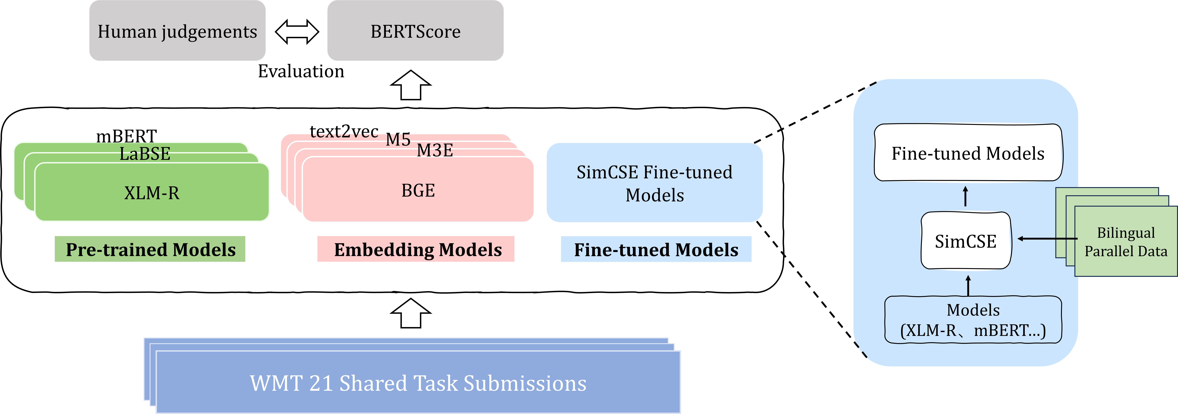

Slide 4
Extraction of Retrievable Elements Experiment
Chinese Patent Application Texts
Extraction Methods
Retrievable Elements
F1 score
JSS
Gold Standard
Patent Examination Reports
Relevant Documents
Retrieval Results
PRES
Relevant Document Retrieval Experiment

Slide 5
