Slide 1
Traffic Memory: A Traffic Jam Simulation
| <number>
Wouter Reckman
Matthia Sabatelli
Gereon Vienken

Slide 2
Problem
Traffic jams are bad
  Individuals
  Economy
  The Planet
How can traffic be improved?

Slide 3
Related Work
| <number>
Gabel et al. (2012) The cooperative driver: Multi-agent learning for preventing traffic jams.

Slide 4
Our Solution
| <number>
Avoid traffic jams with memory
  Repeated jams for daily traffic

Slide 5
Our Implementation
| <number>
Fived grid
Cars with start and end location
Cars repeat route every day
Rout caculation with weighted A*

Slide 6
Tools
| <number>
Python program
Django
JavaScript

Slide 7

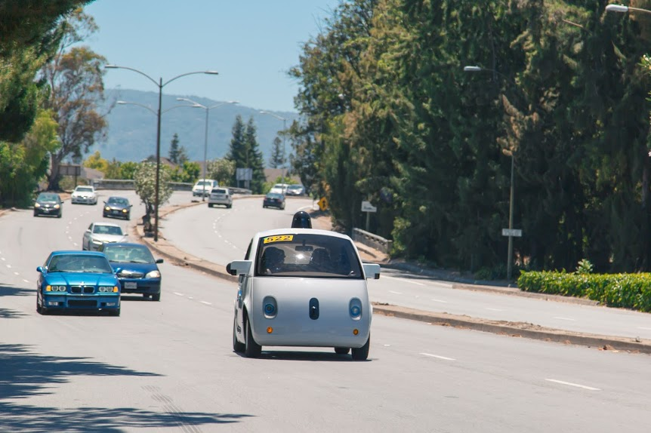
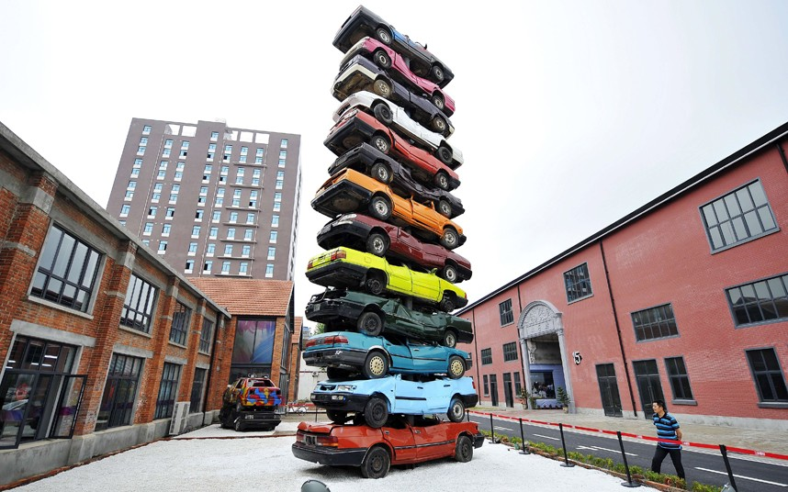
Our Data structure
| <number>

Slide 8
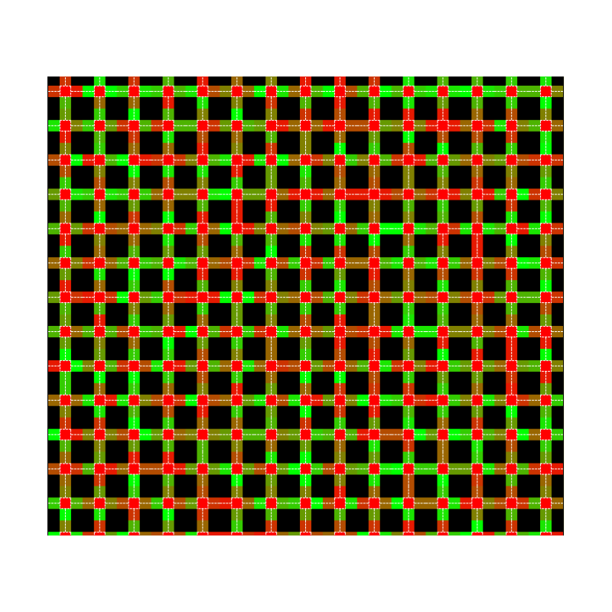
Traffic representation
| <number>

Slide 9
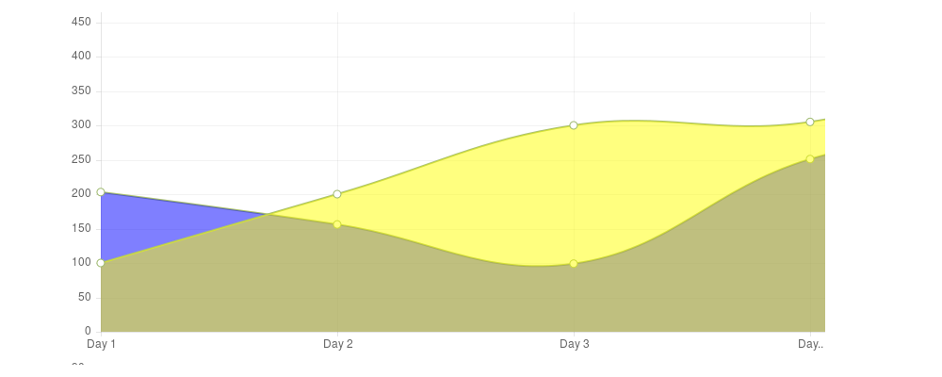
Results 1
| <number>
Comparison of speed average

Slide 10
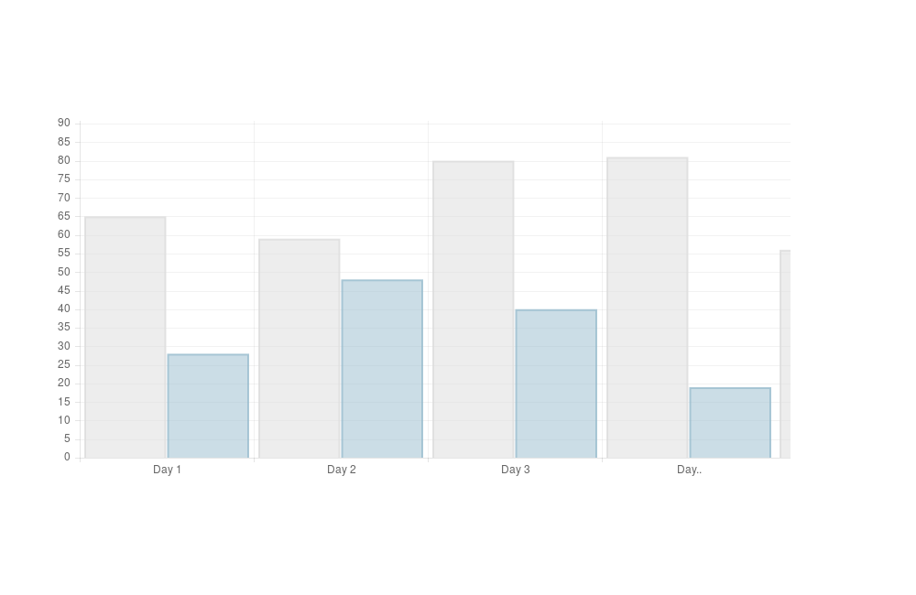
Results 2
| <number>
Amount of fuel used

Slide 11

Results 3
| <number>
Percentage of traffic jams

